Slide 1

Project Title: LLM firewall security scanner
Group members
By Krishna sai manas Karthik
Tejaswi
Narsi reddy
jahnavi

Slide 2

Project overview
The objective of the project is to classify prompts as either safe or unsafe and to filter out unsafe prompts by fine-tuning the LLaMA 3.1 8B model using LoRA technique or low rank adaptation.
To create a virtual firewall which do not generate responses to harmful prompts.
The datasets are sourced from Hugging Face, GitHub, and safety prompt repositories.
What is purpose of this project and Why safeguard LLM’s?
To prevent misuse of language models, such as generating harmful, biased, or inappropriate content, ensuring ethical and responsible AI usage.

Slide 3

various attacks on LLM
Here are three common attacks on Language Learning Models (LLMs):
1. Prompt Injection Attacks:
Manipulating the input prompts to force the model into generating unintended or malicious outputs, such as bypassing restrictions.
2. Data Poisoning Attacks:
Injecting malicious or biased data into the training dataset to influence the model's behavior or compromise its integrity.
3. Adversarial Attacks:
Crafting inputs with subtle modifications to trick the model into producing incorrect or harmful outputs.

Slide 4
Defensive measure against LLM attacks
1 Input Validation and Sanitization
- Ensures user inputs are clean and free from malicious content, reducing the risk of prompt injection attacks.
2. Fine-Tuning with Safety Datasets
- Enhances the model’s behavior by training it on curated, safe datasets to minimize harmful or biased outputs.
3. Reinforcement Learning with Human Feedback (RLHF)
- Aligns the model’s responses with ethical standards by incorporating real-world feedback into its training.

Slide 5
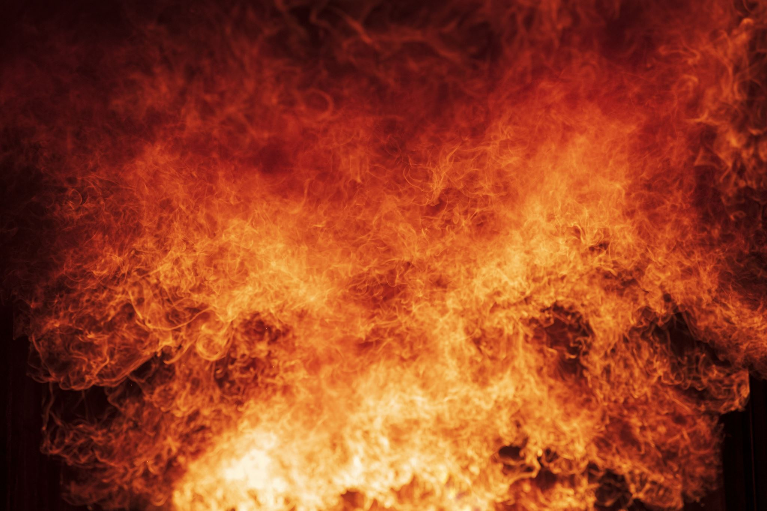
Challenges for LLM safeguard
Challenges in Creating a Firewall for LLMs:
1. Evolving Threats
- New attack techniques emerge frequently, making it hard to anticipate all threats.
2. Language-Specific Limitations
- Filtering works well in English but struggles with non-English languages, leading to potential gaps.
3. Balancing Usability and Safety
- Over-restriction can limit functionality, while under-restriction increases risk.

Slide 6

Project implementation
Data Extraction: First step was to extract harmful datasets from various sources hugging face, Git-hub repos and safety prompts website.
Data cleaning and merging: Then the model is cleaned of any null values or duplicate values and datasets from various data sources are merged together into unified dataset.
Feature selection: The dataset has columns like id unique identification number, prompt which is input in text format, label has two values safe and unsafe and data-source name of the source where data set is extracted from.
Dataset Preparation: The dataset is translated into 132 unique languages excluding English using google translator and merged together. Then the dataset is pushed to hugging face for finetuning Llama 3.1.

Slide 7
Project implementation
Model selection: we imported Llama 3.1 8b instruct model from hugging face for finetuning dataset.
Model configuration: configure lora adapters for llama 3.1 8b
Model instructions setup: configure the model to avoid generating responses for unsafe prompts.
Model training: train the model calculating loss function
Model prediction: Display and validate the predicted responses
Save the model: save the model configurations and results
Future preferences: After the model is saved you can train model with more data in the future and finetune for specified task.

Slide 8

Thank you

