Slide 1

Project Title:Emotion Classification in Twitter Messages Using Pre trained Models
Names: Krishna sai manas Karthik Bhiravajosyula

Slide 2

Project Statement
This Project aims to classify emotions based on texts into six different categories that include
Sadness, Joy, Anger, Fear, Surprise and Love.
Goal of this Project:
Develop an effective Classification model that analyses different sentiments in social media and business platforms.

Slide 3

Data Collection
Dataset Source: This data set was extracted from Kaggle website named “emotion classification”.
Dataset Details: The data set has columns labelled ‘text’ which is user input and label value ranging from 0 to 5 which are classified into six categories ‘sadness (0)’, ‘joy (1)’, ‘love (2)’, ‘anger (3)’, ‘fear (4)’, ‘surprise (5)’.
Data Preparation: The data is cleaned dropped null values and plotted a bar graph to understand the distribution of data based on labels

Slide 4

Model Architecture
Distil-BERT: The model is trained using distil-BERT which is lighter weight version of BERT model having 66M
Parameters which is effective for classification tasks and sentiment analysis.
The model imports sequence classification from distil BERT specially fined tuned for category classification. It is easier to load and fast for training the dataset.
GPT-2: The model is trained using GPT-2 pre trained model excellent to generate long text and documents but special library GPT2forsequenceclassification is good for classification tasks for complex dataset.
This model uses 1.5 Billion parameters and takes almost 15 to 20 times more time to train the dataset. It is mainly used for generating tasks but depending on data it can be used for classification tasks and in some research papers it outperforms other transformer models.

Slide 5
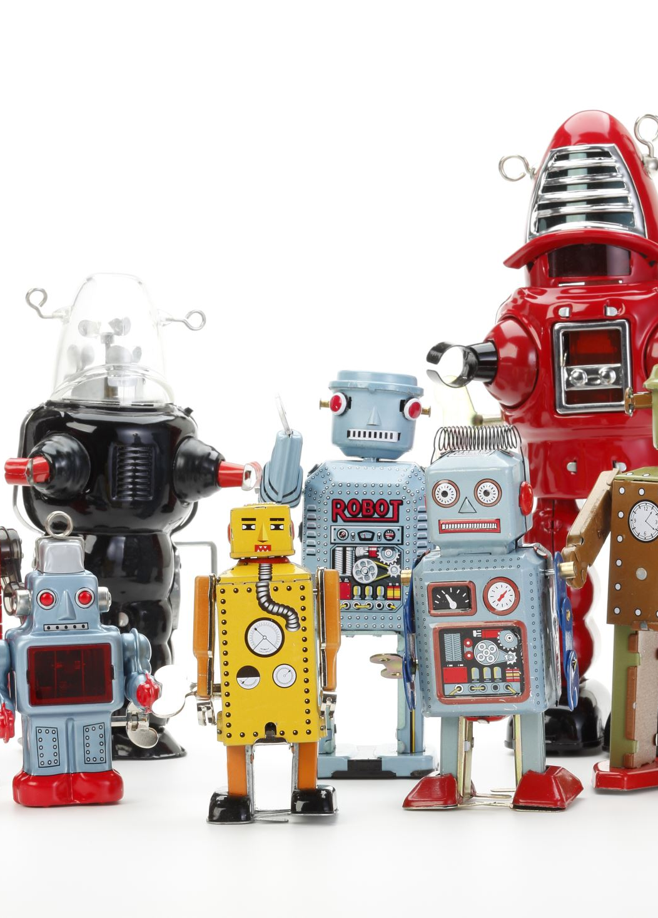
Training the model
1) First GPT, distil-BERT pre trained models are imported using transformers library.
2) The dataset uses 30,000 rows and split into 70 percent training and 30 percent testing.
3) As we use hugging face to import these models we convert our pandas data-frame to Dataset
Where the models directly use this library.
4) The data is tokenized where the text is break into individual tokens and these tokens are encoded to tensors or vectors which is used for model training.
5) Then we caluculate evaluation metrics like Accuracy, F1-score, Precision, Recall on our dataset.
6) we compare predictions with actual values to plot confusion matrix.

Slide 6

Parameters
Distil-bert Parameters: we store results in /results directory.
we use epoch evaluation strategy.
we set number of epochs to 1 since the model is already with large data
We set maximum batch size to 8
GPT-2 Parameters: same as distil bert but we set batch size to 2 and for every logging of 10 steps we save our results because the model takes longer time to load and don’t want to lose our results.
Used mixed precision of fp-16 to reduce load on gpu and cpu for effective usage of resourecs.

Slide 7
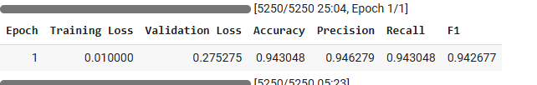
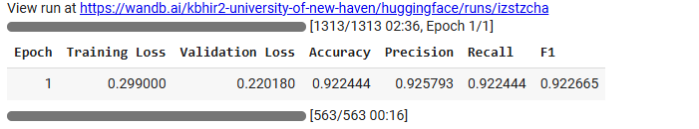
Evaluation metrics
For both the models we calculated accuracy, recall, precision, F1-score and plotted confusion matrix to convey the results.
For Distil- Bert: The result snippet for distil-bert
For GPT-2: The result snipper for GPT-2

Slide 8
Conclusion
Trained the Dataset using Distil-BERT and GPT-2 for emotional classification with impressive accuracy of >90%.
utilised tokenizing the dataset and also predicted the results for other inputs of unseen data.
The final distribution showed that model predicts ‘sadness’, ‘joy’, ’anger’ with impressive Precision.

