Slide 1


Capstone Project – 1 PLAY STORE APP REVIEW ANALYSIS TEAM MEMBERS:- Manas Ranjan Behera Yamuna Nitish Singh

Slide 2

EDA APPROACH:-
Problem Statement
Introduction
Loading the Libraries
Loading Data Frame
Exploring The Data
Cleaning
Data Wrangling
Data Visualisation
Conclusion
Challenges

Slide 3

PROBLEM STATEMENT:-
The Play Store apps data has enormous potential to drive app-making businesses to success.
Actionable insights can be drawn for developers to work on and capture the Android market.
Each App Containing values of the category, rating, size and much more.
Another dataset contains customer reviews of the android apps.
In user has given reviews which are measured in positive, negative, or neutral sentiment.

Slide 4
INTRODUCTION:-
There are two datasets-
Play Store Data Frame:
Play Store is a platform for browsing and downloading Android applications provided by Google. It is an official app store for certified Android applications developed using the Android Software Development Kit. Each app has values for the category, rating, size and more.
User Review Data Frame:
Mostly user reviews will accompany the ratings to elaborate on how and why they have a positive, negative or neutral opinion. The user ratings and reviews serve as social proof that helps other users to decide if they want to install the app or not.

Slide 5
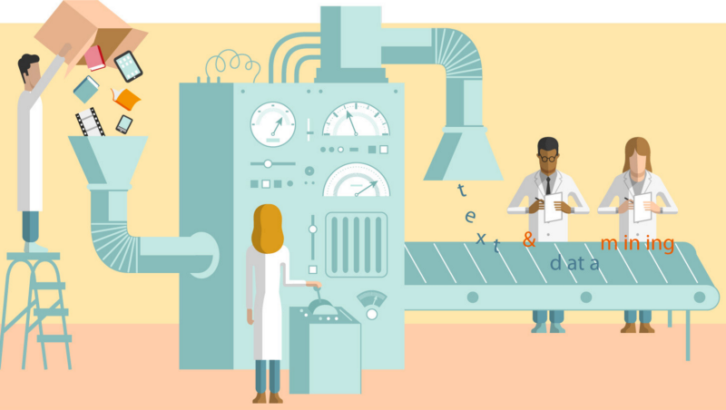
DATASET PREPAIRATION:-
Loading the data sets: Two datasets, First Play store app dataset and User Reviews dataset.
Import Libraries: NumPy, Pandas, Seaborn and Matplotlib

Slide 6
DATA SUMMARY :-
PLAY STORE DATASET
App: Name of the application. ● Size_in_MB: Memory
Size of the
application in MB.
Category: Apps are divided into different categories. Those categories are mentioned in this column such as Games, Travel, Books, Family, etc.
Installs: The number of installations of that particular application.
Type: Whether that app is paid or free of cost.
Rating: Rating is been given out of 5 which is calculated as the avg ratings given by the user.
Price_in_dollars: Price of the app if its not free.
Content_Rating: This column specifies who can access this application that can be teen, everyone, mature 17+, etc.
Reviews: Number of reviews received from the user.
Current_Ver: Latest version of the app.

Slide 7

DATA SUMMARY
CONTD…
USER REVIEWS DATA SET
Genres: The subcategory of the app.(game, family, health & fitness)
App: Name of the application.
Translated_Review: Review in English by the user.
Last_Updated: The last updated date of the app.
Sentiment: The result of the review is either positive or Negative.
Android_Ver: Minimum Android version supported by the app.
Sentiment_Polarity: It expresses the sentiment which ranges between -1 to 1 where -1 represents negative review and 1 represents positive and others depend on the type of review.
Sentiment_Subjectivity: This value ranges between 0 to 1. Lower values
indicate factual information and higher values represent values indicating personal or public opinions.

Slide 8


DATA PROCESSING
The data provided is not structured data. We need to process that data into the proper format.
In the play store dataset in the Size column the data given was in two formats in KB and MB so we need to process this data into one format i.e., in MB.
In Android Ver and Current Ver column hyphen was present and some characters were present in the column so we need to process that as well by removing them.
In Android Ver and up was present which was not useful while analyzing so I removed that as well.

Slide 9
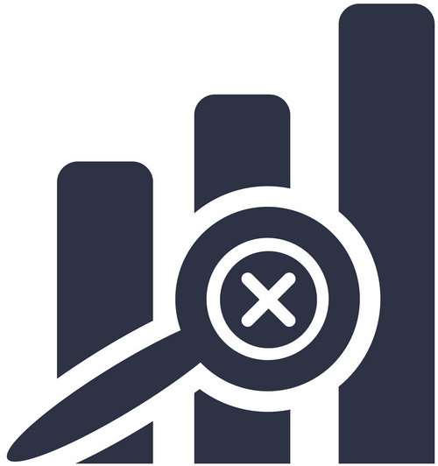
EXPLORING THE DATA:-
In the Playstore dataset there are 10,841 rows and 13 columns.
In the User Reviews dataset there are 64,295 rows and 5 columns.
Except Rating column other columns are having data type as an object.
In User Review there are 2 columns with data type float and others are of object

Slide 10

DATA CLEANING:-
Changing the data type from ‘object’ to ‘float’
Cleaned the ‘Review’, ‘Price’ , ‘Size’ and ‘Installs’ column and changed the type from ‘object’ to ‘float
Removed $ sign from Price column and making that as float type from object. Updating last updated column data type as date-time
Null Values Removal
In the play store dataset, there were null values present in Rating, Type, Content Rating, Android Ver, Current Ver these columns were having null values.
Rating is numerical data so I have used the median to fill the null values whereas other columns are categorical values for that I have used mode to fill the null values
Removing Duplicates
There were duplicates present in the play store dataset.
I dropped the duplicate rows based on ‘App’ column

Slide 11
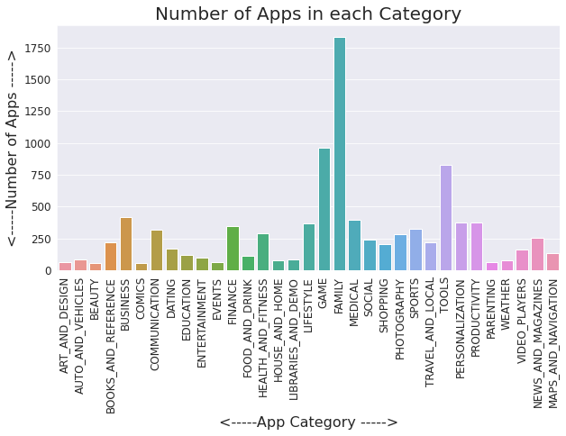
DATA VISUALIZATIONS:-
Most of the apps in Play Store belongs to the category of 'Family'.
And then 'Game' and 'Tools'.

Slide 12
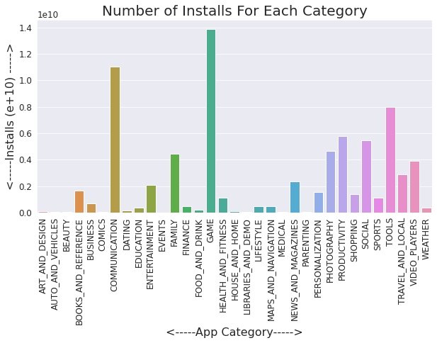
IMPORTANT FINDINGS:-
Most of the downloaded and installed apps are from the category of 'Games'.
And then 'Communication' and 'Tools'.

Slide 13
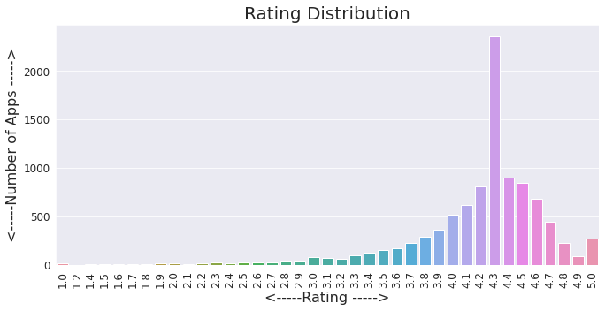
IMPORTANT FINDINGS:-
The highest rating is 4.3.
There very few apps (less than 500) are having 5.0 rating.
Most of the apps in the Play Store are having rating higher than 4 or in the range of 4 to 4.7.

Slide 14
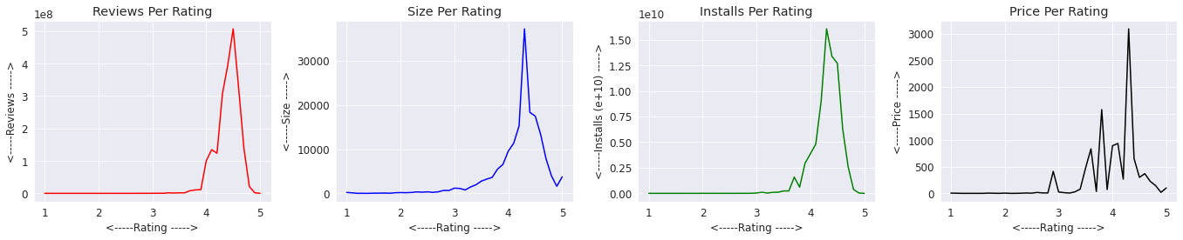
IMPORTANT FINDINGS:-
Most of the apps with higher rating range of 4.0 - 4.7 are having high amount of reviews, size, and installs.
So, users generally prefer apps having higher rating.
In terms of price, it doesn't reflect a direct relationship with rating, as we could see a fluctuation in term of pricing even at the range of high rating.
But, the apps having higher prices have the good rating.

Slide 15
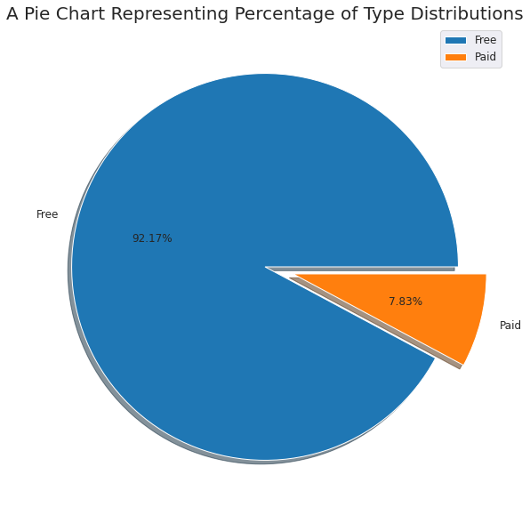
IMPORTANT FINDINGS:-
Most of the apps in Play Store are 'Free'.

Slide 16
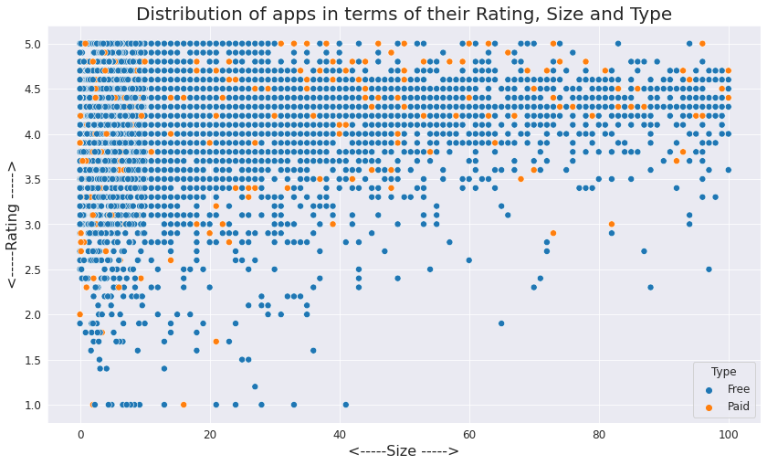
IMPORTANT FINDINGS:-
Most of the free apps are small in size (within 40 MB).
Most of the high rating apps are also smaller in size.

Slide 17
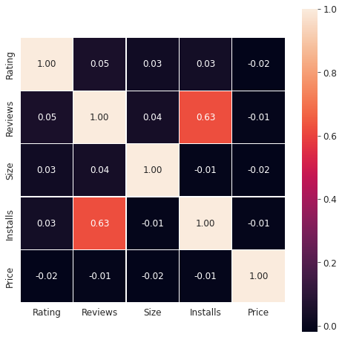
IMPORTANT FINDINGS:-
The number of installs is greater if reviews are higher.
A positive correlation exists between Installs and reviews i.e., 0.63.

Slide 18
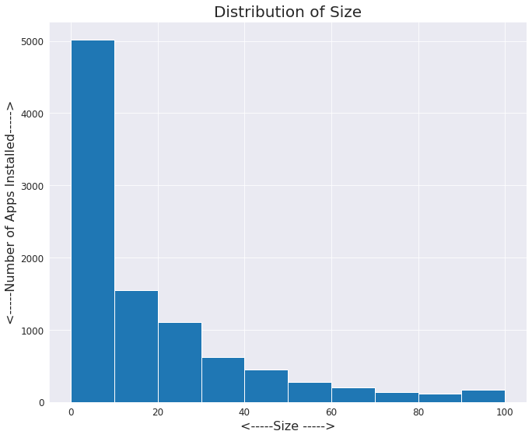
IMPORTANT FINDINGS:-
Most of the apps in Play store are smaller in size (within 10 MB).

Slide 19
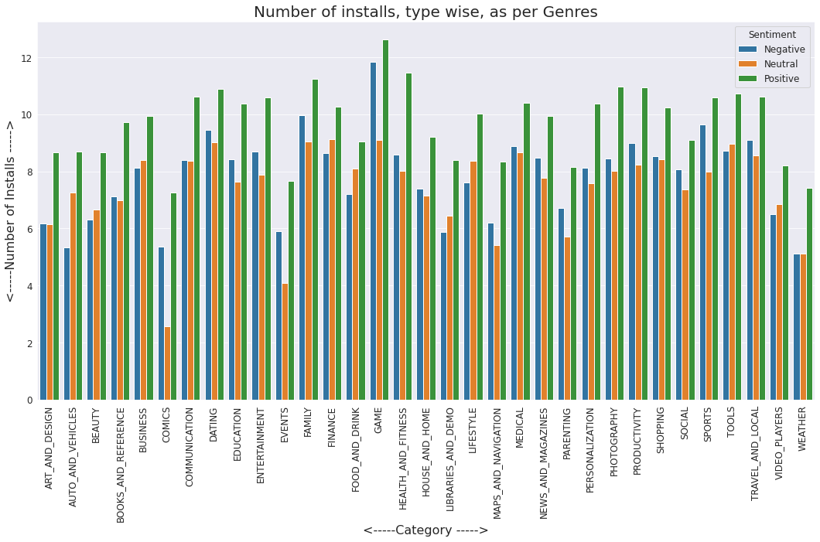
IMPORTANT FINDINGS:-
The maximum number of positive review belongs to the genre 'Game'.
The maximum number of negative review also belongs to the genre 'Game'.
And the maximum number of neutral review belongs to the genre 'Family'.

Slide 20
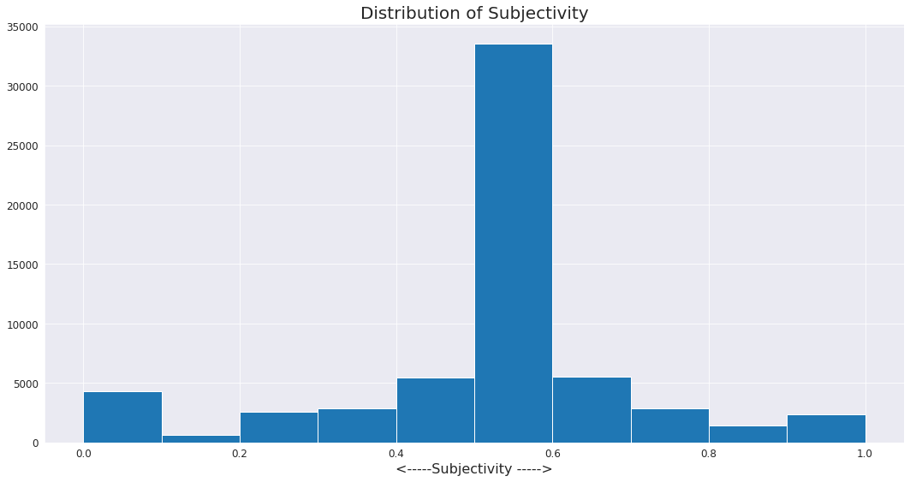
IMPORTANT FINDINGS:-
Maximum number of sentiment subjectivity lies between 0.5 to 0.6.
From this we can conclude that maximum number of users give reviews to the applications, according to their experience.

Slide 21
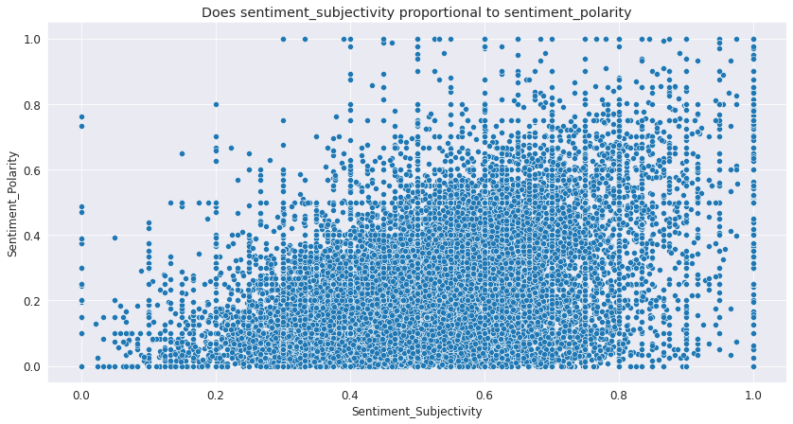
IMPORTANT FINDINGS:-
Sentiment subjectivity is not always proportional to sentiment polarity.
But in maximum number of cases, it shows a proportional behaviour when variance is too high or low.

Slide 22

CONCLUSION:-
The Google Play Store Apps report provides some useful insights regarding the trending of the apps in the play store. as per the graphs visualizations shown above, most of the trending apps (in terms of users' installs) are from the categories like GAME, COMMUNICATION and TOOL even though the amount of available apps from these categories are twice as much lesser then the category FAMILY. The trending of these apps are most probably due to their nature of being able to entertain or assist the user. Besides, it also shows a good trend where we can see that developers from these categories are focusing on the quality of the apps.
CONTD…

Slide 23
CONCLUSION:-
Other than that, the charts shown above actually implies that most of the apps having good ratings of above 4.0 are mostly confirmed to have high number of reviews and user installs. There are some spikes in term of size and price but it shouldn't reflect that apps with high rating are mostly big in size and pricy as by looking at the graphs they are most probably are due to some minority. Furthermore, most of the apps that are having high number of reviews are from the categories of SOCIAL, COMMUNICATION and GAME like Facebook, WhatsApp Messenger, Instagram, Messenger – Text and Video Chat for Free, Clash of Clans etc.
CONTD…

Slide 24
CONCLUSION:-
Even though apps from the categories like GAME, SOCIAL, COMMUNICATION and TOOL of having the highest number of installs, rating and reviews are reflecting the current trend of Android users, they are not even appearing as category in the top 5 most expensive apps in the store (which are mostly from FINANCE and LIFESTYLE). As a conclusion, we learnt that the current trend in the Android market is mostly from these categories which either assisting, communicating or entertaining apps.

Slide 25

CHALLENGES:-
While data cleaning there were columns with a lot of unnecessary data. For ex. In the Current Ver column, there were hyphens and it was also containing random strings at the end.
In some app names emojis were there we need to clean those as well.

Slide 26


