Slide 1

Git

Slide 2
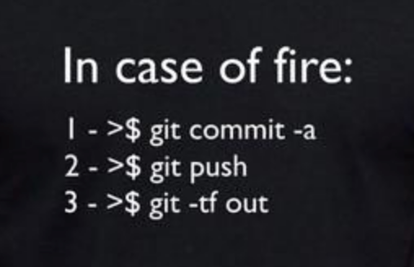
Git
Git is a distributed revision control and
source code management system with an emphasis on speed.
Git was initially designed and developed by Linus Torvalds for Linux kernel development.

Slide 3
Version Control System
Version Control System (VCS) is a software that helps software developers to work together and maintain a complete history of their work.
Allows developers to work simultaneously.
Does not allow overwriting each other’s changes.
Maintains a history of every version.

Slide 4
Types of VCS
Centralized VCS (CVCS)
CVCS uses a central server to store all files and enables team collaboration.
It has a single point of failure
Everybody commits to the main branch

Slide 5
Types of VCS
Distributed VCS (DVCS)
In DVCS each snapshot is a full backup of the of the repository.
Every operation can be done offline.
Everybody commits to their own branch.

Slide 6
Advantages of Git
Free and open source
Fast and small
Implicit backup
Security (SHA1)
Easy to branch

Slide 7
Git
The basic git workflow consists in:
Initialize the repository
Add files to the staging area
Commit files
push files to remote server (optional)

Slide 8
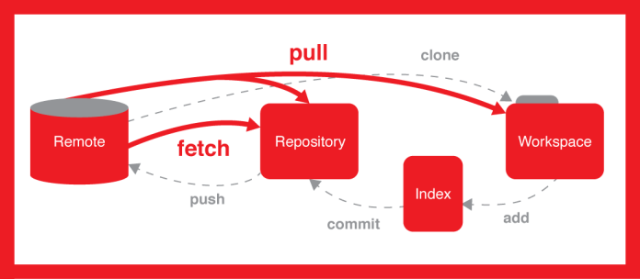
Git

Slide 9
Git terms
Tree - Tree is an object, which represents a directory.
Commits - Commit holds the current state of the repository.
Branch - Branches are used to create another line of development.
Tag - Tag assigns a meaningful name with a specific version in the repository.
Clone - Clone operation creates the instance of the repository.

Slide 10
Git terms
Pull - Pull operation copies the changes from a remote repository instance to a local one.
Push - Push operation copies changes from a local repository instance to a remote one.
HEAD - A pointer, which always points to the latest commit in the branch.

Slide 11
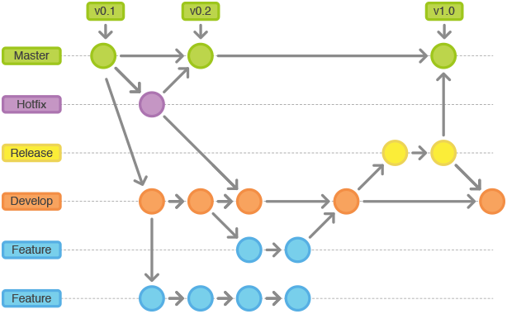
Git

Slide 12

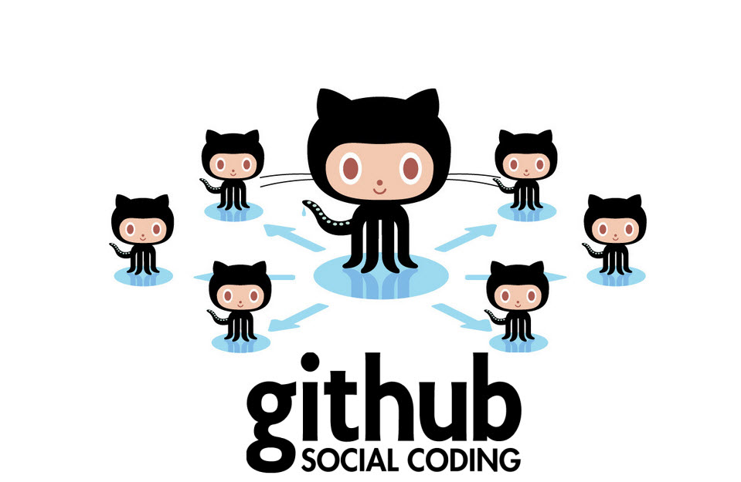

Slide 13
GitHub
GitHub is a web-based hosting service for version control using git.
GitHub offers free (public) and paid (private) accounts.
It also allows large team to collaborate and has a very intuitive graphic interface.

