Slide 1
P-Value

Slide 2
p-value
Most people think that p-value means probability.
Although they are related, they are not the same!!!!

Slide 3

A simple example
Flip of a coin two time
1˚ Flip
2˚ Flip
50% of the time will get Heads
50% of the time will get Tails
50% of the time will get Heads
50% of the time will get Tails
What is the probability of getting 2 heads in a row?
What is the p-value for getting 2 heads in a row?

Slide 4
What is the probability of getting two heads in a row?
First flip
Second flip
Outcome
0.5
H
HH
There are 4 different outcomes - each one equally likely.
0.5
H
HT
0.5
T
0.5
0.5
H
TH
T
0.5
T
TT

Slide 5
What is the probability of getting two head in a row?
First flip
Second flip
Outcome
Because each of them are equally likely we can calculate probability this way.
0.5
H
HH
0.5
H
HT
0.5
T
0.5
0.5
H
TH
T
0.5
T
TT

Slide 6
What is the probability of getting two head in a row?
First flip
Second flip
Outcome
0.5
H
HH
0.5
H
HT
0.5
T
0.5
0.5
H
TH
T
0.5
T
TT
The number of times HH occurred
1
=
= 0.25
Total # of outcomes
4

Slide 7
What about 2 tails?
First flip
Second flip
Outcome
0.5
H
HH
0.5
H
HT
0.5
T
0.5
0.5
H
TH
T
0.5
T
TT
The number of times TT occurred
1
The Probability of getting HH is the same as for getting TT
=
= 0.25
Total # of outcomes
4

Slide 8
What about 1 heads and 1 tails?
First flip
Second flip
Outcome
The Probability of getting one H and one T (regardless of order) is....
0.5
H
HH
0.5
H
HT
0.5
T
0.5
0.5
H
TH
T
0.5
T
TT
The number of times HT or TH occurred
2
=
= 0.5
Total # of outcomes
4

Slide 9
Why don’t we care about the order?
Usually the order of things does not matter.
If we are interested in mouse weights, it does not matter if we weigh mouse X before or after mouse Y.
The weighing order does not change the weight of the mouse.

Slide 10
What is the p-value for HH?
A p-value is the probability that random chance generated the data, or something else that is equal or rarer.
A p-value consists of 3 parts:

Slide 11
What is the p-value for HH?
We’ve already taken care of this first part...
HH 1
HH, HT,TH,TT 4
0.25
A p-value is the probability that random chance generated the data, or something else that is equal or rarer.
Part 1:

Slide 12
What is the p-value for HH?
We’ve already taken care of this first part...
HH 1
HH, HT,TH,TT 4
0.25
A p-value is the probability that random chance generated the data, or something else that is equal or rarer.
+
TT is considered equal to HH since it has the same probability of occurring

Slide 13
What is the p-value for HH?
We’ve already taken care of this first part...
HH 1
HH, HT,TH,TT 4
0.25
A p-value is the probability that random chance generated the data, or something else that is equal or rarer.
+
TT 1
HH, HT,TH,TT 4
0.25

Slide 14
What is the p-value for HH?
We’ve already taken care of this first part...
HH 1
HH, HT,TH,TT 4
0.25
A p-value is the probability that random chance generated the data, or something else that is equal or rarer.
+
TT 1
HH, HT,TH,TT 4
+
0.25
Since nothing is rarer than HH, this part is equal to zero.

Slide 15
What is the p-value for HH?
We’ve already taken care of this first part...
HH 1
HH, HT,TH,TT 4
Adding up the three parts, give us the p-value for HH = 0.5
0.25
A p-value is the probability that random chance generated the data, or something else that is equal or rarer.
+
TT 1
HH, HT,TH,TT 4
+
0.25
Since nothing is rarer than HH, this part is equal to zero.

Slide 16
To summarize
The probability of getting HH is 0.25
The p-value for getting HH is 0.5
In this case, these are not equal!

Slide 17
A slightly more complicated example
We flip the coin 5 times and get heads each time...
What is the probability of that?
Number of outcomes of interest
We need to figure out what the outcomes are and plug in this equation
Probability =
Total number of outcomes of interest

Slide 18
The Probability of getting HHHHH
Outcome
TTHHH
THTHH
THHTH
THHHT
HTTHH
HTHTH
HTHHT
HHTTH
HHTHT
HHHTT
TTTHH
TTHTH
THTTH
HTTTH
TTHHT
THTHT
HTTHT
THHTT
HTHTT
HHTTT
HHHHH
THHHH
HTHHH
HHTHH
HHHTH
HHHHT
TTTTH
TTTHT
TTHTT
THTTT
HTTTT
TTTTT
All outcomes

Slide 19
The Probability of getting HHHHH
Outcome
This is the 5 heads outcome
TTHHH
THTHH
THHTH
THHHT
HTTHH
HTHTH
HTHHT
HHTTH
HHTHT
HHHTT
TTTHH
TTHTH
THTTH
HTTTH
TTHHT
THTHT
HTTHT
THHTT
HTHTT
HHTTT
HHHHH
THHHH
HTHHH
HHTHH
HHHTH
HHHHT
TTTTH
TTTHT
TTHTT
THTTT
HTTTT
TTTTT

Slide 20
The Probability of getting HHHHH
Outcome
TTHHH
THTHH
THHTH
THHHT
HTTHH
HTHTH
HTHHT
HHTTH
HHTHT
HHHTT
TTTHH
TTHTH
THTTH
HTTTH
TTHHT
THTHT
HTTHT
THHTT
HTHTT
HHTTT
HHHHH
THHHH
HTHHH
HHTHH
HHHTH
HHHHT
TTTTH
TTTHT
TTHTT
THTTT
HTTTT
TTTTT
This is the 4 heads 1 tails outcome

Slide 21
The Probability of getting HHHHH
Outcome
TTHHH
THTHH
THHTH
THHHT
HTTHH
HTHTH
HTHHT
HHTTH
HHTHT
HHHTT
TTTHH
TTHTH
THTTH
HTTTH
TTHHT
THTHT
HTTHT
THHTT
HTHTT
HHTTT
HHHHH
THHHH
HTHHH
HHTHH
HHHTH
HHHHT
TTTTH
TTTHT
TTHTT
THTTT
HTTTT
TTTTT
This is the 3 heads 2 tails outcome

Slide 22
The Probability of getting HHHHH
Outcome
TTHHH
THTHH
THHTH
THHHT
HTTHH
HTHTH
HTHHT
HHTTH
HHTHT
HHHTT
TTTHH
TTHTH
THTTH
HTTTH
TTHHT
THTHT
HTTHT
THHTT
HTHTT
HHTTT
HHHHH
THHHH
HTHHH
HHTHH
HHHTH
HHHHT
TTTTH
TTTHT
TTHTT
THTTT
HTTTT
TTTTT
This is the 2 heads 3 tails outcome

Slide 23
The Probability of getting HHHHH
Outcome
TTHHH
THTHH
THHTH
THHHT
HTTHH
HTHTH
HTHHT
HHTTH
HHTHT
HHHTT
TTTHH
TTHTH
THTTH
HTTTH
TTHHT
THTHT
HTTHT
THHTT
HTHTT
HHTTT
HHHHH
THHHH
HTHHH
HHTHH
HHHTH
HHHHT
TTTTH
TTTHT
TTHTT
THTTT
HTTTT
TTTTT
This is the 1 heads 4 tails outcome

Slide 24
The Probability of getting HHHHH
Outcome
TTHHH
THTHH
THHTH
THHHT
HTTHH
HTHTH
HTHHT
HHTTH
HHTHT
HHHTT
TTTHH
TTHTH
THTTH
HTTTH
TTHHT
THTHT
HTTHT
THHTT
HTHTT
HHTTT
HHHHH
THHHH
HTHHH
HHTHH
HHHTH
HHHHT
TTTTH
TTTHT
TTHTT
THTTT
HTTTT
TTTTT
This is the 5 tails outcome

Slide 25
The Probability of getting HHHHH
Outcome
TTHHH
THTHH
THHTH
THHHT
HTTHH
HTHTH
HTHHT
HHTTH
HHTHT
HHHTT
TTTHH
TTHTH
THTTH
HTTTH
TTHHT
THTHT
HTTHT
THHTT
HTHTT
HHTTT
HHHHH
THHHH
HTHHH
HHTHH
HHHTH
HHHHT
TTTTH
TTTHT
TTHTT
THTTT
HTTTT
TTTTT
Number of outcomes of interest
Probability =
Total number of outcomes of interest

Slide 26
The Probability of getting HHHHH
# Outcome = 32
TTHHH
THTHH
THHTH
THHHT
HTTHH
HTHTH
HTHHT
HHTTH
HHTHT
HHHTT
TTTHH
TTHTH
THTTH
HTTTH
TTHHT
THTHT
HTTHT
THHTT
HTHTT
HHTTT
HHHHH
THHHH
HTHHH
HHTHH
HHHTH
HHHHT
TTTTH
TTTHT
TTHTT
THTTT
HTTTT
TTTTT
1
Probability =
= 0.03125
32

Slide 27
The p-value of getting HHHHH
Outcome
TTHHH
THTHH
THHTH
THHHT
HTTHH
HTHTH
HTHHT
HHTTH
HHTHT
HHHTT
TTTHH
TTHTH
THTTH
HTTTH
TTHHT
THTHT
HTTHT
THHTT
HTHTT
HHTTT
HHHHH
THHHH
HTHHH
HHTHH
HHHTH
HHHHT
TTTTH
TTTHT
TTHTT
THTTT
HTTTT
TTTTT
A p-value is the probability that random chance generated the data, or something else that is equal or rarer.

Slide 28
The p-value of getting HHHHH
Outcome
TTHHH
THTHH
THHTH
THHHT
HTTHH
HTHTH
HTHHT
HHTTH
HHTHT
HHHTT
TTTHH
TTHTH
THTTH
HTTTH
TTHHT
THTHT
HTTHT
THHTT
HTHTT
HHTTT
HHHHH
THHHH
HTHHH
HHTHH
HHHTH
HHHHT
TTTTH
TTTHT
TTHTT
THTTT
HTTTT
TTTTT
A p-value is the probability that random chance generated the data, or something else that is equal or rarer.
Again, in this case, there is nothing rarer than HHHHH

Slide 29
The p-value of getting HHHHH
Outcome
TTHHH
THTHH
THHTH
THHHT
HTTHH
HTHTH
HTHHT
HHTTH
HHTHT
HHHTT
TTTHH
TTHTH
THTTH
HTTTH
TTHHT
THTHT
HTTHT
THHTT
HTHTT
HHTTT
HHHHH
THHHH
HTHHH
HHTHH
HHHTH
HHHHT
TTTTH
TTTHT
TTHTT
THTTT
HTTTT
TTTTT
A p-value is the probability that random chance generated the data, or something else that is equal or rarer.
Part: 1
Pr(5 heads)
1
32

Slide 30
The p-value of getting HHHHH
Outcome
TTHHH
THTHH
THHTH
THHHT
HTTHH
HTHTH
HTHHT
HHTTH
HHTHT
HHHTT
TTTHH
TTHTH
THTTH
HTTTH
TTHHT
THTHT
HTTHT
THHTT
HTHTT
HHTTT
HHHHH
THHHH
HTHHH
HHTHH
HHHTH
HHHHT
TTTTH
TTTHT
TTHTT
THTTT
HTTTT
TTTTT
A p-value is the probability that random chance generated the data, or something else that is equal or rarer.
Since there is nothing rarer and part 3 is zero, this is what we get
Part: 1
Part: 2
Pr(5 heads)
1
32
Pr(5 tails)
1
32
+
= 0.0625

Slide 31
What about 4 heads and 1 tails?
Number of outcomes of interest
# Outcomes = 32
Probability =
Total number of outcomes of interest
TTHHH
THTHH
THHTH
THHHT
HTTHH
HTHTH
HTHHT
HHTTH
HHTHT
HHHTT
TTTHH
TTHTH
THTTH
HTTTH
TTHHT
THTHT
HTTHT
THHTT
HTHTT
HHTTT
HHHHH
THHHH
HTHHH
HHTHH
HHHTH
HHHHT
TTTTH
TTTHT
TTHTT
THTTT
HTTTT
TTTTT
5
32
Pr(4 heads and 1 tails) =
= 0.15625
What’s the p-value?

Slide 32
What about 4 heads and 1 tails?
5
32
# Outcomes = 32
Pr(4 heads and 1 tails) =
= 0.15625
TTHHH
THTHH
THHTH
THHHT
HTTHH
HTHTH
HTHHT
HHTTH
HHTHT
HHHTT
TTTHH
TTHTH
THTTH
HTTTH
TTHHT
THTHT
HTTHT
THHTT
HTHTT
HHTTT
HHHHH
THHHH
HTHHH
HHTHH
HHHTH
HHHHT
TTTTH
TTTHT
TTHTT
THTTT
HTTTT
TTTTT
A p-value is the probability that random chance generated the data, or something else that is equal or rarer.

Slide 33
What about 4 heads and 1 tails?
5
32
# Outcomes = 32
Pr(4 heads and 1 tails) =
= 0.15625
TTHHH
THTHH
THHTH
THHHT
HTTHH
HTHTH
HTHHT
HHTTH
HHTHT
HHHTT
TTTHH
TTHTH
THTTH
HTTTH
TTHHT
THTHT
HTTHT
THHTT
HTHTT
HHTTT
HHHHH
THHHH
HTHHH
HHTHH
HHHTH
HHHHT
TTTTH
TTTHT
TTHTT
THTTT
HTTTT
TTTTT
A p-value is the probability that random chance generated the data, or something else that is equal or rarer.

Slide 34
What about 4 heads and 1 tails?
5
32
# Outcomes = 32
Pr(4 heads and 1 tails) =
= 0.15625
A p-value is the probability that random chance generated the data, or something else that is equal or rarer.
TTHHH
THTHH
THHTH
THHHT
HTTHH
HTHTH
HTHHT
HHTTH
HHTHT
HHHTT
TTTHH
TTHTH
THTTH
HTTTH
TTHHT
THTHT
HTTHT
THHTT
HTHTT
HHTTT
HHHHH
THHHH
HTHHH
HHTHH
HHHTH
HHHHT
TTTTH
TTTHT
TTHTT
THTTT
HTTTT
TTTTT
Pr(4 heads and 1 tails) =
+
Pr(1 heads and 4 tails) =
+
Pr(5 heads) + Pr(5 tails) =
Part 1
+
Part 2
+
Part 3

Slide 35
What about 4 heads and 1 tails?
5
32
# Outcomes = 32
Pr(4 heads and 1 tails) =
= 0.15625
A p-value is the probability that random chance generated the data, or something else that is equal or rarer.
TTHHH
THTHH
THHTH
THHHT
HTTHH
HTHTH
HTHHT
HHTTH
HHTHT
HHHTT
TTTHH
TTHTH
THTTH
HTTTH
TTHHT
THTHT
HTTHT
THHTT
HTHTT
HHTTT
HHHHH
THHHH
HTHHH
HHTHH
HHHTH
HHHHT
TTTTH
TTTHT
TTHTT
THTTT
HTTTT
TTTTT
Pr(4 heads and 1 tails) =
+
Pr(1 heads and 4 tails) =
+
Pr(5 heads) + Pr(5 tails) =
0.15625
+
0.15625
+
0.03125 + 0.03125
p-value = 0.375

Slide 36
With coin tosses, it’s easy to list all possible outcomes
HHHHH THHHH HHTTH HHHHT (etc ...)
But what if we want to calculate probabilities of heights?
152.1 cm 152.6 cm 153.1 cm etc...
152.2 cm 152.7 cm 153.2 cm etc...
152.3 cm 152.8 cm 153.3 cm etc...
152.4 cm 152.9 cm 153.4 cm etc...
152.5 cm 153.0 cm 153.5 cm etc...
Do we list every value for height?
How many decimal places to use?
Fortunately we don’t need to worry about listing all possible values, or how many decimal places to use!!!

Slide 37
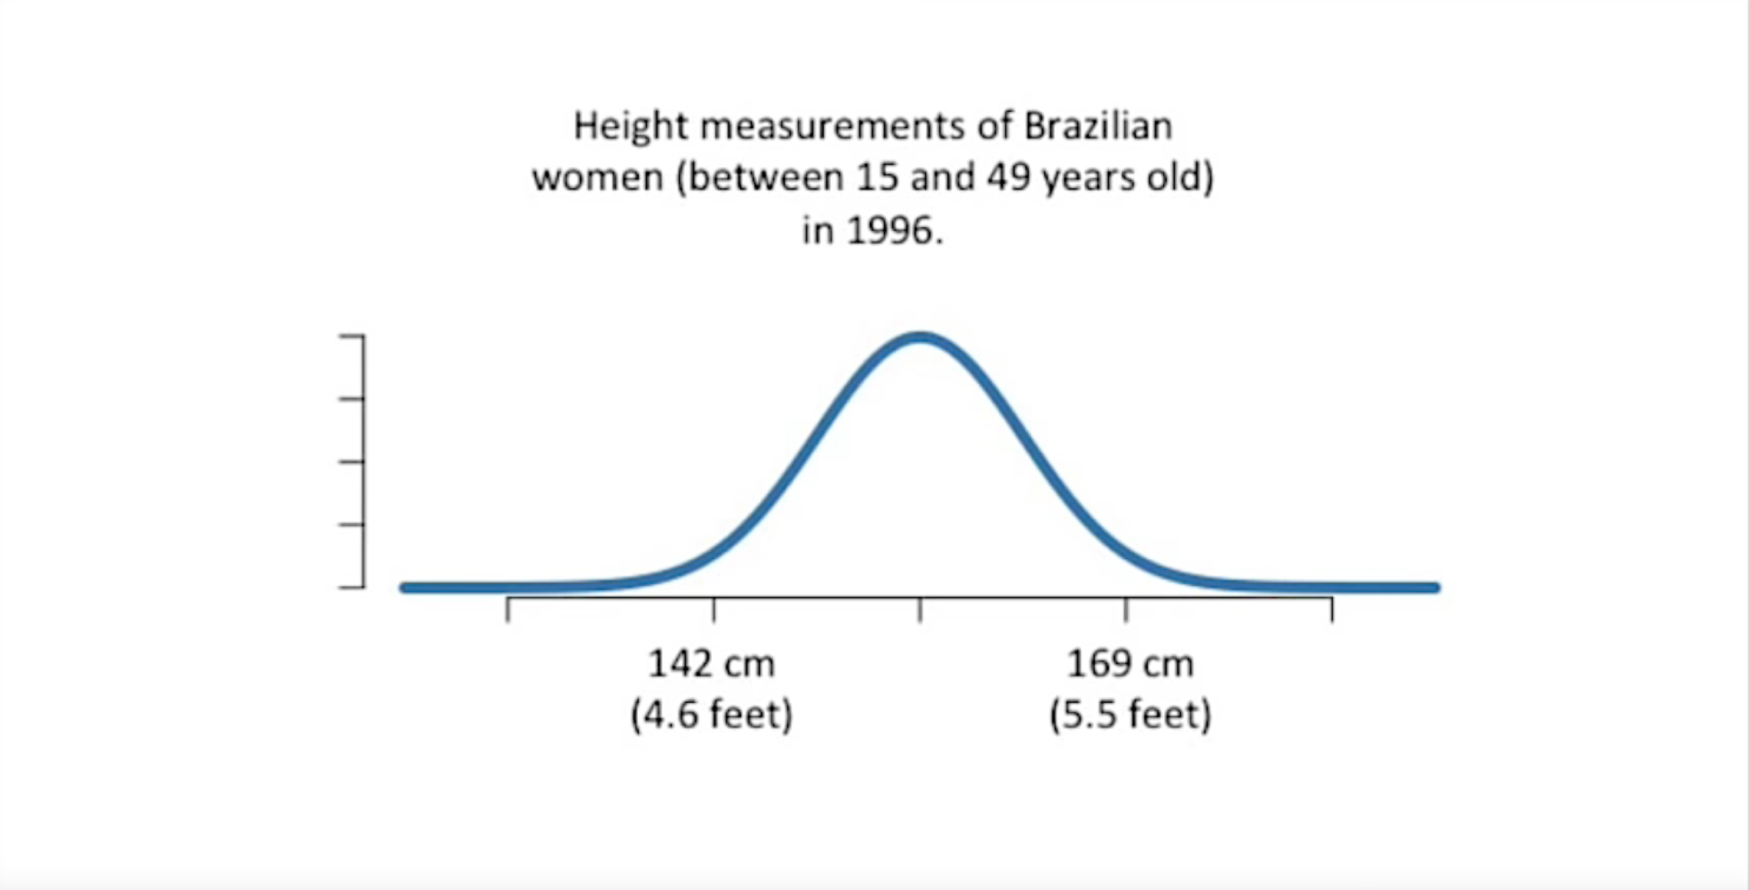
Instead we can use something called “density”

Slide 38
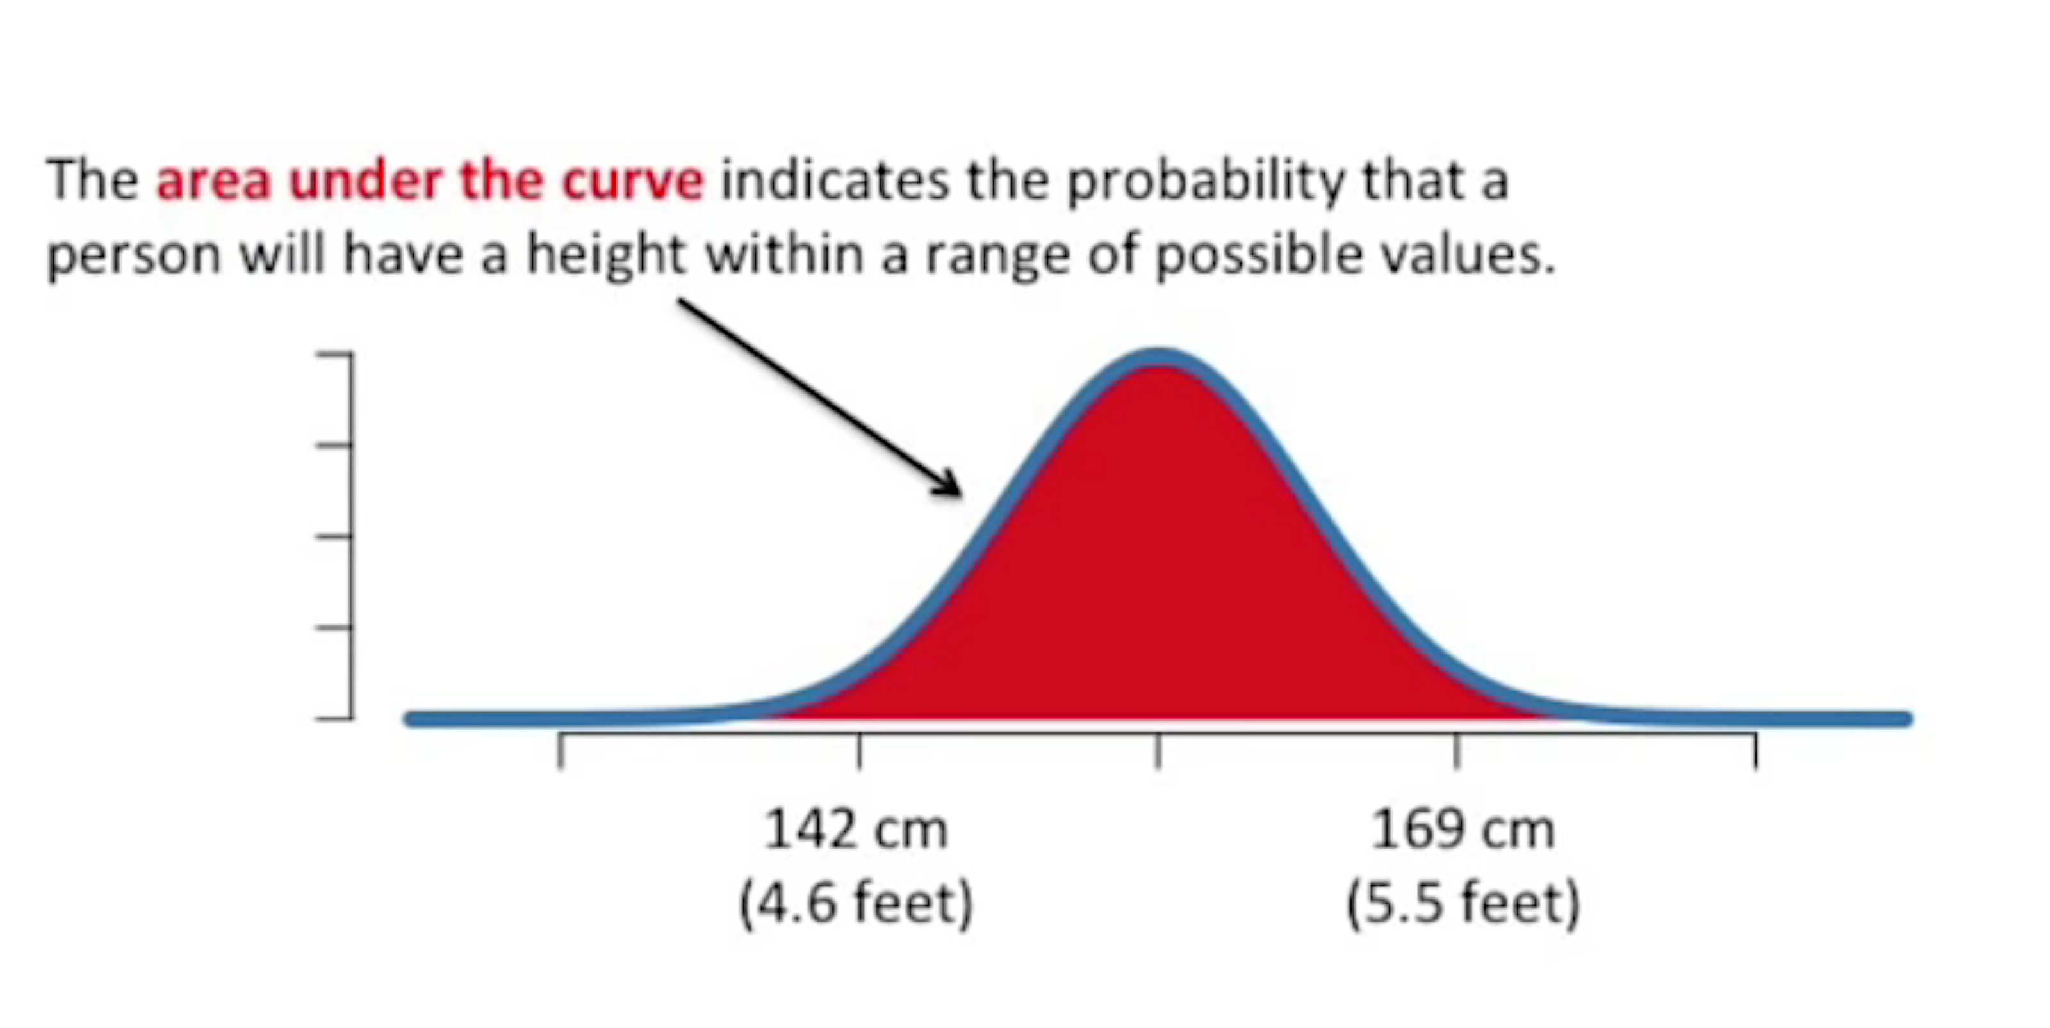

Slide 39
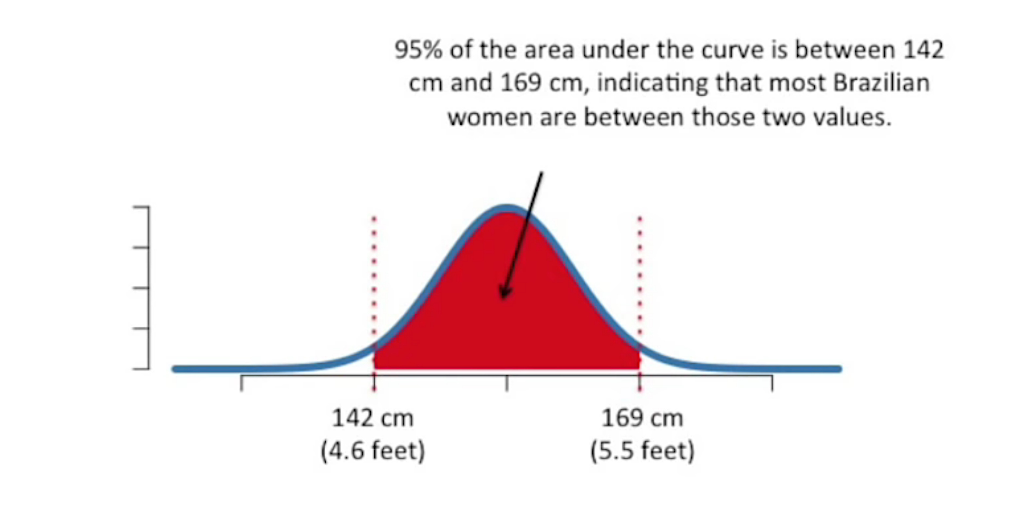
In other words, there is a 95% probability that each time we measure someone, their height will be between 142 and 169 cm

Slide 40
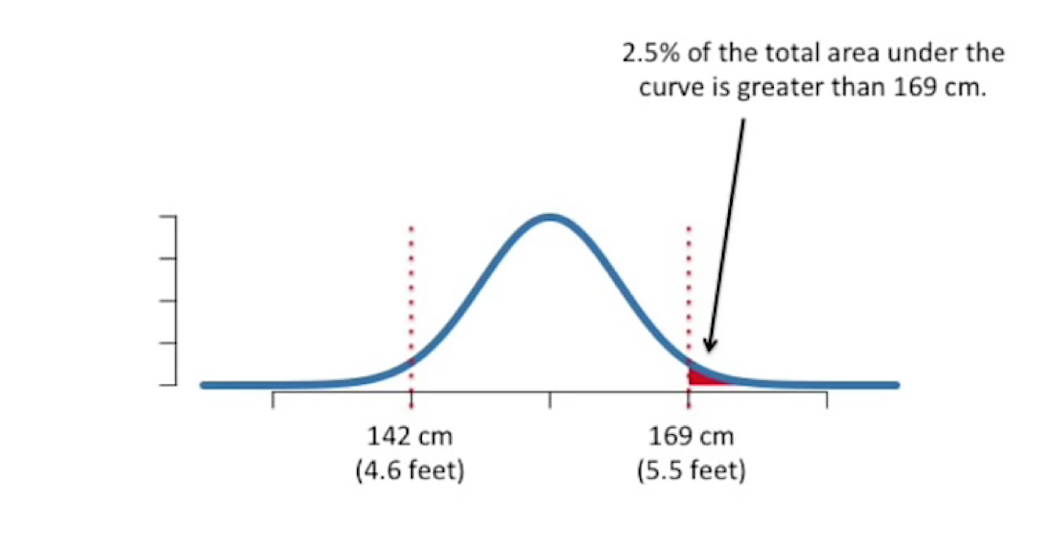
In other words, there is a 2.5% probability that each time we measure a Brazilian woman, their height will be between greater than 169 cm

Slide 41
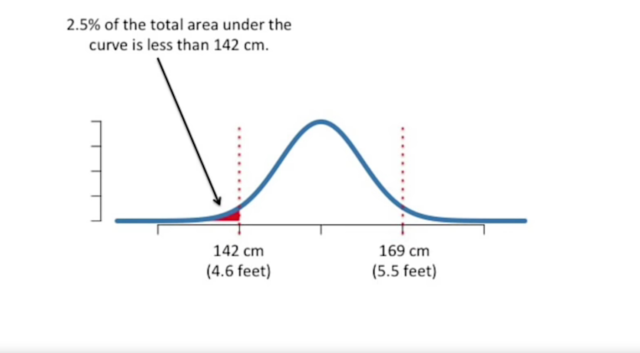
In other words, there is a 2.5% probability that each time we measure a Brazilian woman, their height will be between less than 142 cm

Slide 42
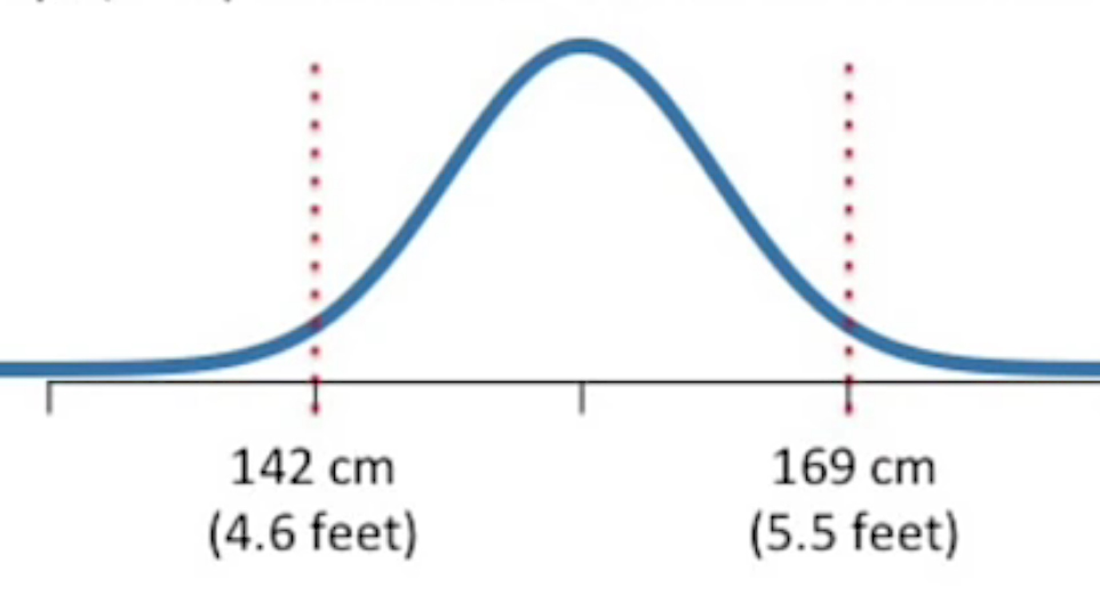
To calculate p-values, you add up the percentages of areas under the curve.
For example, the p-value for someone who is 142 cm tall is...

Slide 43
To calculate p-values, you add up the percentages of areas under the curve.
For example, the p-value for someone who is 142 cm tall is...
The 2.5% of the area for people 142 cm or shorter
This account for the first half of the “equal to or rarer” part of calculating a p-value

Slide 44
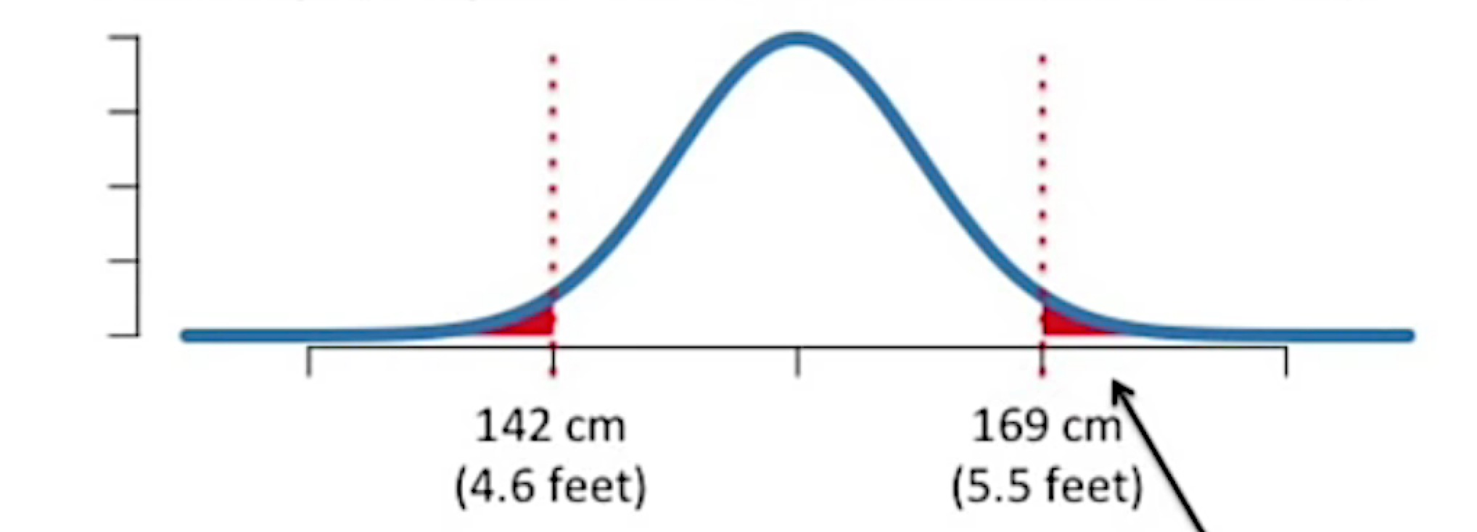
To calculate p-values, you add up the percentages of areas under the curve.
For example, the p-value for someone who is 142 cm tall is...
This account for the other half of the “equal to or rarer” part of calculating a p-value
The 2.5% of the area for people 169cm or taller
Thus the p-value is 0.05 or 5%

Slide 45
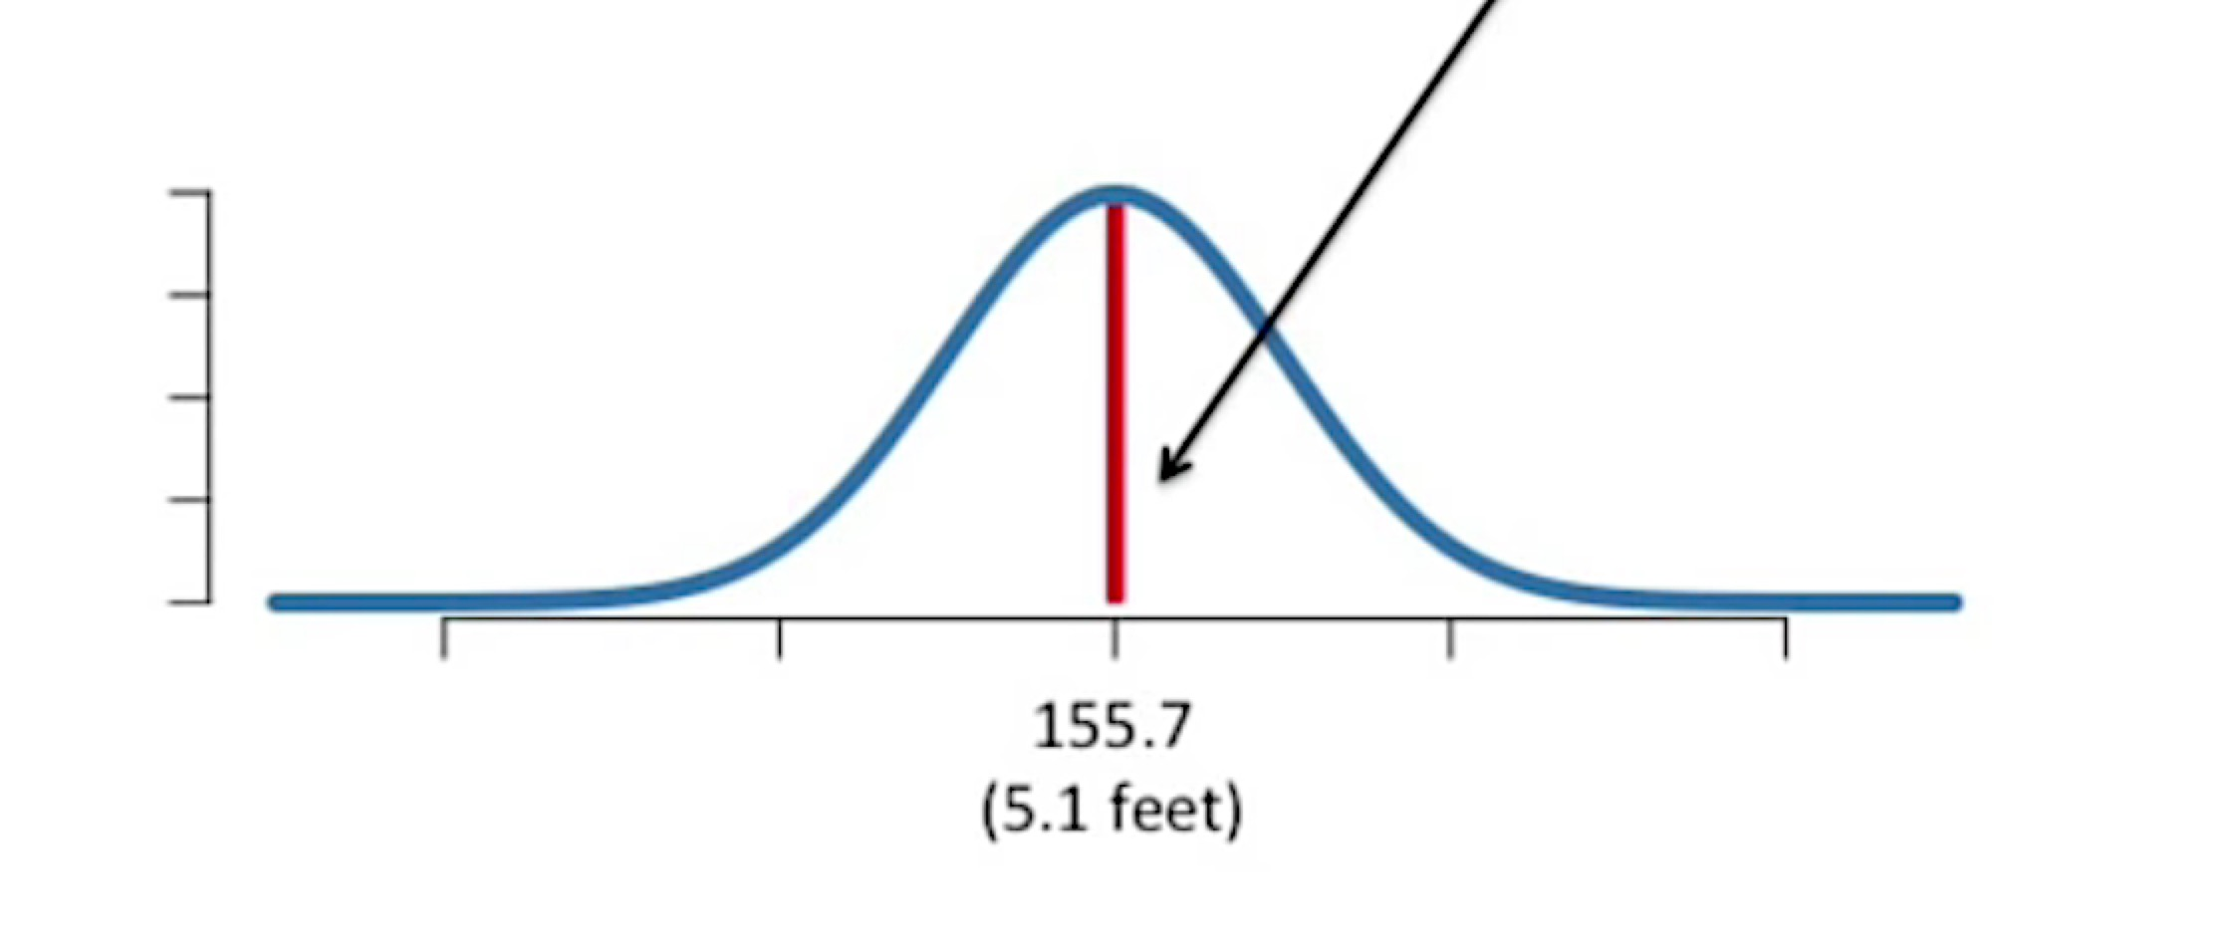
What is the p-value for someone who is between 155.4 and 156 cm tall?
Note: The Probability of someone being between 155.4 and 156 cm is only 0.04
This is the red area... Barely a line!
This is the first part of calculating a p-value. It is the probability of the event of interest.

Slide 46
What is the p-value for someone who is between 155.4 and 156 cm tall?
The next part is to calculate the probability of rarer events happening. It has to be done in two parts.

Slide 47
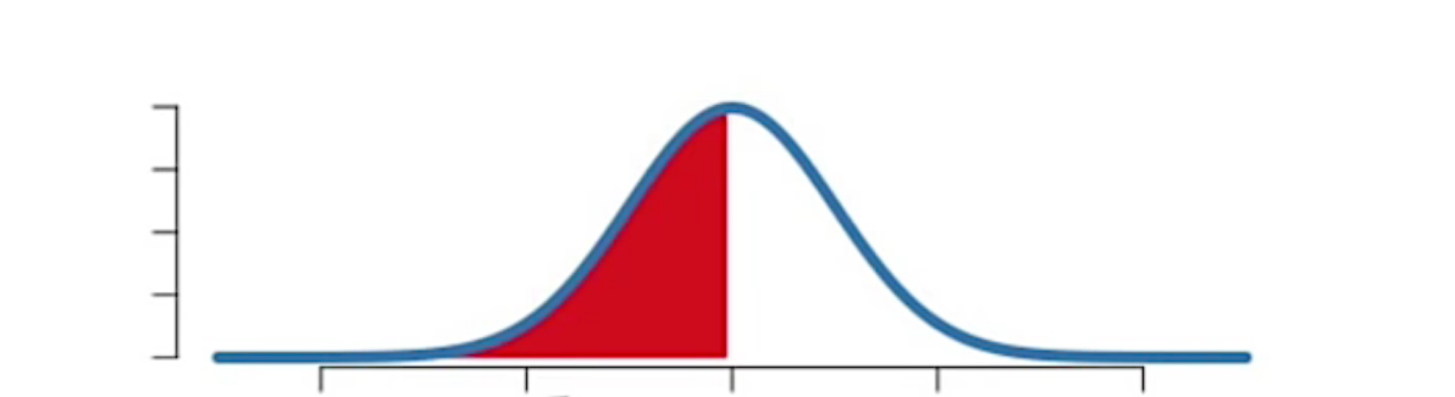
What is the p-value for someone who is between 155.4 and 156 cm tall?
48% of this area is for people shorter than 155.4cm

Slide 48
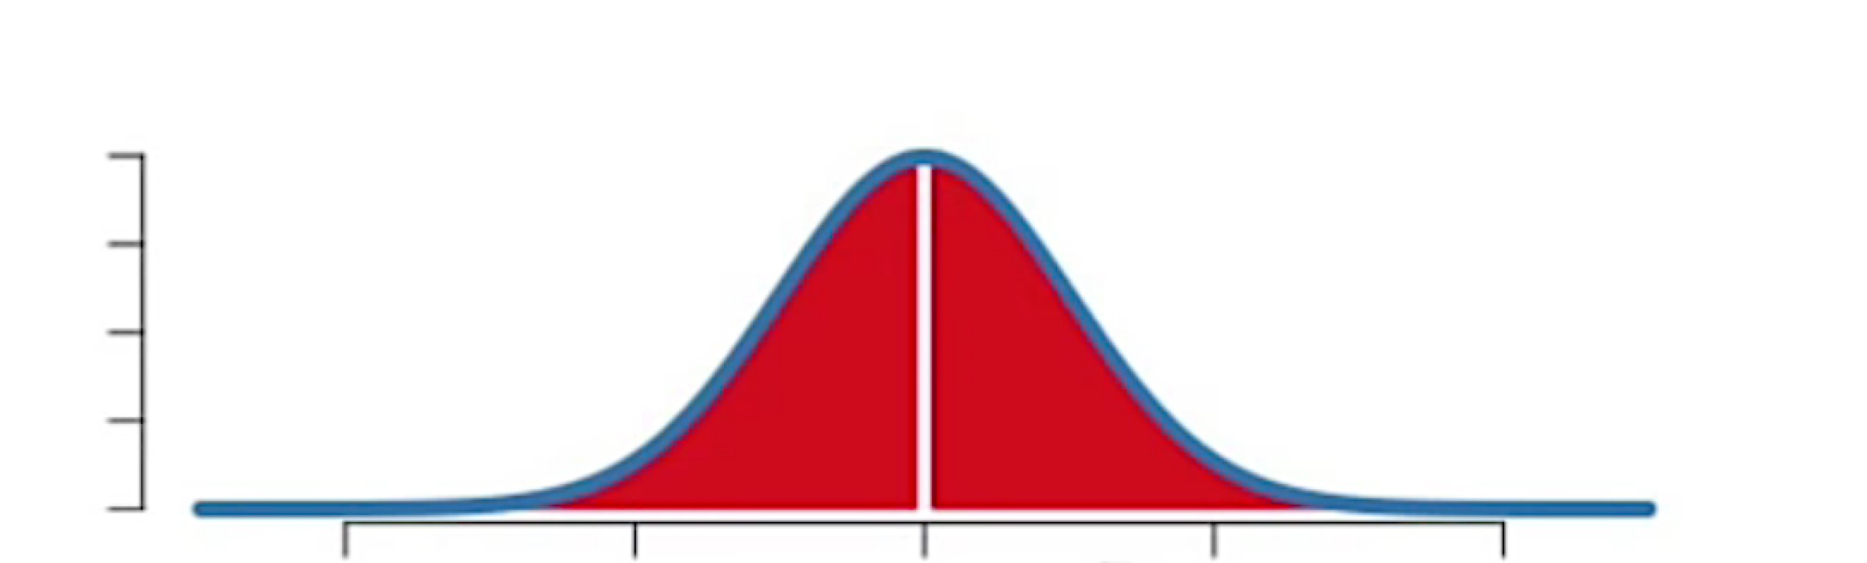
What is the p-value for someone who is between 155.4 and 156 cm tall?
48% of this area is for people taller than 169cm

Slide 49
What is the p-value for someone who is between 155.4 and 156 cm tall?
4% of the people are between 155.5 and 156 cm tall
48% of this area is for people shorter than 155.4cm
48% of this area is for people taller than 169cm
p-value = Pr(interest) + Pr(equal) + Pr(rarer)
p-value = 4 + 48 +48 = 100 or p-value = 1

Slide 50
To keep in mind
In this example the probability of measuring someone between 155.4 and 156cm tall is tiny 0.04, however the p-value is huge 1
In other words there is nothing special about measuring someone with this height, although the probability is very low.

