Slide 1
Semantics

Slide 2
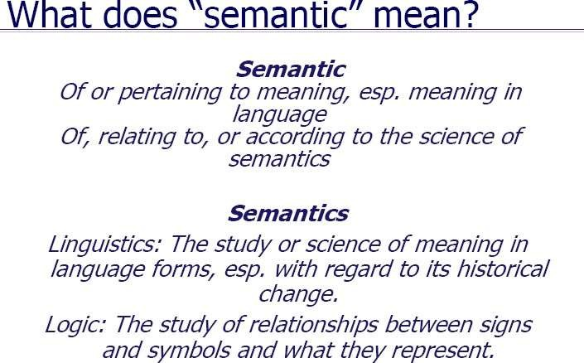

Slide 3
How do you do semantics?
Generalization –. It occurs when one specific experience
represents a whole class of experiences
organizing concepts by kind
Aggregation
Aggregating complexes into simpler concepts
Common Properties
Relationships (connecting properties)
Attributes (flat properties)
Naming Conventions
Terms / Phrases
Language

Slide 4
What else do semantics provide?
Contextual Meaning
Inferred Relationships
Causality (Casual Relations between words)
Granularity - Breaking down an event into smaller parts

Slide 5
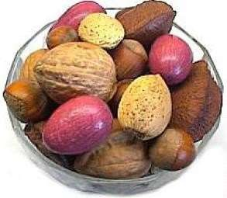
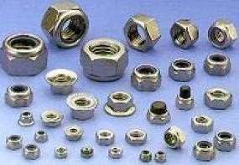
The Problem of Semantic Ambiguity
context=food
context=hardware
Did you say you were looking for
mixed nuts?
People use context to derive the correct meaning.

Slide 6
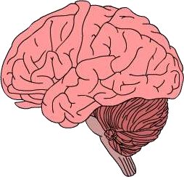
Word Senses
footra
strea k
ce duratio
tes n t
pla y
operate
tall y
g
move fast
sca t
o
has form
A single word maps To many concepts
“run”

Slide 7
Definition
Semantic processing deals with rewriting a
parse tree into a “meaning representation”
Logic, SQL, Knowledge base
Poorly understood compared to syntax
applications that need complex semantics, like database front ends or high-quality Machine Translation had limited success in the past.
How can we represent the meaning of an English sentence?
Programming languages: “meaning” is equivalent machine code
a = b +c
means
Load a,b,c add b,c store a

Slide 8
Meanings of words
Lexemes - basic unit of meaning in the lexicon
Examples:
Red, n: the color of blood or a ruby
Blood, n: the red liquid that circulates in the heart, arteries and veins of animals
Right, adj: located nearer the right hand esp. being on the right when facing the same direction as the observer
Do dictionaries gives us definitions??

Slide 9
Three Perspectives on Meaning
Lexical Semantics
The meanings of individual words
Formal Semantics (or Compositional Semantics or Sentential
Semantics)
How those meanings combine to make meanings for individual sentences or utterances (manner of speaking; power of speaking)
Discourse or Pragmatics
How those meanings combine with each other and with other facts about various kinds of context to make meanings for a text or discourse
Dialog or Conversation is often lumped together with
Discourse

Slide 10
Relations among words
Homonymy (Words with identical forms but different meanings)
Instead, a bank can hold the investments in a custodial account in the client’s name.
But as agriculture burgeons on the east bank, the river will shrink even more.
Other examples: be/bee?, wood/would?
Homophones (Sum, Some) (Son, Sun)
Homographs (lead - to go first with followers behind/a type of metal)
Applications: spelling correction, speech recognition, text-to-speech

Slide 11
Relationships between word meanings
Homonymy
Polysemy - word having several meanings.
Synonymy
Antonymy
Hypernomy - A word with a broad meaning constituting a category into which words with more specific meanings. For example, colour is a hypernym of red.
Hyponomy - Relationship between more general term Ex: Red is hyponym of colour, car is a hyponym of vehicle
Meronomy - A meronym refers to a part of a whole. Engines
have parts: carburetor, Headlights …
finger' is a meronym of 'hand

Slide 12
Homonymy
Homonymy:
Lexemes that share a form
Phonological, orthographic or both
But have unrelated, distinct meanings
Can be homophones, homographs, or both:
Homophones:
Write and right
Piece and peace

Slide 13
Homonymy causes problems for NLP applications
Text-to-Speech
Same orthographic form but different phonological form
bass vs bass
Bass, when pronounced as base, means the lowest pitch, an adult male who sings in the lowest pitch, any number of instruments that play the lowest pitch.
Information retrieval
Different meanings same orthographic form
QUERY: bat care
Basic bat care. Any bat that is found on the ground, or in an exposed area, especially during the day, is likely to need help.
Machine Translation
Speech recognition

Slide 14
Polysemy
Polysemy is the property of a word having several meanings.
The bank is constructed from red brick
I withdrew the money from the bank
Are those the same sense?
Or consider the following example
While some banks furnish blood only to serious patients, others are
less restrictive
Which sense of bank is this?
Is it distinct from (homonymous with) the river bank sense?
How about the savings bank sense?
He left the five minutes ago.
He caught a fish at the
bank
bank.

Slide 15
Polysemy
A single lexeme with multiple related meanings (bank the building, bank the financial institution)
Most non-rare words have multiple meanings
The number of meanings is related to its frequency
Verbs tend more to polysemy
Distinguishing polysemy from homonymy isn’t always easy (or necessary)

Slide 16
Polysemy
They rarely serve red meat, preferring to prepare seafood, poultry, or game birds.
He served as U.S. ambassador to Norway in 1976 and 1977.
He might have served his time, come out and led an upstanding life.
Homonymy: distinct and unrelated meanings, possibly with different etymology (multiple lexemes).
Polysemy: single lexeme with two meanings.
Example: an “idea bank”

Slide 17
Metaphor and Metonymy
Metaphor and metonymy are similar in various aspects but the major difference is that if a metaphor substitutes a concept with another, a metonymy selects a related term. So, if metaphor is for substitution, metonymy is for association.
For example, the sentence ‘ ’ is a
he is a tiger in class
metaphor. Here the
word tiger is used in substitution
for displaying an attribute of character of the person.
The sentence ‘
the tiger called his students to the
meeting room
’ is a metonymy. Here there is
no
substitution
; instead the person is associated with a
tiger for his nature.

Slide 18
Metaphor and Metonymy
Metaphor and Metonymy are specific Types of Polysemy.
Metaphor:(A metaphor is a figure of speech containing an implied comparison. With metaphors, words or phrases that are ordinarily applied to one thing are applied to something you wouldn't necessarily pair it with. Here's a metaphor example: “The curtain of night fell upon us.”
Her eyes were like diamonds

Slide 19
Metaphor and Metonymy (Contd)
Metonymy (Metonymy is a figure of speech that replaces the name of a thing with the name of something else with which it is closely associated).
A famous example is, "The pen is mightier than the sword," from Edward Bulwer Lytton's play Richelieu.
This sentence has two metonyms:
"Pen" stands for "the written word." "Sword" stands for "military aggression."

Slide 20
Synonyms
Words that have the same meaning in some or all contexts.
Look / see
Happy / Joyful
big / large
automobile / car
Beautiful / Pretty/Attractive
Water / H₂0
Two lexemes are synonyms if they can be successfully substituted for each other in all situations
If so they have the same propositional meaning

Slide 21
Synonyms
But there are few (or no) examples of perfect synonymy.
Why should that be?
Even if many aspects of meaning are identical
Still may not preserve the acceptability based on notions of politeness, slang, register, genre, etc.
Example:
Water and H₂0

Slide 22
Synonymy
Principle of substitutability
How big is this plane?
Would I be flying on a large or small plane?
Miss Nelson, for instance, became a kind of big sister to Mrs. Van Tassel’s son, Benjamin.
?? Miss Nelson, for instance, became a kind of large sister to Mrs. Van Tassel’s son, Benjamin.

Slide 23
Synonymy is a relation between senses rather than words
Consider the words big and large
Are they synonyms?
How big is that plane?
Would I be flying on a large or small plane?
How about here:
Miss Nelson, for instance, became a kind of big sister to Benjamin.
?Miss Nelson, for instance, became a kind of large sister to Benjamin.
Why?
big has a sense that means being older, or grown up
large lacks this sense

Slide 24
Antonyms
Senses that are opposites with respect to one feature of their meaning
Otherwise, they are very similar!
dark / light
short / long
hot / cold
up / down
in / out
More formally: antonyms can
define a binary opposition or at opposite ends

Slide 25
Hyponymy
•
A term that denotes a subcategory of a more general class:
“Chair” and “table” are hyponyms of “furniture.”
One sense is a hyponym of another if the first sense is more specific, denoting a subclass of the other
car is a hyponym of vehicle
dog is a hyponym of animal
mango is a hyponym of fruit
Conversely
vehicle is a hypernym/superordinate of car
animal is a hypernym of dog
fruit is a hypernym of mango
superordinate | vehicle | fruit | furniture | mammal
hyponym | car | mango | chair | dog

Slide 26
Hypernymy more formally
A hypernym describes a more broad term
Extensional:
The class denoted by the superordinate
extensionally includes the class denoted by the hyponym
Entailment:
A sense A is a hyponym of sense B if being an A entails being a B
Hyponymy is usually transitive
(A hypo B and B hypo C entails A hypo C)

Slide 27
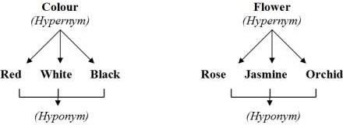
EXAMPLE OF HYPONYMS AND HYPERONYMS

Slide 28
Semantic ambiguity
A sentence may have a single syntactic structure, but multiple semantic structures
Every boy loves a dog
Vagueness – some senses are more specific than others
“Person” is more vague than “woman”
Quantifiers: Many people saw the accident

Slide 29
Semantics
Mary untangled a library.
What’s wrong with this sentence?
It is syntactically correct, but semantically weird
Since Untangled stands for free from a tangled or twisted state.

Slide 30
Pragmatics
Mary was hired as the new library director.
She had a hard job because the library was a mess. Mary untangled a library.
The context disambiguates the meaning.
This is a complicated cognitive feat!

Slide 31
Discourse
Mary was hired as the new library director.
Mary had a hard job because the library was a mess. She untangled it.
The prior discourse provides references for the pronouns.
In general, temporal sequences require discourse knowledge to be understood.

Slide 32
World Knowledge
Speaker A:
Mary was hired as the new library director.
She had a hard job because the library was a mess. Mary untangled a library.
Speaker B:
It doesn’t matter. She’s still fired.
World knowledge allows you to understand what this conversation is about.
It includes knowledge about jobs, office politics, the structure of argument, and more.

Slide 33
Semantic Analysis

Slide 34
Semantic Analysis
To Understand the meaning of a sentence, there are three types of semantic analysis that we can use
We can determine the Semantic Feature of key words in the sentence
We can analyze the Lexical Relation of these words in the
sentence
We can analyze the Semantic Roles (Thematic Role / Theta Role) of key words in the sentence(i.e. the roles they fulfill in the situation described in the sentence.

Slide 35
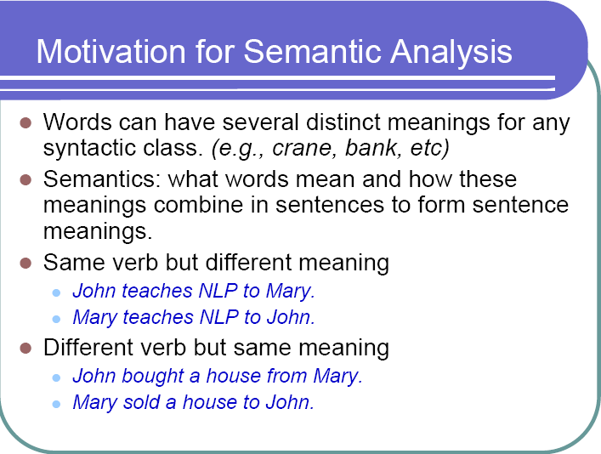

Slide 36
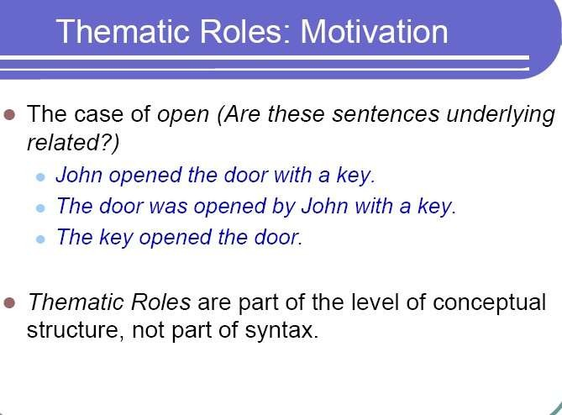

Slide 37
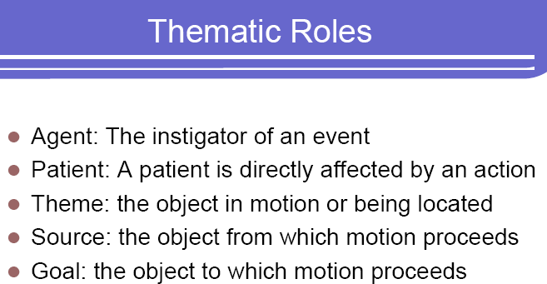

Slide 38
List of Basic Thematic Roles
AGENT: the initiator of some action, capable of acting with volition.
– Jack ate the beans.
PATIENT: the entity undergoing the effect of some action, often undergoing some change of state.
– Sue mowed the lawn.
THEME: the entity which is moved by an action, or whose location is
described.
– Fred threw the rock.
EXPERIENCER: the entity which is aware of the action or state described by the predicate but which is not in control of the action or state.
– Kim saw the deer.

Slide 39
BENEFICIARY: the entity for whose benefit the
action was performed.
– Mary studied hard for her mother.
INSTRUMENT: the means by which an action is performed or something comes about.
– Fred opened the lock with a paper clip.
LOCATION: the place in which something is situated
or takes place.
– The picture hangs above the fireplace.
GOAL: the entity towards which something moves, either literally or metaphorically.
– Lee walked to school.
SOURCE: the entity from which something moves, either literally or metaphorically.
– Sue ran from the policeman.

Slide 40
ACTOR: the entity which performs, effects, instigates, or controls the situation denoted by the predicate (supertype of AGENT):
– The bus hit a pedestrian.
RECIPIENT: a subtype of GOAL involved in actions
describing changes of possession.
– Bill sold the car to Mary
PERCEPT/STIMULUS: the entity which is perceived or experienced.
– Mary fears thunder.

Slide 41
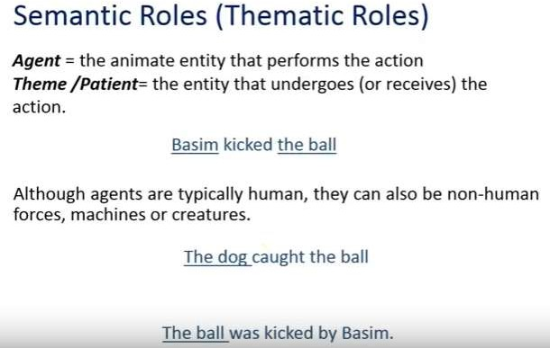

Slide 42
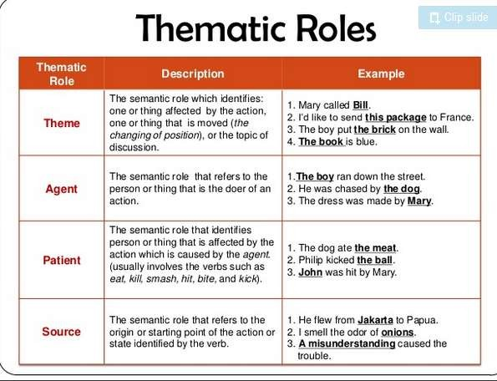

Slide 43
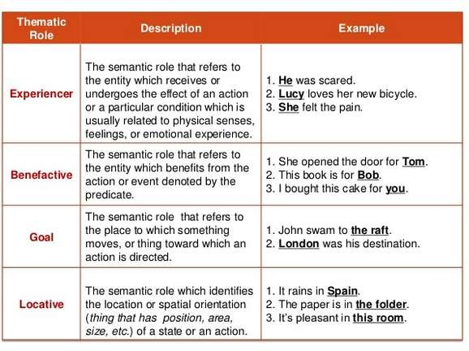

Slide 44
