Slide 1

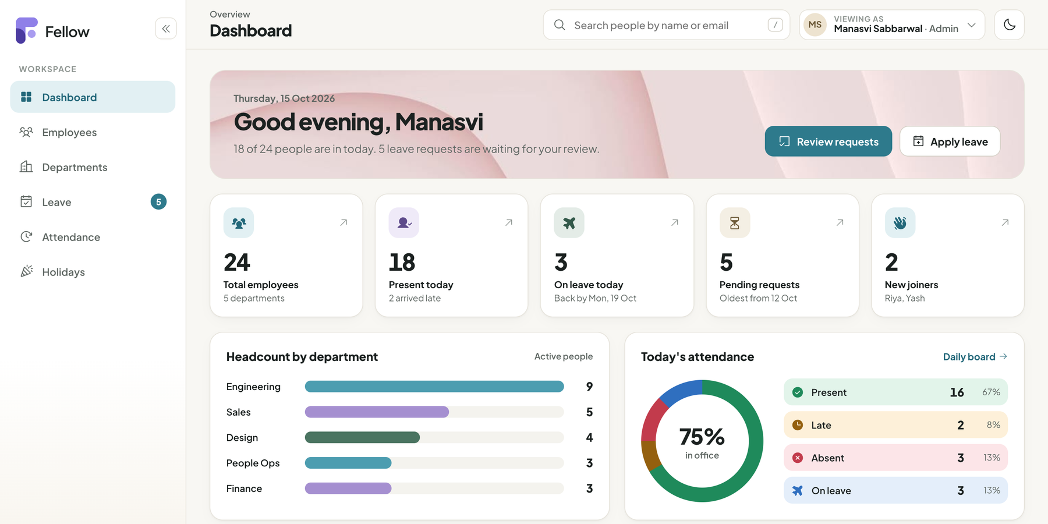
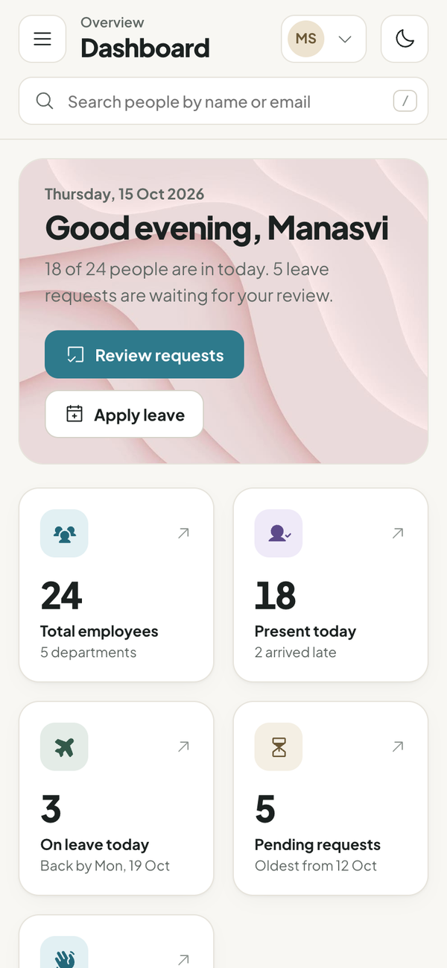
Fellow
an HR app, shipped the DevOps way
From a React screen to a monitored Kubernetes deployment: tested, scanned, containerised, provisioned with Terraform and delivered through GitOps.
DEVOPS CAPSTONE
OCT 2026
Manasvi Sabbarwal
Notes:
Hi, I am Manasvi. This is Fellow, an employee management app, and more importantly the full DevOps pipeline around it: from code to a monitored Kubernetes deployment.

Slide 2
THE PROJECT
Meet Fellow
A lightweight HR workspace for a 20 to 200 person company. People, departments, leave and attendance live in one place, with a dashboard that answers "who is in today?" at a glance.
25
REST endpoints
7
screens, light and dark
34
automated tests
Live on staging.fellow.localhost
Notes:
Fellow is the application I built. It manages employees, departments, leave and attendance. The dashboard is wired to the real FastAPI backend and PostgreSQL, nothing is mocked.

Slide 3






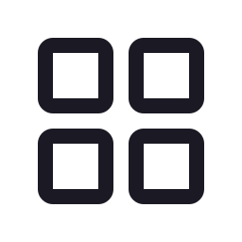
FEATURES
Everything HR needs, nothing it doesn’t
People directory
Attendance
Search, filter, table or card view, full profiles with tenure and team.
Server-timed check in and out, late after 09:30, daily board.
Departments
Holidays
Heads, live headcount, delete blocked while people remain.
Public and optional days that feed leave and attendance rules.
Leave
Dashboard and roles
Balances per type, weekends and holidays skipped, approve or reject.
busy cat, busy HR team
"Viewing as" switcher: admins approve, employees self-serve.
Notes:
Six feature areas. The interesting rules live in the backend: leave days skip weekends and holidays, balances are checked on apply, nobody can approve their own leave, and check-in time comes from the server so it cannot be faked.

Slide 4
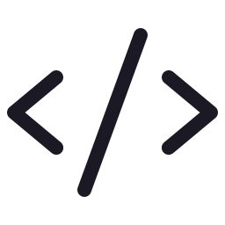

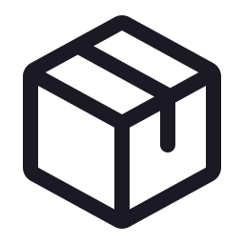


TECH STACK
The stack
Build
Verify
Ship
Run
Observe
React 18 + Vite
pytest (34)
Docker (non-root)
Terraform
Prometheus
react-router
Trivy
GitHub Actions
LocalStack
Grafana
FastAPI
actionlint
GHCR, SHA tags
kind
ServiceMonitor
PostgreSQL 16
helm lint
Argo CD
Helm
kube-state-metrics
SQLAlchemy
Code review
ingress-nginx
Alembic
HPA
Notes:
The stack, grouped by job: build the app, verify it, ship it, run it, and observe it. Every tool here is actually wired into the pipeline, not just listed.

Slide 5
ARCHITECTURE
How a request travels
AWS VPC on LocalStack · Terraform
kind Kubernetes cluster · 3 nodes
Frontend x2
React on nginx
Prometheus
scrapes /metrics
Grafana
13-panel board
/
Browser
fellow.localhost
Ingress
nginx controller
Backend x2-6
FastAPI + HPA
PostgreSQL
StatefulSet + PVC
Argo CD
syncs from Git
/api
Notes:
A browser hits the ingress controller. Slash goes to the React frontend, slash api goes to FastAPI. The backend autoscales from 2 to 6 pods, Postgres runs as a StatefulSet, Prometheus scrapes metrics, Grafana visualises them, and Argo CD keeps the cluster in sync with Git. Terraform created the network and the cluster.

Slide 6

CI/CD AND GITOPS
Push once, ship safely
1
2
3
4
5
6
7
Push
Test
Build
Scan
Publish
Promote
Sync
git push to main
pytest + frontend build
two Docker images
Trivy, fail on HIGH
GHCR, tag = commit SHA
bot commits the new tag
Argo CD rolls staging
5 / 5
jobs green on every push to main
~2 min
from commit to a pod running it
Notes:
Every push runs tests first, so broken code never becomes an image. Images are scanned by Trivy and the build fails on HIGH or CRITICAL CVEs. Images are tagged with the commit SHA, then a bot commits that tag to Git and Argo CD deploys it. That is GitOps: Git is the source of truth.

Slide 7


INFRASTRUCTURE AS CODE
Terraform, end to end
15
resources applied
What one terraform apply creates
VPC
10.20.0.0/16 in ap-south-1
23
with EKS switched on
Subnets
2 public + 2 private, 2 AZs
2
AZs, one NAT gateway
Routing
internet gateway, NAT, route tables
reviewing terraform plan
EKS
cluster, IAM, node group (switch)
terraform plan
terraform apply
terraform destroy
kind
3 node cluster, ports 80/443
Runs against LocalStack by default; one variable switches it to real AWS.
Notes:
Terraform describes the AWS network: a VPC with two public and two private subnets, NAT and routing, plus EKS behind a switch. LocalStack emulates AWS locally so nothing is billed, and the same code runs on real AWS by flipping one variable. Terraform also creates the kind cluster, so destroy really tears everything down.

Slide 8
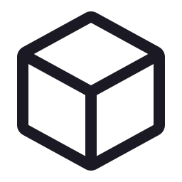
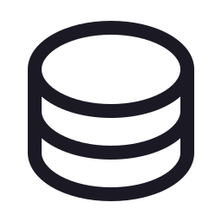

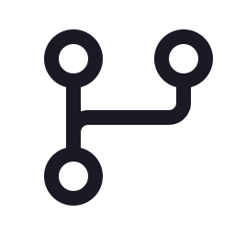
KUBERNETES AND HELM
One chart, two environments
Helm chart
Safe migrations
Load test
Deployments, Services, Ingress, HPA, Postgres StatefulSet, ServiceMonitor and a Grafana dashboard.
An init container runs Alembic under a Postgres advisory lock, so replicas never race.
2 → 6
backend pods, scaled by the HPA when CPU hit 350% of target
Locked down
dev and staging
Non-root pods, dropped capabilities, seccomp, secrets kept out of Git.
helm upgrade for dev; Argo CD syncs staging from GitHub with GHCR images.
fellow.localhost
staging.fellow.localhost
Notes:
One Helm chart runs both environments. Migrations run once under a database lock, pods run as non-root, and the HPA scaled the backend from 2 to 6 pods during the load test.

Slide 9

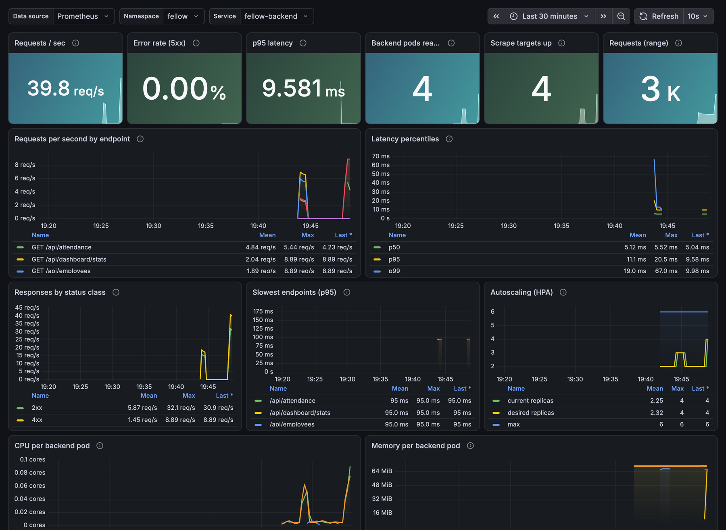
OBSERVABILITY
You can’t fix what you can’t see
13
~40
Grafana panels
req / sec under load
~10 ms
UP
p95 latency
all scrape targets
Notes:
FastAPI exposes Prometheus metrics. A ServiceMonitor tells Prometheus to scrape both backend pods, and the dashboard shipped inside the Helm chart shows traffic, errors, latency percentiles, CPU, memory and HPA replicas live.

Slide 10

DEVSECOPS AND TROUBLESHOOTING
When things broke
3 HIGH CVEs in Starlette (CVE-2025-62727) and old Alpine libs. Upgraded, now 0 HIGH or CRITICAL.
Trivy
10 bugs found in a code review, each fixed with a regression test.
Review
Two replicas migrated at once. Fixed with a Postgres advisory lock.
Race
Controller landed on a node without port 80. Pinned to the control plane.
Ingress
ImagePullBackOff and a Service with no endpoints, reproduced and fixed live.
Labs
Notes:
Security scanning was not a checkbox: Trivy actually failed the first build on a Starlette denial-of-service CVE. A code review found ten bugs, all fixed with tests. And the troubleshooting labs reproduce the two classic Kubernetes failures: a bad image tag and a Service whose selector matches nothing.

Slide 11


KEY LEARNINGS
What I’d tell past me
Gate early
Measure first
Tests and scans before images means nothing broken ever reaches the registry.
Metrics showed the HPA working long before I guessed at limits.
GitOps is calm
Security is a step
Git is the source of truth, so a deploy is just a reviewed commit.
Non-root images, scanned deps and no secrets in Git, every build.
"why is the pod pending?"
Notes:
Four lessons: gate early, let Git drive deploys, measure before tuning, and treat security as a pipeline step rather than a phase at the end.

Slide 12

Demo time
Push a commit, watch it go green, land on staging through Argo CD, then show up on the Grafana board.
Code
github.com/Manasvi-247/fellow-hrms
App
fellow.localhost
Metrics
grafana.localhost
GitOps
argocd.localhost
Thank you · Manasvi Sabbarwal
Notes:
Now the live demo: a push, the pipeline, Argo CD syncing staging, and the metrics moving in Grafana. Thank you.

