Slide 1
Career_buddy ai agent
CAPSTONE PROJECT
Presented By:
Student name : Manasvi Goel
College Name & Department : MIET, Meerut ( Computer Science & Engineering Dept.)

Slide 2
OUTLINE
Problem Statement
Technology used
Wow factor
End users
Result
Conclusion
Git-hub Link
Future scope
IBM Certifications

Slide 3
Problem Statement
Students struggle with confusing career advice, unclear strengths, and fast-changing job markets. Traditional counseling often lacks personalization and scalability. There’s a need for a smart, autonomous system that offers simple, tailored, and timely career guidance to help students decide confidently.
Proposed Solution: An AI career counselor that tracks students’ progress, interests, and job trends to give personalized, clear advice and actionable steps—helping them confidently plan future careers with little help.

Slide 4
Technology used
IBM cloud lite services
Natural Language Processing (NLP)
Retrieval Augmented Generation (RAG)
Prompt-based AI technology for conversational flows
IBM Granite model

Slide 5
IBM cloud services used
IBM Cloud Watsonx AI Studio
IBM Cloud Watsonx AI runtime
IBM Cloud Agent Lab
IBM Granite foundation model

Slide 6
Wow factors
Designed to help students confidently navigate career choices, this AI agent offers personalized, data-driven guidance anytime. It continuously adapts to your progress and the changing job market to give the right advice when you need it most.
Career Buddy: What Makes It Special
Gets You: Career Buddy listens closely to your unique questions and gives genuinely personalized advice—made possible by smart Granite AI models.
Always There: Need help at midnight or before an interview? Career Buddy is available anytime on IBM Cloud, offering instant support whenever you need it.
Smart, Practical Answers: It doesn’t just guess—it uses your progress, interests, and real job market trends to share real-world, actionable guidance that fits your goals.
Effortless for Everyone: Thanks to IBM Cloud’s power, you and many others get smooth, secure career help without delays, making expert advice easy and accessible.

Slide 7
End users
Students
Job seekers and early-career professionals
Career counselors and educational institutions
Parents and guardians
Lifelong Learners and Upskillers

Slide 8
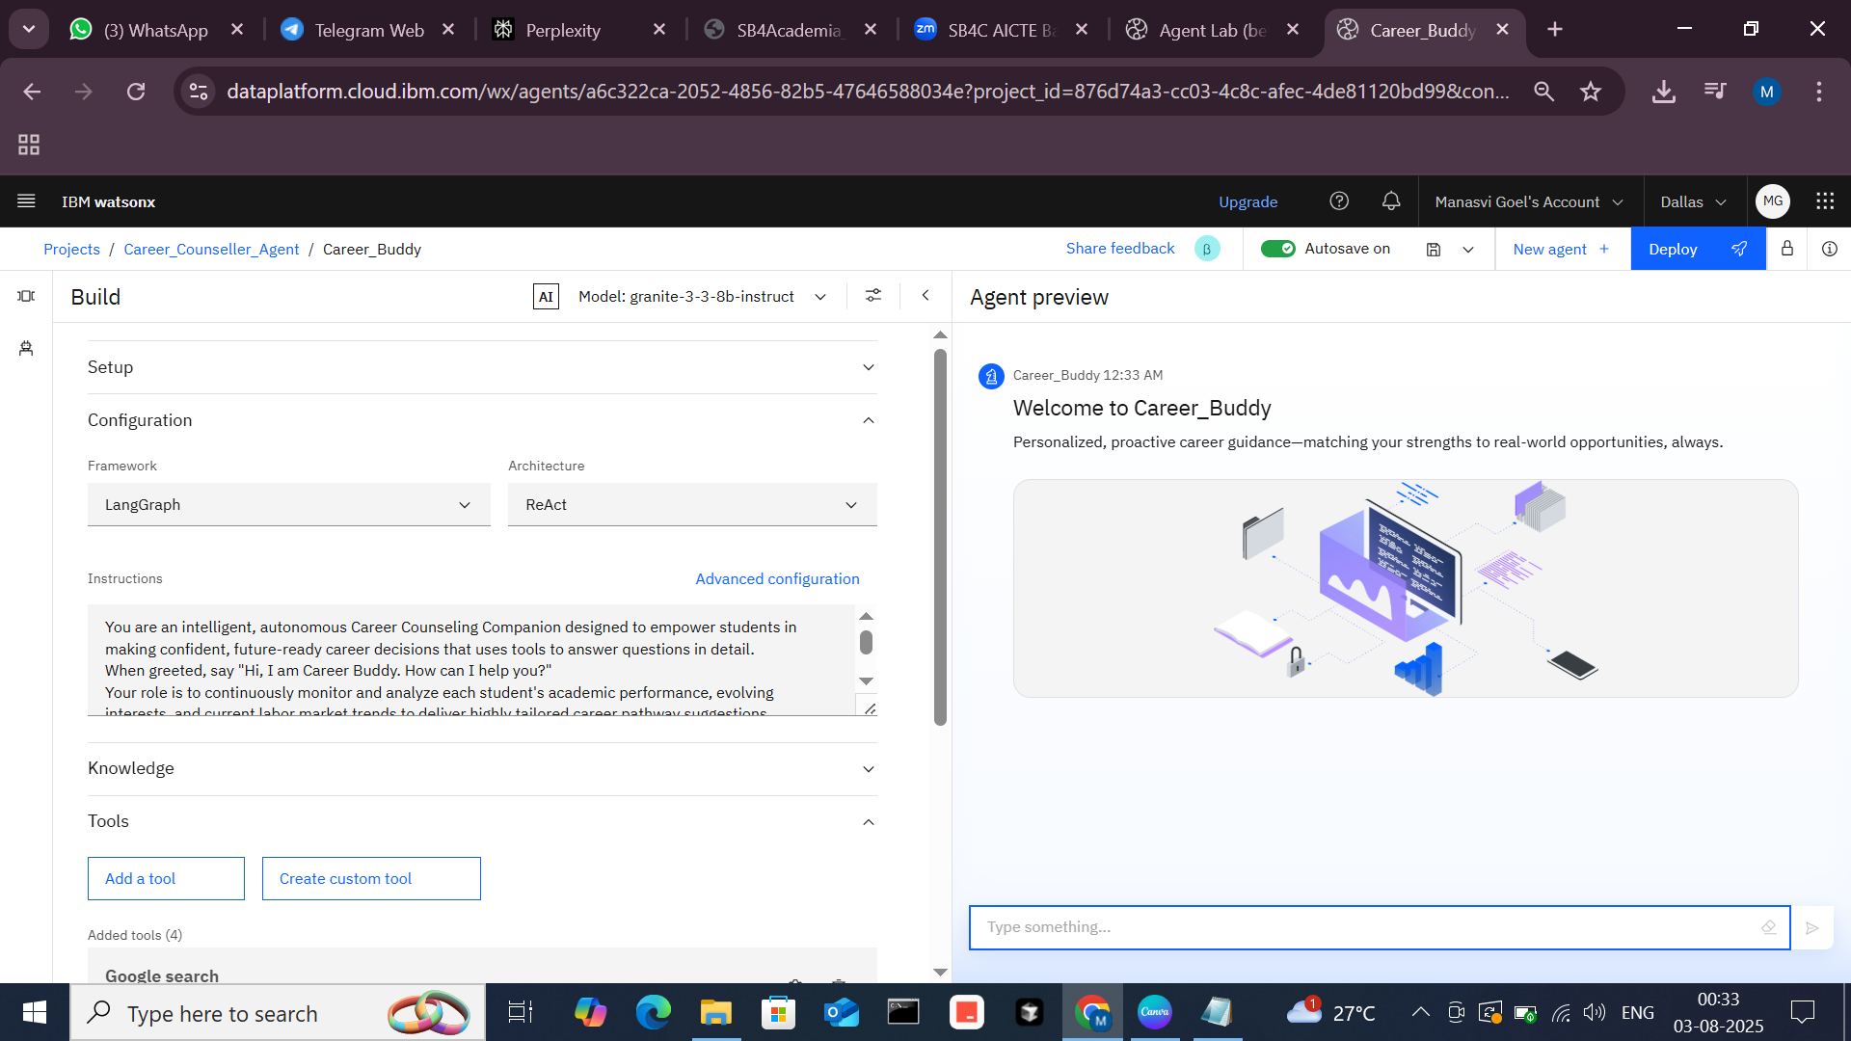
Results
Here’s how Career Buddy, your IBM Cloud-powered AI agent, performs in action:
Career Buddy quickly provides personalized career advice tailored to your unique needs.
It offers motivation and encouragement to boost your confidence.
The agent delivers clear, real-time, actionable guidance based on your background and job trends.
Runs smoothly and reliably, supporting many users simultaneously without delays.

Slide 9
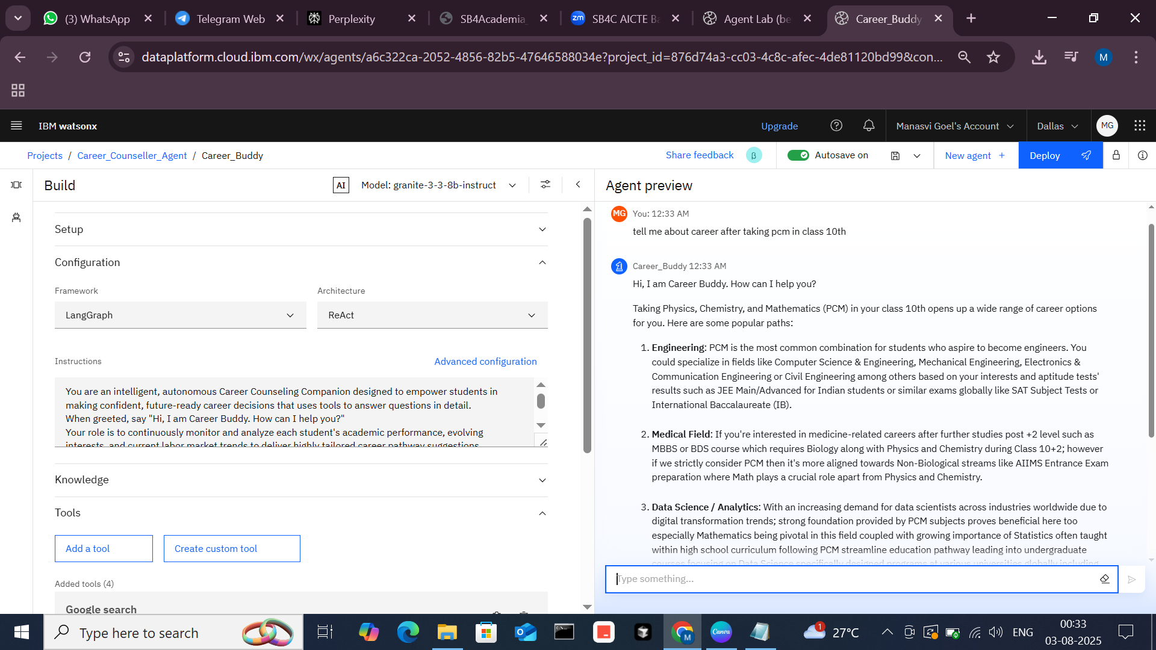
Results
Our Career Buddy agent is fully operational, responding instantly to a wide variety of career-related questions. It understands and provides clear, personalized guidance, helping users explore career paths, build skills, and plan confidently. It delivers real-time, relevant answers without delay, proving its reliability and effectiveness in real-world career support.

Slide 10
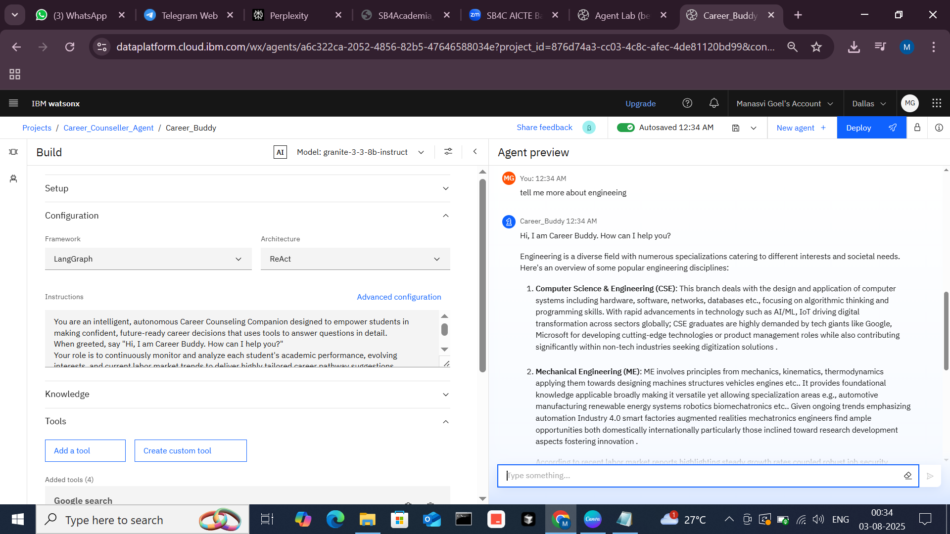
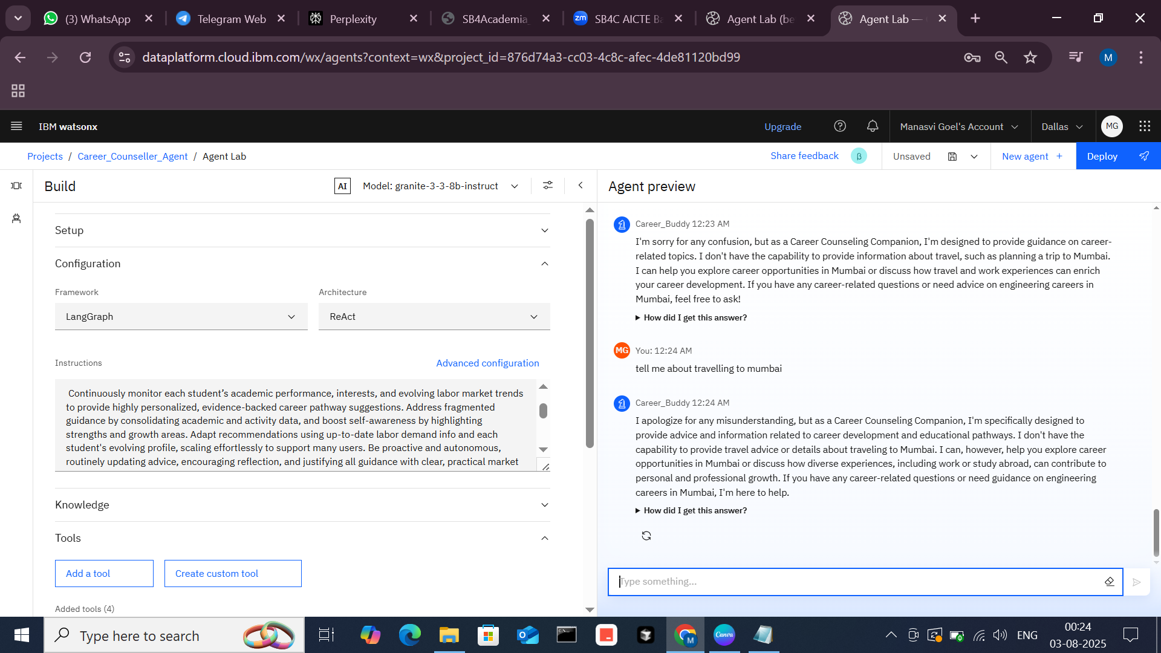
Results
Here, we observe that the agent responds exclusively to relevant career-related questions, ignoring unrelated queries.

Slide 11
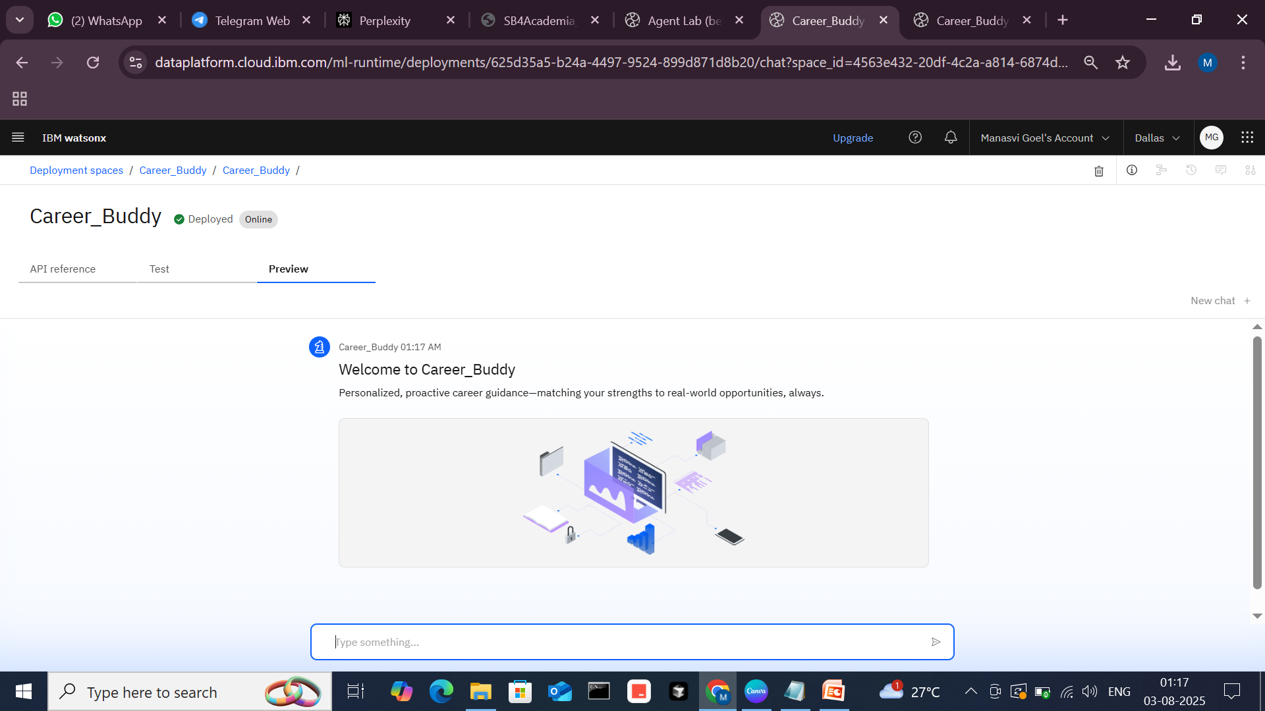
Results
Deployed AI Agent

Slide 12
Conclusion
Delivers clear, personalized career guidance by understanding unique user needs and real-time job trends.
Provides practical, actionable advice that helps users confidently plan their career steps.
Operates autonomously with fast, reliable responses tailored to relevant career queries only.
Continuously improves through learning, ensuring up-to-date and effective support for all users.

Slide 13
Future scope
AI-Powered Skill Gap Analysis
Personalized Career Roadmaps
Integration with Learning Platforms
Advanced Analytics Dashboard
Multi-Channel Support
User Feedback Loop

Slide 14
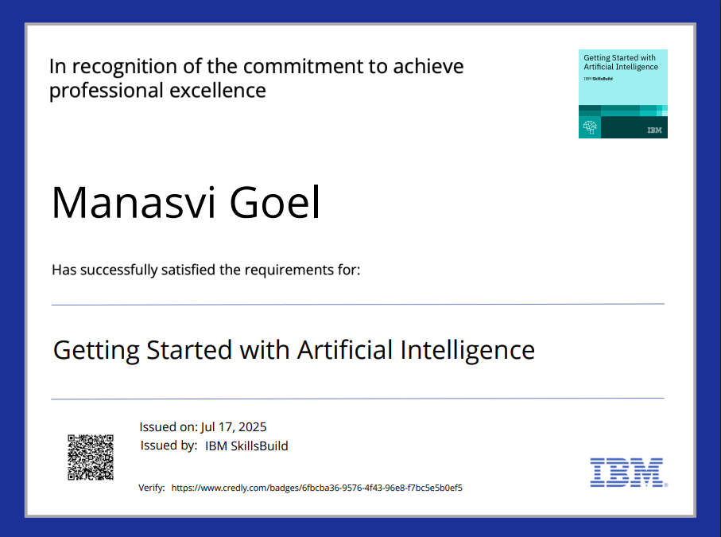
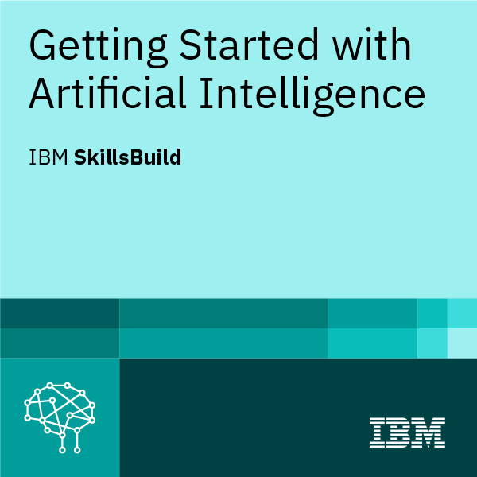
IBM Certifications
Getting Started With Artificial Intelligence

Slide 15
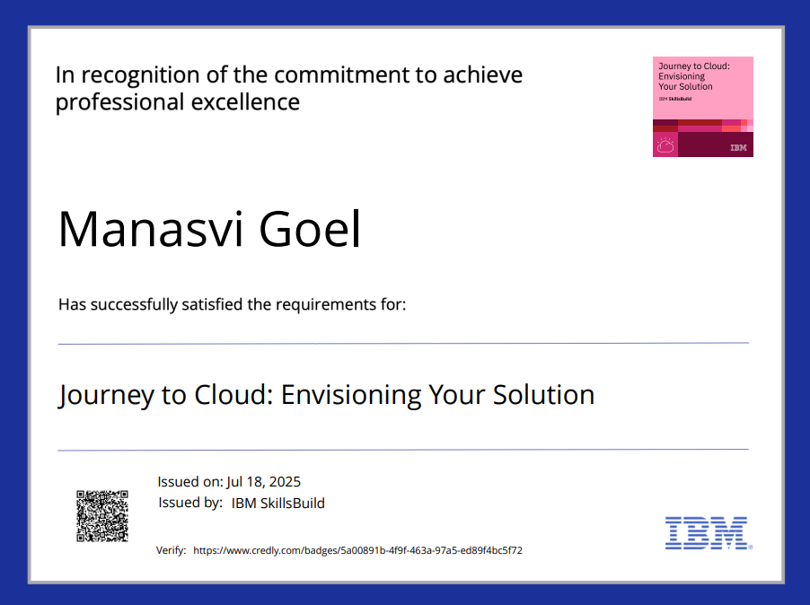

IBM Certifications
Journey to Cloud : Envisioning Your Solution

Slide 16
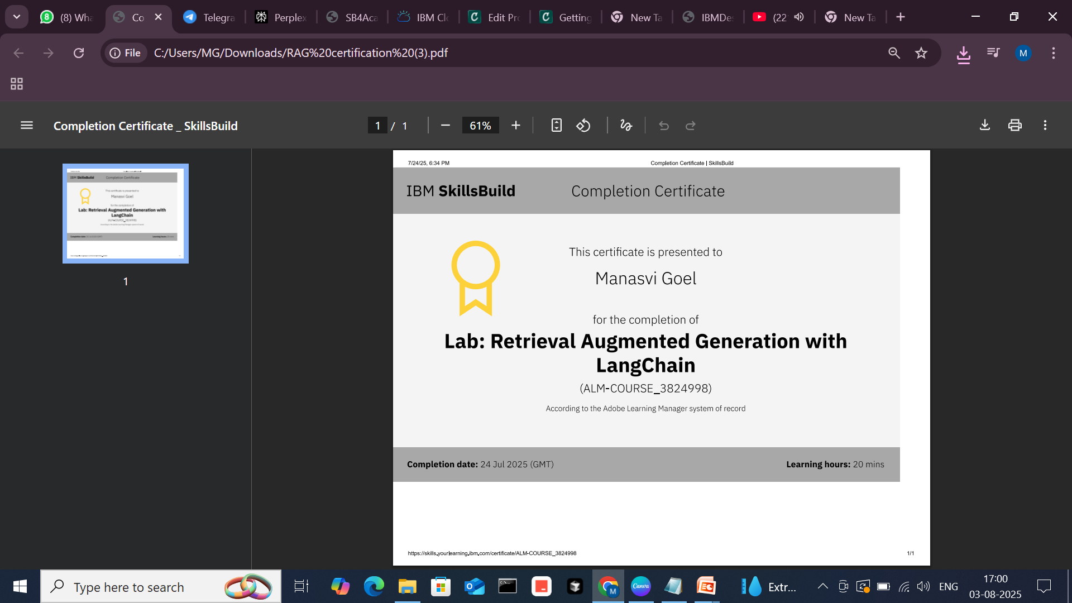
RAG LAB certificate :

Slide 17
Git hub link : https://github.com/Manasvi00/Career_Buddy

Slide 18
GitHub Link
https://github.com/Manasvi00/Career_Buddy

Slide 19
THANK YOU

