Slide 1




SMART SHOPPING: DATA & AI FOR PERSONALIZED E-COMMERCE
Manasvi Joshi

Slide 2


INTRODUCTION
E-commerce is changing—customers want personalized experiences.
Recommendations powered by AI enhance engagement & boost revenue.
Multi-agent AI can dynamically optimize product recommendations.

Slide 3

PROBLEM WITH CURRENT
E-COMMERCE RECOMMENDATIONS
Manual data gathering is slow & inefficient.
Static segmentation lacks user intent.
Generic recommendations lower conversion rates.
Inadequate real-time personalization.

Slide 4

OUR AI-DRIVEN SOLUTION
A dynamic multi-agent system that suggests the appropriate product at the appropriate time.
Agents cooperate to browse history analysis, predict preferences & personalize recommendations.
Employs long-term memory (SQLite) to store customer interactions.

Slide 5
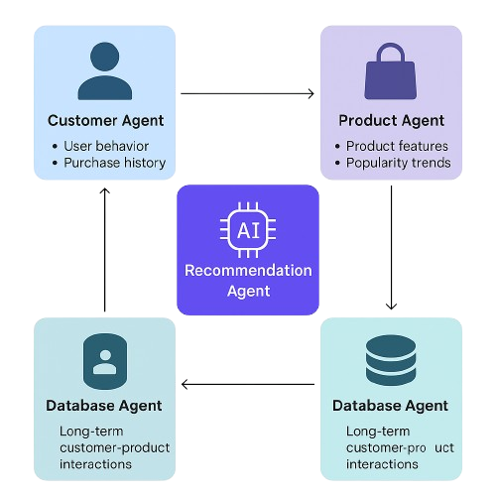
MULTI-AGENT SYSTEM
Customer Agent – Monitors user activity, purchase history
Product Agent – Keeps product features, trend of popularity
Recommendation Agent – AI models create tailored recommendations
Database Agent – holds long-term customer-product interactions (SQLite)

Slide 6

AI & DATA-DRIVEN RECOMMENDATION APPROACH
AI models driven personalized recommendations:
Collaborative Filtering (User-User, Item-Item)
Content-Based Filtering (User preferences & product attributes)
Hybrid Model (Combination of both)
Data Sources: Browsing history, previous purchases, demographics

Slide 7
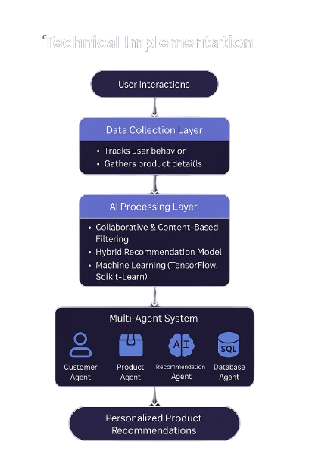
TECHNICAL IMPLEMENTATION
AI Models: Scikit-Learn, TensorFlow, PyTorch
Multi-Agent Framework: SPADE, JADE, Custom Python
Database: SQLite for long-term memory

Slide 8
EXPECTED BENEFITS
Higher conversion rates through hyper-personalization
Better customer retention via AI-based engagement
More efficient inventory management through demand forecasting
Better user experience with customized recommendations

Slide 9


CHALLENGES &
FUTURE IMPROVEMENTS
Data Privacy & Compliance
Cold Start Issues for New Users
Scalability for Large E-Commerce Platforms
Future: Reinforcement Learning for Adaptive AI Recommendations

Slide 10





Let's Revolutionize E-Commerce with AI

