Slide 1

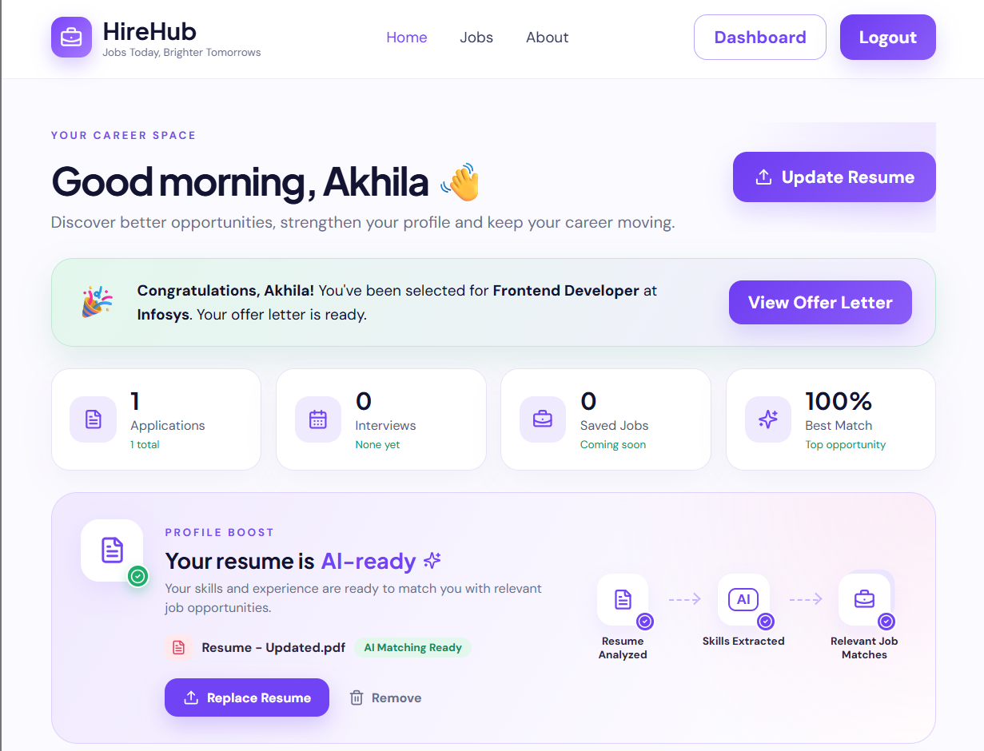
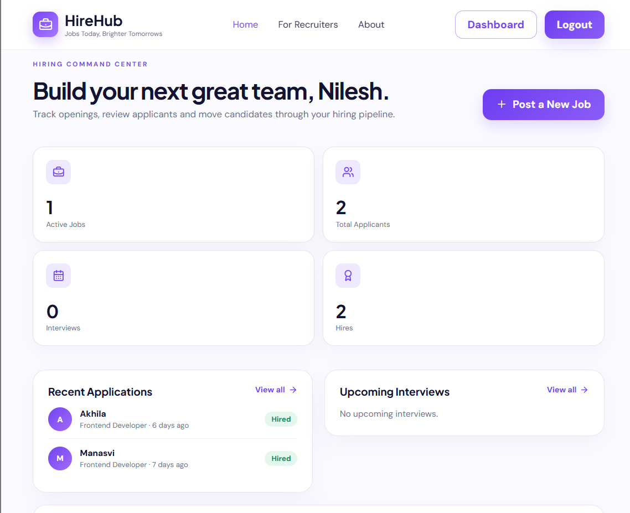

HireHub – AI Resume-Matching Job Portal
Team ID: [12] | Section: [S-3] | Members: [A V S N R Akhila - 2520030022], [Manasvi Nilesh Ghag – 2520030335], | Guide: [Dr. Spandana. S]
Database Systems Engineering and Distributed Backend Development (25CS1302E) | KLH Bachupally Campus, CSE | PBL 2026-27
Abstract
Tools & Technologies
Job portal where candidates’ resumes are AI-parsed into skills and matched to recruiters’ jobs; built with React, Express and MongoDB.
Faster, skill-based hiring for both sides.
Front-End: React 19 + Vite, React Router
Back-End: Node.js + Express + REST APIs; Gemini API, pdf-parse, Tesseract OCR
Database: MongoDB with Mongoose ODM
Tools: Git & GitHub, VS Code, npm, nodemon
Problem Statement & Objectives
Problem: Portals rely on keyword search and manual resume screening, not skill fit.
Objective 1: Auto-parse resumes into skills
Objective 2: Score every job by skill match
Objective 3: Track hiring from apply to offer
Scope: Candidate, recruiter, admin; web app
System Architecture
Front-End
React SPA (Vite)
Candidate, Recruiter
& Admin views
HTTP/JSON
REST API
Node.js + Express
JWT auth + role
guards, Multer
Mongoose
Database
MongoDB
via Mongoose ODM
7 collections
Existing vs Proposed System
Resume Parser
pdf-parse · mammoth
Tesseract OCR · Gemini AI
Match Scoring
% of job’s required
skills the candidate has
AI Chatbot
Gemini API, history
kept in Conversation
Feature | Existing System | Proposed System
Resume | Manual form filling | AI + OCR extraction
Matching | Keyword search only | Skill match score %
Tracking | Status often hidden | Live 7-stage status
Interviews | Arranged by email | Schedule + feedback
Limitation / Gap | Recruiters screen each resume by hand | Match score saved on every application
ER Diagram & Database Design
messages
1
_id
email
title
company
Conversation
Has
User
1
Posts
N
Job
1
Has
N
status
_id
N
1
1
M
Saves
N
1
_id
Interview
userRole
Uploads
Submits
Receives
Leads to
N
status
N
N
1
N
_id
Resume
1
Used in
N
Application
Results in
1
Offer Letter
Feasibility Study
fileName
_id
matchScore
_id
1
status
salary
_id
Technical: One JavaScript stack (React, Node.js, MongoDB); all tools freely available.
Economic: Open-source stack; AI parsing is optional, with a free rule-based fallback.
Operational: Role-based dashboards and one-click resume upload; easy to maintain.
Schedule: Built module by module within the semester timeline.
Implementation Screenshots
Results & Testing
Conclusion
Future Scope
31 REST routes over 7 MongoDB collections
CRUD with JWT role guards and 400/409 checks
Working AI-assisted portal for all 3 roles
Parsing, scoring and tracking all delivered
Semantic (embedding) job matching
Chatbot grounded in live user data
References: [1] Meta, React Documentation, react.dev (accessed 2026) [2] MongoDB Manual, mongodb.com/docs/manual [3] C. de Ruijt & S. Bhulai, “Job Recommender Systems: A Review”, arXiv:2111.13576, 2021

