Slide 1
ZOMATO
Data Analysis Project

Slide 2
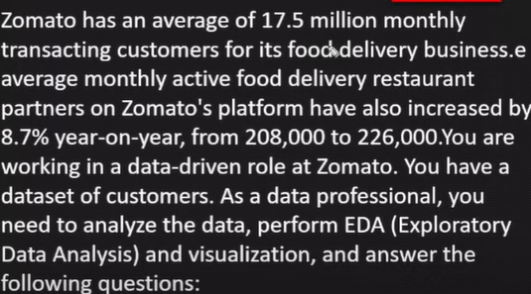

Data Analysis Project Using Python

Slide 3
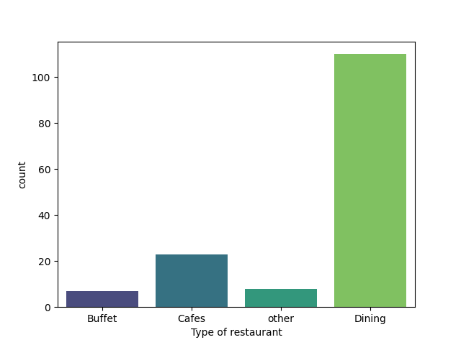
Q-What type of restaurant do the majority of customers order from-
Conclusion-
Majority of the restaurant
falls in dining category.

Slide 4
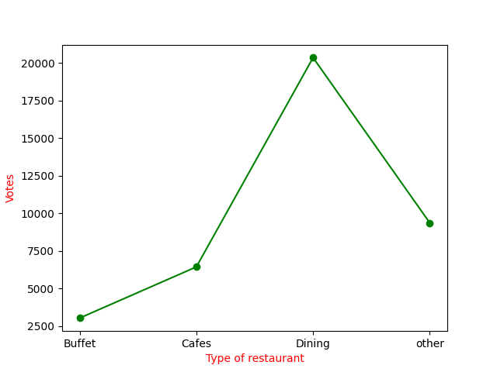
Q-How many votes has each type of restaurant received from customers-
Conclusion-
Dining restaurant has received maximum votes.

Slide 5
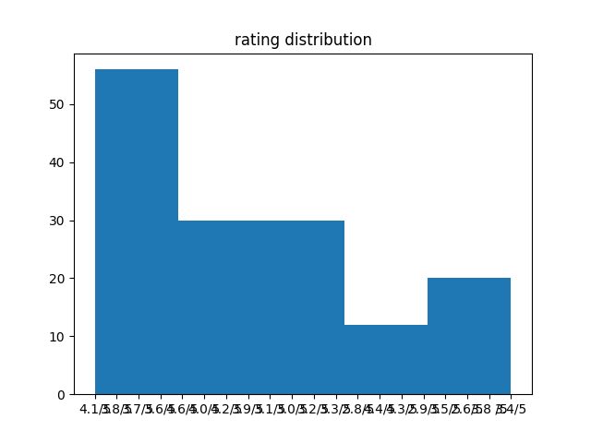
Q3-What are rating majority of customer have received.
Conclusion-
The rating majority of customer have received rating from 3.5 to 4.

Slide 6
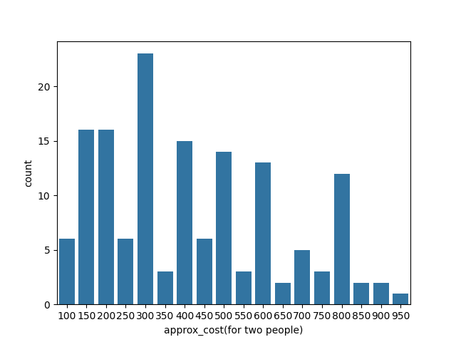
Q4-Zomato has observed that most couples order most of their food online. What is their average spending on each other.
Conclusion-
The majority of couples prefer restaurant with approximation cost of 300 rupees.

Slide 7
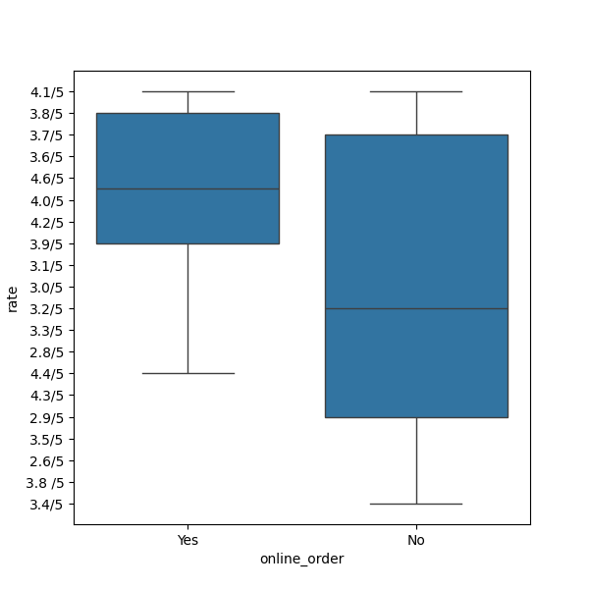
Q5-Which mode(online or offline) has received the maximum rating.
Conclusion-
Offline order received lower rating as compared to online order.

Slide 8
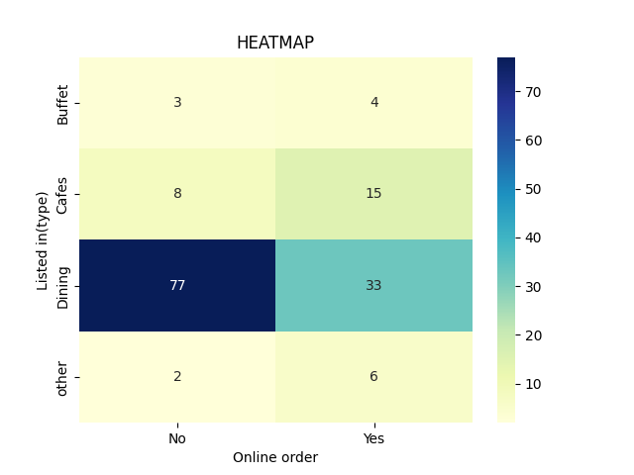
Q6-Which type of restaurant received more offline orders,so that Zomato can customers with some good offers.
Conclusion-
Dining restaurant primarily accept offline orders, whereas cafes primarily receive online orders

