Slide 1

An AI-Assisted Microservices Platform for Personal Budgeting
Under the Guidance of
Dr. KETINENI VENKATESWARI
Assistant Professor,
Department of Computer Science and Engineering,
KLH CSE Bowrampet Campus
Team Members
1. M.Aruna Grace (2420030100)
2. K.Sai Sree Chowdary (2420030168)
3. G.Manaswi (2420030182)

Slide 2









Outline of Project Work
Key stages and milestones in the development of the project.
Focus
Introduction
Literature Survey
Problem Gap Identification
Innovation, Creativity, and Novelty
Objectives
System Architecture
Feasibility and Project Plan

Slide 3

Problem Statement
Personal finance management is becoming harder as spending becomes more fragmented and harder to track.
Managing personal finances has become increasingly challenging due to multiple sources of income, frequent digital transactions, recurring expenses, savings goals, and the lack of a unified system for understanding spending behavior.
Traditional budgeting applications often provide only basic expense tracking and require users to manually analyze their financial data.
This makes it difficult for individuals to identify unnecessary expenses, predict future spending, and make informed financial decisions.

Slide 4


Objectives
These objectives define the core capabilities and outcomes of the proposed personal budgeting system.
1
2
To design and implement a modular microservices architecture for personal budgeting
To develop AI-driven analytics to provide personalized financial insights
3
4
To create an interactive dashboard for financial visualization
To enable automated expense categorization and budget monitoring
5
6
To implement intelligent anomaly detection for unusual spending patterns
To provide proactive financial recommendations and alerts

Slide 5

Literature Survey
A review of recent research papers on AI-driven personal finance, budgeting, and financial management systems.
S. No. | Author/Year | Research Work | Key Contribution | Research Gap
1 | DSouza et al., 2026 | Comprehensive Review of Machine Learning Techniques for Intelligent Personal Finance Management Systems | Provides a broad review of ML methods used in personal finance management, highlighting their role in automation, prediction, and decision support. | Calls for more integrated, user-centric, and real-world validated systems that go beyond isolated ML techniques.
2 | Jadhav & Patil, 2025 | AI-ML Based Expense Categorization and Budgeting System | Proposes an AI-ML driven system for automatic expense categorization and budget tracking to simplify personal financial planning. | Needs stronger handling of diverse transaction patterns and improved adaptability across user profiles and spending behaviors.
3 | Pak, 2026 | How Individuals Use Generative AI for Personal Financial Management | Examines how individuals apply generative AI tools for budgeting, financial advice, and everyday money management tasks. | Further study is needed on trust, accuracy, privacy, and long-term behavioral impact of generative AI in finance.
4 | Halage & Bharathkumar, 2026 | Artificial Intelligence in Personal Finance: Implications for Sustainable Financial Behavior | Explores how AI can influence sustainable financial habits by supporting better spending, saving, and planning decisions. | Lacks deeper empirical evidence on whether AI guidance consistently leads to sustained behavior change over time.
5 | Financial Management System Study, 2025 | Design of a Digital and Intelligent Financial Management System Based on Business-Finance Integration | Introduces an intelligent financial management design that integrates business and finance functions for more efficient management workflows. | Requires validation in broader deployment environments and clearer assessment of usability and scalability.

Slide 6


Problem Gap Identification
A focused review of the key limitations shaping current financial management solutions.
Gap 1
Gap 2
Gap 3
Gap 4
Lack of a unified financial management system
Limited AI-driven insights in traditional budgeting apps
Absence of real-time anomaly detection
Poor scalability in existing microservices implementations
Gap 5
Inadequate user experience for diverse user groups

Slide 7

Innovation, Creativity, and Novelty
This project combines intelligent analytics, modular design, and user-focused experiences to rethink personal finance management.
Novel Integration
Creative Solution
Combining AI-driven analytics with microservices architecture for personal finance
Interactive dashboard with real-time financial insights and personalized recommendations
Novelty in Approach
Advanced AI Techniques
Modular service-oriented design enabling independent scaling and deployment
Machine learning algorithms for spending pattern prediction and anomaly detection
User-Centric Innovation
Scalable Architecture
Intelligent alerts and proactive financial guidance based on behavioral analysis
Cloud-native microservices enabling seamless growth and reliability

Slide 8

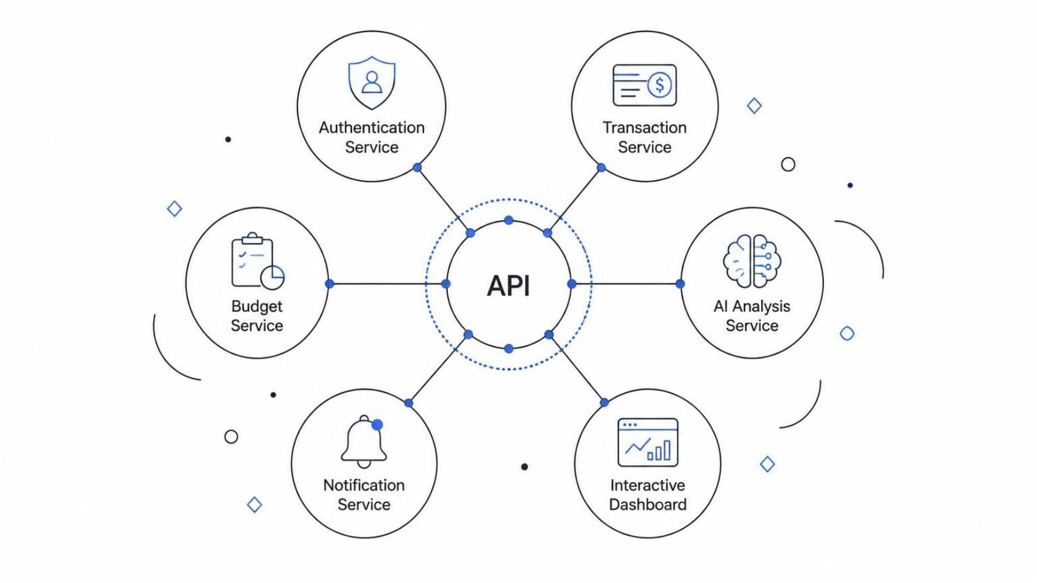
System Architecture
A modular microservices platform connects core financial services through secure APIs for scalable, intelligent management.
The platform is built on a robust microservices architecture, ensuring scalability, maintainability, and independent deployment of components. Each service communicates via well-defined APIs to provide a seamless and intelligent financial management experience.
Authentication Service: Secure user management, including login, registration, and access control.
Transaction Service: Recording and managing all financial activities, such as income and expenses.
Budget Service: Creating, tracking, and monitoring user-defined budgets across various categories.
AI Analysis Service: Generating intelligent financial insights, identifying spending patterns, and providing personalized recommendations.
Notification Service: Delivering timely alerts and reminders for budget limits, upcoming bills, and financial goals.
Interactive Dashboard: A user-friendly interface for visualizing financial data, customizing reports, and interacting with the system.

Slide 9
Feasibility and Project Plan
A phased development timeline from requirements gathering through deployment and documentation.
Requirements Analysis & Design
AI/ML Integration
Testing & Optimization
1
2
3
4
5
6
Microservices Development
Dashboard Development
Deployment & Documentation

Slide 10
Project Progress Review
Status of each planned phase at this review. The front-end is implemented and deployed live.
1
Requirements Analysis & Design
Problem, objectives, literature survey and architecture finalised
Completed
6
front-end modules live
Dashboard, Transactions, Explorer, Agent AI, Policy Engine, Profile
2
Microservices Development
Service logic running in simulation mode (UPI, x402, Algorand)
In Progress
3
AI/ML Integration
Gemini-powered BlockPay AI Assistant integrated for spending checks
In Progress
2 / 6
phases completed
Remaining four phases are actively in progress
4
Dashboard Development
Six front-end modules built with charts, QR and payment flows
Completed
5
Testing & Optimization
End-to-end flows verified with demo data (Hackathon Demo v2.5)
In Progress
Live
on Vercel
blockchainhacathon.vercel.app, running in sandbox mode
6
Deployment & Documentation
Front-end deployed on Vercel; documentation under way
In Progress

Slide 11
Architecture to Implementation
How each planned microservice now appears in the working front-end of BlockPay AI.
Planned Service | Implemented Front-end Feature | Status
Authentication Service | OTP login, verified profile, UPI ID and UPI PIN management | Completed
Transaction Service | Pay / Send, Scan QR, Receive via QR, ledger with filters, search and PDF export | Completed
Budget Service | Spending Policy Engine: daily and per-transaction limits, whitelist, blacklist | Completed
AI Analysis Service | Agent Commerce AI (Gemini) with category breakdown and daily spend vs limit charts | In Progress
Notification Service | Notification centre in the header for alerts and reminders | In Progress
Interactive Dashboard | Unified home: balance, wallet, quick actions and shortcut tiles | Completed
Blockchain Layer (added) | Algorand TestNet wallet, block-referenced transactions, explorer, x402 protocol | Simulated

Slide 12
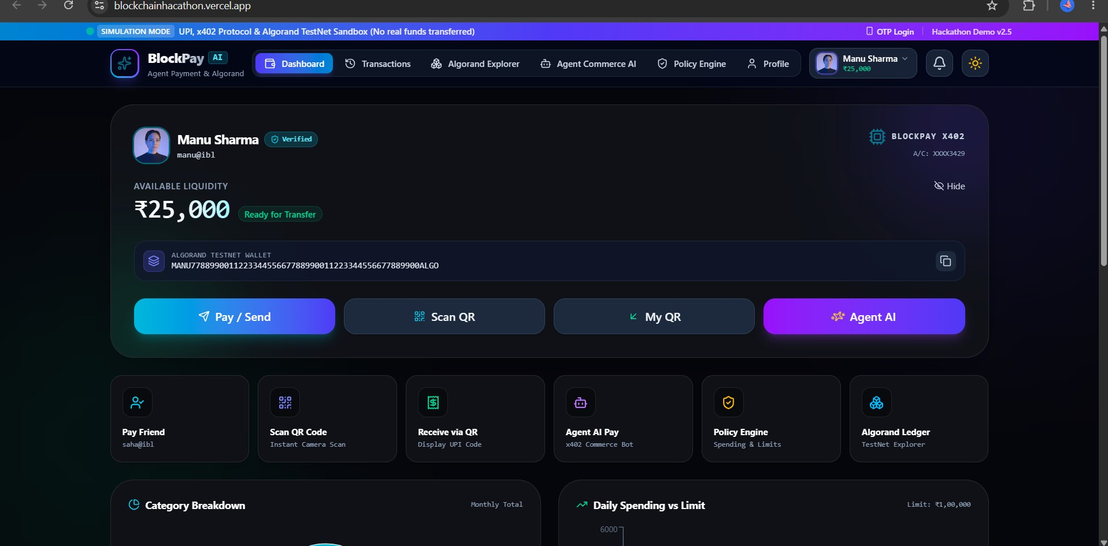
Front-end Implementation: Dashboard
The home screen brings balance, wallet and every core action together in one place.
Balance & Wallet
Available liquidity (₹25,000) with hide toggle and the linked Algorand TestNet wallet
1
One-tap Actions
Pay / Send, Scan QR, My QR and Agent AI buttons
2
Shortcut Tiles
Pay Friend, Receive via QR, Agent AI Pay, Policy Engine, Algorand Ledger
3
Clear Demo Mode
Simulation banner, OTP login and verified user badge
Live deployment: blockchainhacathon.vercel.app
4

Slide 13
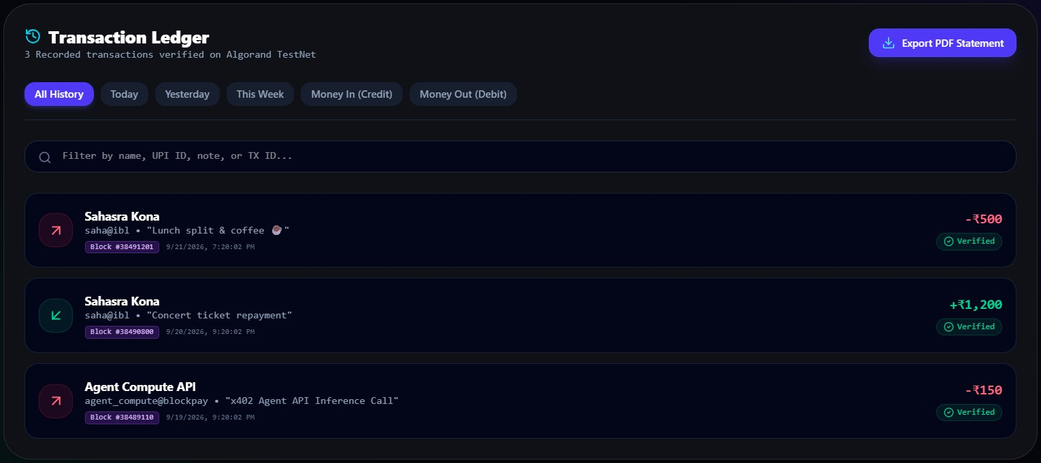
Transaction Ledger
Every payment is recorded, searchable and linked to an Algorand TestNet block.
Block-verified Records
Each entry shows the block number, timestamp and a Verified badge
1
Smart Filters
All, Today, Yesterday, This Week, Money In and Money Out
2
Instant Search
Filter by name, UPI ID, note or transaction ID
3
PDF Statement
Export the full history as a statement in one click
Credits in green, debits in red, including x402 agent API calls
4

Slide 14
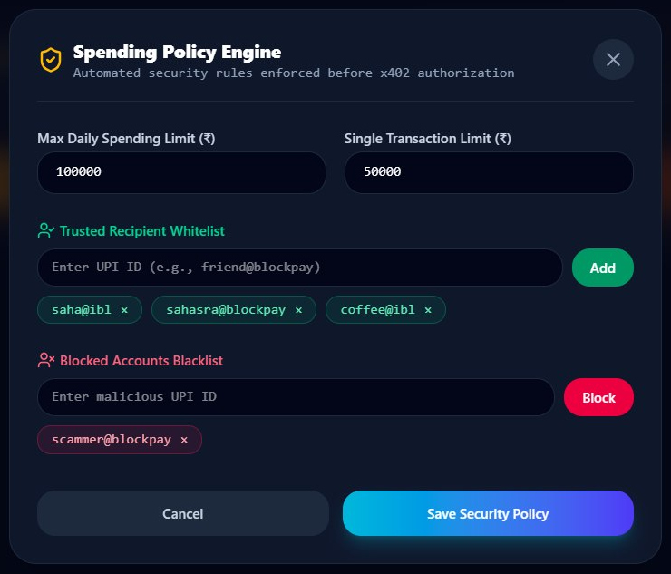
Spending Policy Engine
Automated budget and security rules checked before any x402 payment is authorised.
Spending Limits
Max daily limit ₹1,00,000 and single-transaction limit ₹50,000
1
Trusted Whitelist
Approved recipients such as saha@ibl, sahasra@blockpay and coffee@ibl
2
Blocked Blacklist
Suspicious accounts (e.g. scammer@blockpay) are refused automatically
3
Budget Service in Action
Delivers the budget-monitoring and anomaly-guard objectives
4

Slide 15
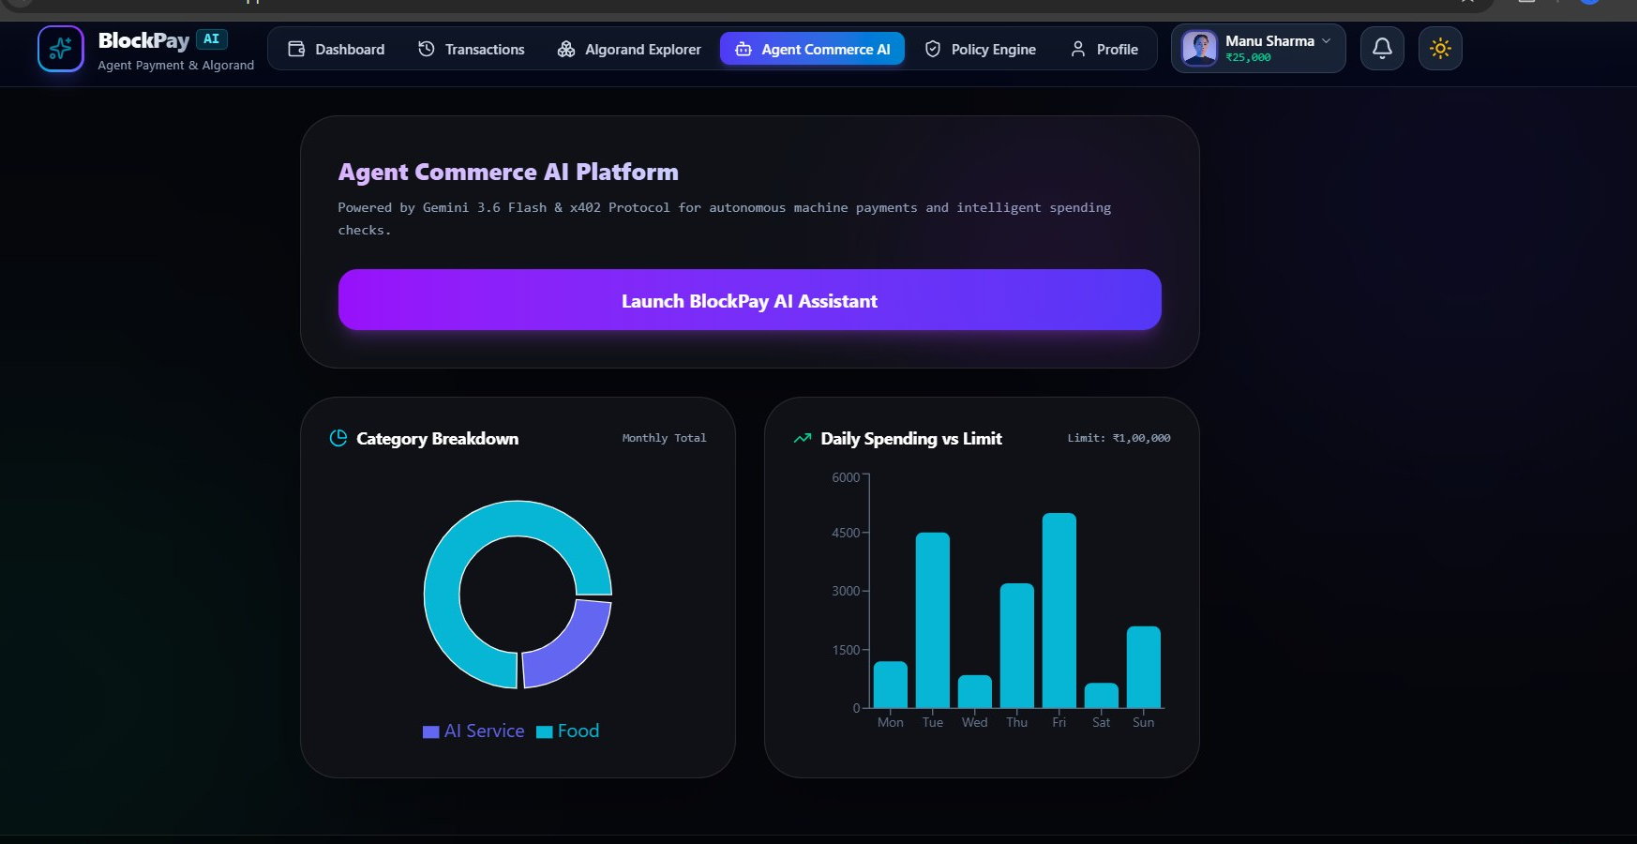
Agent Commerce AI & Analytics
AI assistant and spending analytics for autonomous machine payments.
BlockPay AI Assistant
Powered by Gemini 3.6 Flash for intelligent spending checks
1
x402 Agent Payments
Machine-to-machine payments, e.g. a ₹150 Agent Compute API call
2
Category Breakdown
Monthly donut chart split by category (AI Service, Food)
3
Daily Spend vs Limit
Mon to Sun bar chart measured against the ₹1,00,000 limit
4
Delivers the AI-driven insights objective

Slide 16
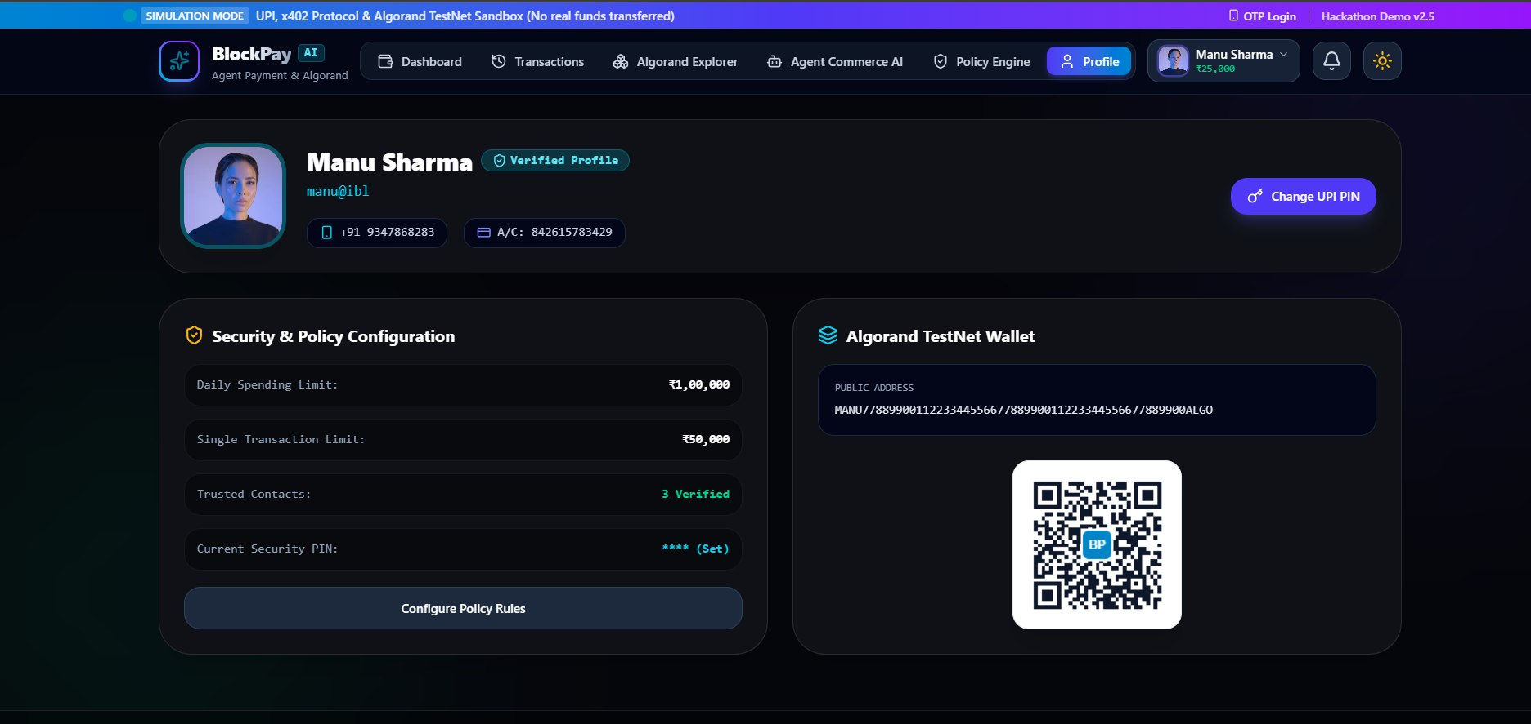
User Profile & Algorand Wallet
Identity, security settings and the blockchain wallet on one screen.
Verified Identity
Name, UPI ID (manu@ibl), phone number and bank account
1
Security Configuration
Limits, 3 verified contacts, UPI PIN set, with Change UPI PIN
2
Algorand TestNet Wallet
Public address with a scannable QR code for receiving funds
3
Configure Policy Rules
Direct link into the Spending Policy Engine
4

Slide 17
Progress Summary & Next Steps
What has been delivered so far and the work planned for the next review.
✓
Achieved So Far
→
Next Steps
Requirements, literature survey and microservices architecture finalised
Six-module front-end built and deployed live on Vercel
Gemini-powered AI assistant and x402 agent payments demonstrated
Policy Engine enforcing daily limits, whitelist and blacklist
Transactions recorded with Algorand TestNet block references
Connect the front-end to the backend microservices through secure APIs
Train and integrate ML models for spending prediction and anomaly detection
Complete alerts in the Notification Service for limits and bills
Functional, performance and usability testing with real users
Finalise deployment and project documentation

