Slide 1

An AI-Assisted Microservices Platform for Personal Budgeting
Under the Guidance of
Dr. KETINENI VENKATESWARI
[Title] Professor,
Department of Computer Science and Engineering,
KLH CSE Bowrampet Campus
Team Members
1. M.Aruna Grace (2420030100)
2. K.Sai Sree Chowdary (2420030168)
3. G.Manaswi (2420030182)

Slide 2









Outline of Project Work
Key stages and milestones in the development of the project.
Focus
Introduction
Literature Survey
Problem Gap Identification
Innovation, Creativity, and Novelty
Objectives
System Architecture
Feasibility and Project Plan

Slide 3
Problem Statement
Personal finance management is becoming harder as spending becomes more fragmented and harder to track.
Managing personal finances has become increasingly challenging due to multiple sources of income, frequent digital transactions, recurring expenses, savings goals, and the lack of a unified system for understanding spending behavior.
Traditional budgeting applications often provide only basic expense tracking and require users to manually analyze their financial data.
This makes it difficult for individuals to identify unnecessary expenses, predict future spending, and make informed financial decisions.

Slide 4


Objectives
These objectives define the core capabilities and outcomes of the proposed personal budgeting system.
1
2
To design and implement a modular microservices architecture for personal budgeting
To develop AI-driven analytics to provide personalized financial insights
3
4
To create an interactive dashboard for financial visualization
To enable automated expense categorization and budget monitoring
5
6
To implement intelligent anomaly detection for unusual spending patterns
To provide proactive financial recommendations and alerts

Slide 5

Literature Survey
A review of recent research papers on AI-driven personal finance, budgeting, and financial management systems.
S. No.
Author/Year
Research Work
Key Contribution
Research Gap
1
DSouza et al., 2026
Comprehensive Review of Machine Learning Techniques for Intelligent Personal Finance Management Systems
Provides a broad review of ML methods used in personal finance management, highlighting their role in automation, prediction, and decision support.
Calls for more integrated, user-centric, and real-world validated systems that go beyond isolated ML techniques.
2
Jadhav & Patil, 2025
AI-ML Based Expense Categorization and Budgeting System
Proposes an AI-ML driven system for automatic expense categorization and budget tracking to simplify personal financial planning.
Needs stronger handling of diverse transaction patterns and improved adaptability across user profiles and spending behaviors.
3
Pak, 2026
How Individuals Use Generative AI for Personal Financial Management
Examines how individuals apply generative AI tools for budgeting, financial advice, and everyday money management tasks.
Further study is needed on trust, accuracy, privacy, and long-term behavioral impact of generative AI in finance.
4
Halage & Bharathkumar, 2026
Artificial Intelligence in Personal Finance: Implications for Sustainable Financial Behavior
Explores how AI can influence sustainable financial habits by supporting better spending, saving, and planning decisions.
Lacks deeper empirical evidence on whether AI guidance consistently leads to sustained behavior change over time.
5
Financial Management System Study, 2025
Design of a Digital and Intelligent Financial Management System Based on Business-Finance Integration
Introduces an intelligent financial management design that integrates business and finance functions for more efficient management workflows.
Requires validation in broader deployment environments and clearer assessment of usability and scalability.

Slide 6

Problem Gap Identification
A focused review of the key limitations shaping current financial management solutions.
Gap 1
Gap 2
Gap 3
Gap 4
Lack of a unified financial management system
Limited AI-driven insights in traditional budgeting apps
Absence of real-time anomaly detection
Poor scalability in existing microservices implementations
Gap 5
Inadequate user experience for diverse user groups

Slide 7

Innovation, Creativity, and Novelty
This project combines intelligent analytics, modular design, and user-focused experiences to rethink personal finance management.
Novel Integration
Creative Solution
Combining AI-driven analytics with microservices architecture for personal finance
Interactive dashboard with real-time financial insights and personalized recommendations
Novelty in Approach
Advanced AI Techniques
Modular service-oriented design enabling independent scaling and deployment
Machine learning algorithms for spending pattern prediction and anomaly detection
User-Centric Innovation
Scalable Architecture
Intelligent alerts and proactive financial guidance based on behavioral analysis
Cloud-native microservices enabling seamless growth and reliability

Slide 8

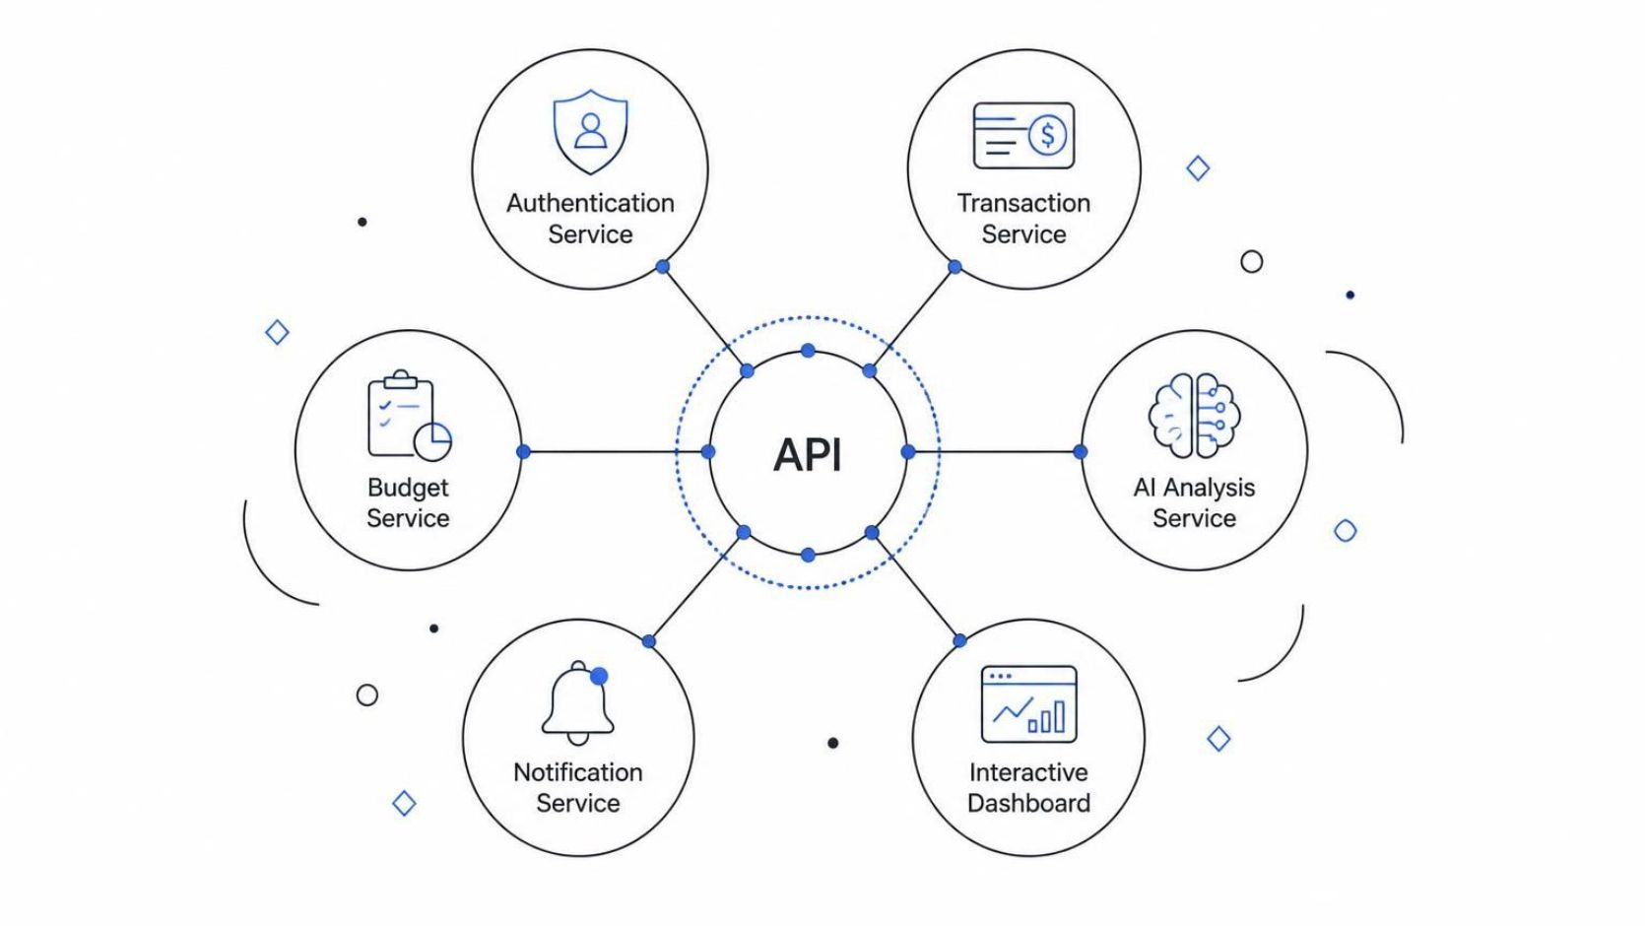
System Architecture
A modular microservices platform connects core financial services through secure APIs for scalable, intelligent management.
The platform is built on a robust microservices architecture, ensuring scalability, maintainability, and independent deployment of components. Each service communicates via well-defined APIs to provide a seamless and intelligent financial management experience.
Authentication Service: Secure user management, including login, registration, and access control.
Transaction Service: Recording and managing all financial activities, such as income and expenses.
Budget Service: Creating, tracking, and monitoring user-defined budgets across various categories.
AI Analysis Service: Generating intelligent financial insights, identifying spending patterns, and providing personalized recommendations.
Notification Service: Delivering timely alerts and reminders for budget limits, upcoming bills, and financial goals.
Interactive Dashboard: A user-friendly interface for visualizing financial data, customizing reports, and interacting with the system.

Slide 9
Feasibility and Project Plan
A phased development timeline from requirements gathering through deployment and documentation.
Requirements Analysis & Design
AI/ML Integration
Testing & Optimization
1
2
3
4
5
6
Microservices Development
Dashboard Development
Deployment & Documentation

