Slide 1
Overview Of Graph Theory
Presented By:
D16-Rushikesh Shinde
D17-Manaswi Bidkar
D19-Sanika Sakatakar
Guided by: Prof. Madhuri R Zawar

Slide 2
Graph Data Structure and Algorithms
A Graph is a non-linear data structure consisting of nodes and edges.
The nodes are sometimes also referred to as vertices and the edges are lines or arcs that connect any two nodes in the graph.
A Graph consists of a finite set of vertices (or nodes) and set of Edges which connect a pair of nodes.

Slide 3
Nodes: These are the most important components in any graph. Nodes are entities whose relationships are expressed using edges. If a graph comprises 2 nodes A and B and an undirected edge between them, then it expresses a bi-directional relationship between the nodes and edge.
Edges: Edges are the components that are used to represent the relationships between various nodes in a graph. An edge between two nodes expresses a one-way or two-way relationship between the nodes.

Slide 4
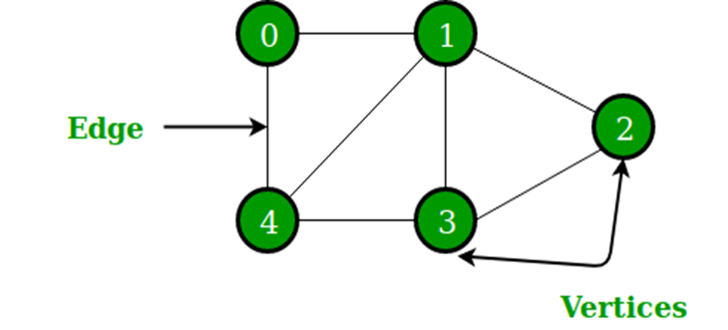
In the above Graph, the set of vertices V = {0,1,2,3,4} and the set of edges E = {01, 12, 23, 34, 04, 14, 13}.

Slide 5
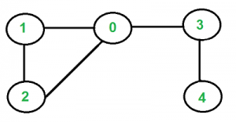
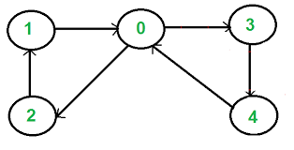
Types Of Graphs
1.Undirected:
An undirected graph is a graph in which all the edges are bi-directional
i.e. the edges do not point in any specific direction.
2.Directed:
A directed graph is a graph in which all the edges are uni-directional
i.e. the edges point in a single direction.

Slide 6
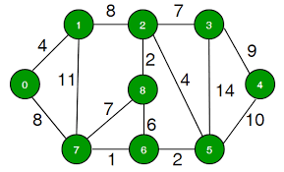
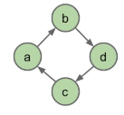
3.Weighted:
In a weighted graph, each edge is assigned a weight or cost.
4.Cyclic:
A graph is cyclic if the graph comprises a path that starts from a vertex and ends at the same vertex. That path is called a cycle. An acyclic graph is a graph that has no cycle.

Slide 7
Graph Representation
You can represent a graph in many ways.
The two most common ways of representing a graph is as follows:
Adjacency matrix
Adjacency list

Slide 8
Adjacency matrix
An adjacency matrix is a VxV binary matrix A. Element Ai,j is 1 if there is an edge from vertex i to vertex j else Ai,jis 0.
Note: A binary matrix is a matrix in which the cells can have only one of two possible values - either a 0 or 1.
The adjacency matrix of the following graph is:
i/j: 1 2 3 4
1: 0 1 0 1
2: 1 0 1 0
3: 0 1 0 1
4: 1 0 1 0
1
2
4
3

Slide 9
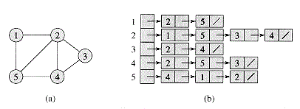
Adjacency list
The other way to represent a graph is by using an adjacency list. An adjacency list is an array A of separate lists. Each element of the array A_{i} is a list, which contains all the vertices that are adjacent to vertex i.

Slide 10
Applications Of Graphs
Graphs are used to solve many real-life problems. Graphs are used to represent networks.
The networks may include paths in a city or telephone network or circuit network.
Graphs are also used in social networks like LinkedIn, Facebook.
It is used to Document link graphs.
Scene graphs: Such graphs are very important in the computer games industry.

Slide 11
Robot planning: Such graph plans are used in planning paths for Autonomous vehicles.
Neural networks
For example, in Facebook, each person is represented with a vertex (or node).
Each node is a structure and contains information like person id, name, gender, locale etc.

Slide 12
Conclusion
In conclusion, our study of graph theory in DSA covered:
  1. Types of Graphs: Directed, undirected, weighted, and unweighted graphs.
  2. Graph Representations: Adjacency matrices and adjacency lists.
  3. Graph Applications: Shortest path algorithms, network topology, social network analysis, and more.
These concepts form the foundation of graph theory, enabling us to model and solve complex problems in various domains.

Slide 13
THANK YOU

