Slide 1
WEL-COME

Slide 2
GOVERNMENT POLYTECHNIC ,KARAD
Industrial Training [22049]
Summer-2023
SUBMITTED BY,
Manaswi Pramod Bidkar
Enrollment No:2100100050

Slide 3
Contents
Introduction And Organizational Structure of Industry
Technology Used in Training
Technology Taught During the Training
Worked On Project in Training
Experiences Encountered in Training
Conclusion and References

Slide 4
Technology
Used in Training

Slide 5
Software: Visual Studio, Notepad++,Google Chrome, UiPath Assistant, Android Studio
Devices: 100mbps hard drive, Pen drives, Mobile services to test mobile
view
Loptop: Hp i5 processor,8GB RAM,512 GB SSD, Windows 11

Slide 6
Technology
Taught
During the Training

Slide 7
HTML(Hyper Text Mark-up Language)
HTML is the standard mark-up language for creating Web pages. HTML stands for Hyper Text Mark-up Language
HTML describes the structure of Web pages using mark-up HTML elements are the building blocks of HTML pages HTML elements are represented by tags.
HTML tags label pieces of content such as "heading", "paragraph", "table", and so on

Slide 8
CSS(Cascading Style Sheets)
CSS stands for Cascading Style Sheet.
CSS describes how HTML elements are to be displayed on screen, paper, or in other media CSS saves a lot of work. It can control the layout of multiple web pages all at once.
External stylesheets are stored in CSS files
  Inline CSS
  Global CSS
  External CSS.

Slide 9
RPA (Robotics Process Automation)
RPA (Robotics Process Automation) which allows organizations to automate task just like a human being was doing them across application and systems. The purpose of RPA is to transfer the process execution from humans to bots. Robotic process automation interacts with the existing IT architecture with no complex system integration required.

Slide 10
RPA (Robotics Process Automation)
RPA automation can be used to automate workflow, infrastructure, back office process which are labor intensive. These software bots can interact with an in-house application, website, user portal, etc. RPA stands for Robotic Process Automation. The Robotic Process Automation is a software program which runs on an end user’s pc, laptop or mobile device. It is a sequence of commands which are executed by Bots under some defined set of business rules. The main goal of Robotics process automation process to replace repetitive and boring clerical task performed by humans, with a virtual workforce. RPA automation does not require the development of code, nor does it require direct access to the code or database of the applications.

Slide 11
Android
Android is an open source and Linux-based operating system for mobile devices such as smartphones and tablet computers. Android was developed by the Open Handset Alliance, led by Google, and other companies. This tutorial will teach you basic Android programming and will also take you through some advance concepts related to Android application development.

Slide 12
Worked On Project in
Training (Short Report)
WEARHER REPORT USING OPEN BROWSER

Slide 13
Reading browser data: (Version 1)
Created a process which will read the data from browser ,filter out the data of given information and store the data in the excel file.
Accessing data from browser(Version-2)
After creating a process index will go to browser and collect the information as per parameters and access that data .
Creating complete process (Final Bot)
After collecting information from browser it will get stored to the created excel file.

Slide 14
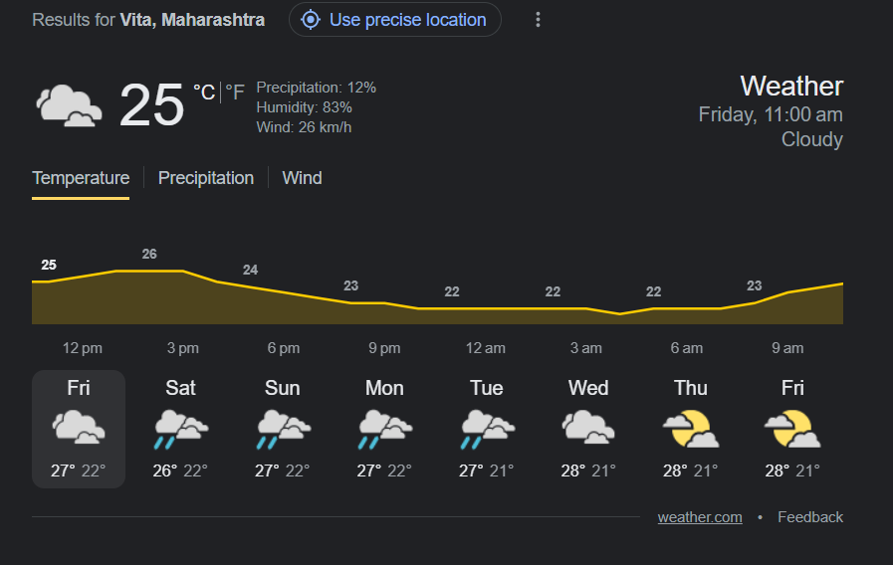
Reading browser data: (Version 1)

Slide 15
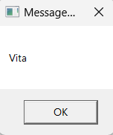
Accessing data from browser(Version-2)

Slide 16
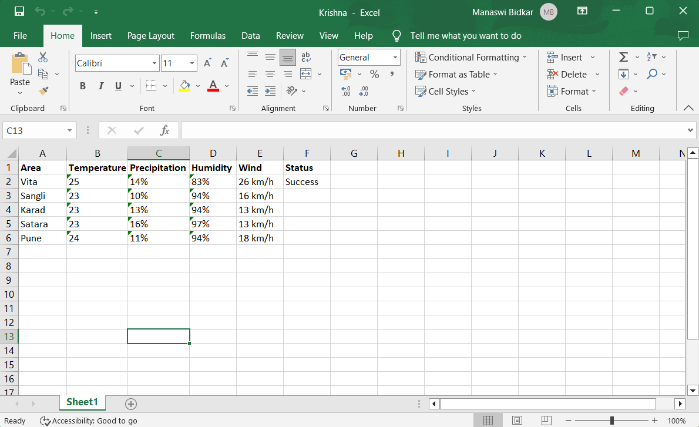
Creating complete process (Final Bot)

Slide 17
THANK YOU
s

