Slide 1


Marathwada Mitra Mandal’s
College of Engineering
An Autonomous Institute affiliated to SPPU
DEPARTMENT OF COMPUTER ENGINEERING
Seminar
Review 1
on
Study on Traffic patterns
using SVM Algorithm
by
Roll No. : TC263 Manaswin Sripatnala
Under the Guidance of
Ms. Mayuri Narkhade

Slide 2
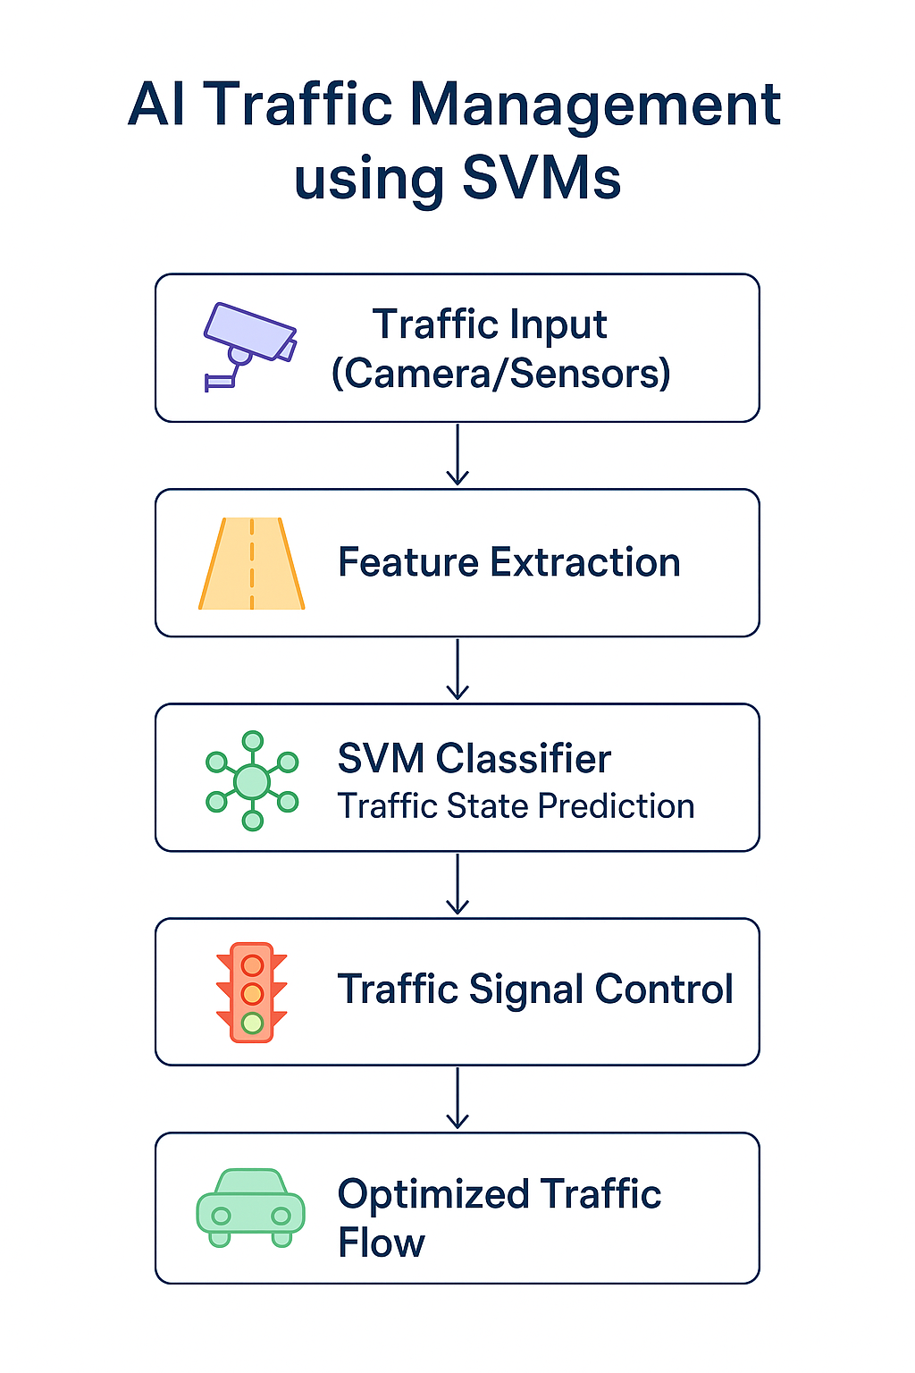
Working Model :
Traffic Input (Camera/Sensors): Collects real-time traffic data using cameras or sensors.
Feature Extraction: Processes the input to extract key features like vehicle count, speed, and congestion level.
SVM Classifier (Traffic State Prediction): Uses SVM to classify the current traffic state (e.g., low, medium, or high congestion).
Traffic Signal Control: Adjusts traffic signals dynamically based on predictions.
Optimized Traffic Flow: Results in reduced congestion and improved traffic efficiency.

Slide 3
1. Introduction
Rising Urban Challenges – Rapid urbanization and increasing vehicles in India are overwhelming existing infrastructure, making smooth mobility difficult.
Impact of Congestion – Traffic jams cause huge losses in time and fuel, increase pollution, and compromise road safety and productivity.
Need for Smart Solutions – While technologies like AI-based monitoring, adaptive signals, and real-time navigation exist, their adoption in Indian cities is still limited, making the problem urgent.

Slide 4
2. Motivation
Motivation & Relevance – Traffic congestion impacts millions daily, wasting fuel, time, and harming the environment. As computer engineering students, we aim to apply AI/ML for a practical and impactful solution.
Key Benefits – AI-based traffic management enables real-time, unbiased monitoring, reduces waiting times, saves fuel, lowers emissions, improves safety, and prioritizes emergency vehicles.
Contribution to Smart Cities – By integrating intelligent traffic control with cameras and AI, the project supports sustainable mobility, better urban planning, and aligns with India’s smart city vision.

Slide 5
3. Problem Statement
Main Challenge – Existing traffic systems rely on fixed timers and limited manual monitoring, causing delays, fuel wastage, and rising pollution in urban areas.
System Limitations – Fixed signals cannot adapt to sudden traffic changes, while human monitoring is error-prone, slow, and unsustainable for 24/7 operations.
Gaps in Current Solutions – Navigation apps aid drivers but aren’t integrated with signals; partial smart systems lack AI-driven control, and large-scale adoption in India remains limited.

Slide 6
4. Scope and Objective
Scope of the Seminar :
Focus Area – Use of AI in traffic management through real-time monitoring, dynamic signal control, and detection of accidents/emergencies.
Applications – Reducing congestion, fuel use, and pollution with AI-driven image processing and adaptive algorithms.
Boundaries – Excludes large-scale infrastructure design, advanced hardware development, and nationwide transport integration; scope remains at city/junction level.
Objectives of the Seminar :
Problem Identification – Analyze inefficiencies in traditional traffic systems and highlight key challenges.
AI Exploration – Apply machine learning, computer vision, and adaptive methods for smarter signal control and improved safety.
Practical Impact – Demonstrate real-world benefits like reduced delays, resource savings, emergency prioritization, and feasibility for smart cities in India.

Slide 7
5. Literature Survey
Paper No. | Author & Year | Title of Paper/Study | Methodology / Approach Used | Key Findings | Limitations / Gaps Identified
[1] | Park et al., 2005 | The Application of Support Vector Machines (SVM) for Traffic Condition Prediction | SVM applied on ITS data for Level of Service (LOS) prediction | Demonstrated accurate traffic condition prediction in real-time ITS datasets | Geographically specific (San Antonio); limited applicability to Indian cities
[2] | Shirsath et al., 2024 | Intelligent Traffic Management for Vehicular Networks using Machine Learning | SVM with RBF kernel for non-linear traffic environment modeling | Achieved better congestion resolution and optimized traffic flow | Focused on vehicular network modeling; real-time adaptive signals not implemented
[3] | Chen et al., 2022 | A SVM Approach for Assessing Traffic Congestion State by Similarity Measures | SVM classification with similarity measures for congestion state detection | High accuracy in real-time congestion classification | No integration into signal regulation; focuses only on congestion state recognition

Slide 8
Sr No. | Author & Year | Title of Paper/Study | Methodology / Approach Used | Key Findings | Limitations / Gaps Identified
[4] | Prasad et al., 2020 | HOG, LBP and SVM based Traffic Density Estimation at Intersection | Image features (HOG + LBP) with SVM classifier on Raspberry Pi | Achieved real-time density estimation at intersections with low computational cost | Limited to single intersections; scalability for city-wide deployment not tested
[5] | Zhang et al., 2021 | Research on Support Vector Machine in Traffic Detection Algorithm | SVM-based automated incident detection with PCA for feature reduction | Improved detection accuracy of incidents compared to traditional methods | Tested only in limited environments; lacks real-world large-scale validation
[6] | Li et al., 2018 | Traffic Flow Forecasting by Combination of SVM with PCA | PCA for dimensionality reduction + SVM regression for flow prediction | Enhanced prediction precision and faster computation for real-time traffic flow | Focused only on forecasting; not integrated with adaptive signal control
[7] | Wang et al., 2019 | Research on SVM-Based Highway Traffic Safety Evaluation Model | Multi-class SVM with AHP-based index system | Effective classification of highway traffic safety levels | Oriented towards highway safety, not urban congestion management

Slide 9
6. Conclusion
Traffic congestion remains one of the biggest urban challenges, leading to fuel wastage, pollution, and reduced quality of life. Traditional traffic systems are unable to adapt to real-time conditions, highlighting the need for smarter solutions. Through our study, we found that AI-based approaches, particularly Support Vector Machines (SVM), show great potential in traffic density estimation, flow prediction, and congestion classification. However, most existing works focus on detection and forecasting rather than direct integration with adaptive traffic signal control. Our project aims to bridge this gap by proposing an AI-driven traffic management system that ensures efficient mobility, reduces environmental impact, and contributes to the vision of sustainable smart cities.

Slide 10
References :
[1] A. V. Prasad, A. Patel, and P. Gupta, “HOG, LBP and SVM based Traffic Density Estimation at Intersection,” arXiv preprint arXiv:2005.01770, pp. 1–6, May 2020.
[2] Y. Zhang, H. Li, and J. Liu, “Research on Support Vector Machine in Traffic Detection Algorithm,” in Proceedings of the International Conference on Artificial Intelligence and Computer Engineering, pp. 189–198, Springer, 2021.
[3] Z. Li, Y. Wang, and X. Wang, “Traffic Flow Forecasting by Combination of SVM with PCA,” Journal of Highway and Transportation Research and Development, vol. 12, no. 2, pp. 112–119, Jun. 2018.
[4] J. Wang, C. Sun, and L. Zhou, “Research on SVM-Based Highway Traffic Safety Evaluation Model,” in Proceedings of the International Conference on Transportation Information and Safety, pp. 654–660, Springer, 2019.
[5] B. Park and C. Messer, “The Application of Support Vector Machines (SVM) for Traffic Condition Prediction,” in Proceedings of the IEEE Intelligent Transportation Systems Conference, pp. 1073–1078, IEEE, Sep. 2005.
[6] P. Shirsath, S. Gajbhiye, and V. Deshmukh, “Intelligent Traffic Management for Vehicular Networks using Machine Learning,” International Journal of Advanced Computer Science and Applications (IJACSA), vol. 15, no. 4, pp. 244–251, Apr. 2024.
[7] L. Chen, Y. Xu, and M. Zhao, “A SVM Approach for Assessing Traffic Congestion State by Similarity Measures,” in Proceedings of the International Conference on Intelligent Transportation Systems and Networks, pp. 55–64, Springer, 2022.

Slide 11

Any Questions ?

Slide 12


