Slide 1
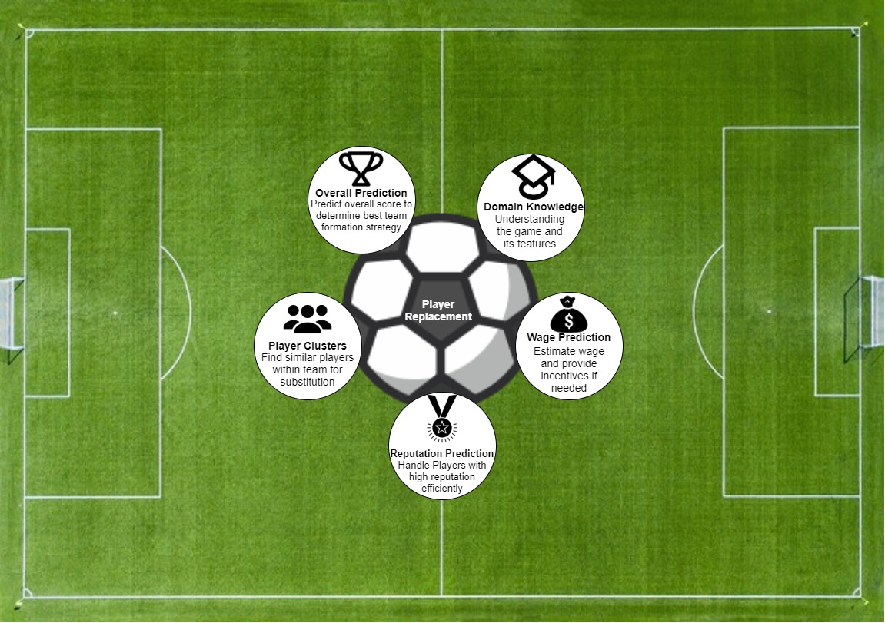
FIFA19 Player Analysis and Predictions.
Use Case: Increase Performance of Individual or Clubs in their Respective Leagues.
Anand Krishnamoorthy
Anugraha Venugopal
Devanshi Deswal
Manaswini Nagaraj

Slide 2
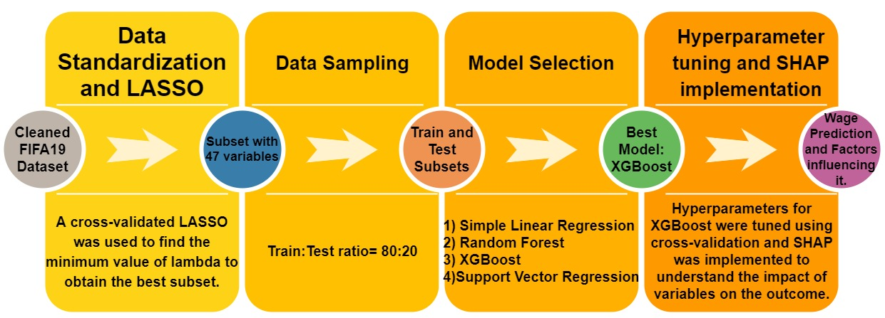
Wage Prediction for Players
Players want to maximize wage. But team budget is a constraint!
Build a model predicting apt wages to make the two ends meet.
Sequence of tasks to predict the Wage of a player
Notes:
On the standardized data, LASSO was applied as a method for feature selection. LASSO (Least Absolute Shrinkage and Selection Operator) applies a L! penalty that leads to the shrinkage of coefficients of some features to zero, in turn reducing the number of total features. To select the appropriate number of features, a lambda value must be specified. This lambda value is chosen through cross-validation approach. For the standardized FIFA19 dataset, the lasso reverted with a total of 47 features out of the initial 79. Then the data was further split into train and test subsets with a ratio of 80:20 respectively.
Tree-based approaches were considered for the prediction of wages, a simple linear model was also built as a base model for comparison. Tree-based models Random forest and XGBoost were built along with a Support Vector Regressor. And among the 4 models, the tree-based models performed better. XGBoost was the best model among all the 4 with an R^2 value of 0.82.
Once the best model was selected it’s hyperparameters were tuned using cross-validation to obtain the best results. After tuning XGBoost gave an RMSE of 8963 and an Ajusted R^2 value of 0.803. Further a SHAP model was implemented to understand how each of the fratures contribute to the final prediction. SHAP uses Shapley values to show how each variables interact with each other and their effect on the prediction value.

Slide 3
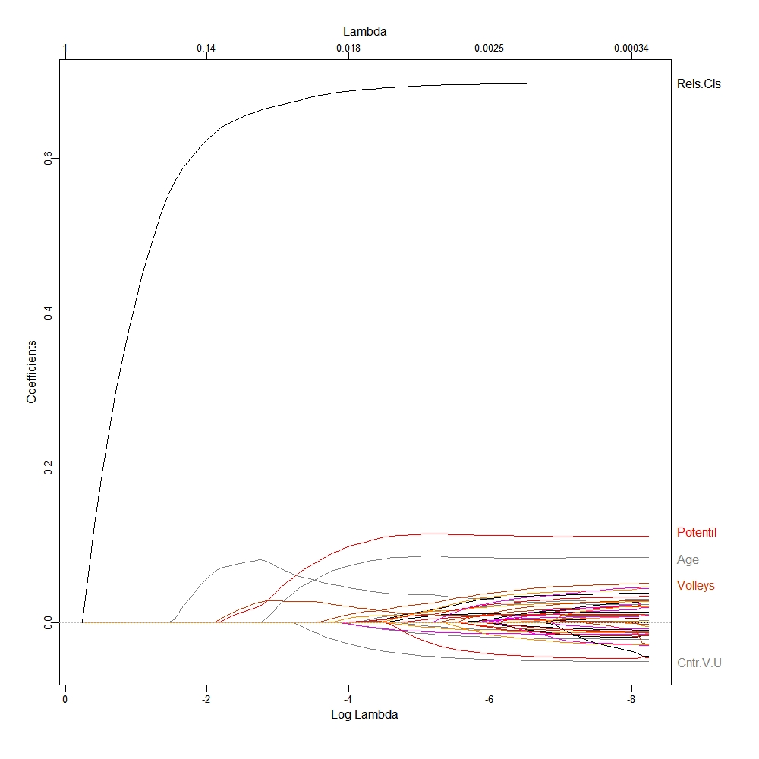
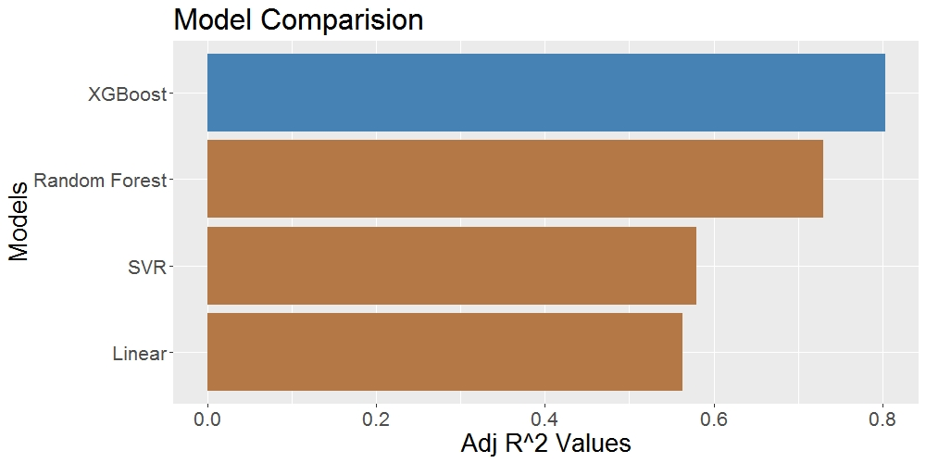
LASSO & XGBoost
Model Comparison
LASSO model
Obtain best subset- simplify the model
Cross Validation
Minimum lambda value- reduction of 32 variables, subset of 47 used to fit model
Model Building
Simple Linear Regression- base model
Tree based model- Random Forest and XGBoost
Support Vector Regression
Model Evaluation
XGBoost- performed best
RMSE- 8963
Adjusted R-squared- .803
Random Forest
Simple Linear
XGBoost
SVR
Notes:
LASSO (Least Absolute Shrinkage and Selection Operator) is a regression analysis method that also performs feature selection along with regularization to enhance the interpretability of a model. Lasso uses an L1 penalty to perform subset selection. L1 penalty had the effect of forcing some of the coefficient estimates to be zero when the tuning parameter lambda is sufficiently large. LASSO yields sparse models. In this project, LASSO was applied over the standardized dataset of 79 features, and a cross-validation approach was used to find the best value of lambda, resulting in the cutting down of 32 variables from the original set.As observed in the Log-Lambda plot above, the variables that are most important shrink the last. It is observed that Release Clause is the most important variable for the model.
With the new subset consisting of 47 features, 4 different models were applied to it. First, a simple linear model was applied as a base for comparison, two tree-based algorithms and support vector regression was applied. Among the four models, the tree-based algorithms- Random Forest and XGBoost showed better performance. Further among these two, XGBoost had the best performance measured by an adjusted R-squared value of 0.8.
XGBoost stands for eXtreme Gradient Boosting, it is an implementation of gradient boosting machines. XGBoost is a decision tree-based ensemble machine learning algorithm that uses a gradient boosting framework. Boosting is an ensemble technique that corrects the errors made by previous models while building the new models, it is called gradient boosting when the boosting technique uses gradient descent algorithm to minimize the loss that occurs while building a new model during each iteration. The models built are sequentially added until no further improvement is seen to obtain one final model. The tree-based approach for XGBoost first builds a decision tree with weak learners, then a new model is built to predict the residuals or errors of the previous model. This process is done stage-wise and the final prediction model is in the form of an ensemble of weak prediction models.
After selecting the best model, it’s hyperparameters were tuned using 10 fold cross-validation. After tuning the model gave an RMSE of 8963 and an adjusted R squared value of 0.8

Slide 4
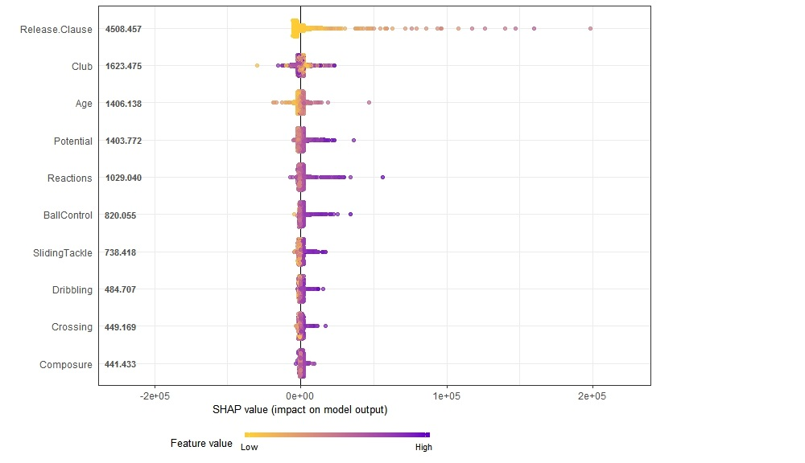
Measuring Impact
SHapley Additive exPlanation(SHAP)- measures the impact of variables in the model to predict “wages” taking into account the interaction with other variables.
Top 10 variables with the highest shapley values.
Highest Contribution- Release Clause, low release clause = low wage.
Better the player is in Ball Control, Sliding Tackle Dribbling and Crossing skills, higher is his Wage.
On an average older the player is, more negative is its effect on his Wage.
Here the colour of the points indicate the value of the feature & the SHAP value on x-axis indicates their impact on prediction.

