Slide 1
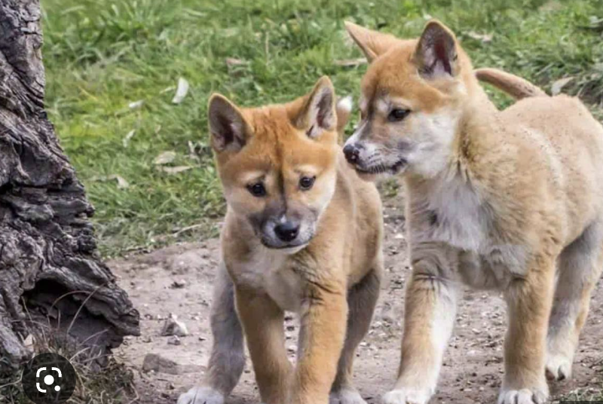
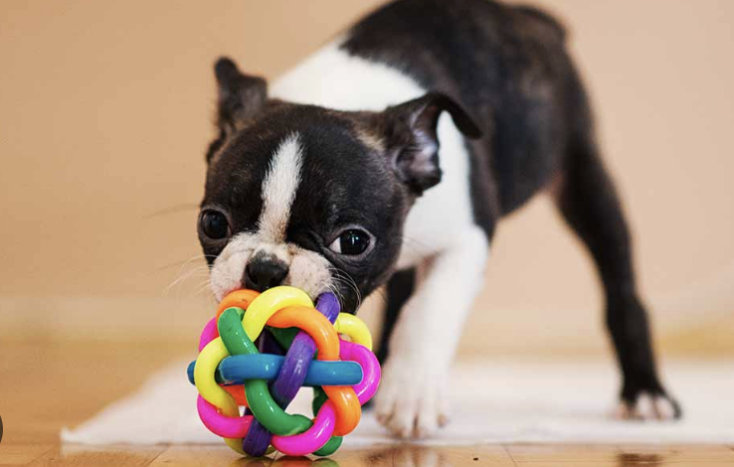
Image Classification of Dog Breed
By
Manaswini Maddu
A25319278

Slide 2
Hypothesis:
The primary goal of this project is to determine the breed of dog from the image. Different image classification algorithms like basic CNN model and CNN with hidden layers are applied and the method that gives the best accuracy is specified. In the Kaggle Notebook itself I have created the notebook and run the project since the environment is ready and the dataset is taken from the directories.
DATASET:
The dataset is taken from the kaggle and it contains 120 breed types along with train and test category. But only train dataset is utilized here which has 10.2k images. But among that only 2 breed type images boston_bull and dingo are considered here. There is also labels csv file which consists of labels for all breed type images and that is used for model creation.

Slide 3
Explanation of Dataset as 5V Model:
Volume: The dog breed table consists of 10222 rows i.e 10222 images of dogs and 2 unique columns. Among that only 2 dog breed type images were considered which have a total of 167 images and 2 dog breed types. Velocity: Based on breeds we can increase the data by adding the different images of breeds to the dataset and so that speed can be increased. This can be implemented for 120 dog breed types thus increasing the speed of data.
Variety: This data consists of 120 different types of breed dog images. They are affenpinscher, afghan_hound, african_hunting_dog, airedale, american_staffordshire_terrier and many more. Among them boston_bull and dingo type are considered. Veracity: The dataset consists of some clear images, and some images might require filtering which is accomplished in the preprocessing stage. The data has some accuracy here. Value: This dataset can be converted to useful information by predicting the dog breed from the image.

Slide 4
Division to Train and Test Data:
Test size is 10% and the Train size is 90%.
In this project we divided the train data directory to train and test data.
The number of images in train data are 150 whereas in test are 17.
The model is designed using train data and tested with the test or validation data.

Slide 5
Exploratory Data Analysis:
This exploratory data analysis is to get a clear idea or to examine about the data.
Firstly number of samples in the train, test and number of unique number of breeds is determined.
Verified whether the derived train data has same images as of labels file since we have to create model based on the labels file.
Dropping null values from the dataset if any since they will increase the noise and decrease the accuracy.
Added file name and file path to the dataset to make data more useful.
Checking the dimensions of the image to see whether it is balanced or not.
Determined the per class (breed) total number of train images, test images, unique breed.
Visualized the number of images in the train and test data set.
Also Average, min and max number of images per class are determined.
Identified how image is stored: Number of pixels across the height * Number of pixels across width * Number of channels (3 - RGB)
Verifying whether all the images have 3 channels or not.

Slide 6
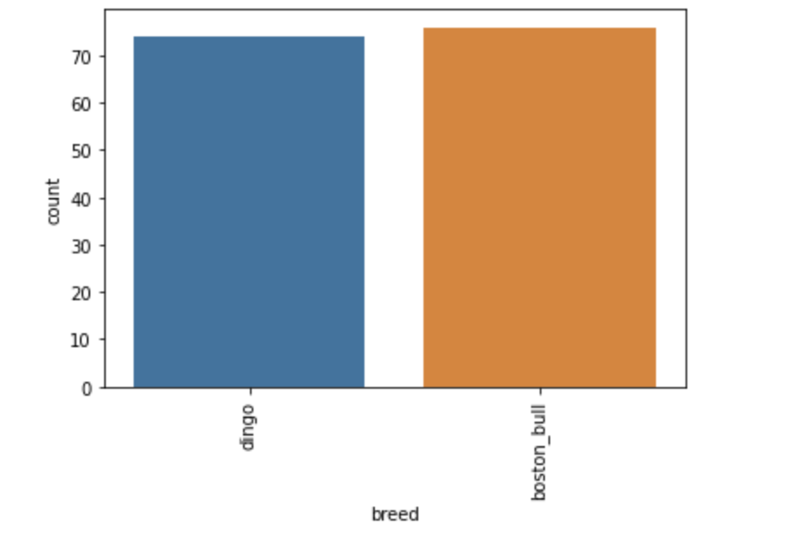
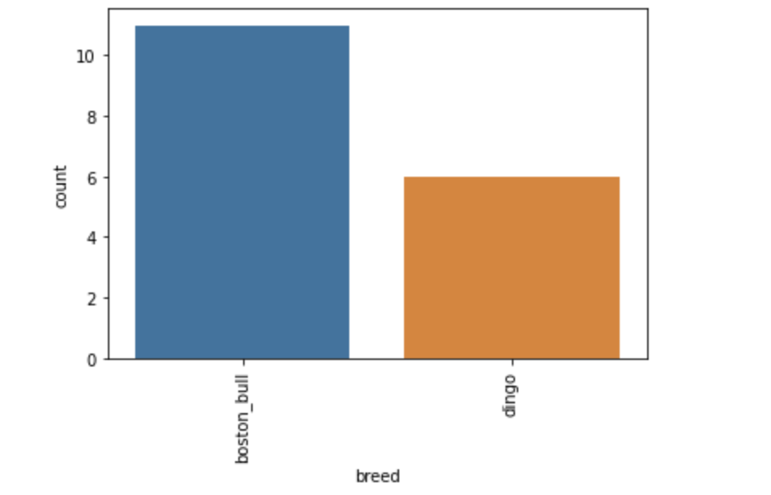
Exploratory Data Analysis:
Train Dataset: 76, 74
Test Dataset: 11, 6

Slide 7
Data Preprocessing:
This is crucial step in this project since this is the process where the raw data is transformed to understandable format.
We should be able to provide data that is understandable by the machine since machines only understand the numerical data.
Dog breeds are mapped to numerical categories and binary classification is utilized since only 2 breeds.
Then all the images are mapped to per class categories that are created earlier. That is all the breed belonging to boston_bull are assigned with 0 and all the breeds belonging to dingo are assigned to class 1.
Images are reshaped and rescalled. Reshaping because the neural networks which are used as classification algorithms take only input of same size.
Rescalling is done to reduce the pixel size from 0 to 255 to 0 to 1. The image will be same only the properties of the image will change.
These steps are verified after executing.
Data Augmentation is performed where diversity of your training set by applying random (but realistic) transformations, such as image rotation. Data is increased by creating the same data in different angles and different flips.

Slide 8
Data Preparation:
Models can only understand the dimensions so a method is defined here to create the data that is understandable by the model.
Data is created and passed to the model. From that we have train and validation data.
By using the train input and train output data the model is designed and that model is verified with the validation input data. Where the results of the validation data input are compared with the output validation data.
Data normalization is also accomplished in this step. The data is normalized here so that image will be contrasted. It is a process that changes the range of pixel intensity values by dividing each of its pixels by the maximum pixel (255) and makes the image look better for visualization.

Slide 9
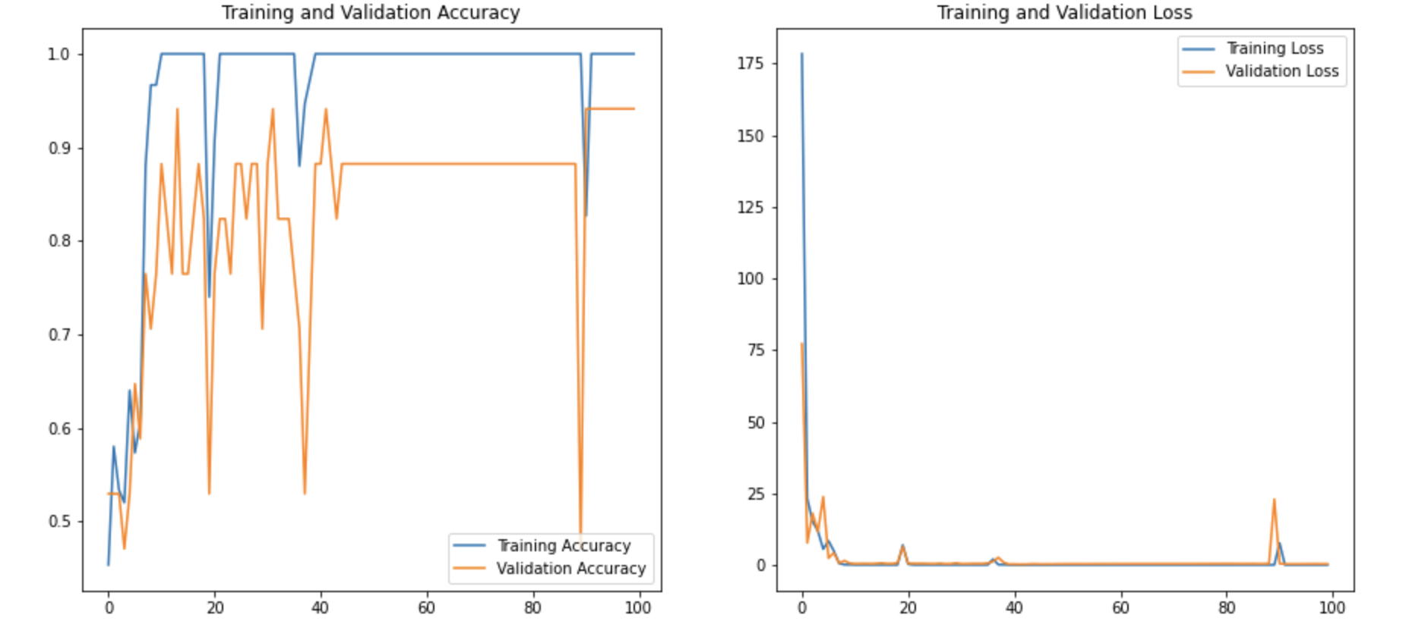
Classification using Basic CNN Model:

Slide 10
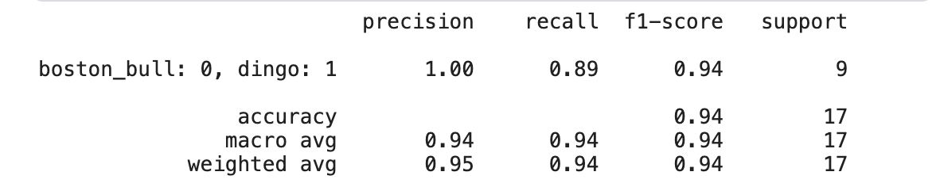
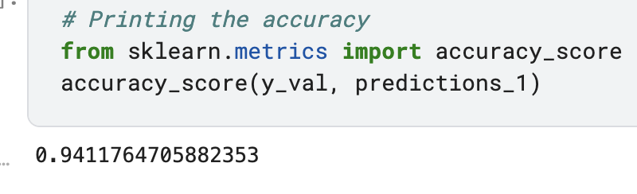
Performance Parameters:

Slide 11
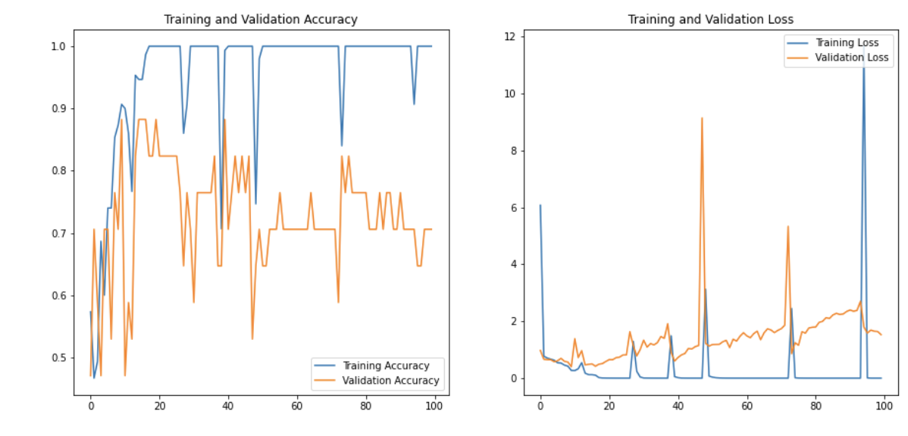
Classification using CNN Model with more hidden layers:

Slide 12
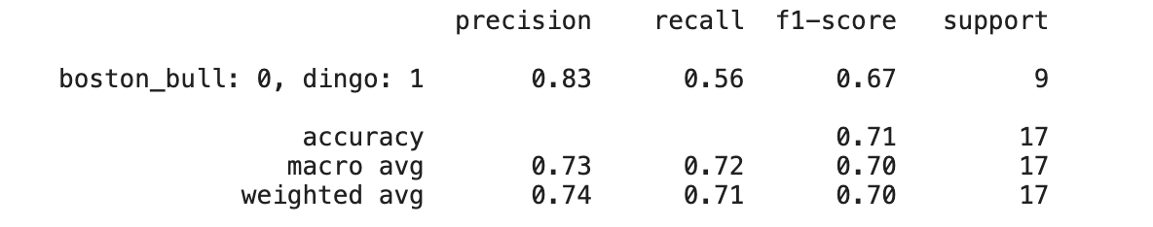
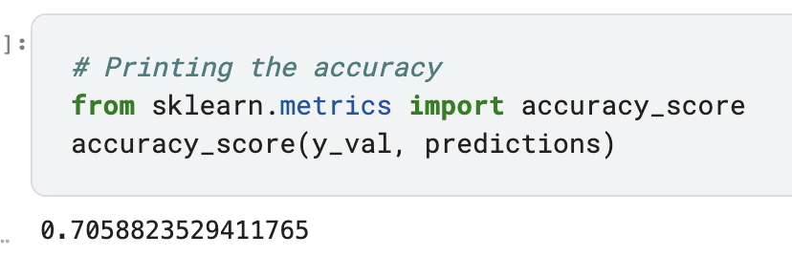
Performance Parameters:

Slide 13
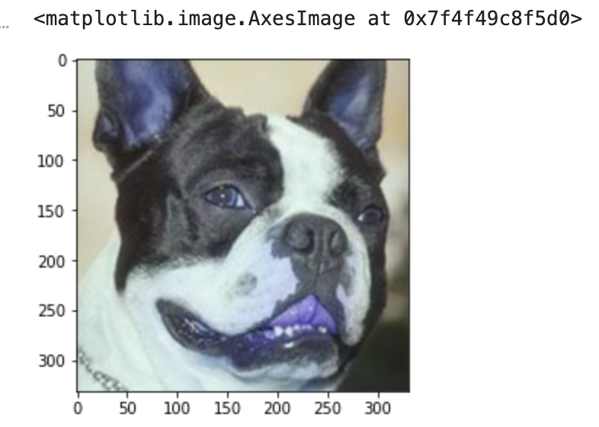
Conclusion:
A basic convolutional neural network (CNN) model is applied for this dataset for the classification of dog breed type and determined the performance parameters of the model like accuracy, precision, f1-score, support but the main factor here considered is accuracy to check the performance of the model and observed that this model achieved an accuracy of 94.11%. Similarly CNN model with more hidden layers is applied for this dataset and performance parameters were determined. The accuracy for this model is 70.5%.
From this we can conclude that for this dataset basic CNN model is giving better accuracy and performance than CNN model with more hidden layers. Since that dataset that is considered here is so limited and therefore the basic model is giving more accuracy. If this project is extended by considering the more dog breed types the CNN with more hidden layers may give the best accuracy than the basic layer. And the low accuracy of the second model is also due to the overfitting problem. The CNN model with more hidden layers must be taking into account the data that is not required for the classification in this particular dataset and making itself complex and thus resulting in misclassification. Thereby it decreases the accuracy and overall performance.

