Slide 1
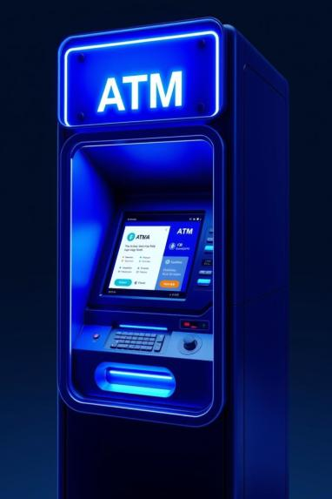

ATM System Using Encapsulation
A Simple Banking Application in Java
Presented by: Manav, Hritik, Prasun, Jatin

Slide 2

Introduction
ATM Functionality
ATMs allow essential banking transactions. Users can check balances, withdraw, or deposit funds.
Encapsulation Focus
This project uses encapsulation. It protects sensitive account details within the system.

Slide 3

What is Encapsulation?
Data Bundling
Encapsulation bundles data (attributes) and methods together. It forms a single unit.
Data Protection
It protects data from direct external access. This prevents unauthorized changes.
Access Modifiers
Access modifiers (private, public) achieve this. They control data visibility.
Security and Simplicity
It increases security. It also reduces complexity in code structure.

Slide 4
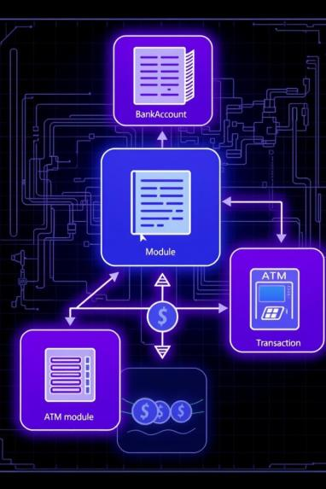



Key Components of the ATM System
BankAccount Class
Manages all account details.
ATM Class
Handles user interactions.
Transaction Interface
Defines transaction behaviors.
This design illustrates clear separation of concerns. Each component has a specific role.

Slide 5
The BankAccount Class
Private Attributes
Public Methods
accountNumber
deposit()
balance
withdraw()
pin
getBalance()
These are not directly accessible. They protect sensitive financial data.
These provide controlled access. PIN verification ensures security.
Example: deposit(double amount) updates the balance.

Slide 6
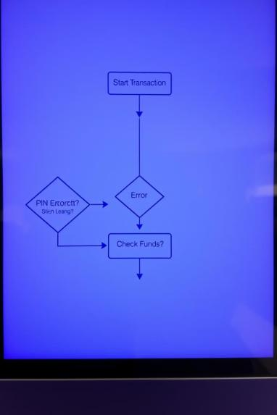



Implementing Transactions
Transaction Interface
Defines a common execute() method. This standardizes all transactions.
Specific Implementations
DepositTransaction and WithdrawTransaction implement it. Polymorphism allows diverse types.
Error Handling
Includes checks for invalid PINs. Manages insufficient funds scenarios.

Slide 7






Benefits of Encapsulation in ATM
Security
Prevents unauthorized access. Keeps sensitive data safe.
Modularity
Easier to maintain. Simplifies future updates.
Data Hiding
Sensitive data is protected. Direct balance modification is prevented.
Encapsulation makes the system robust. It ensures integrity of banking operations.

Slide 8

Conclusion
Robust Applications
Maintainability
Encapsulation is essential. It creates robust banking applications.
Enhanced Security
It promotes code maintainability. This reduces overall system complexity.
Encapsulation significantly improves ATM system security. It protects sensitive data effectively.
Future enhancements include transaction logging and advanced user interfaces. The foundation is strong.

