Slide 1



Cloud Performance Tuning
Title:
Movie-Pal
Presented by:
Manav Khandurie
500097578
R2142211393
B8 CCVT (Sem – V)

Slide 2
Content
Introduction
Objectives
Tech Stack
Methodology
Implementation
Source code

Slide 3
1. Introduction
In this web application, users would be able to:
Movie Discovery: Allow users to easily discover new and upcoming movies based on genere
Watch Trailers: Enable users to watch high-quality movie trailers for the movies they are interested in
Movie Information: Display detailed information about each movie, release date, and genre.
Custom Playlists : Users would be able to create custom playlist according to their preferences
Cast Information : Users would be able to fetch and view general cast details of the movie

Slide 4
2. Objectives
The objectives of a movie discovery web application can vary depending on the project's goals and the specific needs of the target audience. However, here are some common objectives that such an application might aim to achieve:
Enhance Movie Discovery:
Help users discover new and exciting movies they might not have otherwise come across.
User Engagement:
Encourage users to spend more time on the platform by providing engaging content such as movie trailers and user-generated reviews.
Customization and Personalization:
Enable users to create custom playlists and receive personalized movie recommendations.
Convenience:
Make it easy for users to find information about movies, watch trailers, and build playlists in one place.
User Interactivity:
Foster a sense of community by allowing users to rate, review, and share their movie experiences with others.

Slide 5
2.1. Functional Requirements
User Registration and Authentication:
Users must be able to create accounts.
Users should log in securely with username and password.
Movie Discovery:
Users can discover movies by title, genre, release date, or other criteria.
The system should provide a list of matching movies.
Users can view movie details, including title, genre, release date, and a brief description.
Movie Trailers:
Users can watch high-quality trailers for movies.
The system should provide an option to play trailers in high resolution.
Custom Playlists:
Users can create, edit, and delete custom playlists.
Users can add or remove movies from their playlists.
Recommendations:
The system can provide movie recommendations based on user preferences and viewing history.

Slide 6
2.2. Non-Functional Requirments
Performance:
The application should provide quick responses to user actions (e.g., searching, loading movie details, playing trailers).
Scalability:
The system must be scalable to handle a growing user base and increasing data.
Security:
User data and passwords must be securely stored and transmitted.
Access controls and authorization should be in place to protect user information.
Usability:
The user interface should be intuitive and user-friendly.
The application must be accessible to users with disabilities.
Reliability:
The system should be available 24/7 with minimal downtime.
Regular backups and data recovery procedures should be in place.

Slide 7
3. Technology Stack
1.Development
React.js , SCSS , React-Router-Dom
HTML, CSS, SCSS
2.VERSION CONTROL
Git/GitHub
3.Deployment
Microsoft Azure
Some of the common Azure requirements would be:
Virtual Machine: - Virtual servers to host the application
Azure Blob Storage: - Cloud Storage Solution to store static assets

Slide 8
4. Methodology
Project Planning:
Define Objectives: Begin by clearly defining the project's objectives, features, and target audience.
Requirements Gathering: Collect and document detailed functional and non-functional requirements, including those related to user interfaces, data, and security.
Technology Stack Selection: Determine the technologies to be used, including React.js for the frontend, Firebase for the backend, and Docker for deployment.
Architecture Design: Create an architectural design that outlines the system's components, data flows, and how Firebase, React.js, and Docker will work together.
Frontend Development (React.js):
UI/UX Design: Design the user interfaces, considering user experience and ease of navigation.
Component Development: Create React components for different parts of the application, including movie listings, search functionality, user profiles, and playlists.
API Integration: Integrate the TMDB API to fetch movie data, trailers, and other information.
User Authentication: Implement user registration and login functionality using Firebase Authentication.
User Interaction: Develop features for rating movies, leaving reviews, and building custom playlists.

Slide 9

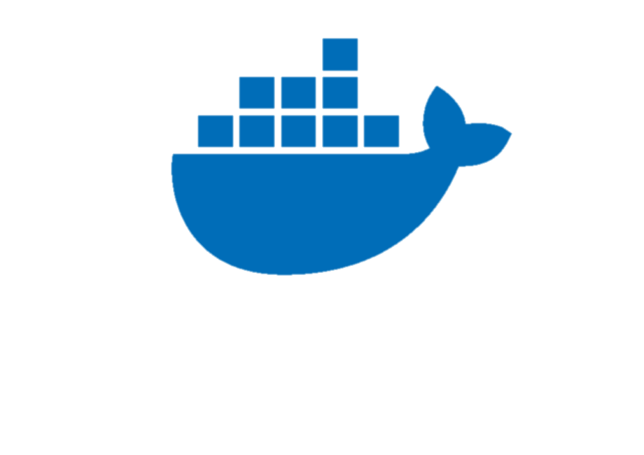
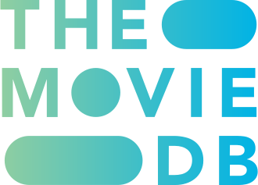

4. Methodology
3. Backend Development (Firebase):
Database Setup: Use Firebase Realtime Database or Firestore to store user data, movie information, and user-generated content.
Authentication and Security: Configure Firebase Authentication and implement security rules to protect user data.
4. Containerization (Docker)
Dockerization: Containerize the application using Docker, which includes creating Dockerfiles to specify the application's runtime environment and dependencies.

Slide 10
Implementation
Live Demonstration of the site.
https://drive.google.com/file/d/1EsPaYL5IXBOlv7NGpDCda4bfWD41jwW6/view?usp=share_link

Slide 11
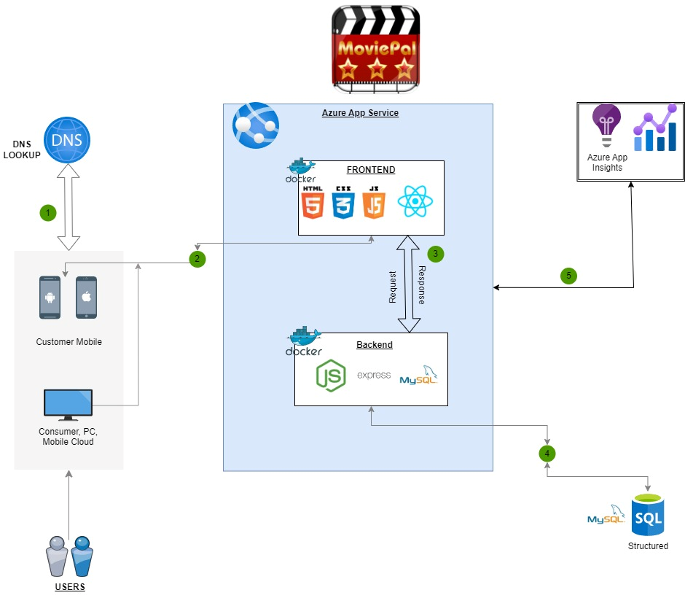
Architecture

Slide 12
Source Code
Code
https://github.com/Manav-Khandurie/Cloud-Performance-Tuning.git
Docker Image
https://hub.docker.com/r/manavkhandurie/manavcptproject

Slide 13
Thank You

