Slide 1


CALCULATOR APP
Manav Shandilya
2110992084
G19
Submitted to:
Mr. Rishik

Slide 2

INTRODUCTION
Welcome to the documentation of the calculator app.
This calculator app is created with react js. It is a fully functional app and has a user friendly interface.

Slide 3

01.
HTML
02.
CSS
03.
JAVASCRIPT
04.
REACT JS
TECHNOLOGIES
USED

Slide 4
KEY COMPONENETS
01.
APP.JS
02.
INDEX
03.
DIGIT BUTTON
04.
OPERATION BUTTON

Slide 5
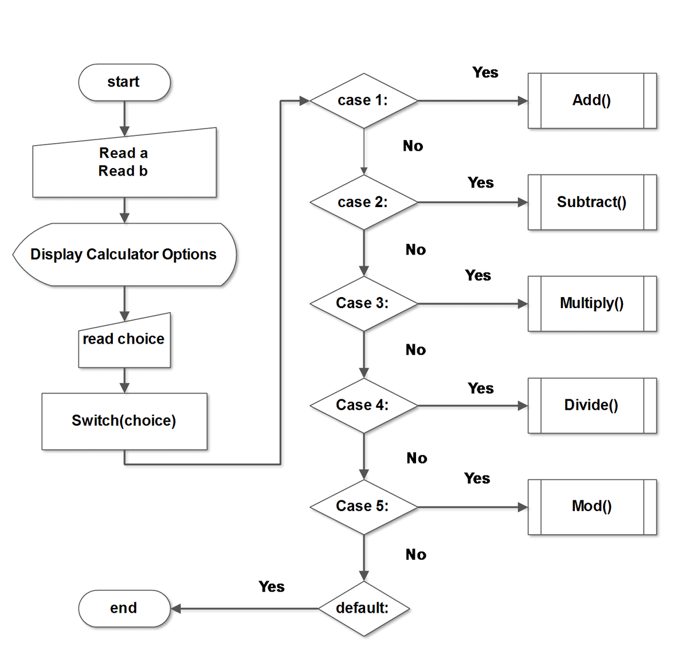
FLOWCHART

Slide 6
CONCLUSION
The React Calculator App provides a straightforward and user-friendly interface for performing basic arithmetic calculations. Designed with modularity and clarity in mind, the app's components work seamlessly to deliver a responsive and intuitive user experience.
The React Calculator App stands as a testament to the power of React in building interactive and user-friendly applications. Whether used as a standalone calculator or as a foundation for a more extensive project, its clean design and thoughtful architecture make it a valuable resource for both learners and developers.

Slide 7
THANK YOU

