Slide 1
Manav Gupta
1

Slide 2
INTRODUCTION
B.Tech Computer Science Graduate (2021–2025), VITM Gwalior
Passionate about AI and building real-world intelligent systems
Built an ML-based heart disease prediction system
(89% accuracy on UCI dataset)
Developed EDUNOVA, an AI-powered education platform with smart notes and quiz generation
Created Harvest Horizon, a crop recommendation and
yield prediction system to assist farmers

Slide 3
Skills
Programming & Tools
Python (Proficient), C++, Git, GitHub, Jupyter, Google Colab
Machine Learning & Data Analysis
Scikit-learn, PyTorch, XGBoost, GridSearchCV, Pandas, NumPy, Seaborn
Web & Backend Technologies
Django, Flask, RESTful APIs, MySQL
Collaborative & Technical Strengths
Problem Solving, Research-Oriented Mindset, Technical Communication, Fast Learner, Team Collaboration

Slide 4
SUBMISSION OVERVIEW

Slide 5
Heart Disease Prediction
Objective
Predict heart disease with ML
Dataset Used
Used UCI dataset (302 patients)
Techniques
EDA, 2 features, 6 models , Evaluated using multiple metrics
Why this project?
Real healthcare impact and learning

Slide 6
Exploratory Data Analysis

Slide 7
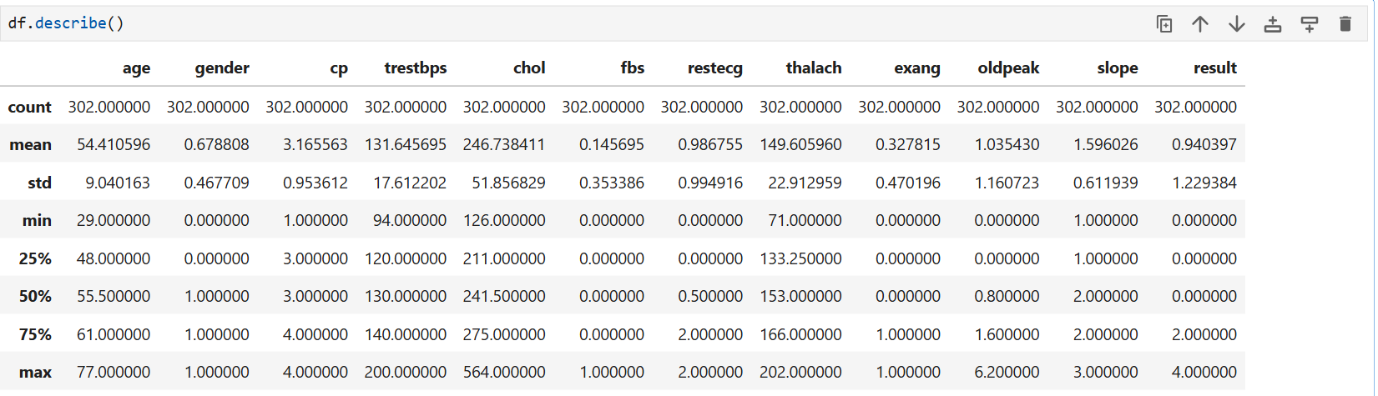
Descriptive Statistics for Numerical and Categorical Features and key insights
Category | Insights
Age & Gender | Age range: 29–77 years Avg. age: ~54.4 Male patients: ~68%
Chest Pain Type | Most have cp = 3 or 4 (asymptomatic or atypical angina)
Vital Signs | Avg. BP: ~131.6 mmHg Cholesterol outliers: up to 564 mg/dl
Fasting Blood Sugar | ~15% have fbs > 120 mg/dl Majority have normal levels
Heart-Related Measures | Avg. max heart rate (thalach): ~150 bpm Most don’t have exang
ST & ECG Observations | Oldpeak is skewed with outliers Slope mostly flat/downsloping ECG spans all categories

Slide 8
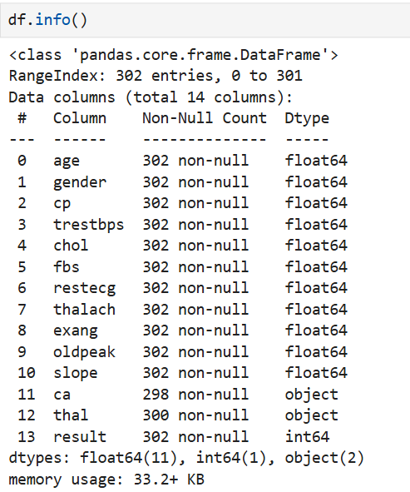
Dataset Structure Overview and Key insights
All columns have complete values except ca and thal.
ca and thal have missing values with 298 and 300 non-null entries, respectively
Most features are stored as float64, even for categorical variables like gender, cp, and fbs
ca and thal were of object type due to non-numeric entries (e.g., "?") — later replaced with NaN
The result (target) column is correctly identified as an integer type for classification

Slide 9
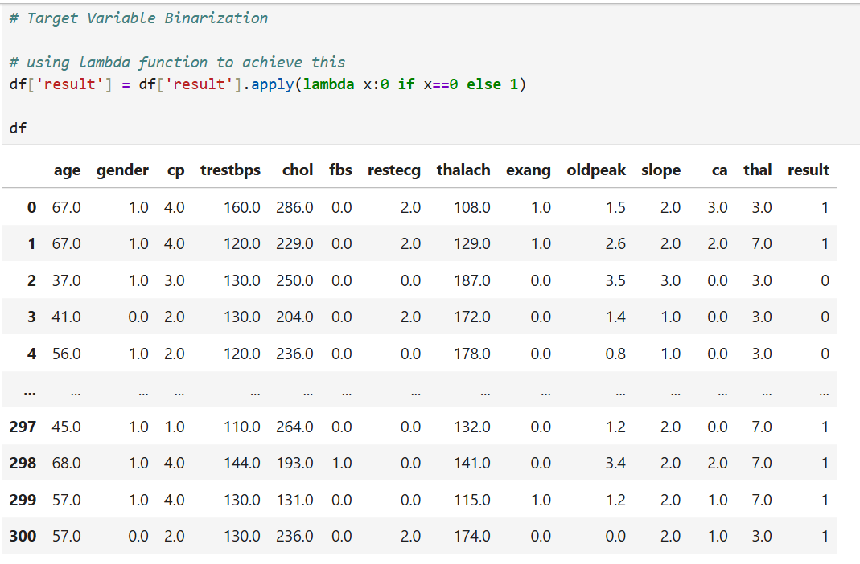
Target Variable Binarization
Original result column had values ranging from 0 to 4
Target Variable(Result):
0 = No heart disease
1–4 = Different levels of heart disease severity
Goal: Convert this into a binary classification problem
Transformed target values into:
0: No Disease
1: Disease Present
This made the task simpler and enhanced result interpretation

Slide 10
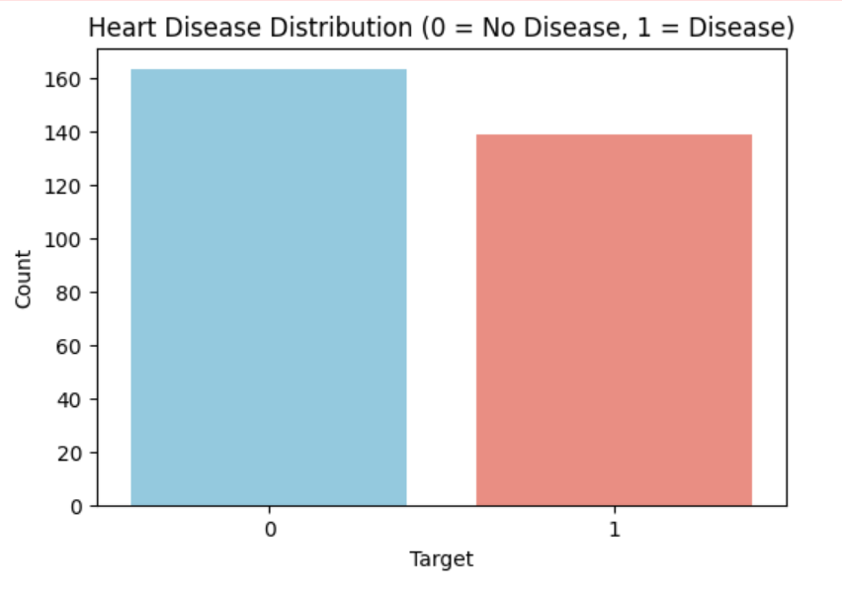
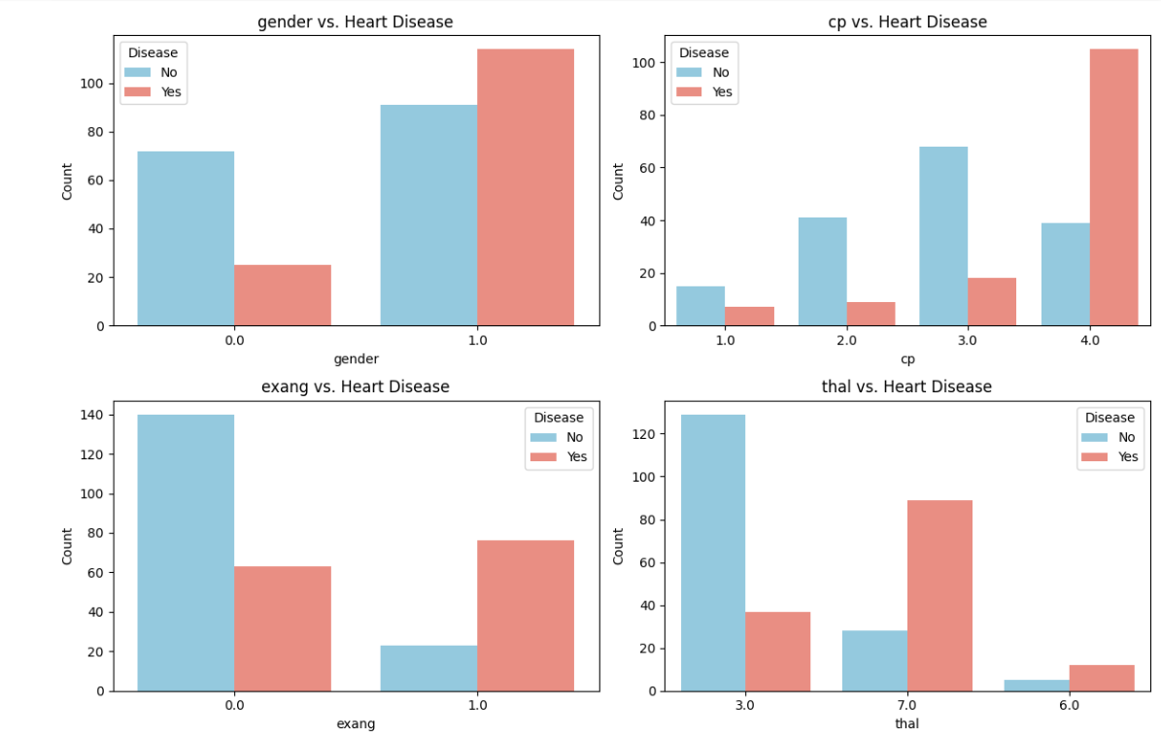
graphical analysis Target Variable Distribution

Slide 11
Key Insights from graphical analysis
Class Imbalance: Dataset is slightly imbalanced — ~53% healthy vs. 47% with disease
Gender: Males show higher prevalence of heart disease compared to females
Exercise-Induced Angina (exang): Strongly associated with heart disease presence
Chest Pain Type (cp): Asymptomatic chest pain (cp=4) is linked to highest disease risk
Thalassemia (thal): Thal = 7 (reversible defect) is a strong indicator of heart disease
Conclusion: Key categorical features reveal important patterns useful for prediction

Slide 12
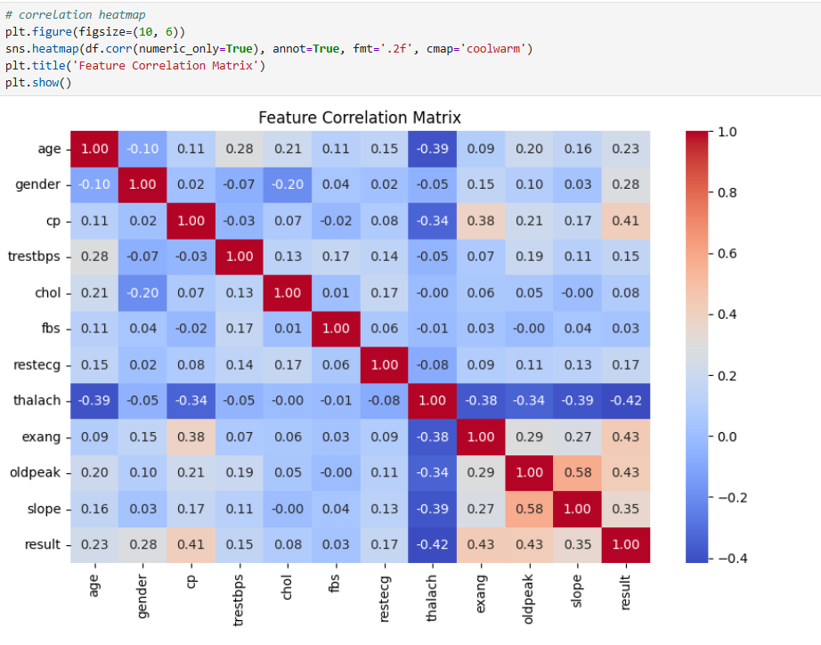
graphical analysis Feature Correlation Heatmap

Slide 13
Key Insights from Feature Correlation Heatmap
Strong positive correlations with disease: cp, exang, oldpeak, and slope
thalach (maximum heart rate) shows strong negative correlation
These features align with previous boxplot and EDA observations
cp, exang, and oldpeak are highly valuable for model prediction
thalach acts as a strong inverse indicator of heart disease
No signs of multicollinearity — all features are safe for use in modeling

Slide 14
Data Preprocessing and Feature Engineering

Slide 15
Data Preprocessing and Feature Engineering
Step | Details
Cleaned Missing Data | Replaced "?" with NaN, then imputed missing values in ca and thal using mode imputation
Converted Data Types | Used pd.to_numeric() to convert appropriate columns to numeric types
Engineered Features | - age_thalach_interaction: Interaction between age and thalach - pulse_pressure: Difference between trestbps and oldpeak
One-Hot Encoding | Applied get_dummies() to categorical columns: cp, thal, restecg, slope
Feature Scaling | Used Z-score standardization with StandardScaler on numerical features
Train-Test Split | Split dataset into 80% train / 20% test with random_state=42 for reproducibility

Slide 16
Model Training and Development

Slide 17
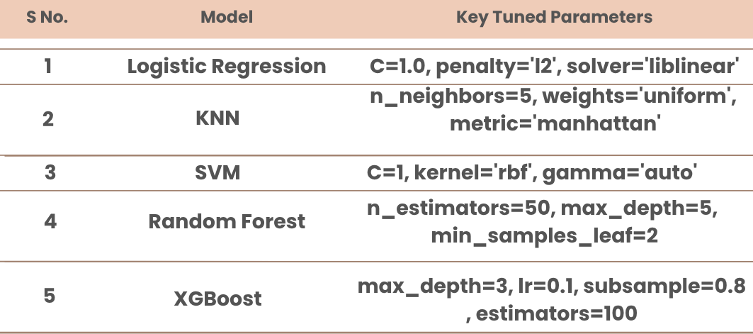
Traditional model trained

Slide 18
Deep learning mlp models basic mlp model
Model Overview:
Developed a simple feedforward neural network (Multilayer Perceptron - MLP) using PyTorch.
Purpose: Binary classification of heart disease presence.
Architecture:
Input Layer: Based on number of features (after preprocessing).
Hidden Layer 1: 64 neurons with ReLU activation.
Hidden Layer 2: 32 neurons with ReLU activation.
Output Layer: 1 neuron with Sigmoid activation for binary output.
Training Details:
Optimizer: Adam (learning rate = 0.001)
Loss Function: Binary Cross-Entropy (BCELoss)
Epochs: 50
Batch Size: 32

Slide 19
Deep learning mlp models deep mlp model
Model Overview:
A deeper MLP architecture implemented to capture more complex non-linear relationships.
Designed to improve over the basic model’s performance.
Architecture:
Input Layer: Matches input features.
Hidden Layer 1: 128 neurons (ReLU)
Hidden Layer 2: 64 neurons (ReLU)
Hidden Layer 3: 32 neurons (ReLU)
Output Layer: 1 neuron (Sigmoid)
Training Details:
Optimizer: Adam (learning rate = 0.001)
Loss Function: Binary Cross-Entropy
Epochs: 50
Batch Size: 32

Slide 20
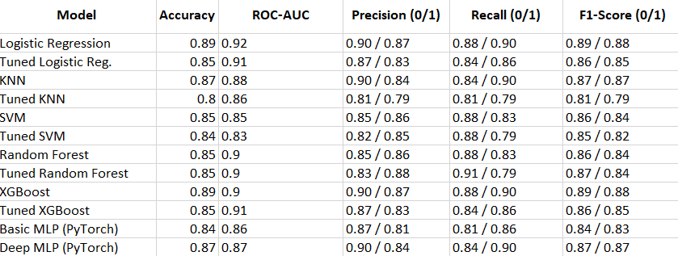
Model Training and Development

Slide 21
Model Evaluation and Comparison

Slide 22
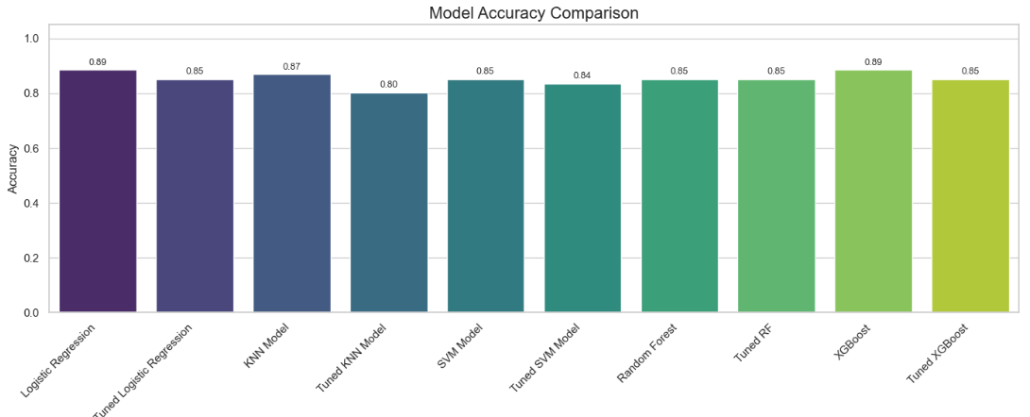
Confusion Matrices

Slide 23
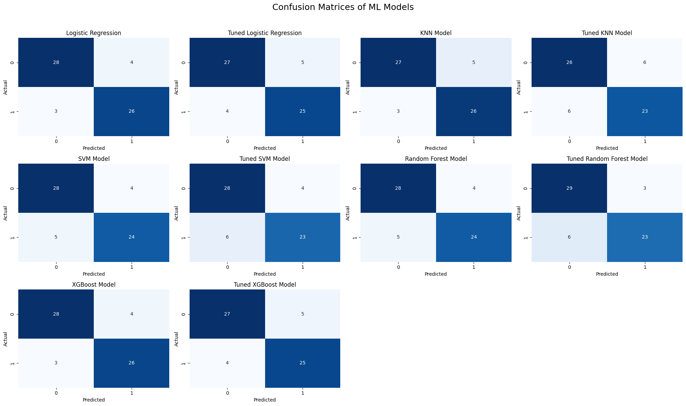
Confusion Matrices

Slide 24
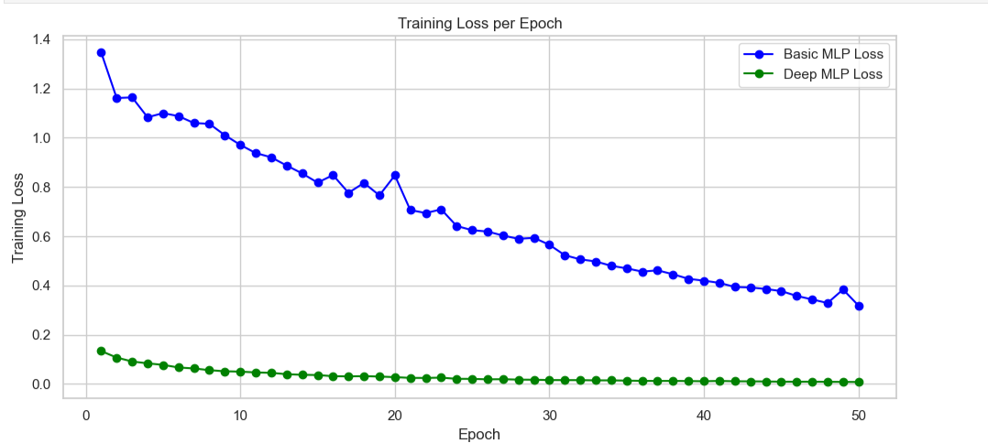
Training Loss Curve for mlp models

Slide 25
Best Performing Models
Best Traditional Model: XGBoost
Accuracy: 0.89 (highest, tied with Logistic Regression)
ROC-AUC: 0.90 (high and balanced)
F1-Score (1): 0.88 (slightly higher than others)
Precision (1): 0.87
Recall (1): 0.90
Why XGBoost wins over logistical regression:
1) Strong overall balance of accuracy, AUC, precision, and recall
2) High F1-score for both classes
3) Handles non-linearity well and supports feature importance analysis
Best Deep Learning Model: Deep MLP (PyTorch)
Accuracy: 87%
Why this model?
Learned complex non-linear patterns in the data
Outperformed basic MLP (2 layers ) in terms of both precision and recall
Architecture: 3 layers (128 → 64 → 32), ReLU activation, 50 epochs
Generalized well without overfitting on the test set

Slide 26
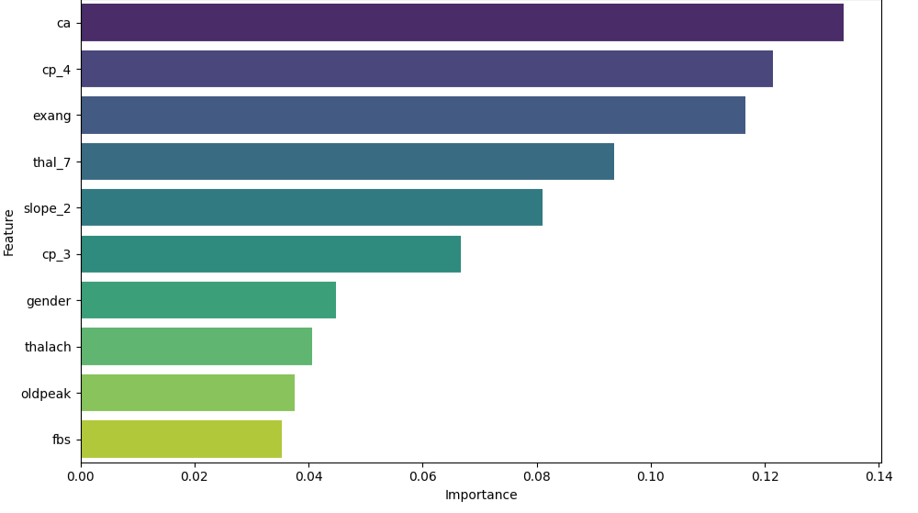
Feature importance
ca indicates that the number of blocked vessels is the strongest predictor of heart disease.
High importance of cp_4 and exang shows chest pain type and exercise-induced angina are critical warning signs.
Moderate importance of slope_2 and thal_7 suggests heart performance under stress and thalassemia type affect risk.
Low importance of fbs, oldpeak, thalach, and gender means these general health indicators contribute less to prediction.

Slide 27
Best-Performing Model Selection
XGBoost Classifier selected as the best-performing model based on all key evaluation metrics.
Performance Metrics: Accuracy – 0.89, ROC-AUC – 0.90, Precision – 0.89, Recall – 0.89, F1-score – 0.89.
Confusion Matrix shows balanced predictions: 26 true positives, 28 true negatives, only 4 false positives, and 3 false negatives.
Outperformed both traditional ML models and deep learning (MLP) in all metrics, even without tuning.
High ROC-AUC of 0.90 reflects strong ability to distinguish between heart disease and non-disease cases.
Feature importance aligns with clinical relevance — key predictors like ca, cp_4, and exang enhance model trust.
MLP slightly underperformed and lacked interpretability, making XGBoost more suitable for real-world clinical deployment.

Slide 28
Relevance of Clinical Evidence Data in Determining Insurance Premium and Coverage Using Machine Learning
My Motivation for the Project
I am passionate about applying AI and data science to solve real-world problems that directly impact people’s lives.
The intersection of healthcare, insurance, and ethical AI is both socially relevant and technically challenging, which excites me.
This project provides the opportunity to work on interpretable models that help build trust in critical domains like health insurance.
I view this internship as a meaningful chance to enhance my practical skills in machine learning and deep learning.
The use of clinical data and collaboration with experts aligns with my goal to create transparent and fair AI-driven solutions.
I am excited to contribute to a project that integrates advanced technology with ethical innovation in the insurance sector.

Slide 29
THANK YOU
Manav Gupta
+91 9250222787
manav08gupta@gmail.como

