Slide 1
IMAGE COMPRESSION
BY
AKASH RUPAPARA – 1641040
MAHARSH SURYAWALA –
NEEL PATEL –
MANAV CHOTALIA –
SAURABH –

Slide 2
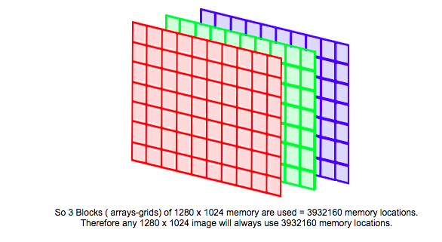
Uncompressed Image
USING DESKTOP 1280 X 1024 PIXEL IMAGE FOR EXAMPLE. EACH PIXEL REQUIRES 3 MEMORY LOCATIONS TO STORE RGB COLOURS.
SO, 3 BLOCKS OF 1280 X 1024 ARE USED = 3932160 MEMORY LOCATIONS.

Slide 3
Lossless and Lossy Compression
The first data compression methods devised were loss-less. That is after compression and decomposition you get back the original data.
These methods relied on the data being inefficiently coded in the first place to get good compression ratios
Graphic image data with lots of fine details when compressed using lossless method entail lots of processing for little compression effect.
New ideas were needed to overcome the problem which led to a detailed examination of the information stored in an image.
An image is shades of light and dark of different hues. The viewer is the human eye and brain. The new ideas were centered around exploiting the strengths and weakness of human system.

Slide 4
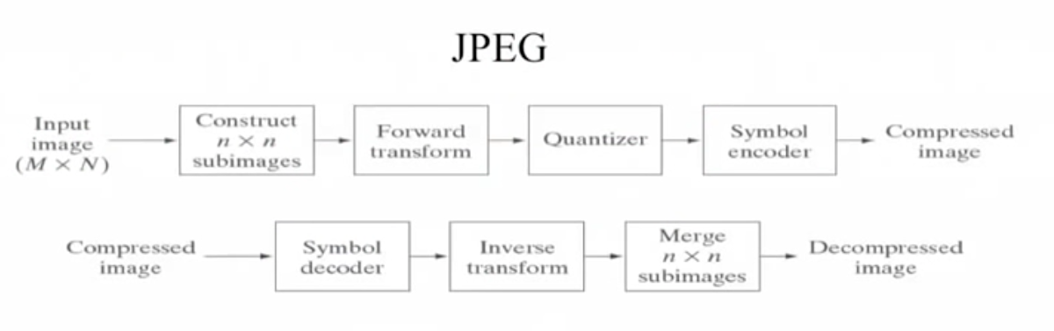
Join Photographic Experts Group

Slide 5
JPEG
In 1987 two groups were combined to form a joint committee (Join Photographic Experts Group) that would research and produce single standard.
JPEG unlike other compression methods is not a single algorithms but maybe thought of as a toolkit of image compression methods to suit the users needs.
JPEG uses a lossy compression method that throws useless data away during encoding.
This is why lossy schemes manage to obtain superior compression ratios over most loss-less schemes.
JPEG is designed to discard information the human eye can’t see.
The eye barely notices slight changes in colour but will pick change in brighness or contrast.

Slide 6
Discrete Cosine Transform
The luminance and chrominance components of the image are divided up into an array of 8x8 pixel block.
Padding is provided if required to ensure blocks on right and bottom of image are full.
These 8x8 pixel blocks are fed into a process that performs a forward Discrete Cosine Transformation(DCT)
The output of this process is a set of 64 values.

Slide 7
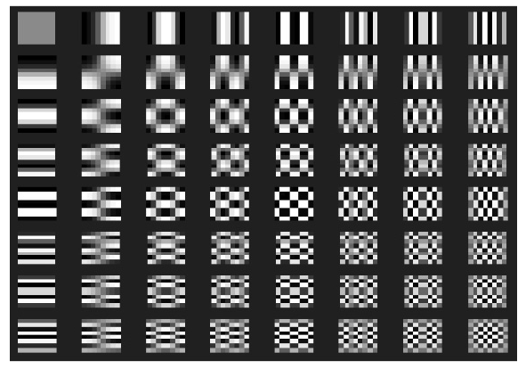
Discrete Cosine Transform
The frequencies as a set of patterns and the DCT process is finding the strength of each pattern in the 8 x 8 block.

Slide 8
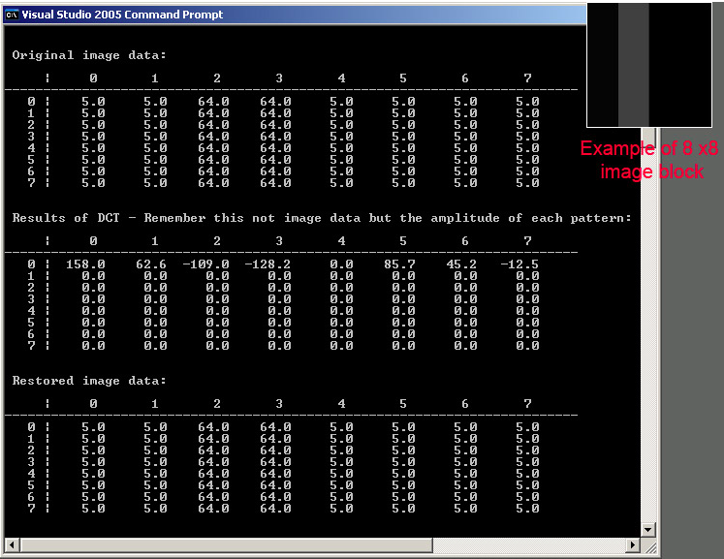
A vertical grey bar. Looking at the DCT terms we can see that only horizontal frequency terms (components) are produced. No terms are seen down the table. Which follows as the vertical brightness levels in the image are constant.

Slide 9
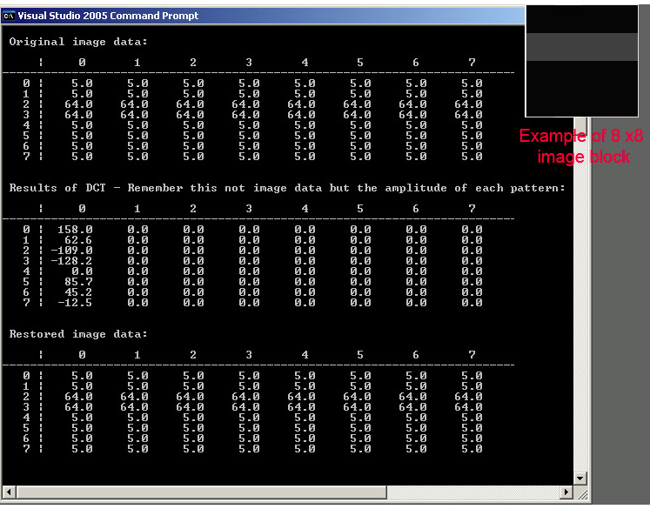
A horizontal grey bar. Looking at the DCT terms we can see that only vertical frequency terms (components) are produced. No terms across the table. Which follows as the horizontal brightness levels in the image are constant.

Slide 10
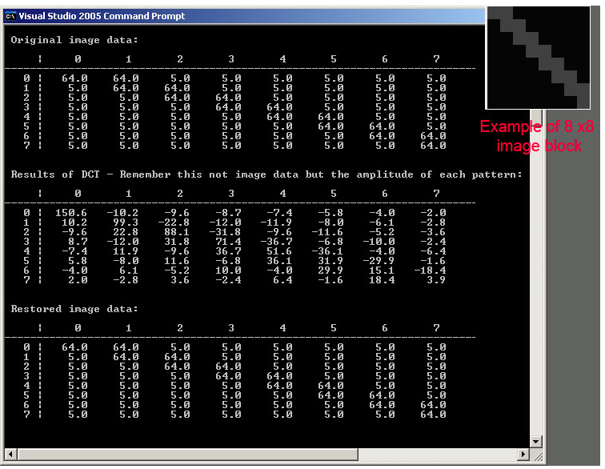
A diagonal grey bar. The DCT table shows both vertical and horizontal frequency terms.

Slide 11
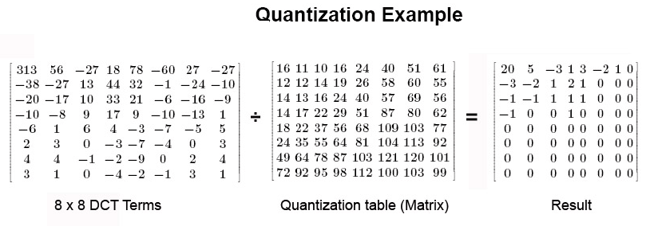
Jpeg Quantization
The next step is the Quantization process which is the main source of the Lossy Compression.
The values in the quantization table are chosen to preserve low-frequency information and discard high-frequency (noise-like) detail as humans are less critical to the loss of information in this area.

Slide 12
JPEG Quantization
Each DCT term is divided by the corresponding position in the quantization table and then rounded to the nearest integer as illustrated before.
In each table the low frequency terms are in the top left hand corner and high frequency terms are in the bottom right.
This is the point at which we can control the quality and amount of compression of JPEG. The lower quality setting , the greater the divisor, increasing the chance of zero result.

Slide 13
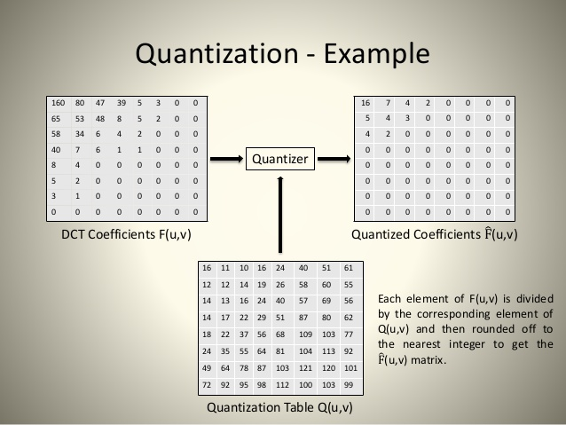

Slide 14
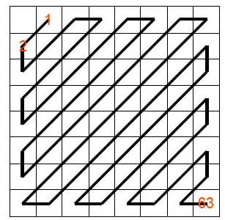
Jpeg Huffman
After quantization the 63 DCT AC terms are collected using the zigzag method illustrated on the left.
This collection method takes advantage of the fact that high frequency terms will tend to zero after quantization improving the chance of getting longer runs of zero which will be idea for good run length compression.
The 63 AC components from the DCT process are compressed using the loss less run length encoding.
This is final stage of the JPEG process, to compress all of the run length compressed DCT terms

Slide 15
THANK YOU

