Slide 1
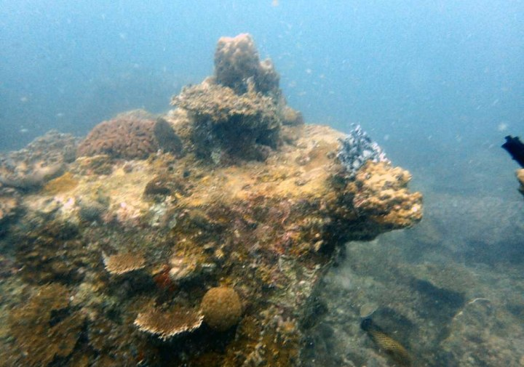
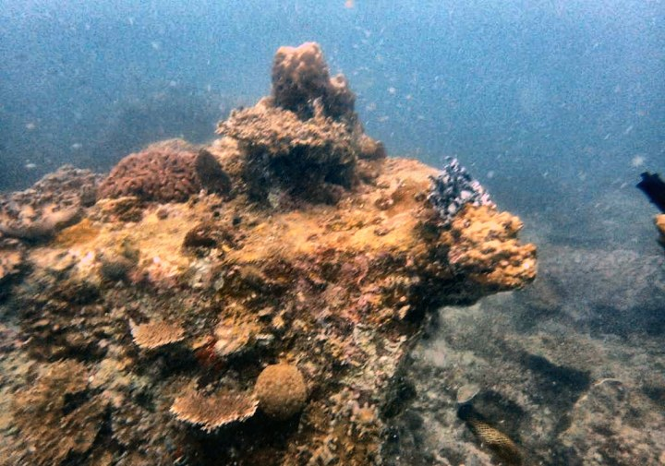
Hybrid underwater image restoration
REVIEW II · BCSE403L DIGITAL IMAGE PROCESSING
Raw
Adaptive colour correction, CLAHE and dehazing, tuned to the type of water in each image
Kopal Sachan · Yathaartha Srivastava · Manav Prakash
VIT School of Computer Science and Engineering · Fall 2026–27
Restored
Notes:
[Kopal · ~1 min]
Good morning. We are presenting our Review II work: a hybrid underwater image restoration pipeline.
On the right is a real image from the UIEB benchmark, before and after our method.
In the next 15 minutes: why underwater images look wrong, how our pipeline fixes each problem, how we evaluated it fairly, and what we found — followed by a live demo.

Slide 2
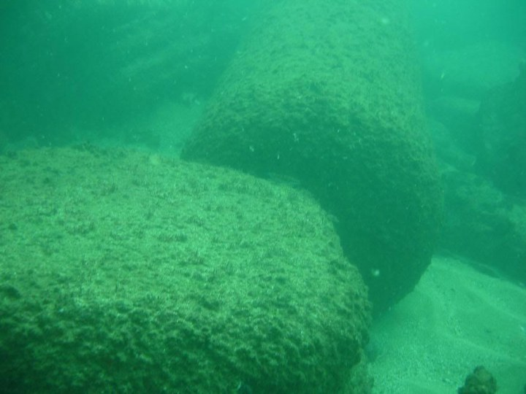



Why underwater photos look wrong
Colour cast
Water absorbs red light first, then green. Images turn blue-green and lose their reds.
Haze
Suspended particles scatter light toward the camera, adding a veil that thickens with distance.
Low light and flat contrast
Raw UIEB image from green, turbid water
Light fades with depth and scattering flattens tones, hiding texture and detail.
Notes:
[Kopal · ~1 min]
Underwater images degrade in three physical ways.
First, colour cast: water absorbs red within the first few metres, so scenes turn blue-green — like the green image on the left.
Second, haze: particles scatter light back toward the camera, adding a fog that grows with distance.
Third, low light and flat contrast at depth.
How strong each problem is depends on the water — deep water loses the most red, turbid water scatters the most. That observation drives our design.

Slide 3



Our goal and what is new
Restore underwater images with classical image processing only, adapt every stage to the type of water, and prove each gain on images never used for tuning.
MODULE 5
MODULE 7
MODULE 9
Water-type routing + red compensation
Per-image fusion weight
Downstream validation
Classifies each image as clear blue, green turbid, deep low-light or hazy bright, then sets how strongly every stage acts, including how much red to restore.
Predicts how to blend a detail stream with a dehazed stream for each image, from 26 no-reference image statistics.
Checks whether restoration helps computer vision, not just appearance: ORB keypoints, matches and edge density.
Plus a finding: popular no-reference quality scores (UCIQE, UIQM) mislead when used to tune a restoration pipeline.
Notes:
[Kopal · ~1 min]
Our goal: restore underwater images using only classical image processing — no deep learning — and make every stage adapt to the water type.
We contribute three novel modules. Module 5 classifies the water and routes parameters, including how much red light to restore. Module 7 predicts, per image, how to blend two complementary processing streams. Module 9 checks that restoration actually helps computer-vision tasks.
We also report a finding: the popular no-reference scores UCIQE and UIQM mislead when you optimise for them.

Slide 4
The pipeline at a glance
4a · CLAHE detail stream
0 · Water-type routing ★
1–3 · Red comp. · white balance · gamma
5 · Fusion weight α ★
6 · Pyramid fusion
4b · Dehazed stream (UDCP)
Raw UIEB image
Classify the water, pick a parameter profile
Rebuild red, neutralise the cast, adjust brightness
Two complementary versions: detail vs. haze removal
Predict how much to trust each stream
Blend per pixel across 5 pyramid levels
Restored output
★ Novel contribution
Notes:
[Kopal · ~1 min]
Here is the whole pipeline. The raw image is first classified by water type — that picks a parameter profile used by every later stage.
Steps 1 to 3 fix colour and brightness: rebuild the missing red, neutralise the remaining cast, adjust brightness.
Then we make two complementary versions: a detail stream with CLAHE, and a haze-free stream with the underwater dark channel prior.
Module 7 predicts how much to trust each stream for this image, and a multi-scale pyramid blends them per pixel. The highlighted boxes are our novel modules. Yathaartha will now take you through each step.

Slide 5
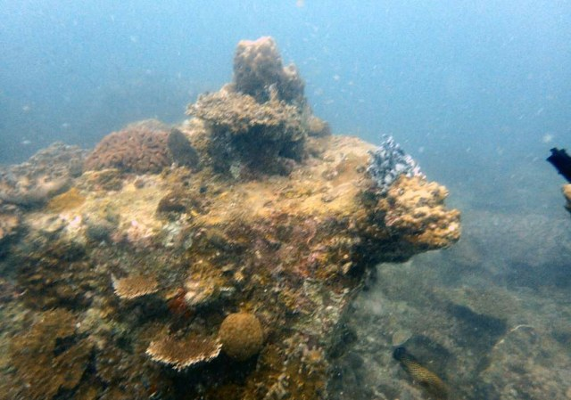
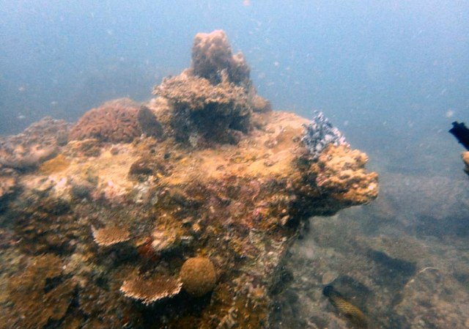
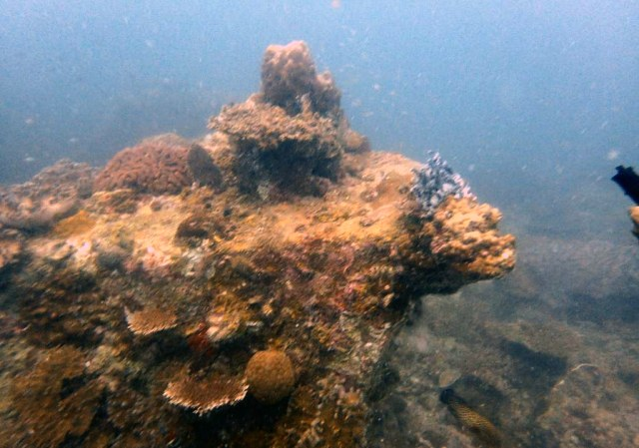
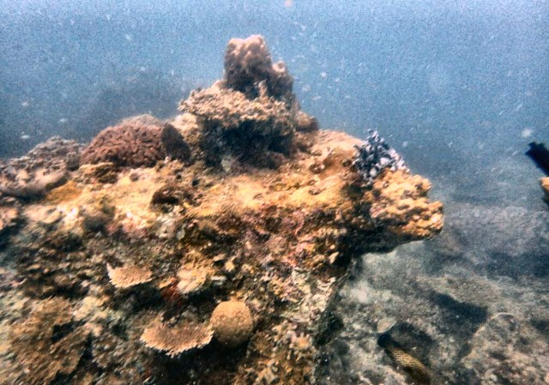
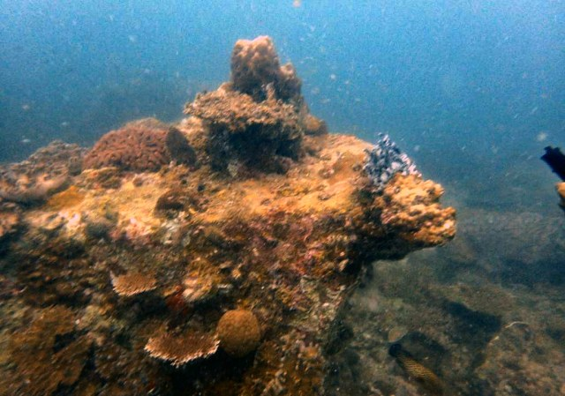

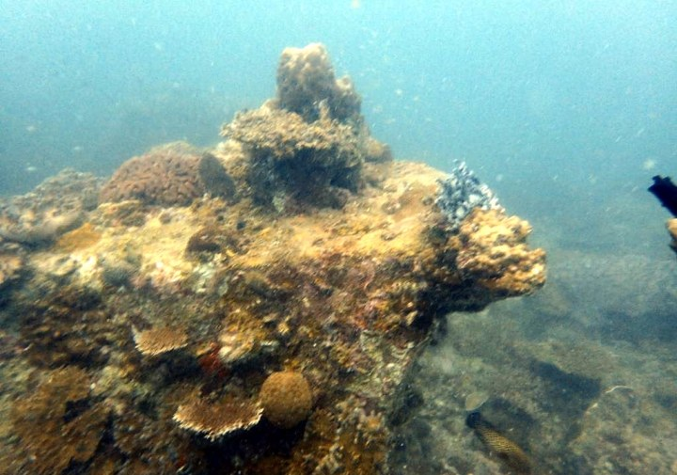
Every stage on one held-out image
Raw input · classified clear blue
1 · Red compensation (s = 0.75)
2 · White balance (cap 1.5×)
3 · Gamma (γ = 1.14)
4a · CLAHE detail stream (clip 1.99)
4b · Dehazed stream (ω = 0.5)
5–6 · Fused result (α = 0.49)
UIEB reference
This image: PSNR 17.51 dB, SSIM 0.875 (CLAHE-only: 18.55 dB, 0.831)
Notes:
[Yathaartha · ~1 min]
This is every stage on one test image, classified clear blue.
Red compensation warms the coral; white balance removes the blue cast; gamma brightens.
The CLAHE stream, bottom left, has the most texture but looks grey. The dehazed stream has depth and colour but is darker.
The fused result, framed, combines both. On this image it scores SSIM 0.875 against 0.831 for CLAHE alone.

Slide 6



Step 0 · Routing: four water types, two profiles
Deep low-light
Profile | Red s | WB cap | Gamma × | CLAHE × | ω
Global (clear blue, green turbid and deep low-light) | 0.75 | 1.5 | 1.05 | 0.6 | 0.5
Hazy bright | 0.75 | 1.5 | 1.2 | 1 | 0.6
mean brightness < 0.30
Green turbid
else if green dominance > 8 and haze > 0.35
Hazy bright
A type keeps its own values only if they beat the single global profile on its calibration images (paired Wilcoxon, p < 0.05). Clear blue, green turbid and deep low-light kept the global stage-1 values.
else if haze > 0.45 and saturation < 0.35
Clear blue
All values were chosen on the 30% calibration split only.
otherwise · 72% of UIEB
Notes:
[Yathaartha · ~1 min]
Module 5 classifies every image with four cheap statistics — brightness, haze, saturation and green dominance — using these rules in order.
Each water type maps to a profile of five parameters. Importantly, these were not hand-tuned: we calibrated them on 30% of the dataset, and a water type only keeps its own profile if it beats a single global profile with statistical significance.
hazy bright kept their own stage-1 values; every type uses the global red strength.

Slide 7
Step 1 · Restoring the red light water absorbs
R′ = R + s · (mean G − mean R) · (1 − R) · G
+0.52 dB
PSNR on held-out images (95% CI 0.41–0.63), plus +0.024 SSIM — the largest single gain in the project
Borrows red from the green channel where green is strong
(1 − R) leaves pixels that are already red untouched
Searched per water type; none beat one global strength (s = 0.75) significantly
Applied before white balance, so balance has real red to work with (Ancuti et al., 2018)
Notes:
[Yathaartha · ~1 min]
Our biggest gain comes from this step. Water removes red so thoroughly that simply scaling the red channel just amplifies noise.
Instead, following Ancuti et al., we rebuild red from the green channel, which survives better and correlates with true red content. The (1 − R) term protects pixels that are already red.
The strength is routed per water type. Calibration ranked the best strengths clear blue (0.75), green turbid (0.75), deep low-light (0.5) and hazy bright (0).
On held-out images this step alone adds 0.52 dB PSNR.

Slide 8
Steps 2–4 · Correct the colour, then build two streams
2
White balance
Gray-world gains make the average colour neutral; each channel at most doubled or halved.
3
Adaptive gamma
A gamma curve sets overall brightness (here γ = 1.14).
4a · CLAHE on lightness (L*)
4b · Underwater dark channel prior
Equalises contrast tile by tile on L* only, so colours don't shift.
Estimates haze per pixel from the G/B dark channel, then removes it.
4
Two streams
The corrected image is processed two complementary ways, then fused.
+ recovers texture and detail
− greyish and noisy on its own
+ removes haze, restores depth
− darker and more saturated
Notes:
[Yathaartha · ~1 min]
White balance applies gray-world gains, capped so a near-empty channel isn't blown up. Gamma sets overall brightness.
Then the key idea of a hybrid: two complementary streams. CLAHE on the lightness channel recovers texture without shifting colours — but alone it looks grey and noisy.
The underwater dark channel prior estimates haze per pixel using only green and blue — red is always dark underwater and would fool it — and removes it. It restores depth but darkens.
Neither is good alone; the next step decides how to combine them.

Slide 9
Steps 5–6 · Blending the streams per image
Fused result · predicted α = 0.49 (a roughly even blend)
Per-image α has real headroom (+0.64 dB with the oracle). The predictor captures about 17% of it, needing no reference at run time. Axis starts at 17 dB to show the gap.
α predicted from 26 no-reference statistics
Per-pixel weights: contrast × saturation × saliency
5-level Laplacian pyramid, so no seams
Notes:
[Yathaartha · ~1 min]
The fusion stage blends the two streams. Weight maps reward contrast, saturation and salient detail, so each pixel draws from whichever stream looks better there, and a Laplacian pyramid hides any seams.
On top of that, Module 7 predicts a global bias alpha for each image, from 26 cheap no-reference statistics.
If we could pick the best alpha per image using the reference, PSNR would rise by 0.64 dB — that is the headroom. Our predictor recovers about 17% of it in cross-validation, with no reference needed at run time.

Slide 10




Evaluation: tune on 30%, report on 70%
268
Three calibration stages
Profile multipliers, red-compensation strength, then the Module 7 model — all on the calibration split, scored by PSNR and SSIM.
calibration images · every parameter is chosen here
Fair ablation
Routing off means one global profile tuned with the same grid and data, not untuned defaults.
Statistics
622
Paired Wilcoxon tests, Holm correction, rank-biserial effect sizes and bootstrap 95% CIs.
held-out test images · every reported number comes from here
Reference caveat
UIEB references are the enhancement volunteers preferred among 12 methods, not ground truth.
Notes:
[Yathaartha · ~1 min]
A key part of this review is how we evaluated. Tuning on the same images you report on inflates results, so we split UIEB once: 268 images for calibration, 622 held out.
All three calibration stages use only the calibration images; every number you will see is on the 622.
Our ablation is fair: "routing off" uses a global profile tuned exactly the same way. And because with 600 images almost anything is "significant", we report Holm-corrected tests with effect sizes and confidence intervals.
One caveat: UIEB references are volunteer-preferred enhancements, not ground truth. Manav will now present the results.

Slide 11
Results: best SSIM, clearly ahead of HE and UDCP
vs CLAHE-only: −0.04 dB PSNR (negligible effect), +0.032 SSIM · vs HE: +1.91 dB, +0.091 SSIM · vs UDCP: +5.29 dB, +0.216 SSIM
All differences significant after Holm correction except PSNR vs CLAHE-only. Mean paired differences per image.
Notes:
[Manav · ~1.5 min]
Here are the main results on the 622 held-out images.
Proposed hybrid: PSNR 18.27 dB, SSIM 0.871. Against histogram equalisation: +1.91 dB; against UDCP: +5.29 dB.
Against CLAHE-only, the strongest classical baseline: level on PSNR (−0.04 dB, negligible, not significant) and +0.032 SSIM (medium effect).

Slide 12
What each part contributes
SSIM change
+0.024
Red-channel compensation
+0.003
Module 7 · predicted α
+0.002
Module 5 · per-type routing
−0.024
Original Module 7 search
Red compensation measured on the no-module baseline; modules vs. the equally tuned control; the original search vs. the predictor.
Notes:
[Manav · ~1 min]
This breaks the result down by component, all on held-out images.
Red-channel compensation: +0.52 dB. Module 7's predicted alpha: +0.16 dB. Per-type routing: +0.02 dB.
The orange bar is the original version of Module 7, which picked alpha by maximising image-quality scores: −0.77 dB against the predictor. That leads to our main finding.

Slide 13
Finding: no-reference scores mislead the optimiser
87%
of images pushed to α = 0 or 1 by maximising UCIQE+UIQM: the scores reward extreme blends
−0.77 dB
held-out PSNR of that search vs. our predictor (large effect)
Every score-maximising choice is worse than a fixed α. HE also tops UCIQE while losing on PSNR/SSIM. Lesson: check a quality score against references before optimising it.
Notes:
[Manav · ~1.5 min]
Our first Module 7 did what many papers do: choose the fusion weight that maximises the image's own UCIQE and UIQM — no reference needed.
We found it backfires. These scores reward extreme blends, so the search pushed alpha to 0 or 1 for 87% of images. Every score-maximising selector on this chart is worse than simply fixing alpha at 0.5, while the oracle shows what's possible.
On held-out images the search costs 0.77 dB against our predictor. Conventional HE tells the same story: it tops UCIQE while losing on fidelity. The lesson: validate a no-reference score against references before you optimise it.

Slide 14
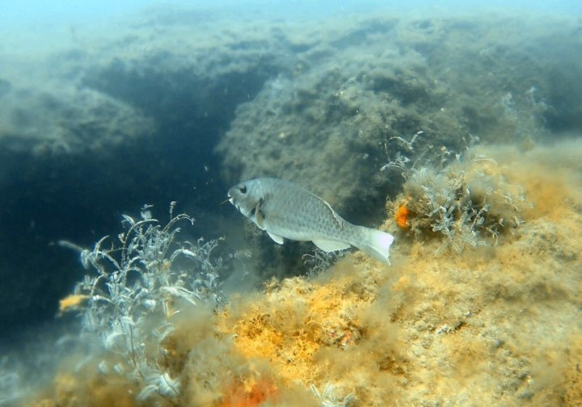
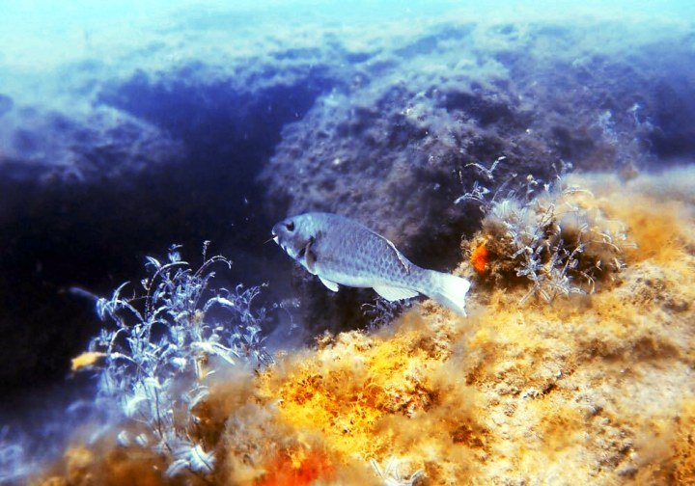
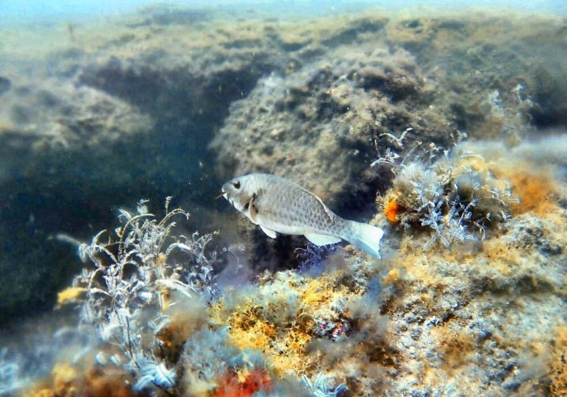
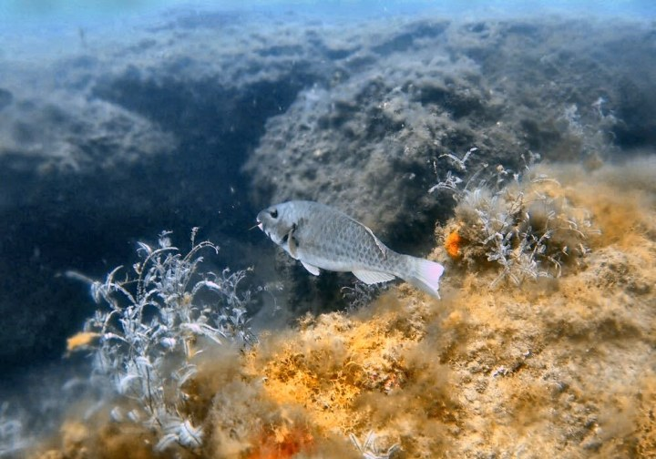
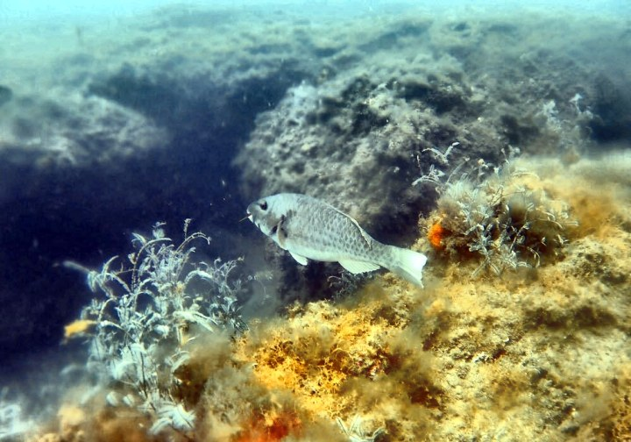
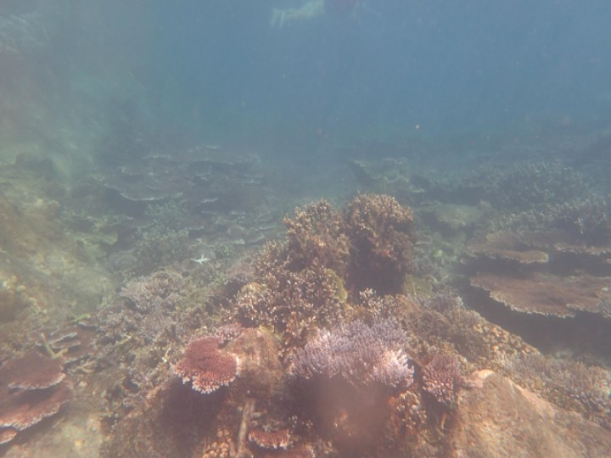
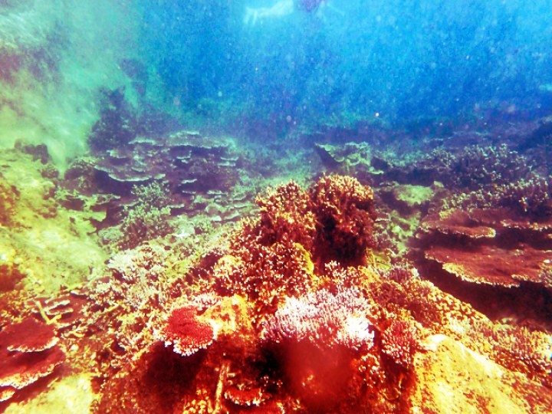
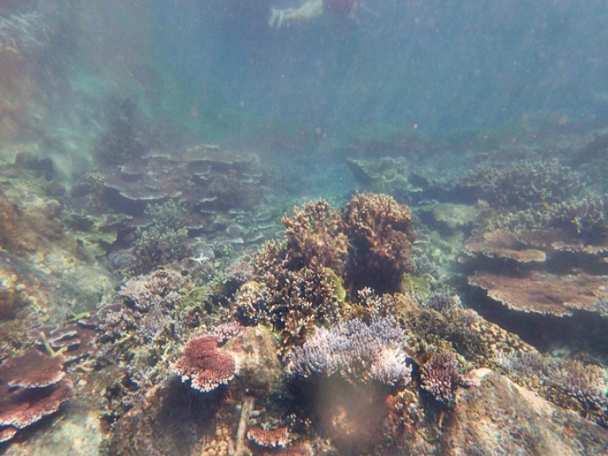
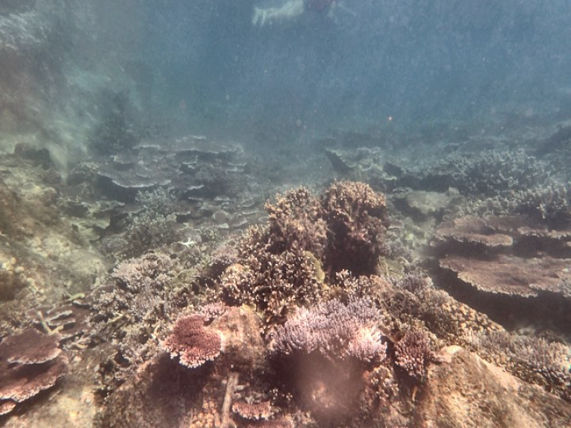
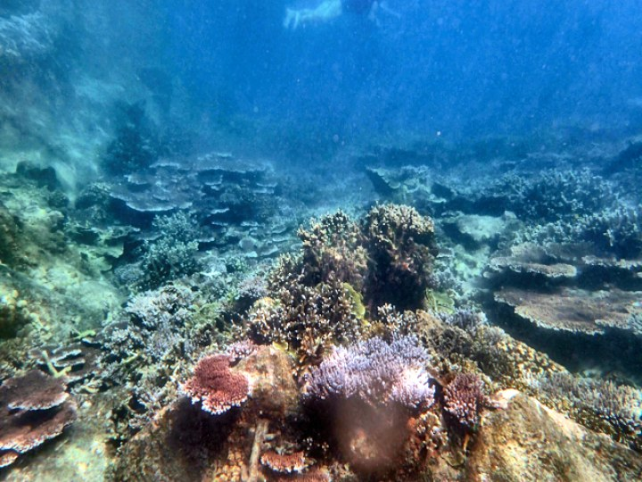
Visual comparison on held-out images
Raw
Conventional HE
CLAHE-only
Proposed hybrid
UIEB reference
green turbid · PSNR / SSIM — proposed 21.59 / 0.932, CLAHE-only 20.91 / 0.921, HE 18.82 / 0.884
hazy bright · PSNR / SSIM — proposed 15.52 / 0.797, CLAHE-only 15.52 / 0.771, HE 14.29 / 0.746
Notes:
[Manav · ~1 min]
Two held-out examples, chosen as typical for their water type — close to the median gain over both CLAHE-only and HE — not cherry-picked.
Top, green turbid water: compare each method's colours with the reference on the right. PSNR 21.59 dB for ours vs 20.91 for CLAHE-only and 18.82 for HE.
Bottom, hazy bright water: PSNR 15.52 vs 15.52 (CLAHE-only) and 14.29 (HE); SSIM 0.797 vs 0.771 and 0.746.
Individual images vary — HE wins on some — which is why every claim is based on the 622-image averages.

Slide 15
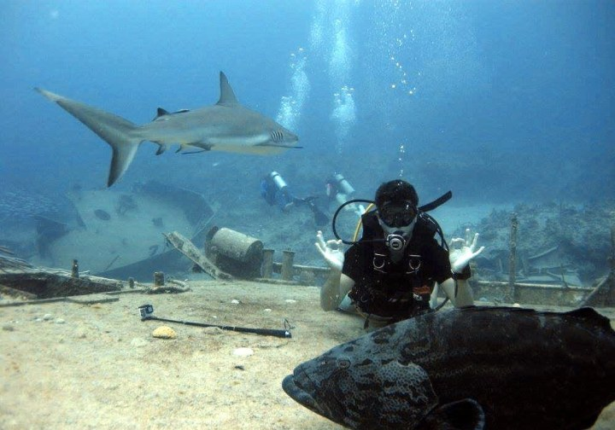
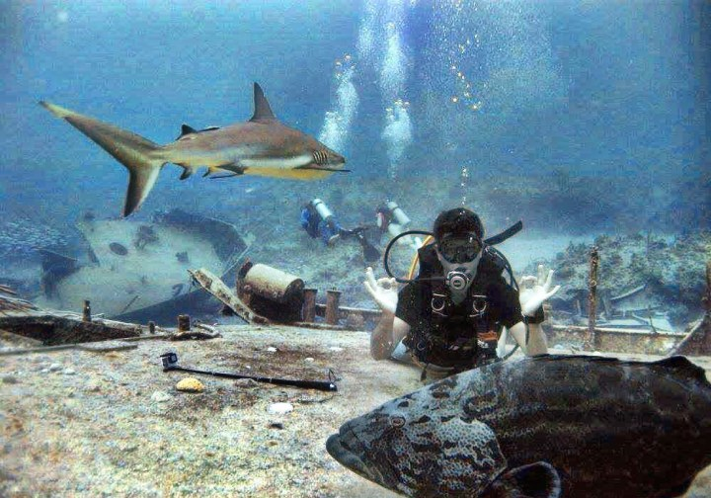
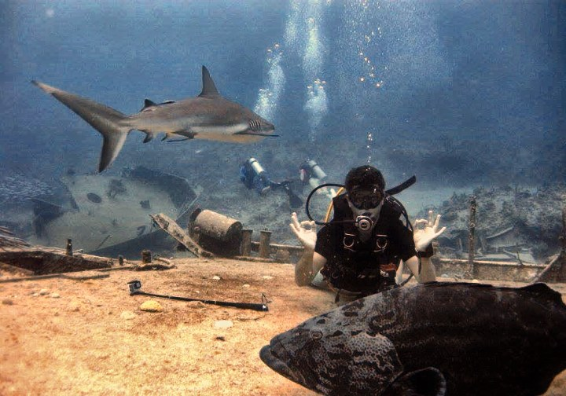
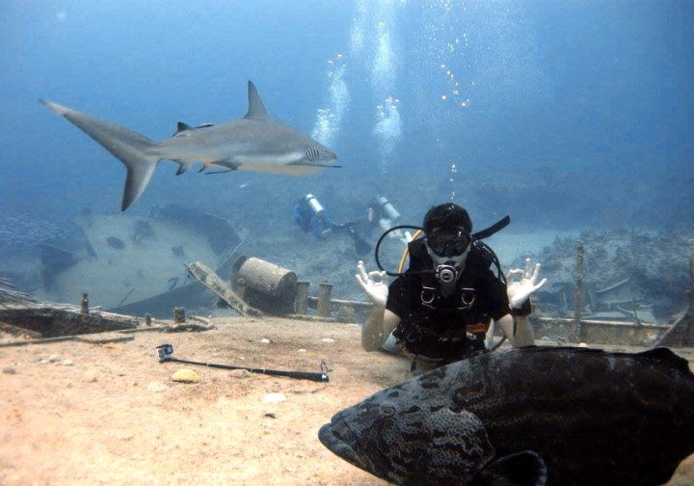

Where it still falls short
Raw
CLAHE-only
Proposed hybrid
UIEB reference
No PSNR gain over CLAHE-only
Routing adds little
Calibration at the grid edge
Level overall (−0.04 dB, negligible, not significant). CLAHE-only scores higher PSNR on 45% of test images, like this clear blue one (17.13 vs 19.24 dB).
A per-image oracle profile would add 1.45 dB over one global profile; four water types capture +0.02 dB of it.
WB cap 1.5, CLAHE × 0.6 and ω 0.5 are the mildest values searched: the references prefer gentler processing than the grid allowed.
Notes:
[Manav · ~1 min]
We want to be upfront about limitations.
First, PSNR: we are level with CLAHE-only overall (−0.04 dB, not a meaningful difference), and CLAHE-only still wins on 45% of test images — like this one, where our restoration drifts from the reference's colours.
Second, routing: there is about 1.45 dB of per-image headroom, and four discrete water types capture only +0.02 dB of it.
Third, calibration chose the mildest values we searched (WB cap 1.5, CLAHE × 0.6 and ω 0.5), so the references prefer gentler processing than our grid allowed.

Slide 16

Rigour: issues we found and fixed
UCIQE on 8-bit Lab
Mis-scaled optimiser
White-balance cap unused
OpenCV's encoding made grey pixels read as chroma ≈181; now computed in true CIELAB.
The objective was ≈49 parts UCIQE to 0.2 UIQM; fixing it exposed the misalignment finding.
The per-type gain cap was defined but never applied; now passed through.
Tuned on the test images
No multiple-comparison control
Gamma convention inverted
Hand-set profiles were judged on the same images; now a held-out 30/70 split.
25 raw p-values; now Holm correction, effect sizes and 95% CIs.
γ was derived for input^γ but applied as input^(1/γ), inverting the adaptivity; fixed and re-calibrated.
Notes:
[Manav · ~1 min]
Before trusting any number, we audited the pipeline and the evaluation and found silent bugs — nothing crashed, the numbers were just wrong.
The most important: UCIQE was computed on OpenCV's 8-bit Lab encoding, which made every grey pixel look highly coloured; and the original optimiser's objective was almost entirely one term. We also stopped tuning on the test images, added multiple-comparison correction, and found an inverted gamma convention — after fixing it we re-ran the whole calibration and evaluation.
Every fix is documented in the results report with before-and-after evidence.

Slide 17

Live demo
1
Compare tab: pick 773_img_ (green turbid) and compare against every method
2
Pipeline tab: walk the stages and drag the α preview slider
3
Toggle Module 5 and Module 7 off and on, watching PSNR/SSIM in the header
Streamlit app
4
Metrics tab: no-reference scores vs. the PSNR/SSIM table
streamlit run app/streamlit_app.py
5
Downstream tab: run ORB keypoint and edge validation
Every metric is computed live on the selected image
6
Switch to 699_img_ (clear blue) to show the limitation
Notes:
[Manav · ~4 min]
[Switch to the browser — the app should already be running and on 773_img_.]
Follow the six steps on the slide; keep it to about four minutes. If the app fails, stay on this deck and use slides 5, 13 and 14 as the visual walkthrough.

Slide 18


Takeaways
Red-channel compensation before white balance is the largest single gain: +0.52 dB PSNR on held-out images.
The full hybrid has the highest SSIM of all compared methods (0.871), matches CLAHE-only on PSNR, and clearly beats HE and UDCP on 622 held-out images.
Optimising no-reference scores hurts fidelity: calibrate against references and report results on held-out data.
Thank you · Questions?
Notes:
[Kopal · ~1 min]
To close, three takeaways. [Read the three lines.]
Thank you — we are happy to take questions. [See docs/PRESENTATION_GUIDE.md for prepared answers.]

