Slide 1
CricSheet
Prepare by : Manav Patel(MD115)

Slide 2
Test Match Data

Slide 3
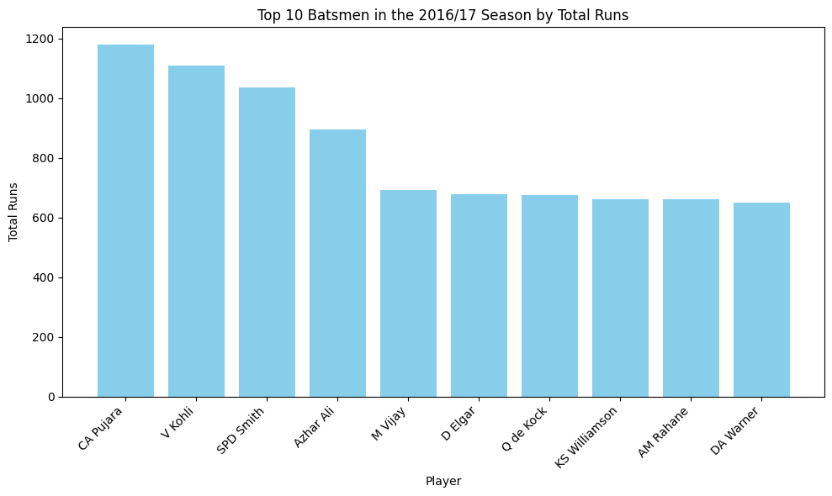
The top 10 batsmen with the highest total runs in the 2016/17 season in Test Cricket.
Indian batsman CA Pujara emerged as the highest run-scorer, followed by Virat Kohli, another Indian batsman.

Slide 4
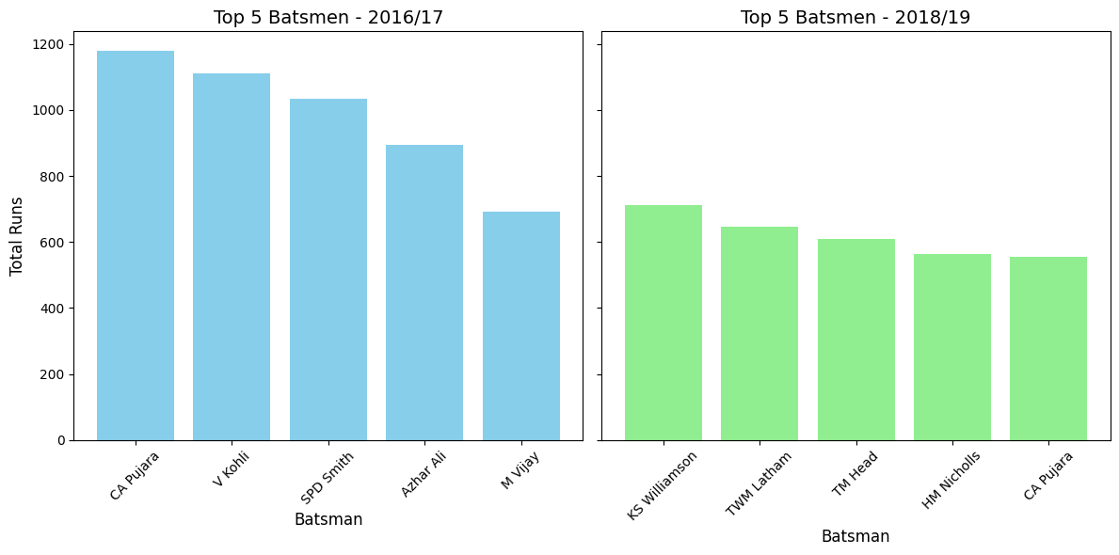
Comparation of the top 5 batsmen based on total runs scored in the seasons 2016/17 and 2018/19.
2016/17 Season: Indian batsman CA Pujara emerged as the highest run-scorer, followed by Virat Kohli, another Indian batsman.
2018/19 Season: New Zealand batsman KS Williamson secured the top spot as the highest run-scorer, with his teammate TWM Latham as the second-highest.

Slide 5
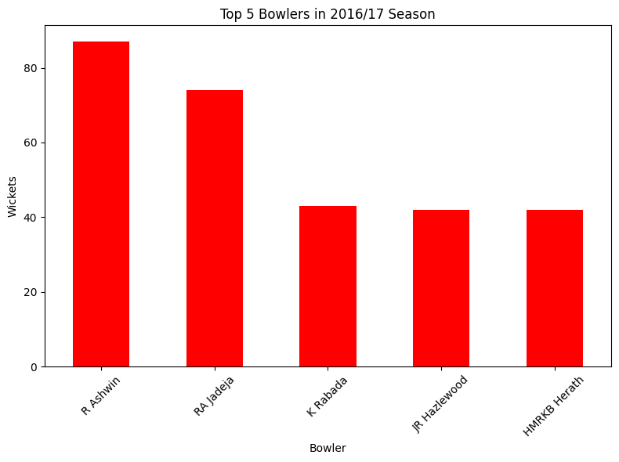
Which bowlers took the most wickets during the 2016/17 season?
Indian bowler R Ashwin emerged as the highest wicket taker, followed by RA Jadeja, another Indian bowler.

Slide 6
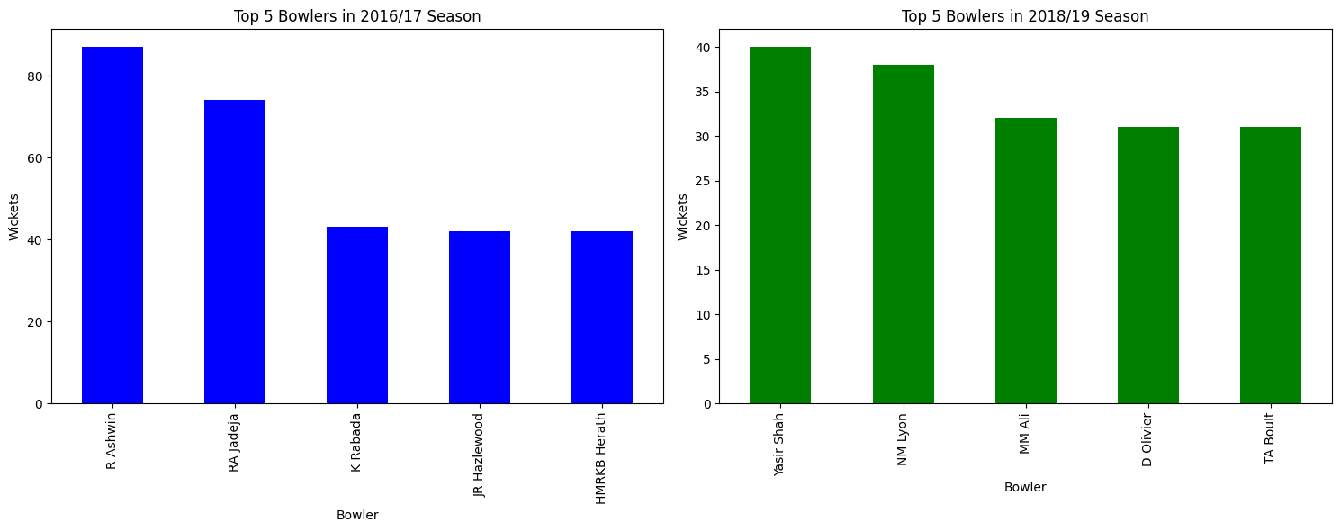
Comparation of the top 5 bowler based on total wicket taker in the seasons 2016/17 and 2018/19.
2016/17 Season: Indian bowler R Ashwin emerged as the highest wicket taker, followed by RA Jadeja, another Indian bowler.
2018/19 Season: Pakistan bowler Yasir Shah secured the top spot as the highest wicket taker, with Australian bowler NM Lyon as the second-highest.

Slide 7
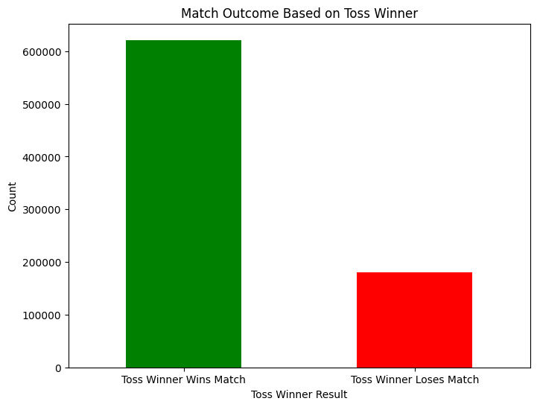
How does winning the toss influence the match outcome?
After analyzing the complete dataset and plotting the graph, it is observed that the toss winner often goes on to win the match. This insight is supported by the graph and can be used for decision-making.

Slide 8
ODI Match Data

Slide 9
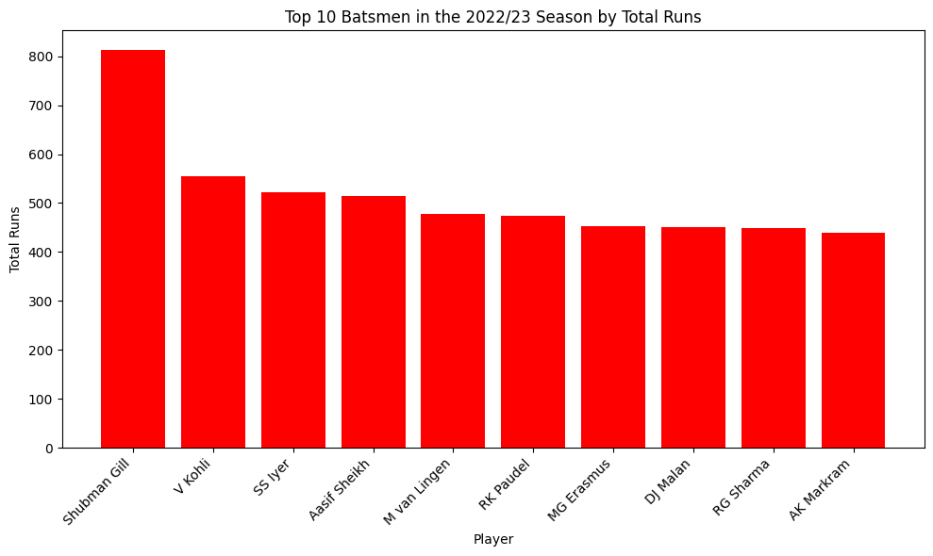
The top 10 batsmen with the highest total runs in the 2022/23 season in ODI Cricket.
Indian batsman Shubman Gill emerged as the highest run-scorer, followed by Virat Kohli, another Indian batsman.

Slide 10
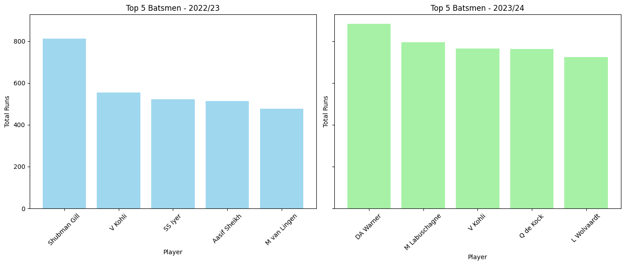
Comparation of the top 5 batsmen based on total runs scored in the seasons 2022/23 and 2023/24.
2022/23 Season: Indian batsman Shubman Gill emerged as the highest run-scorer, followed by Virat Kohli, another Indian batsman.
2023/24 Season: Australian batsman DA Warner secured the top spot as the highest run-scorer, with his teammate M Labuschagne as the second-highest.

Slide 11
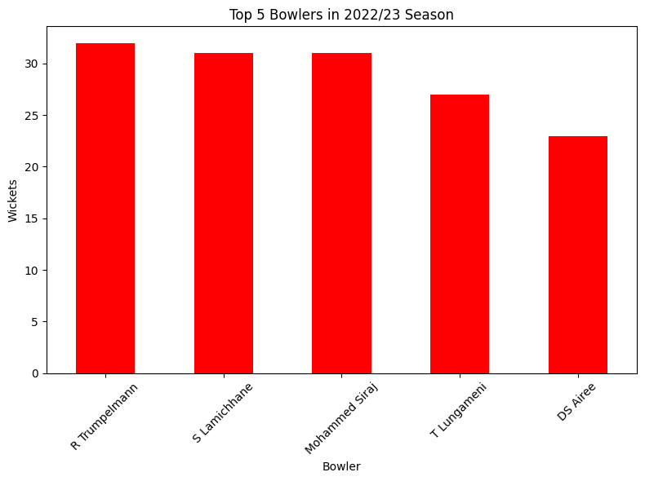
Which bowlers took the most wickets during the 2022/23 season?
Namibia bowler R Trumpelmann emerged as the highest wicket taker, with Nepal Spin bowler S Lamichhane as the second-highest.

Slide 12
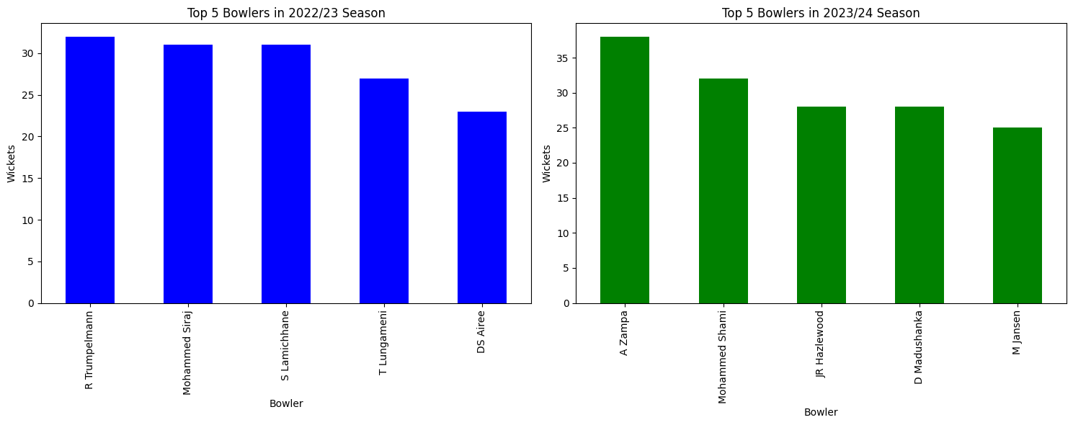
Comparation of the top 5 bowler based on total wicket taker in the seasons 2022/23 and 2023/24.
2022/23 Season: Namibia bowler R Trumpelmann emerged as the highest wicket taker, with Nepal Spin bowler S Lamichhane as the second-highest.
2023/24 Season: Australian Spinner A Zampa secured the top spot as the highest wicket taker, with Indian fast bowler Mohammed Shami as the second-highest.

Slide 13
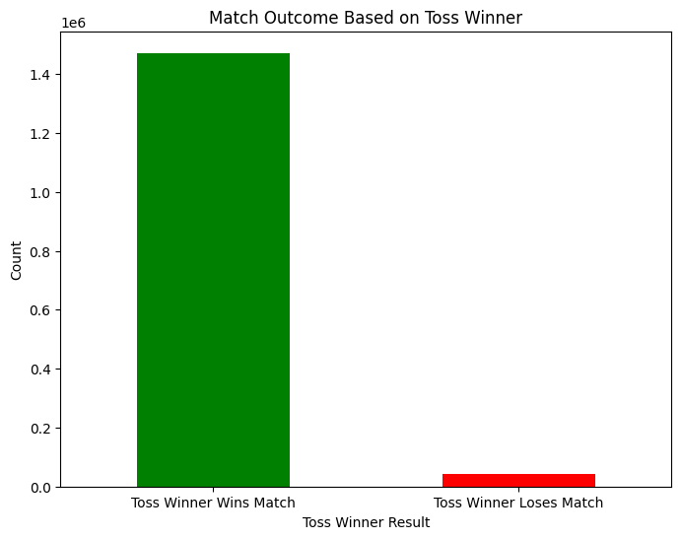
How does winning the toss influence the match outcome?
After analyzing the complete dataset and plotting the graph, it is observed that the toss winner often goes on to win the match. This insight is supported by the graph and can be used for decision-making.

Slide 14
T20s Match Data

Slide 15
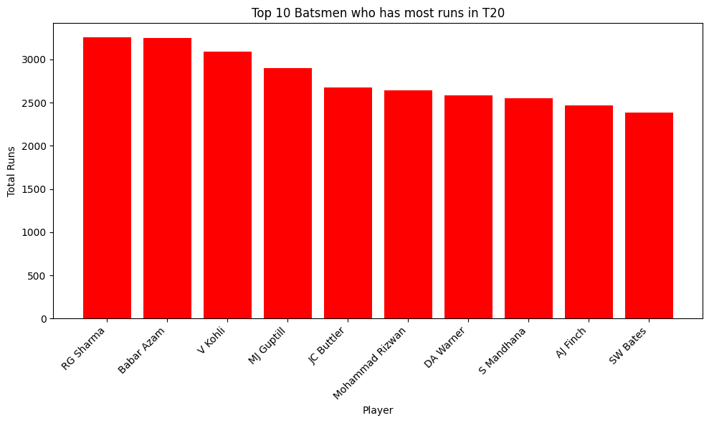
The top 10 batsmen with the highest total runs in T20 Cricket.
Indian batsman RG Sharma secured the top spot as the highest runs scorer in T20 cricket, with Pakistan batsman Babar Azam as the second-highest.
We can see that Indian female batsman S. Mandhana is also among the top 10 highest run scorers in T20 cricket, with nearly 2,500 runs.

Slide 16
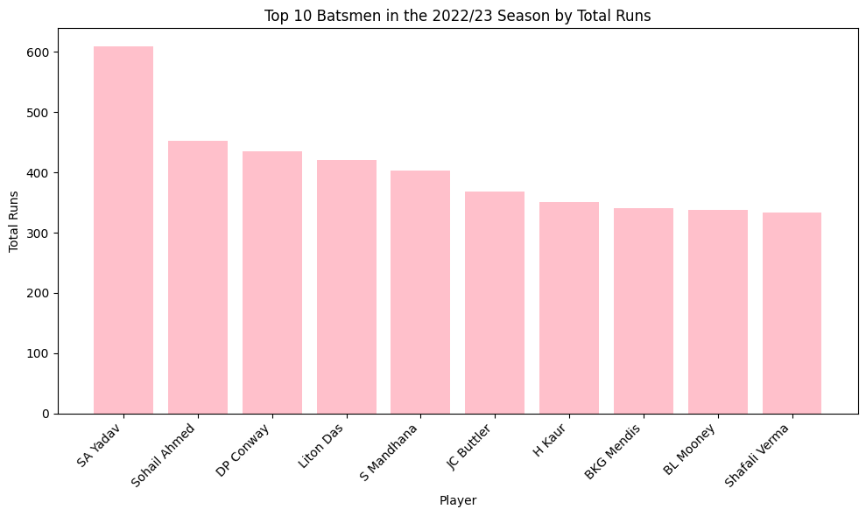
The top 10 batsmen with the highest total runs in the 2022/23 season in T20 Cricket.
Indian batsman SA Yadav secured the top spot as the highest runs scorer in T20 cricket, with Bahrain batsman Sohail Ahmed as the second-highest.
From the graph, we can see that three Indian female batsmen—S. Mandhana, H. Kaur, and Shafali Verma—are among the highest run scorers in the 2022/23 season. Additionally, Australian female batsman B.L. Mooney is also part of this list.

Slide 17
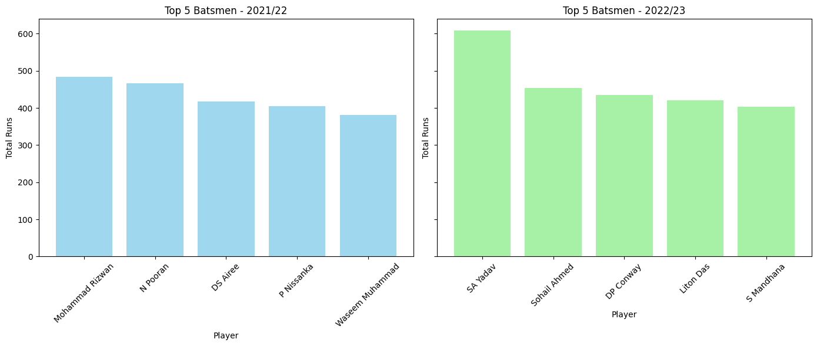
Comparation of the top 5 batsmen based on total runs scored in the seasons 2022/23 and 2023/24.
2021/22 Season: Pakistan batsman Mohammad Rizwan emerged as the highest run-scorer, with West Indies batsman N Pooran as the second-highest
2022/23 Season: Indian batsman SA Yadav secured the top spot as the highest runs scorer in T20 cricket, with Bahrain batsman Sohail Ahmed as the second-highest

Slide 18
Which bowlers took the most wickets during the 2022/23 season?
Namibia bowler R Trumpelmann emerged as the highest wicket taker, with Nepal Spin bowler S Lamichhane as the second-highest.

Slide 19
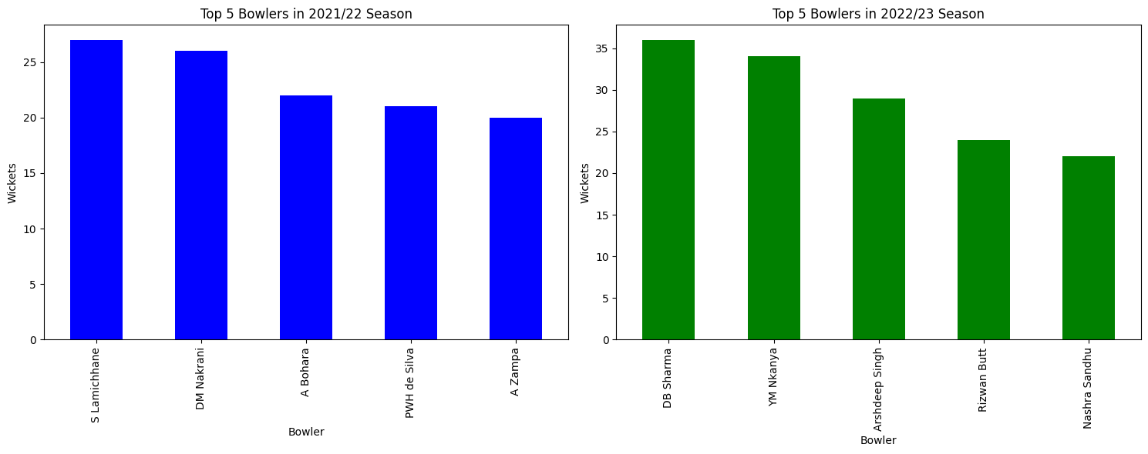
Comparation of the top 5 bowler based on total wicket taker in the seasons 2021/22 and 2022/23.
2021/22 Season: Nepal Spinner S Lamichhane emerged as the highest wicket taker, with Uganda Spin bowler DM Nakrani as the second-highest.
2022/23 Season: Female Indian Spinner DB Sharma secured the top spot as the highest wicket taker, with Tanzania
bowler Yalinde Nkanya the second-highest.

Slide 20
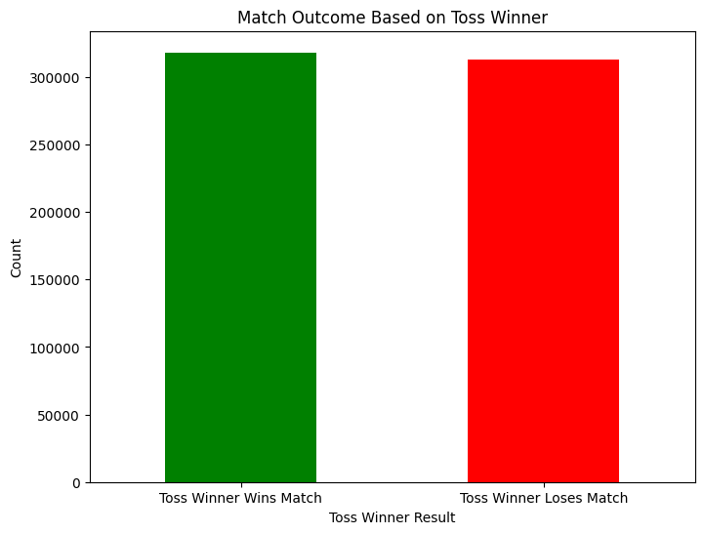
How does winning the toss influence the match outcome?
After analyzing the complete dataset and plotting the graph, it is observed that the toss winner does not significantly impact the match outcome, as the graphs for toss winner winning and losing the match are almost identical. This insight highlights the limited influence of toss results on match decisions.

