Slide 1
Flight Price Prediction (Regression)
Prepared By : Manav Patel (MD115)

Slide 2
The goal of this project is to develop an end-to-end solution for predicting flight ticket prices based on multiple factors such as departure time, source, destination, and airline type.
To achieve this, we will:
Data Processing & Cleaning – Work with a provided dataset, handle missing values, remove inconsistencies, and ensure data quality.
Feature Engineering – Extract meaningful features such as time of the day, day of the week, and airline type to improve model performance.
Model Training – Use regression models to predict flight ticket prices based on the processed features.
Model Tracking – Use Mlflow to track experiments and compare model performance.
Deployment with Streamlit – Build an interactive web application where users can input details like route, departure time, and date to get a predicted ticket price.
Project Title | Flight Price Prediction
Skills Takeaway from this project | Python, NumPy, Pandas, Streamlit, Machine Learning, Mlflow, Exploratory Data Analysis
Domain | Travel and Tourism

Slide 3
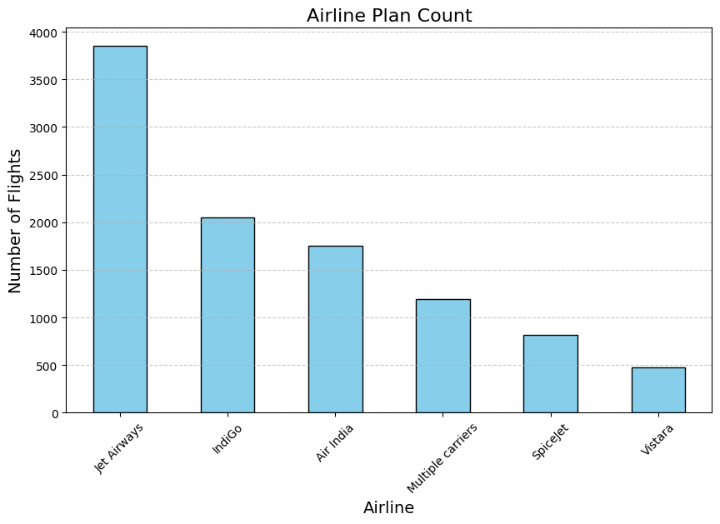
Top 6 Airlines based on the count of flights
According to the bar chart, Jet Airways is the most commonly used airline in India, followed by IndiGo as the second most popular.

Slide 4
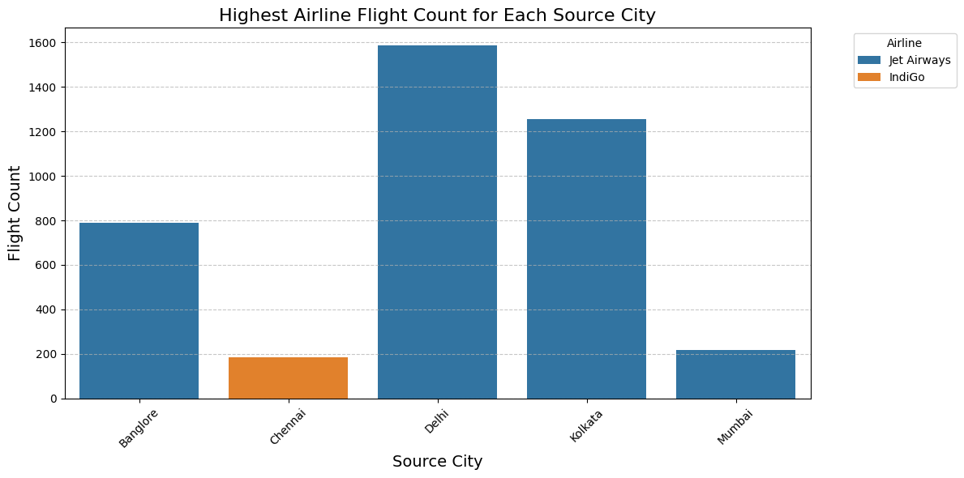
Count of Airline Flight for Each Source City
According to the bar chart, Jet Airways is the most commonly used airline in the source cities, except in Chennai.

Slide 5
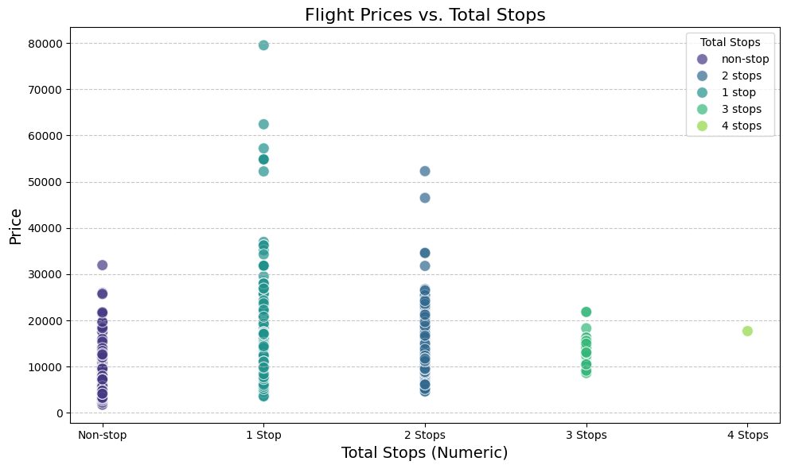
Count of Airline Flight for Each Source City
According to the scatter plot, flights with one stop are more expensive than non-stop flights, and flights with two stops are also pricier than non-stop flights. However, flights with four stops have the lowest prices.

