Slide 1
Passenger Satisfaction (Classification)
Prepared By : Manav Patel(MD115)

Slide 2
The objective of this project is to build a classification model that predicts customer satisfaction levels based on various features such as customer feedback, demographics, and service ratings.
To accomplish this, we will follow these steps:
Data Processing & Cleaning – Work with the provided dataset, handle missing values, remove inconsistencies, and prepare the data for analysis.
Feature Engineering – Extract meaningful features from customer feedback (e.g., sentiment analysis), categorize demographics, and transform service ratings into usable formats.
Model Training – Develop and train a classification model (e.g., Logistic Regression, Random Forest, or Neural Networks) to predict customer satisfaction levels (e.g., "Satisfied," "Neutral," or "Dissatisfied").
Model Evaluation – Assess model performance using accuracy, precision, recall, and other relevant metrics.
Deployment with Streamlit – Create an interactive web application where users can input customer-related details and receive a predicted satisfaction level.
Project Title | Passenger Satisfaction
Skills Takeaway from this project | Python, NumPy, Pandas, Streamlit, Machine Learning, Mlflow, Regression Model Exploratory Data Analysis
Domain | Travel and Tourism

Slide 3
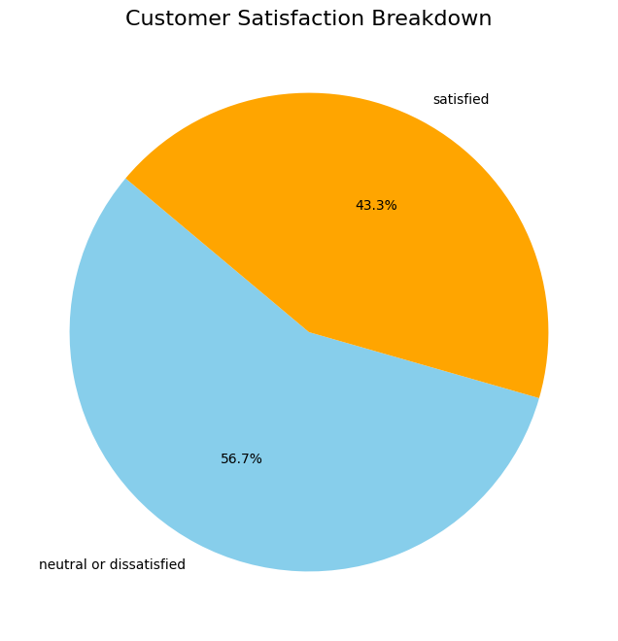
Customer Satisfaction
According to the pie chart, 43.3% of the feedback is classified as satisfied, while 56.7% is neutral or dissatisfied.

Slide 4
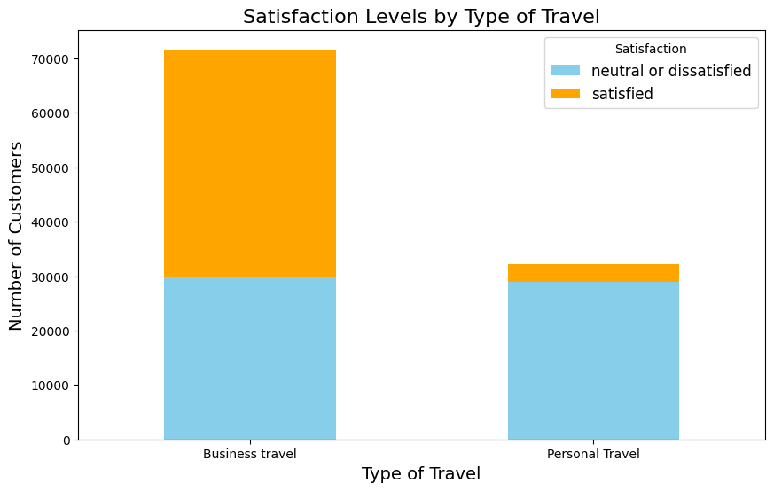
Satisfaction levels by Type of Travel

Slide 5
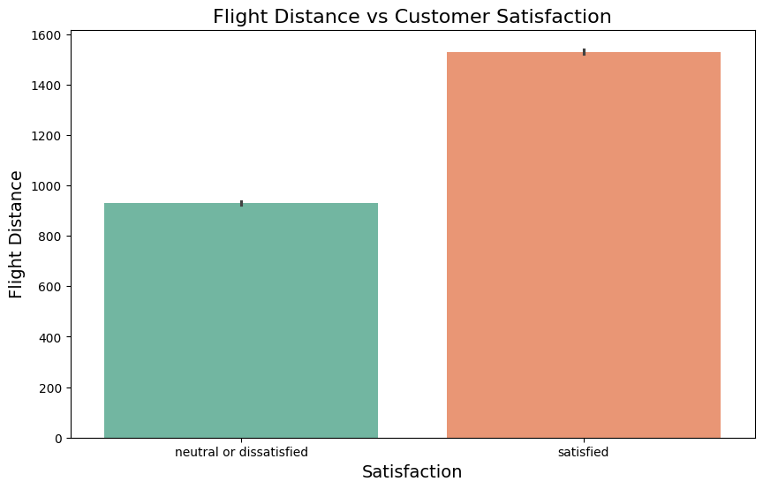
Flight Distance vs Customer Satisfaction

