Slide 1

AEGIS
Self-Healing Multi-Cloud Platform
One application · three cloud free tiers · automatic failover · $0 cost
Final Year Major Project — Evaluation 1
[Your Name] · [College / Department] · August 2026

Slide 2
WHY THIS PROJECT EXISTS
The Problem
▸ One cloud = one point of failure
A single provider outage takes your whole application down — you have no control and no recovery path.
▸ Free tiers are free… but individually unreliable
Google Cloud Run, Oracle Always Free and Render each give real free hosting — but any one of them can sleep, throttle, or go down.
▸ Outages cost money and trust
Downtime means lost users, lost revenue, and damaged reputation — especially for students and early startups with no budget.
▸ Existing solutions are expensive or locked-in
Commercial multi-cloud/DR products cost real money and tie you to one vendor's tooling.

Slide 3
OUR IDEA
Run one app on 3 free tiers — and fail over automatically
1. Deploy the SAME app to 3 clouds' free tiers
Google Cloud Run · Oracle Always Free · Render — zero cost, no code changes (cloud name via env var).
2. Monitor every cloud every 5 minutes
A health monitor polls /health and stores history in Supabase.
3. Route through one smart entry point
A Cloudflare Worker always sends traffic to the healthiest cloud — failover in milliseconds, not minutes.
4. Add an intelligence layer on top
Cost savings, carbon-aware routing, policy-as-code, security scanning, and ML-based predictive failover.
5. Total running cost: $0
Everything runs inside free tiers — the whole point of the project.

Slide 4
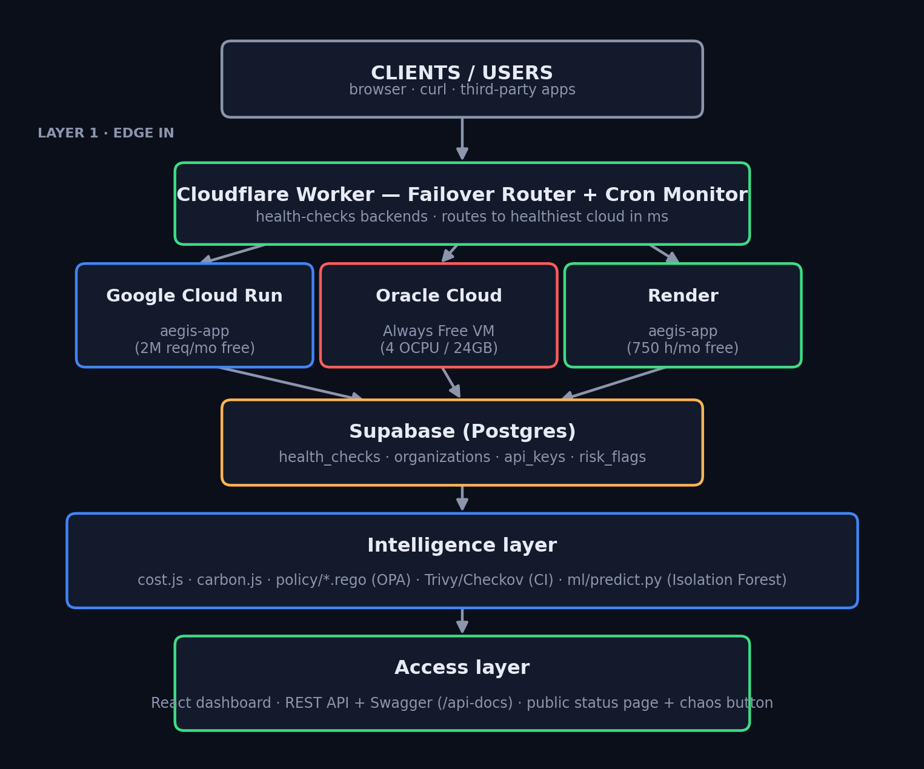
SYSTEM DESIGN
Architecture — 5 layers

Slide 5
PROGRESS — MONTHS 1 TO 3
What's already built
✓ Software Requirements Specification (SRS) + architecture diagrams
✓ Full repo structure + GitHub Projects board (6-month plan)
✓ Core app (Express) with /health contract + Dockerfile
✓ 2 LIVE cloud deployments — Render + Vercel (both free tiers)
✓ https://aegis-platform-pomf.onrender.com/health
✓ https://aegis-platform-lyart.vercel.app/health
✓ FAILOVER ROUTER LIVE — https://aegis-router.manav32478.workers.dev
✓ Health monitor → Supabase (auto-runs every 5 min)
✓ Live status page on every cloud (/status)
✓ CI/CD pipelines: deploy · monitor · security scan · ML
◐ GCP/Oracle optional · ML predictive failover next (Month 4)

Slide 6
THE DEMO
Live: watch failover happen
▶ Open the dashboard
node demo/server.js → localhost:8080 — three clouds, live latency chart.
🔥 Press “Run chaos test”
A random cloud is forced down for 20 seconds.
▶ Watch the router fail over
Traffic instantly moves to the next healthiest cloud — the app never goes down.
▶ Same logic runs in production
The demo router is a direct port of the real Cloudflare Worker (orchestration/router/src/worker.js).

Slide 7
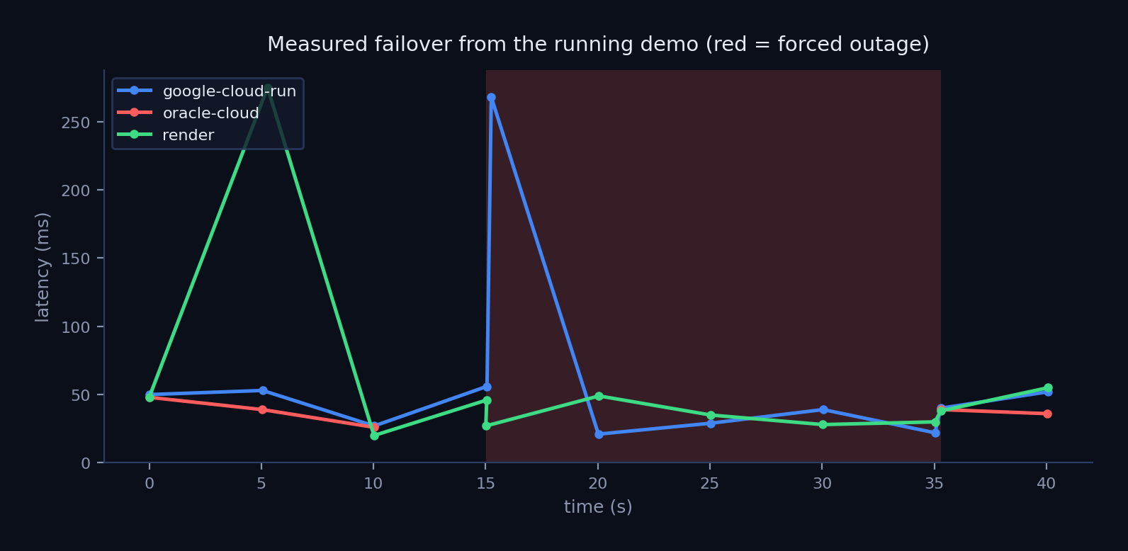
EVIDENCE
Measured failover from the running system

Slide 8
WHERE THIS GOES NEXT
Roadmap — Months 4 to 6
▸ Month 4 — Intelligence layer
Cost intelligence · carbon-aware routing · policy-as-code (OPA) · security scanning (Trivy/Checkov) · ML predictive failover (Isolation Forest).
▸ Month 5 — Product layer
Auth + API keys (Supabase) · REST API with Swagger docs · public status page · load testing with k6.
▸ Month 6 — Hardening & defense
Unit test suite · final report · demo video · viva preparation.
▸ Beyond — startup path
The platform + historical data become the first assets of a real product (Section 7 of the blueprint).

Slide 9
DESIGN DECISIONS
Why we chose these tools
Decision | Why
Cloudflare Workers (not DNS failover) | DNS TTL makes failover take minutes; a Worker retries other backends in milliseconds.
Supabase (Postgres) | Free hosted database + auth; doubles as ML training data.
OPA / Rego policies | Policy decoupled from code — new rules need no app change; auditable.
Isolation Forest (ML) | Adapts to each cloud's normal latency instead of one fixed threshold.
Docker + CI/CD | Identical image on all 3 clouds; every push is scanned and deployed automatically.

Slide 10
Thank you
Questions?

