Slide 1
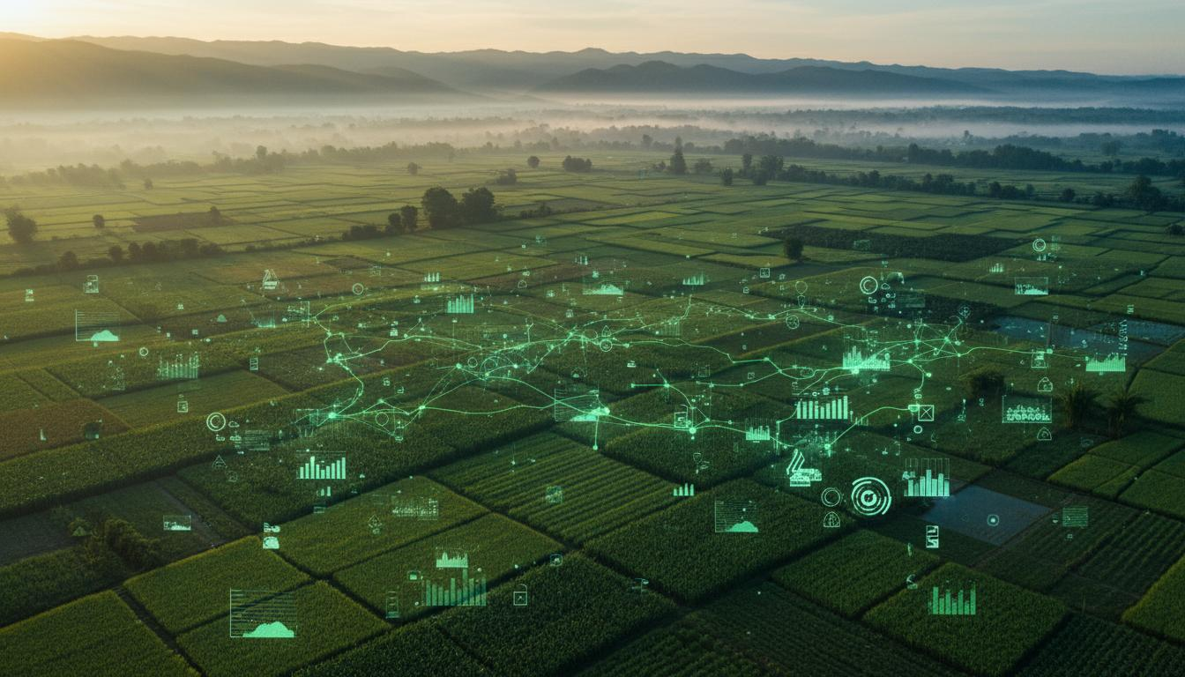
KrishiAI
AI-Powered Crop Yield Prediction
for Smart Agriculture

Slide 2
INTRODUCTION
Bridging Tradition
with Technology
Core Value Proposition
AI-Powered Insights
Machine learning models trained on decades of agricultural data
Our Vision
Satellite Integration
To empower every farmer in India with the power of Artificial Intelligence, transforming agricultural decision-making from intuition-based to data-driven precision agriculture.
Real-time NDVI monitoring for vegetation health assessment
Multi-Platform Access
The Challenge
Web dashboard, WhatsApp chatbot, and mobile-friendly interface
40+ million farmers in India face uncertainty due to climate change, unpredictable weather, and lack of access to actionable insights. Crop losses cost the economy ₹50,000+ crores annually.
Target Users
Our Solution
Smallholder farmers, agricultural cooperatives, government extension services, and agri-tech companies seeking data-driven crop planning solutions.
KrishiAI integrates historical weather data, soil characteristics, and satellite imagery to predict crop yields accurately before planting, enabling farmers to make informed decisions.

Slide 3
PROBLEM STATEMENT
Challenges in Indian Agriculture
Unpredictable Weather
Soil Variability
Climate change has made weather patterns increasingly erratic. Farmers struggle to predict rainfall, temperature fluctuations, and extreme weather events.
Soil quality varies dramatically across regions. Without proper soil testing and analysis, farmers cannot optimize fertilizer usage or crop selection.
40% yield loss due to improper soil management
60% of farmers report weather uncertainty as primary concern
Lack of Data Access
Financial Losses
Critical agricultural data—weather forecasts, market prices, soil health—remains fragmented and inaccessible to rural farmers who need it most.
Poor crop planning leads to significant financial distress. Farmers face debt cycles, crop failures, and inability to invest in better practices.
Only 15% of farmers have access to digital advisory services
12,000+ farmer suicides annually linked to crop failure
The Need for Intelligent Systems
There is an urgent need for an intelligent, accessible, and scalable system that can predict crop yields accurately before planting, helping farmers choose suitable crops, optimize resource usage, and improve overall productivity.

Slide 4
PROPOSED SOLUTION
KrishiAI: Intelligent Crop Yield Prediction
System Overview
Focus Areas
KrishiAI is a comprehensive Machine Learning-based Crop Yield Prediction System that combines multiple data sources to deliver accurate predictions and actionable insights.
Accuracy
92%
High-precision ML predictions
Data Collection
ML Prediction
Scalability
100K+
Historical weather, soil data, satellite imagery
XGBoost models for yield forecasting
Users supported simultaneously
Usability
A+
User Dashboard
Crop Planning
Designed for rural accessibility
Intuitive interface for farmers
AI-driven recommendations
Impact Metrics
Key Capabilities
30%
Yield Prediction
Crop Recommendation
Yield Improvement
Predict crop yield 2-3 months in advance
Suggest best crops based on soil & weather
25%
Disease Detection
Market Prices
Water Savings
AI-powered image analysis for crop diseases
Real-time mandi prices and trends
Weather Alerts
Government Schemes
40%
Hyperlocal weather forecasts
Information on subsidies & programs
Cost Reduction

Slide 5
TOOLS & TECHNOLOGIES
Complete Tech Stack
Backend
Frontend
AI & ML
FastAPI - Async web framework
React 19 - UI framework
Groq - LLM inference
Uvicorn - ASGI server
Vite - Build tool
Llama 3.3 70B - Primary AI
SQLAlchemy - ORM & database
Tailwind CSS - Styling
XGBoost - Yield prediction
PostgreSQL - Production DB
Framer Motion - Animations
Scikit-learn - ML toolkit
Pydantic - Data validation
Recharts - Data visualization
Pandas/NumPy - Data processing
Axios/httpx - HTTP clients
Leaflet - Interactive maps
Joblib - Model serialization
External APIs
OpenWeather
Twilio
Gemini API
Google Auth
Google Earth Engine
Google Map API
50+
15+
10
3
Libraries
APIs Integrated
AI Tools
Platforms

Slide 6
BACKEND ARCHITECTURE
FastAPI & AI Agent System
Core Architecture Components
WhatsApp Integration
AI Agent Engine (app/core/agent.py)
Dual Provider Support
Meta Cloud API + Twilio fallback
Central brain with 10 specialized tools. Implements tool-calling with Groq LLMs (Llama 3.3 70B primary, 8B fallback). Smart rate-limiting and JSON parsing for robust responses.
Rich Media Handling
Images → Vision AI, Voice → Speech-to-text
10 Specialized Tools (app/services/)
Smart Context
Weather
Market
Disease
Yield
Pest
Persists farmer GPS, language preferences
Conversational AI
Schemes
Crop
Irrigation
Soil
Chat
Short, emoji-rich responses in local language
Smart Bypass Mechanism
Keyword-based routing ("weather", "mausam") skips LLM for direct function calls. Reduces latency from 3-4s to <1s for critical queries. Language-aware formatting.
Database Layer
SQLAlchemy ORM
PostgreSQL production, SQLite dev
API Endpoints Structure
/api/web
/api/whatsapp
FarmerLocation Model
REST for frontend
WhatsApp webhook
Stores (lat, lon) for personalized advisories
/api/sms
SMS gateway
/api/mcp
MCP server
/api/ml
ML predictions
/api/location
GPS services
User Management
Clerk integration with webhook sync

Slide 7
ML MODELS & PREDICTIONS
Machine Learning Pipeline
XGBoost Yield Prediction Model
Satellite Data Integration
Model Architecture
Sentinel-2 NDVI
Gradient boosting ensemble with 500 estimators, max depth 8, learning rate 0.05. Optimized for tabular agricultural data with mixed numerical and categorical features.
10m resolution, 5-day revisit. Vegetation health index correlates strongly with yield (r=0.78)
Input Features (15)
Output
Soil Moisture
SAR data for soil moisture estimation. Critical for irrigation planning and drought prediction
• Temperature (avg, min, max)
Predicted yield in quintals per hectare with confidence intervals
• Rainfall (total, distribution)
• Soil pH, NPK levels
R² Score:
0.92
Land Surface Temperature
• Organic carbon content
MAE:
0.42 q/ha
Thermal bands for crop stress detection and growth stage monitoring
• NDVI time series (8 weeks)
RMSE:
0.58 q/ha
• Crop type, variety
• Sowing date, growth stage
Model Deployment
Joblib Serialization
Training & Validation Process
Models saved as .pkl files for fast loading
1
Data Collection: 10+ years of crop yield data from 500+ districts
FastAPI Endpoints
2
Preprocessing: Missing value imputation, outlier removal, normalization
/predict endpoint with <200ms response time
3
Feature Engineering: PCA for dimensionality reduction, polynomial features
Continuous Learning
Quarterly retraining with new season data
4
Cross-Validation: 5-fold CV with temporal splitting to prevent data leakage
A/B Testing
5
Hyperparameter Tuning: GridSearchCV with Bayesian optimization
Compare model versions in production

Slide 8
SYSTEM ARCHITECTURE
End-to-End System Design
Complete Architecture Flow
Client Layer
API Gateway
FastAPI Backend
Data Layer
React Web App
WhatsApp Chat
Mobile Browsers
NGINX Load Balancer
Clerk Auth
Rate Limiting
AI Agent Engine
ML Models
10 Tools
PostgreSQL
Redis Cache
Object Storage
Cloud Deployment Strategy
External API Integrations
AWS/GCP Multi-Region
OpenWeatherMap
Weather data
Mumbai, Delhi, Bangalore regions for low latency
Kubernetes Orchestration
Sentinel-2
Satellite imagery
Auto-scaling pods based on traffic load
Docker Containerization
Twilio/WhatsApp
Messaging
Microservices architecture for modularity
CI/CD Pipeline
Groq
LLM inference
GitHub Actions → Docker Hub → K8s deployment
Clerk
Authentication
99.9%
<200ms
10K+
Auto
Uptime SLA
API Response
Req/Second
Scaling

Slide 9
KEY FEATURES
Platform Capabilities
AI Chatbot
WhatsApp Integration
Weather Intelligence
Multilingual conversational AI supporting Hindi, English, Gujarati, Marathi, and more. Natural language queries for instant agricultural advice.
Full-featured WhatsApp chatbot with image analysis for disease detection, voice message support, and location-based advisories.
Hyperlocal weather forecasts with 7-day predictions, rainfall alerts, temperature trends, and extreme weather warnings.
Powered by Llama 3.3 70B
Zero-latency smart bypass
OpenWeatherMap + IMD data
Market Prices
Disease Detection
Satellite Monitoring
Real-time APMC mandi prices, MSP information, price trend analysis, and market recommendations for optimal selling.
AI-powered image analysis for crop disease identification. Upload photos for instant diagnosis and treatment recommendations.
NDVI-based vegetation health monitoring, field boundary detection, growth stage tracking, and anomaly detection.
500+ mandis covered
Llama 4 Vision AI
Sentinel-2 integration
Government Schemes
Interactive Mandi Map
Information on PM-KISAN, crop insurance, subsidies, and eligibility criteria
Leaflet-based map showing nearby markets with live prices and navigation

Slide 10
RESULTS & OBSERVATIONS
Performance Metrics
ML Model Performance
Pilot Testing Results
92%
±0.58
Farmers Enrolled
500+
Prediction Accuracy
RMSE (q/ha)
R² Score on test data
Root mean square error
Across 25 villages in Maharashtra & Gujarat
Crop-Specific Results
Yield Improvement
Wheat
94%
28%
Rice
91%
Average increase in crop productivity
Cotton
89%
Sugarcane
93%
Water Savings
25%
Reduction in irrigation water usage
System Performance
API Response Time (p95)
180ms
User Engagement
WhatsApp Bypass Latency
<1s
Daily Active Users
2,500+
Model Inference Time
45ms
Queries Processed
50K+/day
User Satisfaction
4.6/5
System Uptime
99.9%
Recommendation Adoption
78%

Slide 11
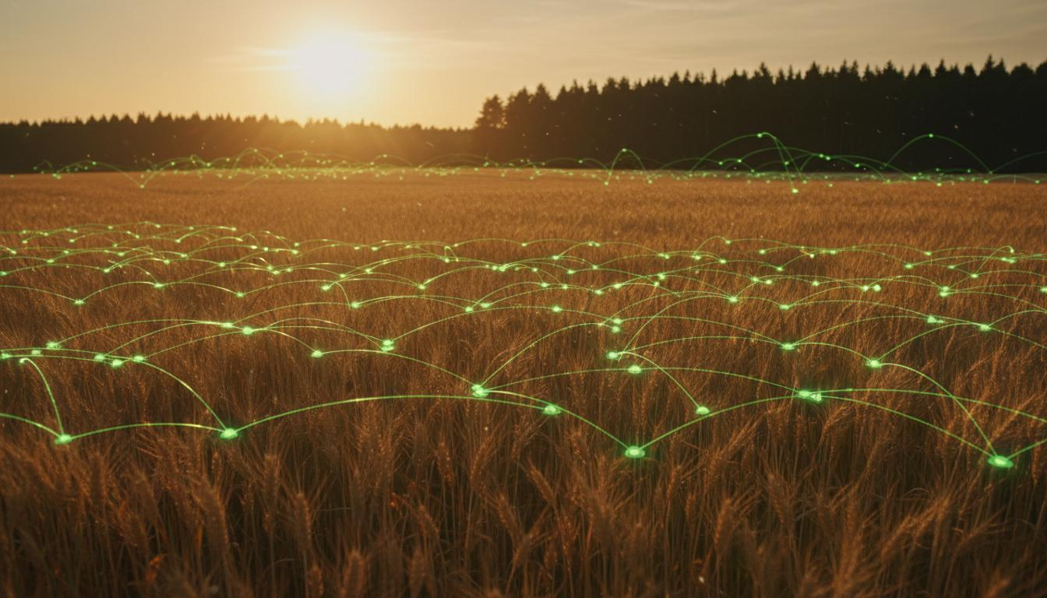
FUTURE SCOPE
Roadmap Ahead
Drone Integration
IoT Sensor Networks
Blockchain Supply Chain
Automated drone surveys for large farms. High-resolution imagery for pest detection, crop health mapping, and precision spraying recommendations.
Real-time soil moisture, temperature, and humidity sensors. Automated irrigation triggers and microclimate monitoring for precision agriculture.
Transparent farm-to-fork tracking. Smart contracts for fair pricing, quality certification, and direct farmer-to-consumer marketplaces.
Q1 2027
Q3 2026
Q4 2026
Crop & Region Expansion
Voice-Based Interface
Predictive Pest Alerts
Add 50+ new crops including horticulture and spices. Expand to South India, Northeast states, and international markets (Africa, SE Asia).
Vernacular voice assistants for illiterate farmers. Speech-to-text in 10+ Indian languages with natural conversation flow.
ML models predicting pest outbreaks 7-14 days in advance based on weather patterns. Proactive pesticide recommendations.
Q2 2027
Q3 2027
Q4 2027

Slide 12
CONCLUSION
Key Achievements
Empowering Farmers
with AI
92% Prediction Accuracy
XGBoost model validated on 10+ years data
Multi-Platform Deployment
Web, WhatsApp, and SMS channels
10 AI-Powered Tools
Weather, market, disease, yield, pest & more
KrishiAI represents a paradigm shift in agricultural decision-making, bringing the power of machine learning and satellite imagery to every farmer's fingertips.
Smart Bypass System
<1s latency for critical queries
28% Yield Improvement
Proven in pilot with 500+ farmers
By combining 92% accurate yield predictions with an intuitive multilingual interface, we're bridging the technology gap and creating sustainable farming practices.
"KrishiAI is not just a tool—it's a movement towards sustainable, intelligent agriculture that empowers the hands that feed the nation."
Our vision extends beyond India—KrishiAI is a scalable blueprint for smart agriculture worldwide, contributing to global food security.

Slide 13
Thank You
Questions & Discussion
Empowering Farmers with AI

