Slide 1
Junit

Slide 2
Day - 1

Slide 3
Unit Testing
A unit test is a way of testing a unit - the smallest piece of code that can be logically isolated in a system.
A unit test is a piece of code written by a developer that executes a specific functionality in the code to be tested and asserts a certain behavior or state.
In most programming languages, that is a function, a subroutine, a method or property.
Generally programmers implement the unit tests

Slide 4
Purpose of the unit tests
To identify software regressions introduced by changes in the source code
It helps the developer to avoid breaking existing code during development activities

Slide 5
Testing terminology
The code which is tested is typically called the code under test. If you are testing an application, this is called the application under test.

Slide 6
Junit annotations
@Test | Identifies a method as a test method.
@Before | Executed before each test. It is used to prepare the test environment (e.g., read input data, initialize the class).
@After | Executed after each test. It is used to cleanup the test environment (e.g., delete temporary data, restore defaults). It can also save memory by cleaning up expensive memory structures.
@BeforeClass | Executed once, before the start of all tests. It is used to perform time intensive activities, for example, to connect to a database. Methods marked with this annotation need to be defined as static to work with JUnit.
@AfterClass | Executed once, after all tests have been finished. It is used to perform clean-up activities, for example, to disconnect from a database. Methods annotated with this annotation need to be defined as static to work with JUnit.

Slide 7
Junit annotations
@Ignore or @Ignore("Why disabled") | Marks that the test should be disabled. This is useful when the underlying code has been changed and the test case has not yet been adapted. Or if the execution time of this test is too long to be included. It is best practice to provide the optional description, why the test is disabled.
@Test (expected = Exception.class) | Fails if the method does not throw the named exception.
@Test(timeout=100) | Fails if the method takes longer than 100 milliseconds.

Slide 8
Assert class
The org.junit.Assert class provides methods to assert the program logic.
The common methods of Assert class are as follows:
void assertEquals(boolean expected,boolean actual): checks that two primitives/objects are equal. It is overloaded.
void assertTrue(boolean condition): checks that a condition is true.
void assertFalse(boolean condition): checks that a condition is false.
void assertNull(Object obj): checks that object is null.
void assertNotNull(Object obj): checks that object is not null.

Slide 9
Jar Files for Junit framework
You need to load junit4.jar and hamcrest-core.jar files in your IDE in order to use the annotations and assert class methods. Click here to download the required jar files.

Slide 10
Ref. Links
Links
https://www.tutorialspoint.com/junit/index.htm
https://www.youtube.com/watch?v=o5k9NOR9lrI
https://www.javatpoint.com/junit-tutorial
https://dzone.com/articles/junit-tutorial-beginners

Slide 11
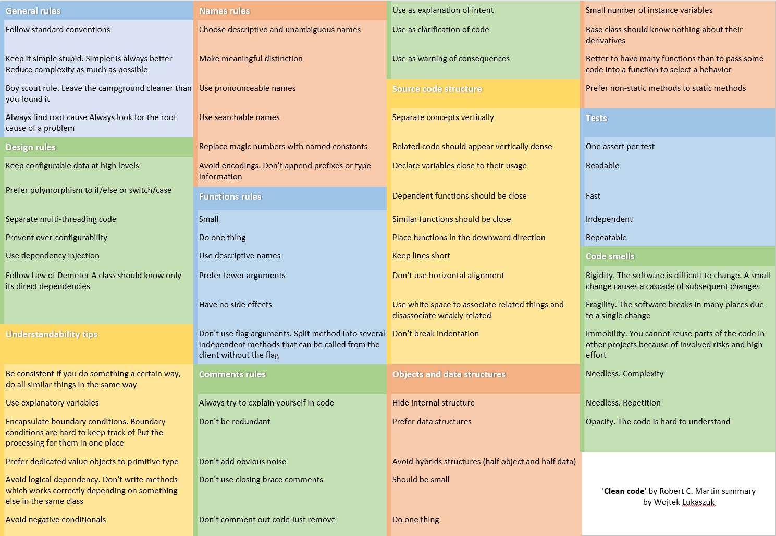
Coding Standards

Slide 12
Handson Day 1
Import the above attached Junit.zip project into the eclipse.
(positive and negative) for all the methods present in Helper.java
Cover all the methods and conditions as part of code coverage

Slide 13
Day - 2

Slide 14
Mockito Framework

Slide 15
What is Mockito Framework
Java based Mocking framework
Mockito is used to mock interfaces/Classes so that a dummy functionality can be added to a mock interface/class that can be used in unit testing
Mocking: Mocking is a way to test the functionality of a class in isolation
Mock objects do the mocking of the real service.
Mock object is a dummy implementation for an interface or a class

Slide 16
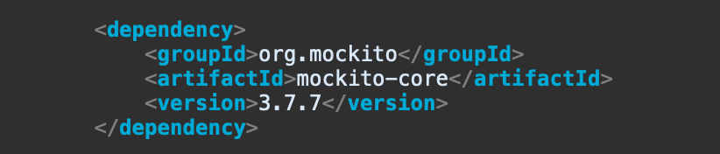
Adding Mockito to a project

Slide 17
Mockito Important Methods
mock() , @mock
when()
thenReturn()
thenThrow()
verify()
spy()
Notes:
mock(): It is used to create mock objects of a concrete class or an interface.
when(): when() is used when we want to add dummy state in mock object
thenReturn(): its used with when() and it is used to return the dummy state of mock object
thenThrow(): its used with when() and it is used to throw exception
verify(): verify that the perticular method of mocked class is called or not
spy(): It is used to partially mock the object. it will work as mock object only for specific expectation, in other case it will work as normal object.

Slide 18
Handson Day - 2
Import the above attached mockitosample.zip project into the eclipse.
Write testcases for AuthenticatorApplication class in the handson package.

Slide 19
Limitation of Mockito Framework
In Mockito Framework, we can not mock static, final and private methods.
PowerMockito is an extension API to support Mockito.
Power Mockito provides capabilities to work with the Java Reflection API in a simple way to overcome the problems.
Avoid PowerMockito as much as possible.

