Slide 1
ReactJs

Slide 2
Prerequisite
HTML5
CSS
Basic Javascript -ECMAScript 6
Ref:
https://www.w3schools.com/html/default.asp
https://www.w3schools.com/css/default.asp
https://www.w3schools.com/js/default.asp

Slide 3

What is ReactJS?

Slide 4
What is ReactJS?
ReactJs is a JavaScript library for building fast and interactive user interfaces for the web as well as mobile Applications
!! ReactJs is not a framework !!
It is an open-source, reusable component-based front-end library.
ReactJs was created by Jordan Walke, who was a software Engineer at Facebook.
ReactJs is managed by Facebook now.

Slide 5

Lets see how react works in real-time !

Slide 6

Instagram, AWS are great examples for ReactJs.

Slide 7
Instagram, AWS are great examples for ReactJs.
Profile Description Component
Profile Picture Component
Profile Stories Component

Slide 8

Instagram, AWS are great examples for ReactJs.
Profile Description Component
React divides the UI into multiple components which helps easier in debugging and each component has its own property and function.
Profile Picture Component
Profile Stories Component

Slide 9
Key Features of ReactJs
JSX - JavaScript Syntax Extension
Virtual DOM
Performance
One-way data binding
Extensions
Debugging

Slide 10
Day 1

Slide 11
Agenda Day - 1
Overview of Tools:
Babel
Webpack
Npm
Npx
React App Setup:
Using create-react-App
From Scratch

Slide 12
Overview of Tools
Babel
Babel is a JavaScript compiler, a toolchain that is mainly used to convert ECMAScript 2015+ code into a backwards compatible version of JavaScript in current and older browsers or environments.
Ref: https://babeljs.io/
Webpack
At its core, webpack is a static module bundler for modern JavaScript applications. When webpack processes your application, it internally builds a dependency graph which maps every module your project needs and generates one or more bundles.
Ref: https://webpack.js.org/
Notes:
Day 1 & 2:
Introduction
Project Setup using CLI & Webpack

Slide 13
Overview of Tools
Npm & Npx
https://nodejs.org/en/download/
https://www.geeksforgeeks.org/what-are-the-differences-between-npm-and-npx/
Ref:
https://reactjs.org/tutorial/tutorial.html#what-is-react
https://reactjs.org/docs/getting-started.html
Notes:
Day 1 & 2:
Introduction
Project Setup using CLI & Webpack

Slide 14
React App Setup
Using create-react-app (CLI) - https://reactjs.org/docs/create-a-new-react-app.html.
From Scratch - https://www.codementor.io/@rajjeet/step-by-step-create-a-react-project-from-scratch-11s9skvnxv
Notes:
Day 1 & 2:
Introduction
Project Setup using CLI & Webpack

Slide 15
Hands On Day - 1
Environment setup for React application.
Create a React application using npx and create-react-app from scratch.
Run in dev mode and create builds with different webpack and configurations.
Run in production mode and test builds with different webpack and configurations.

Slide 16
Day 2

Slide 17
Agenda Day - 2
Hello World program
Introducing JSX
Rendering Elements

Slide 18
Hello World program
https://reactjs.org/docs/hello-world.html
Introducing JSX
JSX stands for JavaScript XML.
JSX allows us to write HTML elements in JavaScript and place them in the DOM without any createElement() and/or appendChild() methods.
After compilation, JSX expressions become regular JavaScript function calls and evaluate to JavaScript objects.
This means that you can use JSX inside of if statements and for loops, assign it to variables, accept it as arguments, and return it from functions:
Ref: https://reactjs.org/docs/introducing-jsx.html
Notes:
Day 3 (Basics)

Slide 19
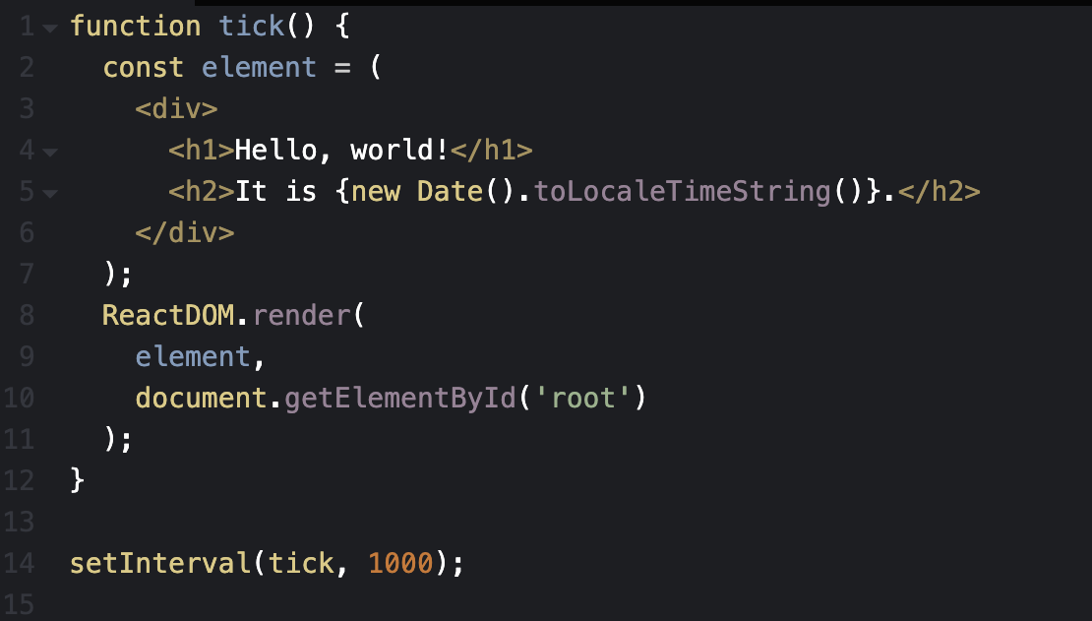

Rendering Elements
https://reactjs.org/docs/rendering-elements.html
Elements are the smallest building blocks of React apps.
Here in the example `element` will be the render by `ReactDOM.render()` method.
We call this HTML, a “root” DOM node because everything inside it will be managed by React DOM.
React DOM compares the element and its children to the previous one, and only applies the DOM updates necessary to bring the DOM to the desired state.
Notes:
Day 3 (Basics)

Slide 20
Hands On Day - 2
Build a login form in App.js using React elements and JSX.

Slide 21
Day 3

Slide 22
Agenda Day - 3
States’ Life cycle
Components and Props

Slide 23
States’ Life cycle methods
Mounting
These methods are called in the following order when an instance of a component is being created and inserted into the DOM:
constructor()
static getDerivedStateFromProps()
render()
componentDidMount()
Ref: https://reactjs.org/docs/react-component.html
Notes:
Day 4 (Basics)

Slide 24
States’ Life cycle methods
Updating
An update can be caused by changes to props or state. These methods are called in the following order when a component is being re-rendered:
static getDerivedStateFromProps()
shouldComponentUpdate()
render()
getSnapshotBeforeUpdate()
componentDidUpdate()
Unmounting
This method is called when a component is being removed from the DOM:
componentWillUnmount()
Ref: https://reactjs.org/docs/react-component.html
Notes:
Day 4 (Basics)

Slide 25
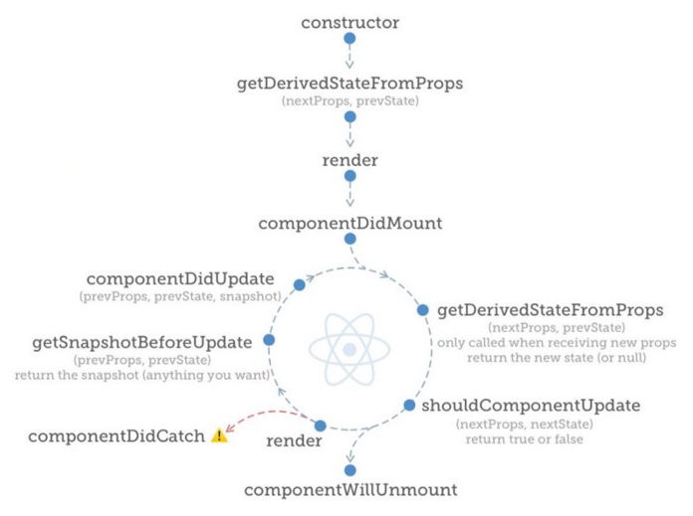
States’ Life cycle methods
Notes:
Day 4 (Basics)

Slide 26
Components and Props
Components let you split the UI into independent, reusable pieces, and think about each piece in isolation. This page provides an introduction to the idea of components. You can find a detailed component API reference here.
Conceptually, components are like JavaScript functions. They accept arbitrary inputs (called “props”) and return React elements describing what should appear on the screen.
Ref: https://reactjs.org/docs/components-and-props.html
Notes:
Day 4 (Basics)

Slide 27
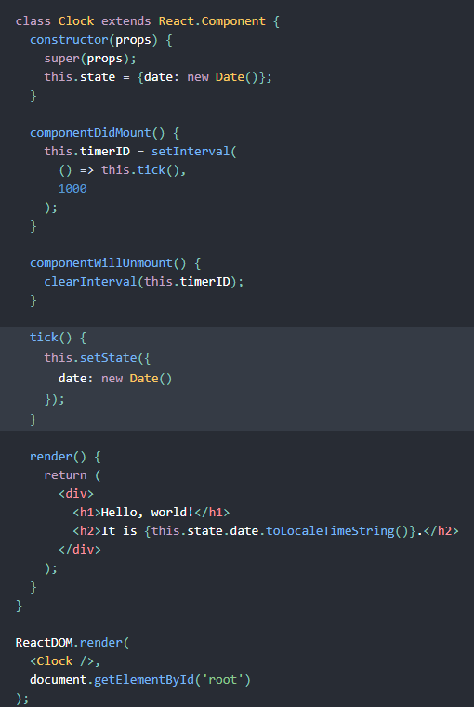
Components and Props
Notes:
Day 4 (Basics)

Slide 28
Hands On Day - 3
Build a login form in App.js using state management.
Build a calculator application.

Slide 29
Day 4

Slide 30
Agenda Day - 4
React Hooks
Handling Events

Slide 31
React Hooks
Basic Hooks
useState
useEffect
useContext
Additional Hooks
useReducer
useCallback
useMemo
useRef
useLayoutEffect
Ref: https://reactjs.org/docs/hooks-intro.html
Notes:
Day 4 (Basics)

Slide 32
Handling Events
Handling events with React elements is very similar to handling events on DOM elements. There are some syntax differences:
React events are named using camelCase, rather than lowercase.
With JSX you pass a function as the event handler, rather than a string.
Ref: https://reactjs.org/docs/handling-events.html
Notes:
Day 4 (Basics)

Slide 33
Hands On Day - 4
Build a calculator application with hooks.

Slide 34
Day 5

Slide 35
Agenda Day - 5
Conditional Rendering
Lists and Keys
Forms

Slide 36
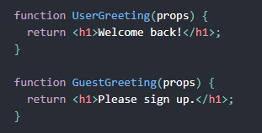
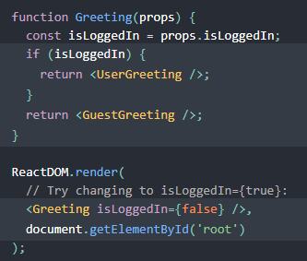
Conditional Rendering:
In React, you can create distinct components that encapsulate behavior you need. Then, you can render only some of them, depending on the state of your application.
Ref: https://reactjs.org/docs/conditional-rendering.html
Notes:
Day 5 (Basics)

Slide 37
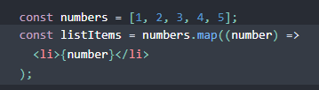
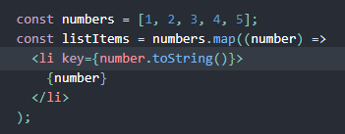
Lists
Lists in react are the same as Arrays in javascript, Here we loop through the numbers array using the JavaScript map() function. We return a <li> element for each item. Finally, we assign the resulting array of elements to list-Items
Keys
Keys help React identify which items have changed, are added, or are removed. Keys should be given to the elements inside the array to give the elements a stable identity:
Ref: https://reactjs.org/docs/lists-and-keys.html
Notes:
Day 5 (Basics)

Slide 38
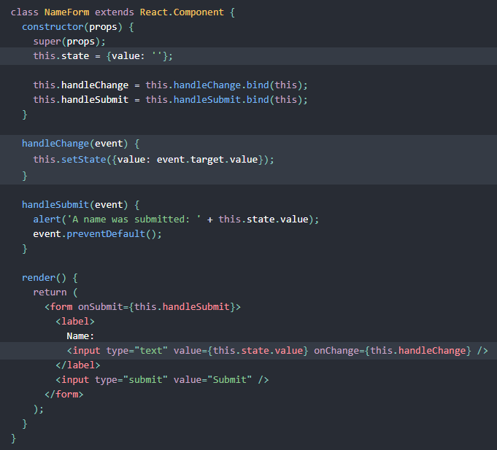
Forms
In HTML, form elements such as <input>, <textarea>, and <select> typically maintain their own state and update it based on user input. In React, mutable state is typically kept in the state property of components, and only updated with setState().
Ref: https://reactjs.org/docs/forms.html
Notes:
Day 5 (Basics)

Slide 39
Hands On Day - 5
Create a To-do list.
Build a registration page using react forms.

Slide 40
Day 6

Slide 41
Agenda Day - 6
Lifting State Up
Composition
Inheritance
Fragments

Slide 42
Lifting State Up, Composition vs Inheritance, Fragments
Lifting State Up
Sharing state is accomplished by moving it up to the closest common ancestor of the components that need it. This is called “lifting state up”.
Ref: https://reactjs.org/docs/lifting-state-up.html
Notes:
Day 6 (Basics)

Slide 43
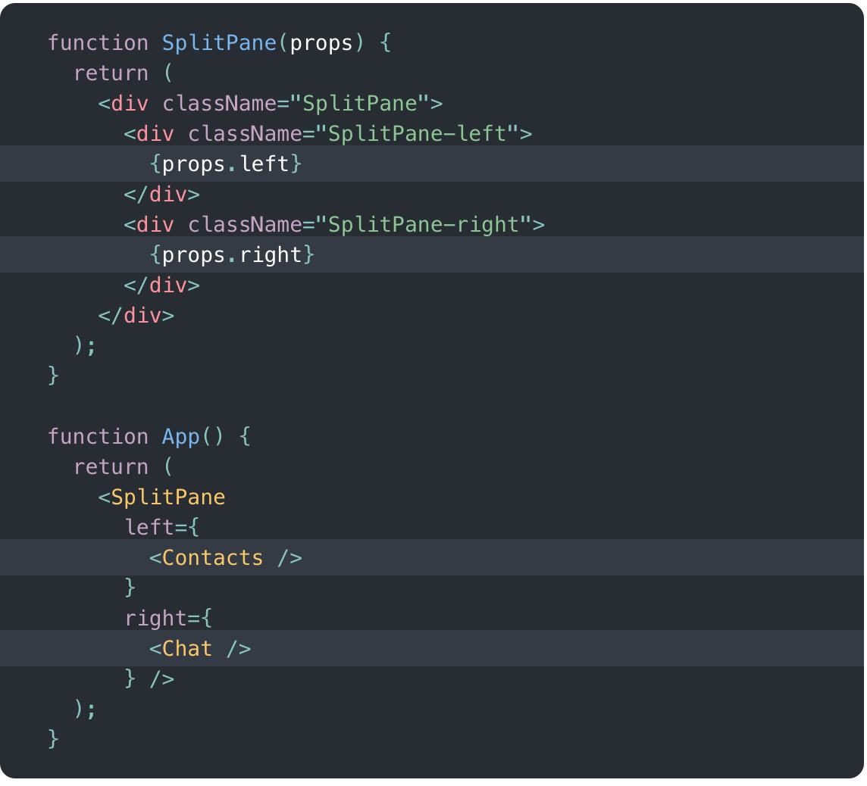
Lifting State Up, Composition vs Inheritance, Fragments
Composition vs Inheritance
React has a powerful composition model, and React community recommend using composition instead of inheritance to reuse code between components.
Ref: https://reactjs.org/docs/composition-vs-inheritance.html
https://akash-mihul.medium.com/inheritance-in-react-components-caaf9d20f249
Composition with component in props
Notes:
Day 6 (Basics)

Slide 44
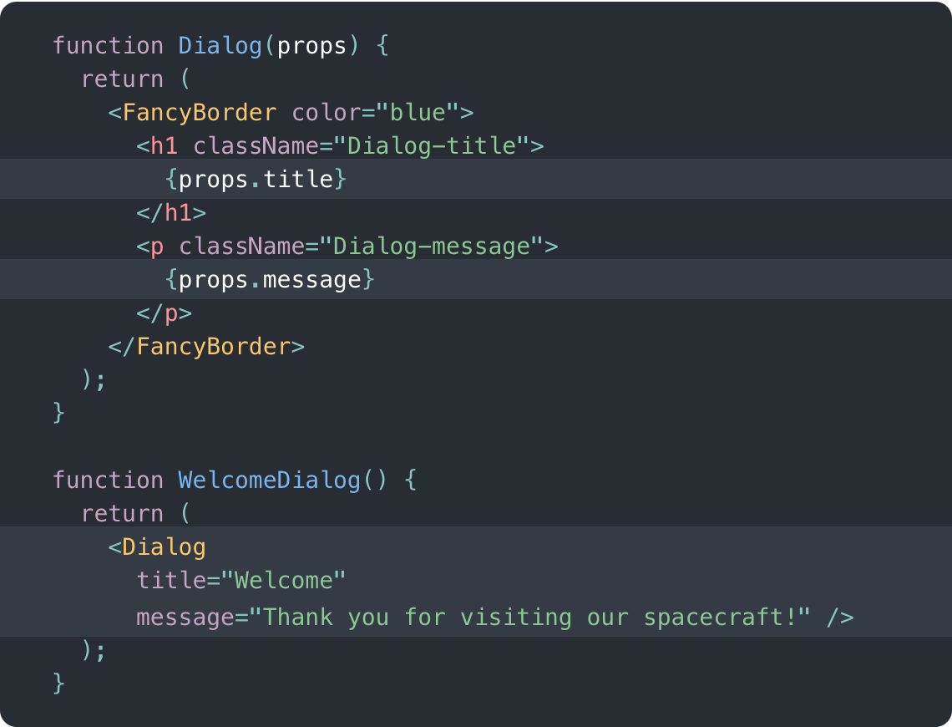
Lifting State Up, Composition vs Inheritance, Fragments
Composition vs Inheritance
React has a powerful composition model, and React community recommend using composition instead of inheritance to reuse code between components.
Ref: https://reactjs.org/docs/composition-vs-inheritance.html
https://akash-mihul.medium.com/inheritance-in-react-components-caaf9d20f249
Composition with value in props
Notes:
Day 6 (Basics)

Slide 45
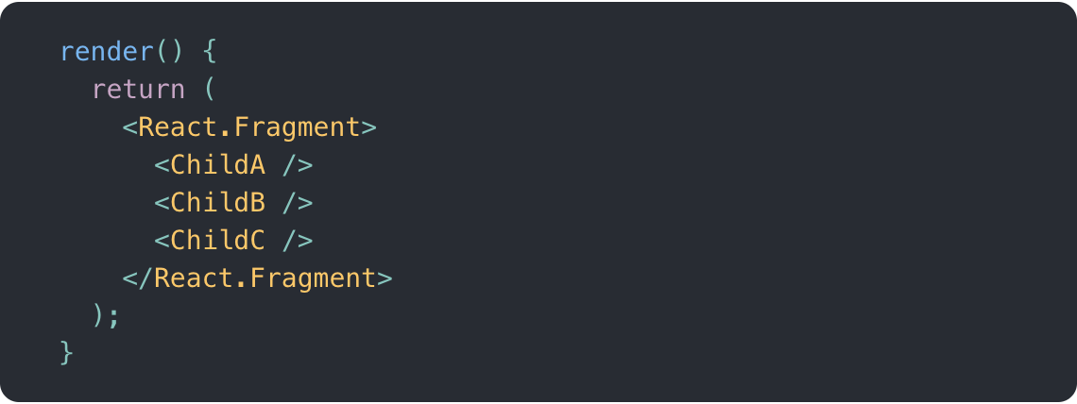
Lifting State Up, Composition vs Inheritance, Fragments
Fragments
A common pattern in React is for a component to return multiple elements. Fragments let you group a list of children without adding extra nodes to the DOM.
Ref: https://reactjs.org/docs/fragments.html
Notes:
Day 6 (Basics)

Slide 46
Hands On Day - 6
Build a unit conversion application.
Square yard to Square feet.
KG to Litres/Gallons.
Miles to Kilometers.
And vice versa.

Slide 47
Day 7

Slide 48
Agenda Day - 7
Type-checking with PropTypes
Higher Order Components
Uncontrolled Components

Slide 49
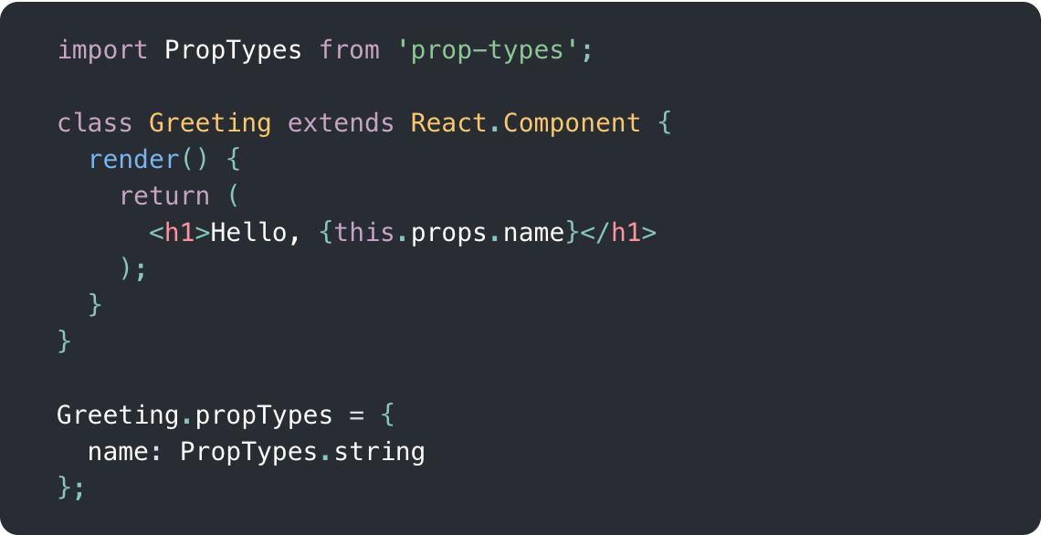
Type-checking with PropTypes, Higher Order Components, Uncontrolled Components
Type-Checking with PropTypes
‘prop-types’ library is used to implement type-checking
This is used to check type of the props passes to the component.
This is used to restrict the other data types into the props.
Also it is useful for other developer to understand the developed code.
Ref: https://reactjs.org/docs/typechecking-with-proptypes.html
Notes:
Day 7 (Basics)

Slide 50
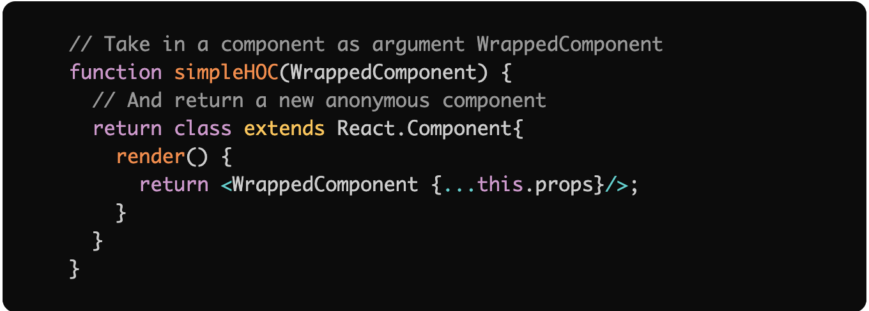
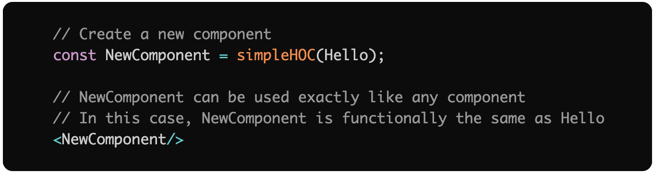
Type-checking with PropTypes, Higher Order Components, Uncontrolled Components
HOC-Higher order components
A higher-order component (HOC) is an advanced technique in React for reusing component logic. HOCs are not part of the React API, per se. They are a pattern that emerges from React’s compositional nature.
A higher-order component is a function that takes a component and returns a new component.
Ref:- https://reactjs.org/docs/higher-order-components.html
https://flexiple.com/react/introduction-to-higher-order-components-in-react-by-example/
Notes:
Day 7 (Basics)

Slide 51
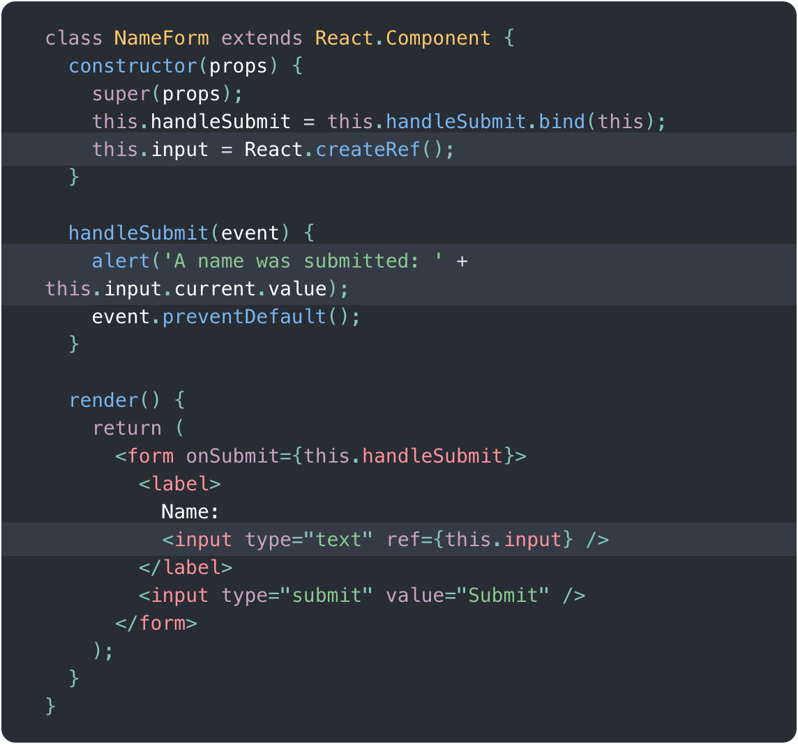
Type-checking with PropTypes, Higher Order Components, Uncontrolled Components
Uncontrolled Components
To write an uncontrolled component, instead of writing an event handler for every state update, you can use a ref to get form values from the DOM.
Ref: https://reactjs.org/docs/uncontrolled-components.html
Notes:
Day 7 (Basics)

Slide 52
Hands On Day - 7
Create a Notification application that loads JSON from a static file and use props to load the notification JSON data.

Slide 53
Day 8

Slide 54
Agenda Day - 8
React Router

Slide 55
React Router
https://reactrouter.com/docs/en/v6/getting-started/overview
https://reactrouter.com/docs/en/v6/getting-started/concepts
https://reactrouter.com/docs/en/v6/examples/lazy-loading
https://reactrouter.com/docs/en/v6/examples/search-params
https://reactrouter.com/docs/en/v6/examples/ssr
Notes:
Day 8 (Basics)
React Router

Slide 56
Hands On Day - 8
Create SPA with navigation menu, on hitting each menu redirect to that page location.
Reference demo:
https://codesandbox.io/s/nn8x24vm60?from-embed

Slide 57
Day 9

Slide 58
Agenda Day - 9
Introduction to Redux
Redux Store

Slide 59
Introduction to Redux, Redux Store
https://devdocs.io/redux-basics/
Notes:
Day 9 (Basics)
React Router & Redux Store

Slide 60
Hands On Day - 9
Create a login page that redirects to the dashboard when the user is logged in else redirect back to the login page if trying to access another URL.

Slide 61
Day 10

Slide 62
Agenda Day - 10
Redux Store (Cont.)
Redux Devtools

Slide 63
Redux Store, Redux Dev Tools
https://devdocs.io/redux-basics/
https://codeburst.io/redux-devtools-for-dummies-74566c597d7
Notes:
Day 10: Redux Store

Slide 64
Hands On Day - 10
Create Todo list using Redux.
Reference: https://redux.js.org/basics/example

Slide 65
Day 11

Slide 66
Agenda Day - 11
Advance ReactJS:
Ref and the DOMS & Forwarding Ref
React developer tools

Slide 67
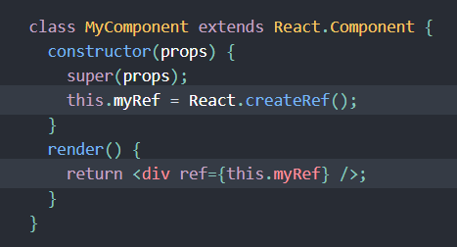
Ref and the DOMS & Forwarding Ref and React developer tools
Ref and the DOMS
Refs provide a way to access DOM nodes or React elements created in the render method.
There are a few cases where you need to imperatively modify a child outside of the typical data flow of using props. At that time, Ref comes in the picture.
Ref: https://reactjs.org/docs/refs-and-the-dom.html
Creating a ref
Notes:
Day 11 - Ref and the DOMS & Forwarding Ref

Slide 68
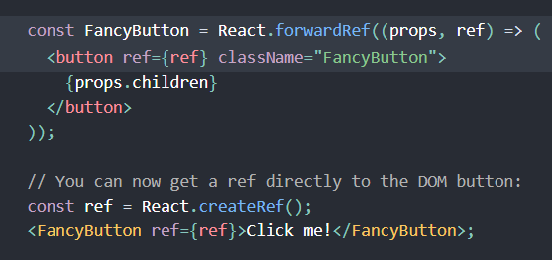
Ref and the DOMS & Forwarding Ref and React developer tools
Forwarding Refs
Ref forwarding is a technique for automatically passing a ref through a component to one of its children.
React components hide their implementation details, including their rendered output.
In the example given here, other components using FancyButton usually will not need to obtain a ref to the inner button DOM element.
Ref: https://reactjs.org/docs/forwarding-refs.html
Ref Forwarding
Notes:
Day 11 - Forwarding Ref

Slide 69
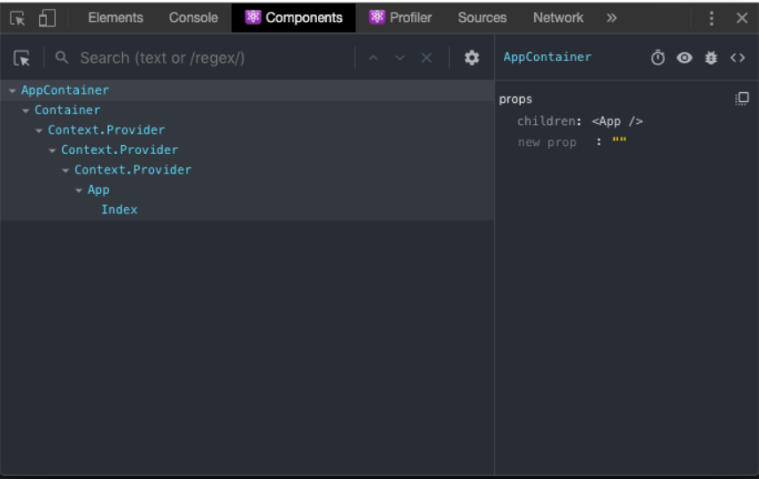
React developer tools
React developer tools
Available for both Chrome and Firefox, the React Developer Tools are an essential instrument you can use to inspect a React application.
They provide an inspector that reveals the React components tree that builds your page, and for each component you can go and check the props, the state, hooks, and lots more.
Ref: https://flaviocopes.com/react-developer-tools/
Developer Tool
Notes:
Day 11 - React developer tools

Slide 70
Hands On Day - 11
Implement Ref, Forwarding and test react dev tools.

Slide 71
Day 12

Slide 72
Agenda Day - 12
Advance ReactJS
Error Boundaries
Optimizing Performance

Slide 73
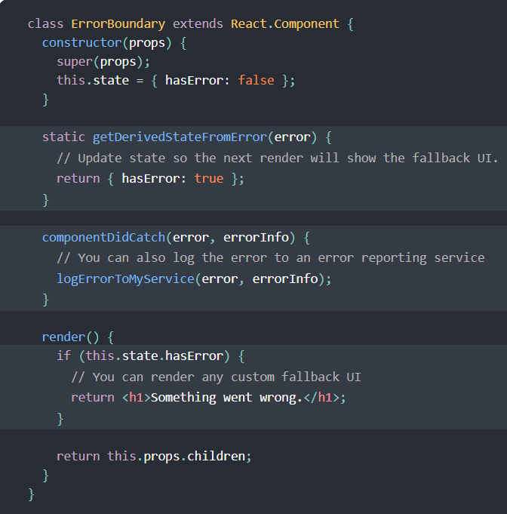
Error Boundaries and Optimizing Performance
Error Boundary
Error Boundaries
A JavaScript error in a part of the UI shouldn’t break the whole app. To solve this problem for React users, React 16 introduces a new concept of an “error boundary”.
Error boundaries are React components that catch JavaScript errors anywhere in their child component tree, log those errors, and display a fallback UI instead of the component tree that crashed.
Ref: https://reactjs.org/docs/error-boundaries.html
Notes:
Day 12 - Error Boundaries

Slide 74
Error Boundaries and Optimizing Performance
Optimizing Performance
Internally, React uses several clever techniques to minimize the number of costly DOM operations required to update the UI.
For many applications, using React will lead to a fast user interface without doing much work to specifically optimize for performance. Nevertheless, there are several ways you can speed up your React application.
Some of the techniques are:
Using the Production Build
Using Single-File Builds and Plugins like Webpack, Browserify etc.
Avoiding Reconciliation
Virtualizing Long Lists, etc.
Ref: https://reactjs.org/docs/optimizing-performance.html
Notes:
Day 12 - Optimizing Performance

Slide 75
Hands On Day - 12
Implement error boundaries and various scenarios to optimize the performance of app.

Slide 76
Day 13

Slide 77
Agenda Day - 13
Final Exercise & Axios

Slide 78
Final Exercise & Axios
Axios
Many projects on the web need to interface with a REST API at some stage in their development. Axios is a lightweight HTTP client based on the $http service within Angular.js v1.x and is similar to the native JavaScript Fetch API.
Axios is promise-based, which gives you the ability to take advantage of JavaScript’s async and await for more readable asynchronous code.
You can also intercept and cancel requests, and there’s built-in client-side protection against cross-site request forgery.
Ref: https://www.digitalocean.com/community/tutorials/react-axios-react
Notes:
Day 13 - Axios

Slide 79
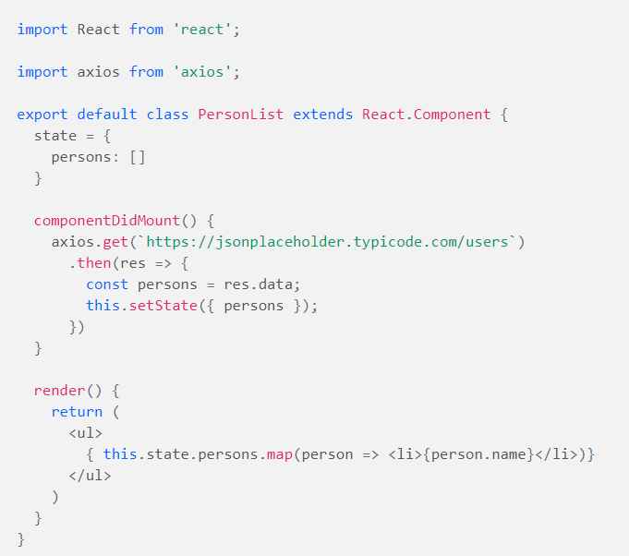
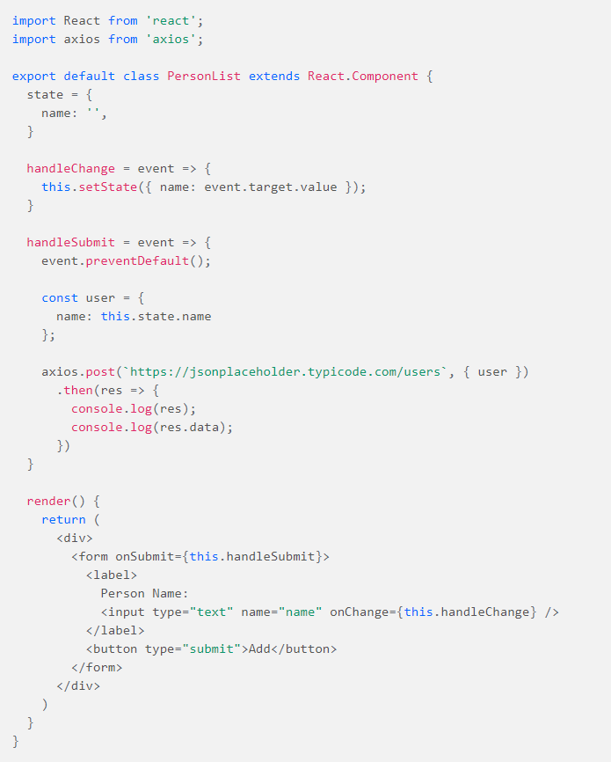
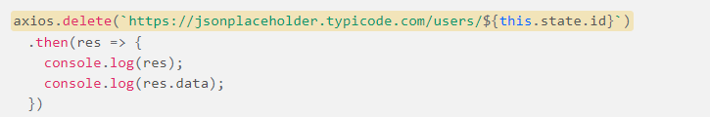
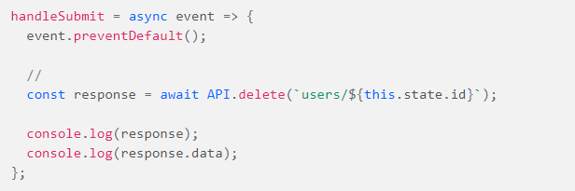
Final Exercise & Axios
GET Request
POST Request
DELETE Request
Using Async & Await
Notes:
Day 13 - Axios

Slide 80
Hands On Day - 13
Final Exercise
Open API for reference.
https://api.nasa.gov/
https://jsonplaceholder.typicode.com/
Ex. 1 https://jsonplaceholder.typicode.com/todos/1
Ex. 2 https://jsonplaceholder.typicode.com/todos

Slide 81
Day 14

Slide 82
Agenda Day - 14
ESLint - requirement & configuration

Slide 83
Configuring ESLint
ESLint is designed to be completely configurable, meaning you can turn off every rule and run only with basic syntax validation, or mix and match the bundled rules and your custom rules to make ESLint perfect for your project. There are two primary ways to configure ESLint:
Configuration Comments - use JavaScript comments to embed configuration information directly into a file.
Configuration Files - use a JavaScript, JSON or YAML file to specify configuration information for an entire directory and all of its subdirectories. This can be in the form of an .eslintrc.* file or an eslintConfig field in a package.json file, both of which ESLint will look for and read automatically, or you can specify a configuration file on the command line.
https://eslint.org/docs/user-guide/getting-started
https://eslint.org/docs/user-guide/configuring/
Notes:
Day 14 - Basic foundation for type scripting

Slide 84
Hands On Day - 14
Configure ESLint to the app and fix all warnings

Slide 85
Day 15

Slide 86
Agenda Day - 15
Final Exercise & TypeScript

Slide 87
Basic foundation for type scripting and how type scripting can be integrated with react?
Basic foundation for type scripting
TypeScript stands in an unusual relationship to JavaScript. TypeScript offers all of JavaScript’s features, and an additional layer on top of these: TypeScript’s type system.
For example, JavaScript provides language primitives like string, number, and object, but it doesn’t check that you’ve consistently assigned these. TypeScript does.
This means that your existing working JavaScript code is also TypeScript code. The main benefit of TypeScript is that it can highlight unexpected behavior in your code, lowering the chance of bugs.
Ref: https://www.typescriptlang.org/docs/handbook/typescript-in-5-minutes.html
Notes:
Day 14 - Basic foundation for type scripting

Slide 88
Basic foundation for type scripting and how type scripting can be integrated with react?
How type scripting can be integrated with react?
To start a new Create React App project with TypeScript, you can run any of the following commands:
npx create-react-app my-app --template typescript
yarn create react-app my-app --template typescript
To add TypeScript to an existing Create React App project, first install it using any of the following commands:
npm install --save typescript @types/node @types/react @types/react-dom @types/jest
yarn add typescript @types/node @types/react @types/react-dom @types/jest
Next, rename any file to be a TypeScript file (e.g. src/index.js to src/index.tsx) and restart your development server!
Ref: https://create-react-app.dev/docs/adding-typescript/
Notes:
Day 14 - How type scripting can be integrated with react?

Slide 89
Basic foundation for type scripting and how type scripting can be integrated with react?
(Additional Resources)
https://www.typescriptlang.org/play/index.html?jsx=2&esModuleInterop=true&e=196#example/typescript-with-react
https://github.com/typescript-cheatsheets/react-typescript-cheatsheet#reacttypescript-cheatsheets
Notes:
Day 14 - Additional Resources

Slide 90
Hands On Day - 15
Create a React App + Typescript Project.

