Slide 1
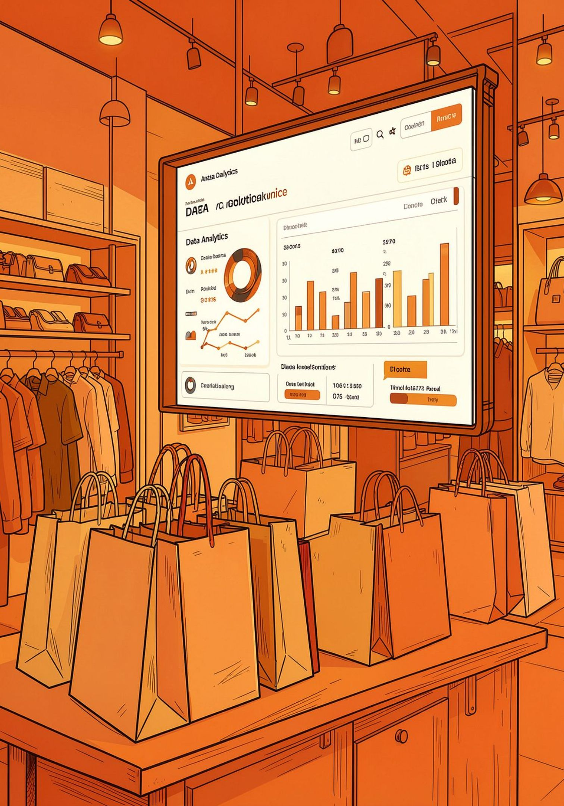
Customer Shopping Behavior Analysis
Uncovering spending patterns, segments, and preferences from 3,900 transactions to guide strategic decisions.

Slide 2

Dataset at a Glance
3,900
Transactions
Rows of purchase data
18
Features
Demographics, purchases, behavior
37
Missing Values
Review Rating column only
50
Locations
Geographic coverage

Slide 3


Data Preparation in Python
Load & Explore
pandas: df.info(), .describe()
Clean & Standardize
Imputed Review Rating (median by category); snake_case columns
Feature Engineering
age_group bins; purchase_frequency_days
SQL Server Load
Cleaned DataFrame loaded for SQL analysis

Slide 4
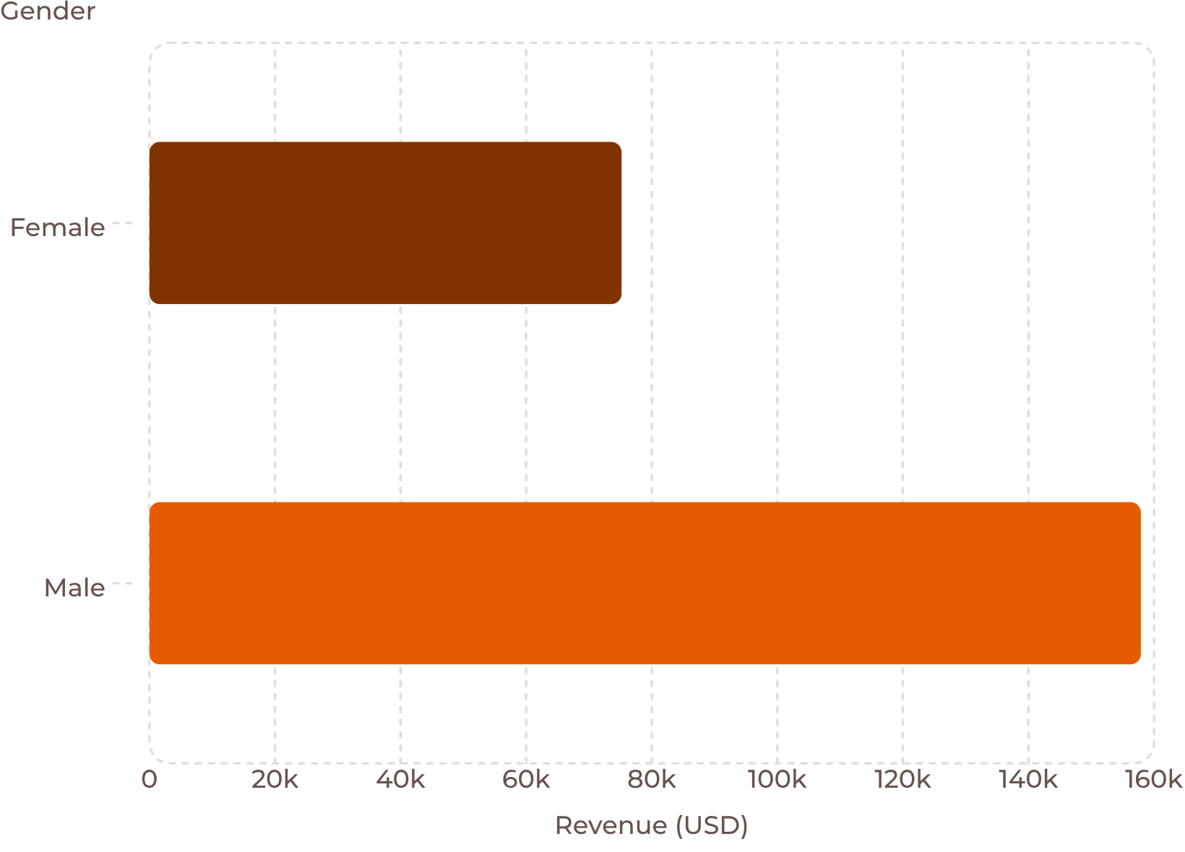

Revenue by Gender
Key Insight
Male customers generated 2.1x more revenue than female customers — $157,890 vs. $75,191.
2,652 male customers vs. 1,248 female customers in the dataset.

Slide 5
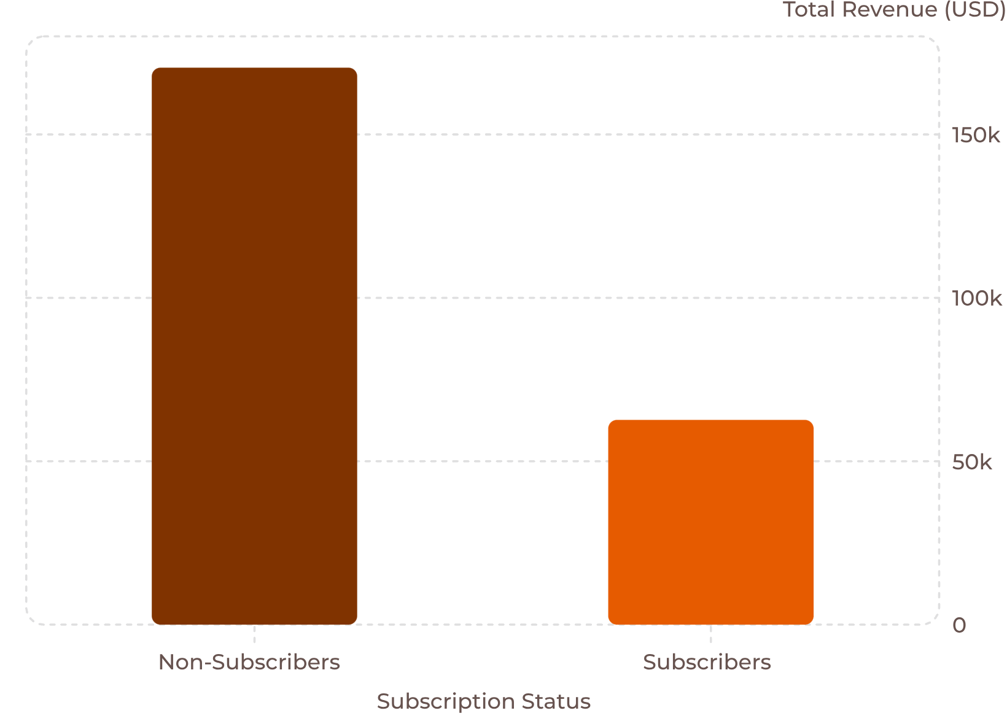
Subscribers vs. Non-Subscribers
Subscriber Profile
27% of customers subscribe
Avg spend nearly equal: $59.49 vs. $59.87
958 repeat buyers (5+ purchases) are subscribers
Subscribers show loyalty — opportunity to grow this segment.

Slide 6
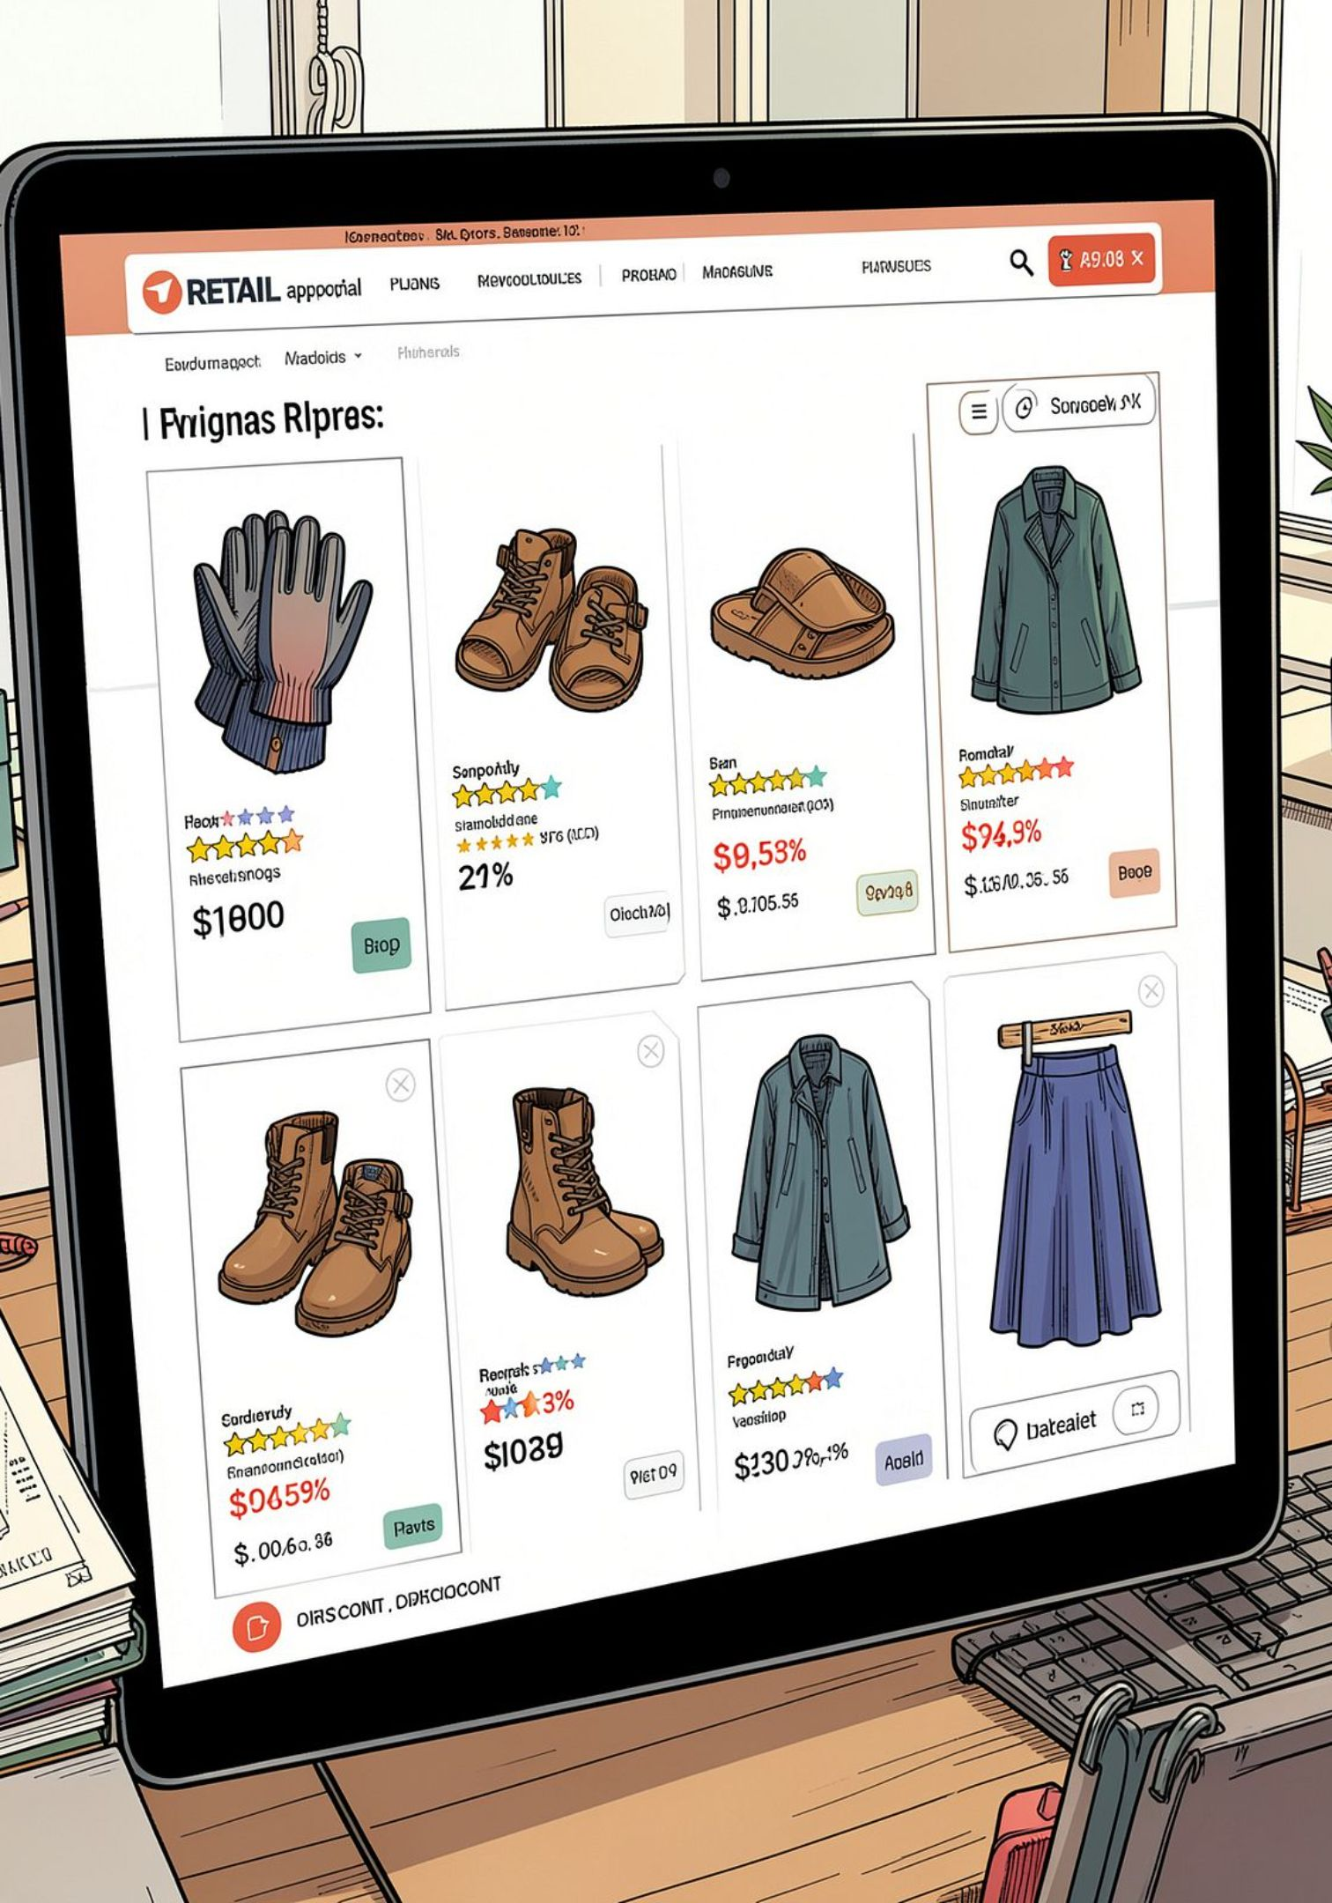
Top Products by Rating & Discount Rate
⭐ Highest Rated
Gloves (3.86), Sandals (3.84), Boots (3.82), Hat (3.80), Skirt (3.78)
🏷️ Most Discounted
Hat (50%), Sneakers (49.7%), Coat (49.1%), Sweater (48.2%), Pants (47.4%)

Slide 7
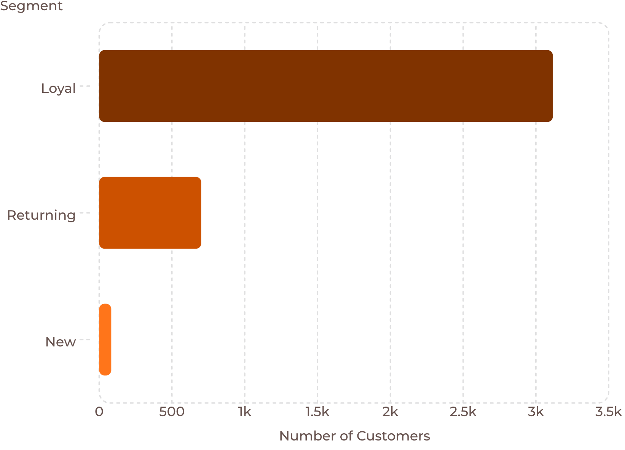

Customer Segmentation
Segment Breakdown
Loyal — 80%
3,116 customers
Returning — 18%
701 customers
New — 2%
83 customers

Slide 8
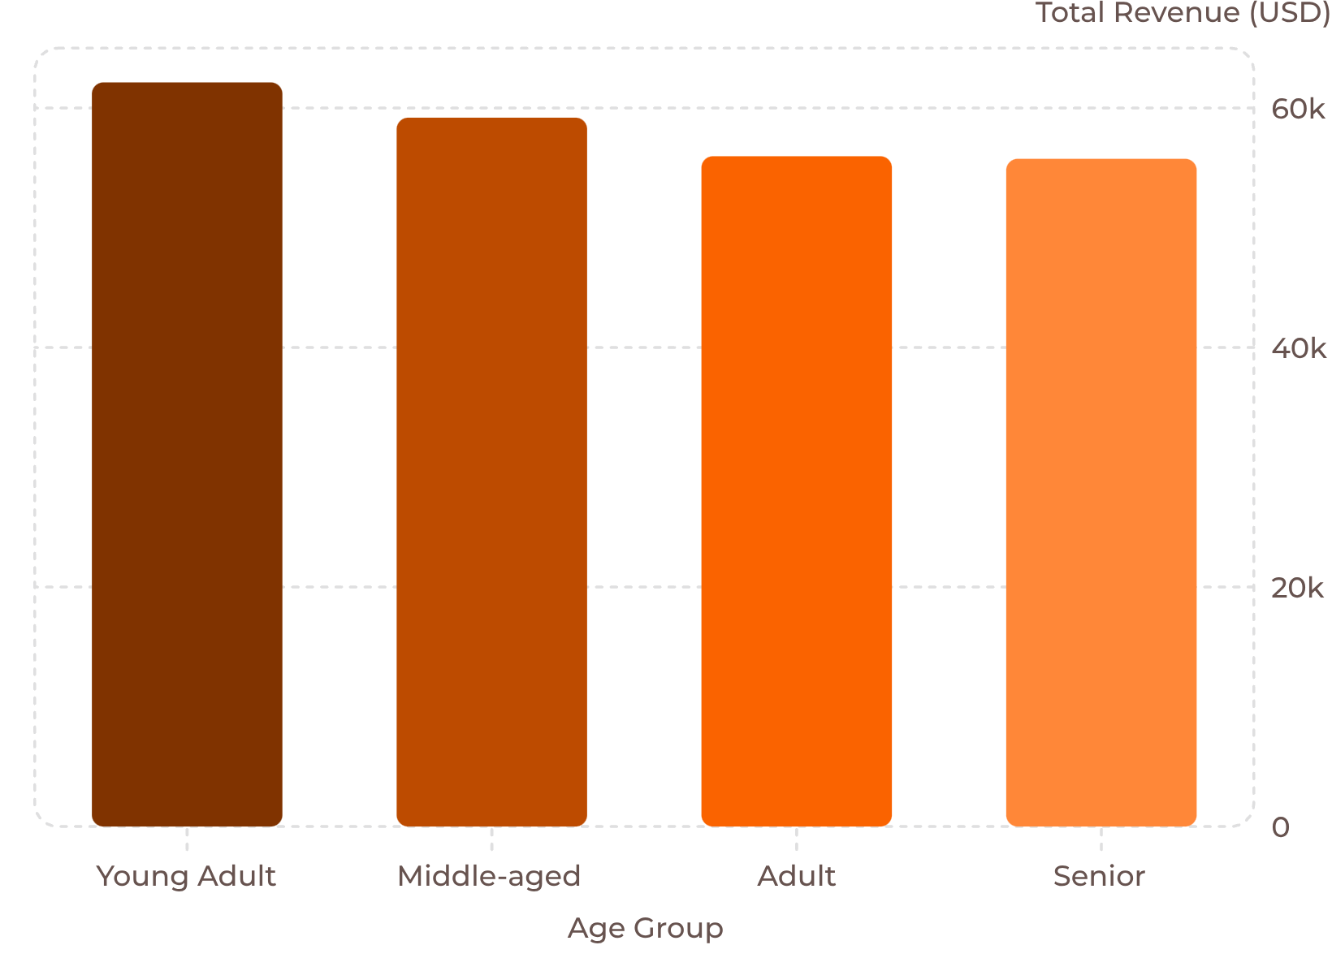
Revenue by Age Group
Insight
Young Adults lead revenue at $62,143. Revenue declines gradually with age — all groups remain significant contributors.

Slide 9
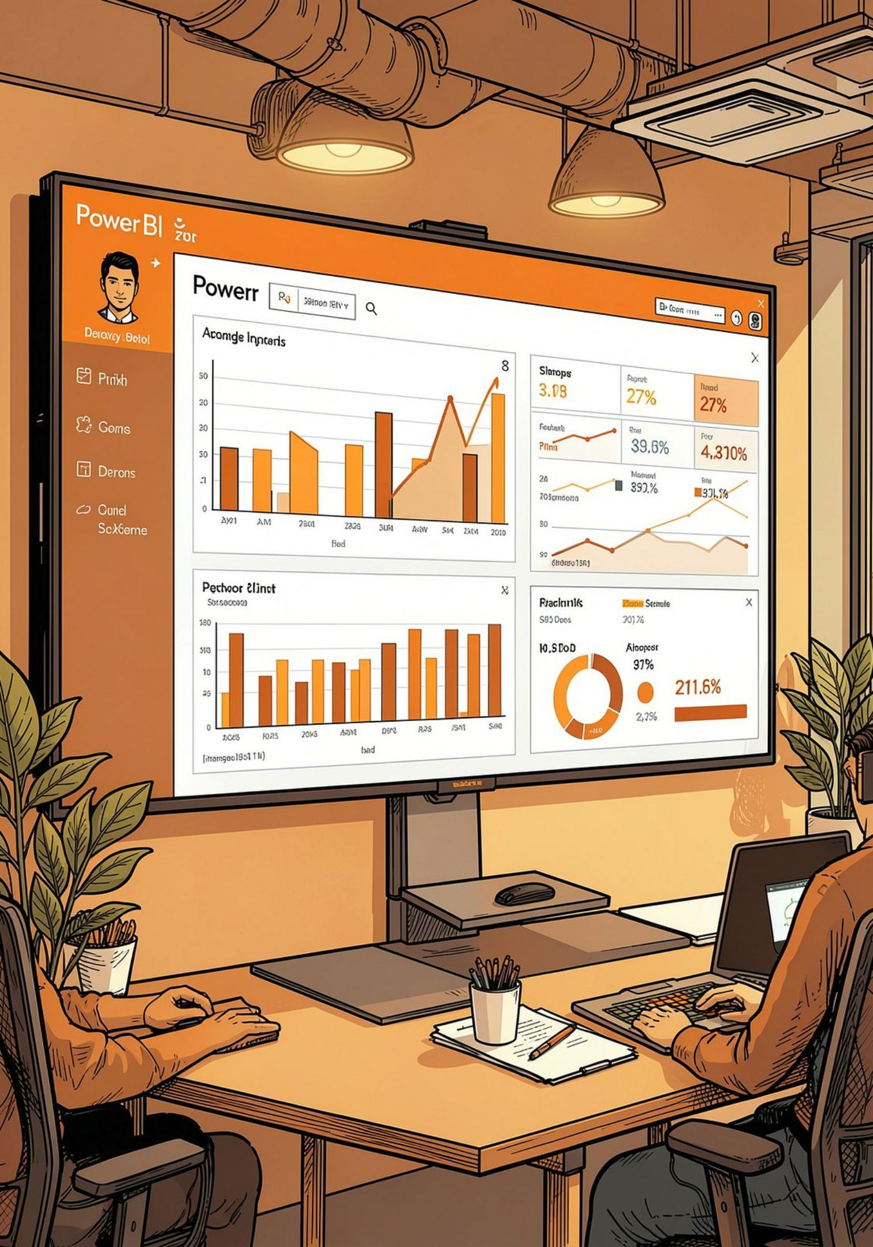
Power BI Dashboard
3.9K
Customers
$59.76
Avg Purchase
3.75
Avg Rating
Clothing
Top revenue category (~$90K)

Slide 10





Business Recommendations
Boost Subscriptions
Promote exclusive subscriber benefits
Loyalty Programs
Reward repeat buyers toward "Loyal" segment
Review Discount Policy
Balance sales lift with margin control
Targeted Marketing
Focus on high-revenue age groups & express-shipping users

