Slide 1
S3T: Student Support Triage
Reusable NLP asset that sorts student-support messages by category and urgency, extracts key details and flags what a person must read first
Group 6 | NMIMS MPSTME
Name (Roll no.)
Name (Roll no.)
Name (Roll no.)
Name (Roll no.)
Name (Roll no.)
Speech and Natural Language Processing | Final Project
Notes:
Introduce the team and S3T. One student message goes in; S3T returns the category, the urgency, confidence scores, the details it found, a recommended route and whether a person must review it. Ten slides, about one minute each, live demo on slide 8. Source: docs/FINAL_REPORT.md.

Slide 2
02 | Problem
Support inboxes mix routine requests with urgent ones
Student-support teams receive login problems, fee questions, transcript requests, students falling behind and, occasionally, a student in crisis
Sorting by hand is slow; an urgent message can sit unread behind routine ones
Task: one component that classifies each message, rates its urgency, extracts key details and explains how sure it is
Safety goal: crisis language and High urgency always reach a person
Constraint: advisory only; no automatic replies or decisions about a student
Output per message
Field | Values
Category | Academic Difficulty, Mental Health & Wellbeing, Financial Aid, Administrative, Technical Support
Urgency | Low, Medium, High
Confidence | Every class probability, top confidence, margin, high/medium/low band
Entities | Courses, deadlines, blockers, emotions
Action | Recommended route + human-review flag with reasons
One JSON result per message; the same contract for the module, command line and API.
Notes:
Support teams get a mixed inbox. Our brief: classify, rate urgency, extract details, and say how confident we are, while making sure crisis and High-urgency messages always reach a person. Source: docs/FINAL_REPORT.md, Problem and users.

Slide 3
03 | Use case
Who uses it: support staff first, other university systems second
Primary user: a student-support staff member triaging the inbox
S3T suggests the team, the urgency and the route; the staff member decides
Every High-urgency or low-confidence result is flagged for a person with its reasons
Crisis language goes straight to the wellbeing team, marked High
Second user: other components call the same API, e.g. our early-warning bridge, which flags students who missed tests and assignments
Consumers of one result
Consumer | Receives | Action
Support staff | Category, urgency, route, review flag + reasons | Assigns and prioritises
Wellbeing team | Crisis messages, High urgency | Immediate personal follow-up
Early-warning bridge (Week 7–8) | Category, courses, crisis flag | Flags at-risk students; asks partners for help
Not for automatic replies, grading or discipline.
Notes:
The user is support staff. S3T suggests; they decide. Review reasons are explicit codes. Crisis messages always go to people. Other systems use the same API; our own early-warning bridge is one of them. Source: docs/MODEL_CARD.md intended use; docs/FINAL_REPORT.md.

Slide 4
04 | Data
Generated training and test data, plus a hand-written challenge set
Messages per set
How each set was built
Training: 60 template sentences with varied greetings and closings; ~4% labels flipped as noise
Test: 15 held-out template sentences
Challenge: written by the team to break the model: Indian-university terms, Hinglish, negation, indirect crisis wording, out-of-scope
Labels: 5 categories × 3 urgency levels
95% interval for category macro-F1 is wide (0.59–0.98) because the test set has 15 sentences
Distinct source sentences: 60 (training), 15 (test). No real student messages.
Ready for real data: docs/DATA_COLLECTION.md and python -m s3t evaluate.
Notes:
Be clear that all data is generated: 1,170 training messages from 60 sentences, 299 test messages from 15 held-out sentences. The 30-message challenge set was written to break the model. Real classmate messages are the open Week 2 feedback. Source: docs/MODEL_CARD.md Data; docs/DATA_COLLECTION.md.

Slide 5
05 | NLP approach
Three classifiers compared; the hybrid wins on both tasks combined
Preprocessing: validate, lower-case, Porter-stem
Features: TF-IDF 1–2 grams and all-MiniLM-L6-v2 sentence embeddings (384 numbers)
One classifier per task: category (5 classes) and urgency (3 levels)
Extraction by regular expressions: courses, deadlines, blockers, emotions
Crisis lexicon: core phrases + extended list for indirect wording
Rules: R1 crisis → High + review; R2 deadline soon → urgency +1; R3 category confidence < 0.55 → review; R4 High → review
Three approaches on the same data
Approach | Model | Role
A. Baseline | Stemmed TF-IDF; logistic regression / Naive Bayes | Week 2 baseline
B. SBERT | MiniLM embeddings; logistic regression | Week 4
C. Hybrid | Embeddings + TF-IDF; logistic regression | Served model (default)
The 0.55 review threshold is calibrated by grouped cross-validation on training data only.
Notes:
Same features feed three classifier variants; the hybrid concatenates SBERT embeddings with TF-IDF. Around the model: extraction, a crisis lexicon and four rules that can override the model for safety. Thresholds are calibrated without touching the test set. Sources: docs/MODEL_CARD.md; docs/week6_report.md section 3.

Slide 6
06 | Architecture
From message to JSON in six layers
01
Input
Student message (1–2,000 characters) and optional id; batches of up to 100
02
Preprocessing
Validate, lower-case, stem; TF-IDF and MiniLM sentence-embedding features
03
NLP Model
Hybrid logistic regression: category (5) and urgency (3) with all class probabilities
04
Post-processing
Extract courses, deadlines, blockers, emotions; crisis lexicon; rules R1–R4; review flag
05
API / Asset
Python module, command line, HTTP API (/v1/triage) sharing one schema; HTTP 422 on bad input
06
Application
Staff demo page on 127.0.0.1:5050 and the early-warning bridge to other groups
Notes:
Walk top to bottom. A message enters, is validated and turned into TF-IDF and embedding features, the hybrid model scores category and urgency, post-processing adds extraction, crisis detection and rules, and the result is served through three interfaces. The application layer is the demo page and early-warning bridge. Full diagram: docs/architecture.png.

Slide 7
07 | Results
Hybrid: best balance of category and urgency accuracy
Macro-F1 on the test set (n = 299, higher is better)
Key metrics, hybrid model
Metric | Test | Challenge
Category accuracy | 0.860 | 0.607
Urgency accuracy | 0.819 | 0.750
High-urgency recall | 0.981 | 0.900
High-urgency precision | 0.515 | 0.643
Flagged for review | 47% | 63%
Silent category errors | 21 (7.0%) | 3
At confidence ≥ 0.90: right on 145 of 146 test messages
Final testing: pytest 19/19, verify 31/31, integration 19 + 1 skipped
Notes:
Hybrid category macro-F1 0.859, close to SBERT's 0.880, and urgency 0.794, far above SBERT's 0.602. High-urgency recall 0.981, but precision 0.515: it over-predicts High, which drives the 47% review rate. Accuracy drops on the hand-written challenge set (0.607). All test suites pass. Sources: docs/week6_report.md 4.1–4.2; reports/week6_verification.md; docs/TEST_REPORT.md.

Slide 8
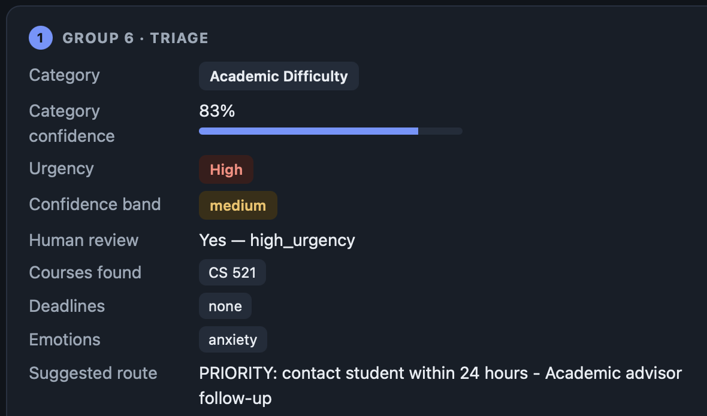
08 | Demonstration
Demo: paste a message, get a triage result with reasons
Sample runs
Missed M1 test, assignments pending (CS 521): Academic Difficulty 0.83, High, review; early warning HIGH
Canvas login, quiz closes today: Technical Support; deadline "today" raises urgency (R2)
"I feel hopeless…": crisis detected, High, immediate human follow-up
Transcript request, no rush: Administrative, not at risk
Live run on the team Mac, hybrid model
Start: ./run_demo.sh, then open http://127.0.0.1:5050
Notes:
Live demo at 127.0.0.1:5050. Run the at-risk sample: Academic Difficulty 0.83, High urgency, review required, CS 521 found, anxiety. Then the routine query and the unknown-course sample. Mention partners (Groups 5 and 7) are optional and shown as not connected. If the live run fails, use this screenshot. Sources: team Mac run 29 Oct; integration/e2e_check.py scenarios.

Slide 9
09 | Reusable asset
Any application can call it with one message
Interface | Purpose
POST /v1/triage | Triage one message: {"text", "id"}
POST /v1/triage/batch | Up to 100 messages in one call
GET /health, /v1/info | Status; model, thresholds, warnings
Python | Triage().predict(text, id="t1")
CLI | python -m s3t triage | evaluate | calibrate | verify
Example request
curl -s localhost:8000/v1/triage \
-H "Content-Type: application/json" \
-d '{"text": "My scholarship has not arrived"}'
Response (trimmed, illustrative)
{"category": {"label": "Financial Aid", "confidence": 0.9},
"urgency": {"label": "Medium"},
"confidence_band": "high",
"recommended_action": "Route to financial aid office",
"human_review": {"required": false, "reasons": []},
"advisory_only": true}
Bad input (empty, too long, not text) → clear error / HTTP 422
Optional API key (S3T_API_KEY); message text never logged or echoed
Week 7–8: early-warning bridge calls S3T and, when running, Group 5 and Group 7
Notes:
Other applications send one message and get one JSON object back. The same works from Python or the command line. Invalid input returns 422. The response shown is illustrative of the field layout, not a recorded run. Sources: docs/API.md; docs/ASSET_GUIDE.md section 3.

Slide 10
10 | Limitations and future work
What remains to be solved
Limitations
Future work
No real student messages: challenge-set category accuracy is 0.61 vs 0.86 on generated test data
Test set informed design choices in Weeks 4–6
High over-predicted: precision 0.515, so 47% of messages go to review
Crisis detection is a keyword list, untested on real wording
No out-of-scope class; no negation handling
Collect 50–100 consented classmate messages, label twice, score once with s3t evaluate
Reduce High over-prediction; report review rate and missed High together
Wellbeing-staff review of the crisis lexicon
Add an out-of-scope class and negation handling
Authentication, rate limiting and audit logging before real use
Notes:
Be direct: all data is generated, the drop to 0.61 on hand-written messages shows real performance will be lower, and the model over-predicts High. Future work starts with real, consented classmate messages. Sources: docs/week6_report.md sections 5 and 7.

