Slide 1
DockIQ
OPERATIONAL OVERVIEW
01
From temperature exception to controlled resolution
One demonstrated loop: guided detection, grounded SOP guidance, and prioritized supervision.
TEMPERATURE DEVIATION
GUIDED DETECTION
Context-aware severity
28 F observed / 0 F maximum
Product thresholds and issue context shape the alert.
Worker-entered reading for a temperature-controlled product
1
Detect
Threshold comparison flags a critical exception.
GROUNDED RESOLUTION
Procedure before prose
Guide
Do not unload; close trailer doors; preserve context.
Knowledge-base steps include confidence and source.
2
3
Ground
Cold Chain SOP 2.3 is cited with resolution steps.
PRIORITIZED SUPERVISION
Critical work surfaces first
4
Escalate
The unresolved issue enters the supervisor priority queue.
Severity, age, dock, and impact organize the queue.
LIVE OR FALLBACK AI | Core workflow remains available
Controlled demo access. Synthetic records. No production metrics or sensor integration claimed.

Slide 2
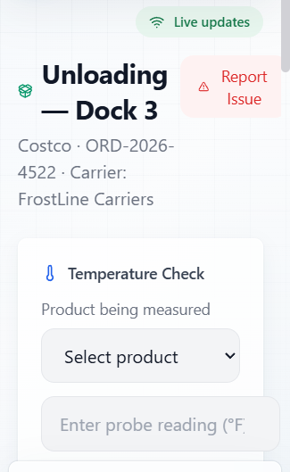
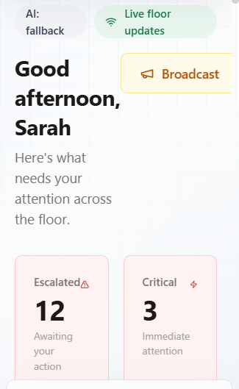
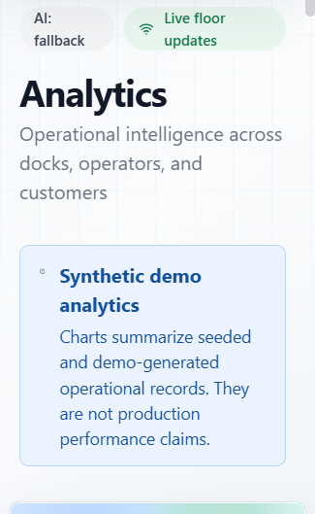
DockIQ
DEMONSTRATED JOURNEY
02
One loop, two operating views, one auditable record
Worker guidance and supervisor action share validated API state and deterministic demo data.
WORKER VIEW
SUPERVISOR PRIORITY QUEUE
SYNTHETIC ANALYTICS
ARCHITECTURE
React + Vite
FastAPI + WebSocket
SQLite
Live endpoint / local KB
Worker and supervisor views
Validated commands and events
Deterministic demo state
Optional AI, grounded fallback
8-MINUTE ROUTE
0:00
0:45
1:30
2:30
3:30
4:45
5:45
6:45
8:00
Problem
Demo access
Worker context
Detect
SOP guidance
Escalate
Resolve
Analytics
Close

