Slide 1
ABOUT DARSHAN UNIVERSITY
ENROLLMENT NO. 24010101056
NAME- Manav Delvadiya
DEPARTMENT- Computer Science
SEMESTER- 3
SUBJECT- OAT

Slide 2

About Darshan University
Darshan University (DU) is a prominent institution offering a broad slate of academic programs and professional courses at the undergraduate, graduate, and postgraduate levels in Engineering & Technology, Science, Management, and Yoga. The University is located in peaceful and sylvan surroundings with a distinctive collegiate structure, about 19 km from Rajkot, Gujarat, India. It was established as an Engineering Institute in 2009 by Shree G. N. Patel Education & Charitable Trust with the objective of imparting quality education and training in various fields of Engineering and Technology. It has since been transformed into Darshan University through an Act by the Government of Gujarat under the Gujarat State Private Universities (Amendment) Act, 2021 (Act No. 15).
Since its inception, the institution has grown steadily and created a unique identity in the field of Engineering & Technology by implementing a skill- and training-based foundation for education. The academic environment on campus fosters creativity and encourages the exploration of technical skills. Darshan University is committed to the generation of knowledge, fostering innovation, and contributing to the development of the Nation.
Our Motto
This verse advises us to perform our allocated duty excellently. Kaushalam signifies doing work with devotion and without attachment.
Such detached attitude enhances its values and improves the concentration and skill of the worker. If we work with elegance, fortitude,
and skill our Body-Mind-Soul will co-operate with our hands. Any work becomes valuable if carried out with full concentration, dedication,
and abilities and also helps us to become valuable to others as well as to society.

Slide 3
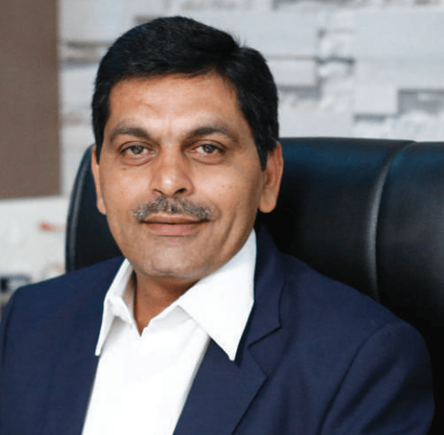
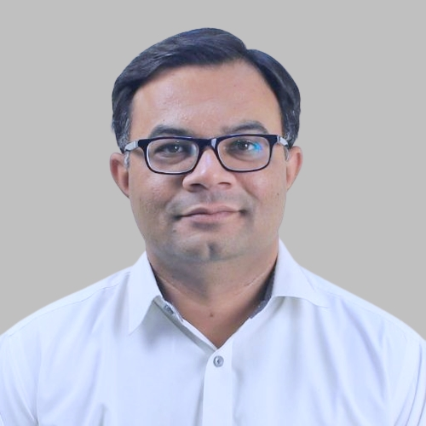
Prof. Manish V. Sanghani, an academician with an in-depth knowledge and profound skill set in teaching pedagogy, education and administration. He has completed his Bachelor of Civil Engineering from Lukhdhirji Engineering College, Morbi, and his Master of Engineering in Structural Engineering from The Maharaja Sayajirao University, Baroda.
He has started his career as a lecturer at Dr. Jivraj Mehta Government Polytechnic for 10 years. In 1997, he has moved to V. V. P. engineering college where he has worked as an Assistant Professor for 11 years.
Dr. Nilesh Gambhava is a distinguished professor in the Department of Computer Science and Engineering at Darshan University. He earned his Bachelor of Engineering degree from G.H. Patel College of Engineering & Technology, Vallabh Vidyanagar, in 2001, followed by a Master of Engineering from B.V.M. Engineering College in 2004, where he was awarded a Gold Medal by Sardar Patel University. In October 2018, Dr. Gambhava completed his Ph.D. from Nirma University, specializing in "Web Mining in Social Networking." Dr. Gambhava has been an integral part of Darshan University since the inception of the institute.

Slide 4
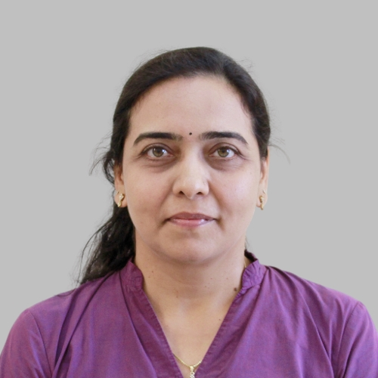
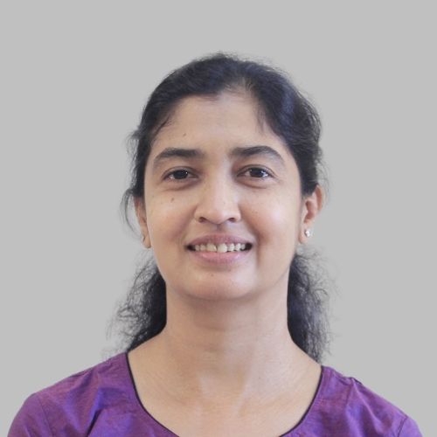
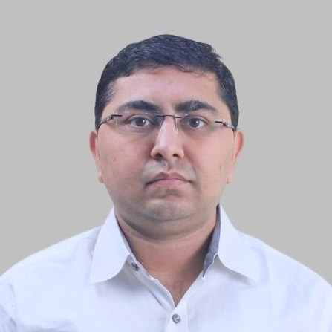
Prof. Chintan Kanani
Head of The Department
Dr. Gopi Sanghani
Dean - Faculty of Computer Science
Dr. Jignasa Mehta
Dean - Faculty of Engineering, Head

Slide 5
BoS - Mechanical Engineering
Sr. | Member | Designation
1 | Dr. Jignasa Mehta Dean, DIET | Chairperson
2 | Dr. Hiren Joshi Associate Professor, Government Engineering College, Rajkot | Member
3 | Dr. Dipesh Kundaliya Assistant Professor, VVP Engineering College, Rajkot. | Member
4 | Mr. Abhishek Suchak Scientist-C & Centre In-charge | Member

Slide 6
Programs Offered
Admission 2025
Direct Admission for all programs has already started.
For admission regarding query: +91-7096979952 +91-7096979962
Diploma (After 10th)
Computer Engineering
Civil Engineering
Electrical Engineering
Mechanical Engineering

Slide 7
WHY DARSHAN UNIVERSITY ?
1 | Dedicated Faculties We proudly hold the record of lowest attrition rate till date to accomplish dedication.
2 | Disciplined Environment Mobile App for parents to track the progression of students. Mobile phones and related gadgets are strictly prohibited for students within the institute premises.
3 | Skill Development Activities We address the opportunities and challenges to encounter new demands of changing global and innovative technologies.
4 | Industry Interaction & Consultancy Work We possess Civil Consultancy Cell, Energy Management Cell & ASWDC that provide a platform for students to enhance their technical & industrial skills.
5 | Excellent Placement Record We proudly hold a good placement record and assure that each eligible student gets an opportunity to be placed in a recognized firm.
6 | Extra-curricular We provide a platform for the cultural fest Udaan (Annual day), Thanganaat (Navratri Festival), Frolic (Technical Fest), Sprint (Annual Sports week), etc.

Slide 8
SCHOLARSHIPS
Government Scholarships
[1] MYSY (Mukhyamantri Yuva Swalamban Yojana)
Eligibility: Student must have secured 80 or more Percentile in 10th / 12th exam and family income must be less than Rs. 6 lakh/annum.
Amount of Scholarship:
For Degree Engineering: Rs. 50,000/- or 50% of tuition fees whichever is less.
For Diploma Engineering: Rs. 25,000/- or 50% of tuition fees whichever is less.
For B.Com./BBA/BCA/B.Sc.: Up to Rs. 10,000/- or 50% of tuition fees whichever is less.
[2] Scholarships for SC/ST Students
Eligibility: Student must belong to SC or ST category and family income must be less than Rs. 2,50,000/annum.
Amount of Scholarship: Approximately 100% of tuition fees as per Government norms.
(Portal: https://mysy.guj.nic.in/)

Slide 9
COMPUTER DEPARTMENT PLACEMENT RECORD 2023

Slide 10
COMPUTER DEPARTMENT PLACEMENT RECORD 2024

Slide 11
COMPUTER DEPARTMENT PLACEMENT RECORD 2025

Slide 12
COMPUTER DEPARTMENT 2024 PLACEMENT RECORD

Slide 13
PLACEMENT SUMMARY
Branch wise Summary --------------------
# | Program | Registered Students | Placed Students | Placed % | Companies Visited | Highest Package | Average Package
1 | B.Tech. (Computer Science and Engineering) | 172 | 161 | 93.60 | 81 | 7.00 LPA | 3.78 LPA
2 | B.Tech. (Civil Engineering) | 15 | 15 | 100.00 | 9 | 2.50 LPA | 1.80 LPA
3 | B.Tech. (Mechanical Engineering) | 5 | 5 | 100.00 | 22 | 3.00 LPA | 2.32 LPA
4 | B.Com | 2 | 2 | 100.00 | 111 | 2.40 LPA | 2.28 LPA
5 | BBA | 24 | 21 | 87.50 | 110 | 3.00 LPA | 2.07 LPA
6 | MBA | 50 | 40 | 80.00 | 129 | 6.00 LPA | 2.78 LPA

