Slide 1


SMART INDIA HACKATHON 2025
TITLE PAGE
Problem Statement ID :- 25129
Problem Statement Title :- Student Innovation
Theme :- Fitness & Sports
PS Category :- Software
Team ID :-
Team Name :- Eleventh Hour

Slide 2
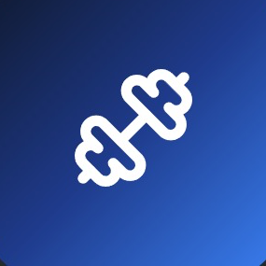
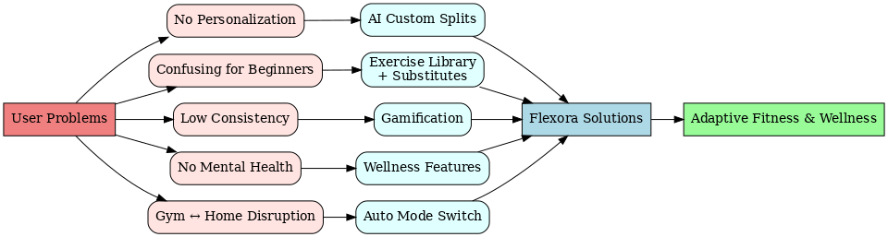
PROPOSED SOLUTION
Eleventh
Hour
Flexora: smart, adaptive fitness and wellness app designed to bridge the gap between traditional workout programs and personalized coaching
@SIH Idea submission- Template

Slide 3
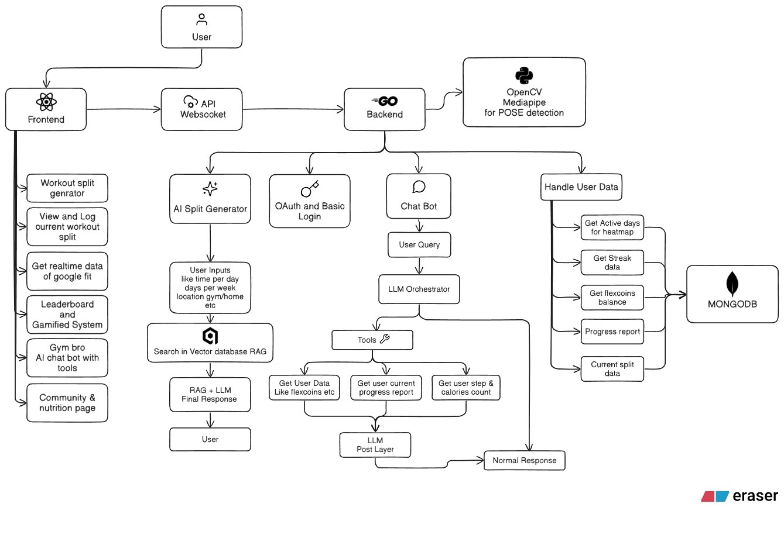
TECHNICAL APPROACH
Eleventh
Hour
Tech Stack:
Frontend: React JS, Tailwind CSS, Redux, Framer Motion (possibly React Native in the future)
Backend: GoLang, REST API, WebSockets, MongoDB, QDrant (possibly ExpressJS in the future)
GenAI: Google Gemini 2.5 Flash, Retrieval-Augmented Generation, ReACT (Reasoning and Acting), GenKit (possibly OpenAI GPT-4o in the future)
Future AI inetgration: Python, MediaPipe, OpenCV
Cloud & Deployment: GitHub, Docker (currently on Render and Vercel; later moving to AWS/GCP)
API Services: OAuth, Google Fit API (later stage: Google Calendar API)
Add-ons: Redis, Postman
@SIH Idea submission- Template

Slide 4
FEASIBILITY AND VIABILITY
Eleventh
Hour
Category | Analysis | Challenges & Risks | Overcoming Strategies
Feasibility | Highly feasible due to AI-driven personalization. Addresses key market gap. | AI Accuracy: Poor workout plans can erode trust. | User Feedback Loop: Use ratings to refine AI. Expert-backed Rules: Ensure rules are designed by fitness pros.
Market | Strong competitive advantage with dynamic AI. | Saturation: Facing established giants (e.g., Nike, Peloton). | Niche Focus: Target a specific group first (e.g., home gym users). Strong Branding: Emphasize "adaptability" as a core differentiator.
User Experience | Comprehensive features for high engagement. | Onboarding Friction: Too much info requested upfront. UI Clutter: Risk of overwhelming users with features. | Progressive Onboarding: Ask for minimal info initially. Clean UI: Prioritize a simple, intuitive design.
Monetization | High potential for a subscription model. | Freemium Pressure: Competing with apps that offer free services. | Freemium Model: Offer basic features for free, charge for advanced AI coaching. Tiered Pricing: Provide monthly, annual, and lifetime options.
Development | Scalable architecture is achievable. | Complexity & Cost: Building the AI, video library, and tracking is resource-intensive. | MVP: Launch with a Minimum Viable Product to test core features. Modular Build: Add new features incrementally.
@SIH Idea submission- Template

Slide 5
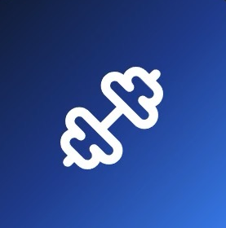
IMPACT AND BENEFITS
Eleventh
Hour
Category | Impact on Target Audience | Benefits
Social | Builds supportive communities through leaderboards & streaks; improves overall well-being | Encourages healthier lifestyles, reduces sedentary behavior, integrates mental health & fitness
Economic | Provides affordable personalized coaching alternative | Saves money vs. personal trainers/gyms; enables subscription & partnership revenue models; boosts user productivity
Environmental | Encourages home workouts & minimal-equipment training | Reduces need for daily commutes to gyms → lower carbon footprint; promotes sustainable, digital-first solutions
Personal | Personalized, adaptable fitness & wellness journey | Saves time, fits user lifestyle, improves discipline, confidence, and consistency
@SIH Idea submission- Template

Slide 6
RESEARCH AND REFERENCES
Eleventh
Hour
Relevant Links :
https://www.ongraph.com/ai-in-fitness-industry/
https://aws.amazon.com/what-is/retrieval-augmented-generation/
https://www.sciencedirect.com/science/article/pii/S1071581923002148
https://pmc.ncbi.nlm.nih.gov/articles/PMC5627651/
@SIH Idea submission- Template

