Slide 1
Mathematical Induction, Relations, Equivalence relations, Partitions, Partial Orderings, Totally Ordered, Hasse Diagrams, Lattices

Slide 2

To prove that if dominoes are arranged in the manner given below , if first one falls then all the dominoes will fall.

Slide 3

To prove that we can successfully zip a proper zipper if the first teeth of zip is zipped successfully

Slide 4
Mathematical Induction
Introduction
Mathematical Induction can be used to prove statements which asserts the propositional function P(x) is true for all positive integers x.
Why do we need proof by induction?
Often theorems state that a propositional function, P(n) is true for all positive integers n
We prove the theorem by using mathematical induction
Induction is the process by which we conclude that what is true of certain individuals of a class, is true of the whole class, or that what is true at certain times will be true in similar circumstances at all times
Notes:
4

Slide 5
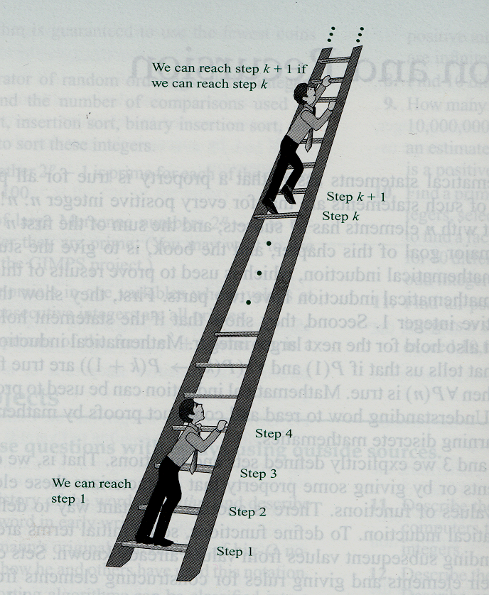
Introduction
When we prove statements using mathematical induction, we first show that P(1) is true. Then we will check to make sure that P(2) is also true and P(3) is also true because P(2) implies (P3).
Ways to remember:
Notes:
5

Slide 6
Peano’s Postulates
Axiom/Postulate:
a proposition that is not proved or demonstrated but considered to be self-evident.
its truth is taken for granted, and serves as a starting point for deducing and inferring other truths.
The Peano Postulates formally define the properties of the natural numbers:
1. For every natural number n, n = n.
2. For all natural numbers, if n = m, then m = n.
3. For all naturals if k = m and m = n then k = n.
4. If n is a natural number and n = m, then m is also a natural number.
5. 0 is a natural number.
6. For every natural number n, its “successor” S(n) is a natural number.
7. For every natural number n, S(n) ≠ 0.
8. For all natural numbers m and n, if S(m) = S(n), then m = n.
Notes:
6

Slide 7
Peano’s Postulates
(P1) 0 is a natural number
(P2) If x is natural number, there is another natural number denoted by x’ (and called the successor of x)
(P3) 0 != x’ for any natural number x
(P4) If x’ = y’, then x = y
(P5) If Q is a property that may or may not hold of the natural numbers, and if (I) 0 has the property Q, and (II) whenever a natural number x has the property Q, then x’ has the property Q, then all numbers have the property Q (Principle of Induction)
(Mendelson,E. Introduction to Mathematical Logic. Princeton, NJ: Van Nostrand, 1965.)
Notes:
7

Slide 8
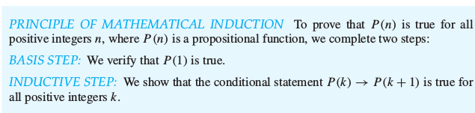
Proof by Mathematical Induction
A proof by mathematical induction has two parts
1. Basis Step:
Show that P(1) is true
2. Inductive Step:
Assume P(k) is true(called as inductive hypothesis) and
Show that P(k + 1) is true on the basis of the inductive hypothesis
Notes:
8

Slide 9
Example 1 (Summation Type)
Show by mathematical induction, for all n ≥ 1; 1 + 2 + 3 + … + n = n (n+1)
2
Basic step
Prove that P(1) is true.
The first number in the sequence is 1, so
P(1) = 1 (1 + 1) = 1
2
Therefore, it is true. ( can proceed to the next step)
Notes:
9

Slide 10

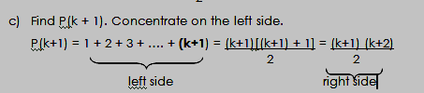
Proving for all n ≥ 1; 1 + 2 + 3 + … + n = n (n+1) 2
We will ASSUME this is TRUE
Notes:
10

Slide 11
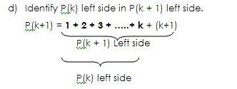
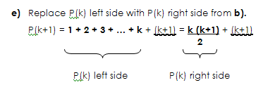
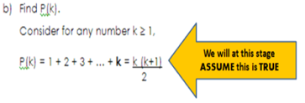
Now check against the sequence to prove that after adding k+1 to k, the statement is still true
Notes:
11

Slide 12
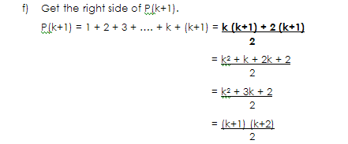
Conclusion
So, with Principle of Mathematical Induction, P(n) is true for all n ≥ 1.
Notes:
12

Slide 13
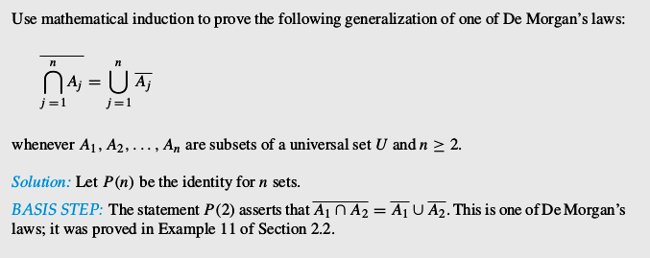
Notes:
13

Slide 14
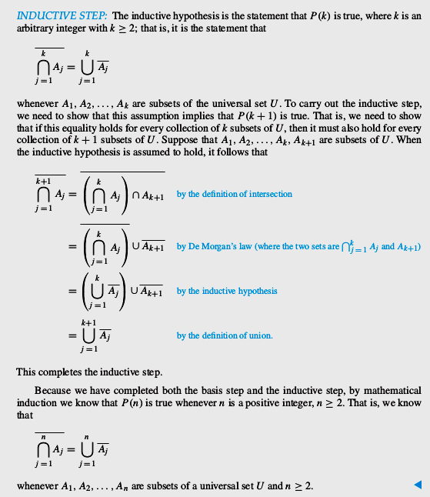
Notes:
14

Slide 15
Relations
Relations & their properties
Definition 1
Let A and B be sets. A binary relation from A to B is a subset of A x B.
In other words, a binary relation from A to B is a set R of ordered pairs where the first element of each ordered pair comes from A and the second element comes from B.
15
Notes:
15

Slide 16
Relations
Notation:
aRb ⇔ (a, b) ∈ R
aRb ⇔ (a, b) ∉ R
Let A = {0, 1, 2} and B = {a, b}. Then {(0, a), (0, b), (1, a), (2, b)} is a relation from A to B.
0
R | a b
0 1 2 | X X X X
a
1
b
2
16
Notes:
16

Slide 17
Relations
Relations on a set
Definition 2
A relation on the set A is a relation from A to A.
Example: A = set {1, 2, 3, 4}. Which ordered pairs are in the relation R = {(a, b) | a divides b} Solution: Since (a, b) is in R if and only if a and b are positive integers not exceeding 4 such that a divides b
R = {(1,1), (1,2), (1,3), (1,4), (2,2), (2,4), (3,3), (4,4)}
17
Notes:
17

Slide 18
Relations
Properties of Relations
Definition 3
A relation R on a set A is called reflexive if (a, a) ∈ R for every element a ∈ A.
18
Notes:
18

Slide 19
Relations
Example (a): Consider the following relations on {1, 2, 3, 4} R₁ = {(1,1), (1,2), (2,1), (2,2), (3,4), (4,1), (4,4)} R₂ = {(1,1), (1,2), (2,1)} R₃ = {(1,1), (1,2), (1,4), (2,1), (2,2), (3,3), (3,4), (4,1), (4,4)} R₄ = {(2,1), (3,1), (3,2), (4,1), (4,2), (4,3)} R₅ = {(1,1), (1,2), (1,3), (1,4), (2,2), (2,3), (2,4), (3,3), (3,4), (4,4)} R₆ = {(3,4)} Which of these relations are reflexive?
19
Notes:
19

Slide 20
Relations
Solution: R₃ and R₅: reflexive ⇐ both contain all pairs of the form (a, a): (1,1), (2,2), (3,3) & (4,4). R₁, R₂, R₄ and R₆: not reflexive ⇐ not contain all of these ordered pairs. (3,3) is not in any of these relations.
R₁ = {(1,1), (1,2), (2,1), (2,2), (3,4), (4,1), (4,4)} R₂ = {(1,1), (1,2), (2,1)} R₃ = {(1,1), (1,2), (1,4), (2,1), (2,2), (3,3), (3,4), (4,1), (4,4)} R₄ = {(2,1), (3,1), (3,2), (4,1), (4,2), (4,3)} R₅ = {(1,1), (1,2), (1,3), (1,4), (2,2), (2,3), (2,4), (3,3), (3,4), (4,4)} R₆ = {(3,4)}
20
Notes:
20

Slide 21
Relations
Definition 4:
A relation R on a set A is called symmetric if (b, a) ∈ R whenever (a, b) ∈ R, for all a, b ∈ A. A relation R on a set A such that (a, b) ∈ R and (b, a) ∈ R only if a = b, for all a, b ∈ A, is called antisymmetric.
21
Notes:
21

Slide 22
Relations
Example: Which of the relations from example (a) are symmetric and which are antisymmetric?
Solution:
R₂ & R₃: symmetric ⇐ each case (b, a) belongs to the relation whenever (a, b) does. For R₂: only thing to check that both (1,2) & (2,1) belong to the relation For R₃: it is necessary to check that both (2,1) & (4,1) belong to the relation. None of the other relations is symmetric: find a pair (a, b) so that it is in the relation but (b, a) is not.
R₁ = {(1,1), (1,2), (2,1), (2,2), (3,4), (4,1), (4,4)} R₂ = {(1,1), (1,2), (2,1)} R₃ = {(1,1), (1,2), (1,4), (2,1), (2,2), (3,3), (4,1), (4,4)} R₄ = {(2,1), (3,1), (3,2), (4,1), (4,2), (4,3)} R₅ = {(1,1), (1,2), (1,3), (1,4), (2,2), (2,3), (2,4), (3,3), (3,4), (4,4)} R₆ = {(3,4)}
22
Notes:
22

Slide 23
Relations
Solution (cont.):
R₄, R₅ and R₆: antisymmetric ⇐for each of these relations there is no pair of elements a and b with a ≠ b such that both (a, b) and (b, a) belong to the relation. None of the other relations is antisymmetric.: find a pair (a, b) with a ≠ b so that (a, b) and (b, a) are both in the relation.
R₁ = {(1,1), (1,2), (2,1), (2,2), (3,4), (4,1), (4,4)} R₂ = {(1,1), (1,2), (2,1)} R₃ = {(1,1), (1,2), (1,4), (2,1), (2,2), (3,3), (3,4), (4,1), (4,4)} R₄ = {(2,1), (3,1), (3,2), (4,1), (4,2), (4,3)} R₅ = {(1,1), (1,2), (1,3), (1,4), (2,2), (2,3), (2,4), (3,3), (3,4), (4,4)} R₆ = {(3,4)}
23
Notes:
23

Slide 24
Relations
Definition 5:
A relation R on a set A is called transitive if whenever (a, b) ∈ R and (b,c) ∈ R, then (a, c) ∈ R, for all a, b, c ∈ R.
24
Notes:
24

Slide 25
Relations
Example: Which of the relations in example (a) are transitive?
R₄ , R₅ & R₆ : transitive ⇐ verify that if (a, b) and (b, c) belong to this relation then (a, c) belongs also to the relation R₄ transitive since (3,2) and (2,1), (4,2) and (2,1), (4,3) and (3,1), and (4,3) and (3,2) are the only such sets of pairs, and (3,1) , (4,1) and (4,2) belong to R₄. Same reasoning for R₅ and R₆.
R₁ : not transitive ⇐ (3,4) and (4,1) belong to R₁, but (3,1) does not.
R₂ : not transitive ⇐ (2,1) and (1,2) belong to R₂, but (2,2) does not.
R₃ : not transitive ⇐ (4,1) and (1,2) belong to R₃, but (4,2) does not.
R₁ = {(1,1), (1,2), (2,1), (2,2), (3,4), (4,1), (4,4)} R₂ = {(1,1), (1,2), (2,1)} R₃ = {(1,1), (1,2), (1,4), (2,1), (2,2), (3,3), (3,4), (4,1), (4,4)} R₄ = {(2,1), (3,1), (3,2), (4,1), (4,2), (4,3)} R₅ = {(1,1), (1,2), (1,3), (1,4), (2,2), (2,3), (2,4), (3,3), (3,4), (4,4)} R₆ = {(3,4)}
25
Notes:
25

Slide 26
Equivalence relations
A relation on a set A is called an equivalence relation if it is reflexive, symmetric, and transitive
Consider relation R = { (a,b) | len(a) = len(b) }
Where len(a) means the length of string a
It is reflexive: len(a) = len(a)
It is symmetric: if len(a) = len(b), then len(b) = len(a)
It is transitive: if len(a) = len(b) and len(b) = len(c), then len(a) = len(c)
Thus, R is a equivalence relation
26
Notes:
26

Slide 27
Equivalence classes
Let R be an equivalence relation on a set A. The set of all elements that are related to an element a of A is called the equivalence class of a.
The equivalence class of a with respect to R is denoted by [a]_{R}
When only one relation is under consideration, the subscript is often deleted, and [a] is used to denote the equivalence class
Note that these classes are disjoint!
As the equivalence relation is symmetric
27
Notes:
27

Slide 28
More on equivalence classes
Consider the relation R = { (a,b) | a mod 2 = b mod 2 }
Thus, all the even numbers are related to each other
As are the odd numbers
The even numbers form an equivalence class
As do the odd numbers
The equivalence class for the even numbers is denoted by [2] (or [4], or [784], etc.)
[2] = { …, -4, -2, 0, 2, 4, … }
2 is a representative of it’s equivalence class
There are only 2 equivalence classes formed by this equivalence relation
28
Notes:
28

Slide 29
More on equivalence classes
Consider the relation R = { (a,b) | a = b or a = -b }
The equivalence class for an integer a:
[7] = { 7, -7 }
[0] = { 0 }
[a] = { a, -a }
There are an infinite number of equivalence classes formed by this equivalence relation
29
Notes:
29

Slide 30
Partitions
Consider the relation R = { (a,b) | a mod 2 = b mod 2 }
This splits the integers into two equivalence classes: even numbers and odd numbers
Those two sets together form a partition of the integers
Formally, a partition of a set S is a collection of non-empty disjoint subsets of S whose union is S
In this example, the partition is { [0], [1] }
Or { {…, -3, -1, 1, 3, …}, {…, -4, -2, 0, 2, 4, …} }
30
Notes:
30

Slide 31

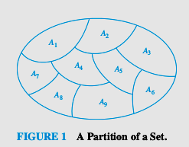
31
Notes:
31

Slide 32
Which of the following are partitions of the set of integers?
The set of even integers and the set of odd integers
Yes, it’s a valid partition
The set of positive integers and the set of negative integers
No: 0 is in neither set
The set of integers divisible by 3, the set of integers leaving a remainder of 1 when divided by 3, and the set of integers leaving a remainder of 2 when divided by 3
Yes, it’s a valid partition
The set of integers less than -100, the set of integers with absolute value not exceeding 100, and the set of integers greater than 100
Yes, it’s a valid partition
The set of integers not divisible by 3, the set of even integers, and the set of integers that leave a remainder of 3 when divided by 6
The first two sets are not disjoint (2 is in both), so it’s not a valid partition
32
Notes:
32

Slide 33
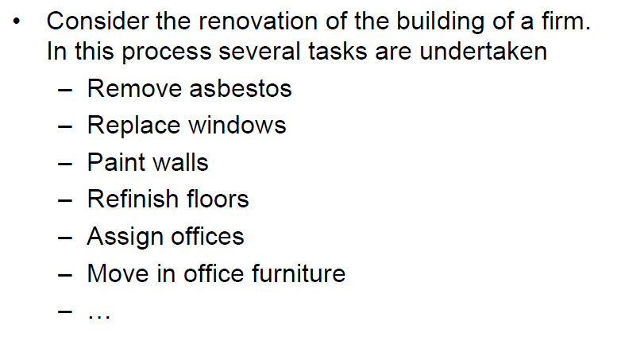

Slide 34
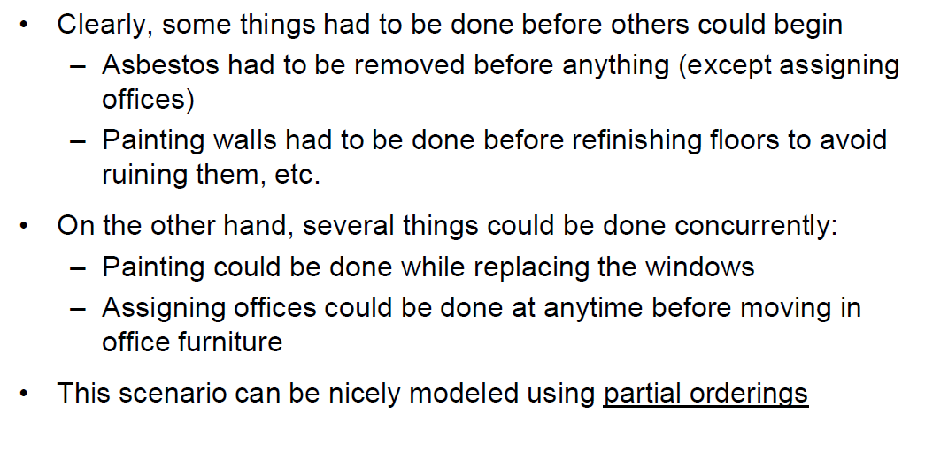

Slide 35
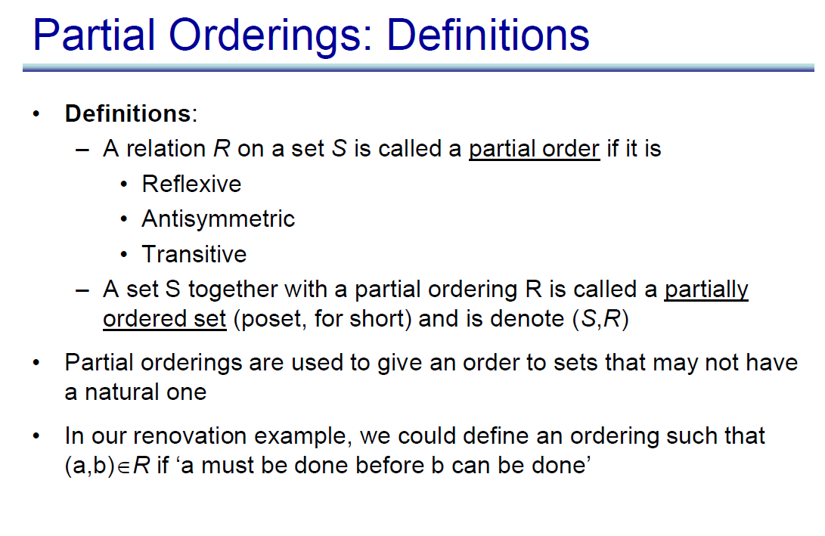

Slide 36
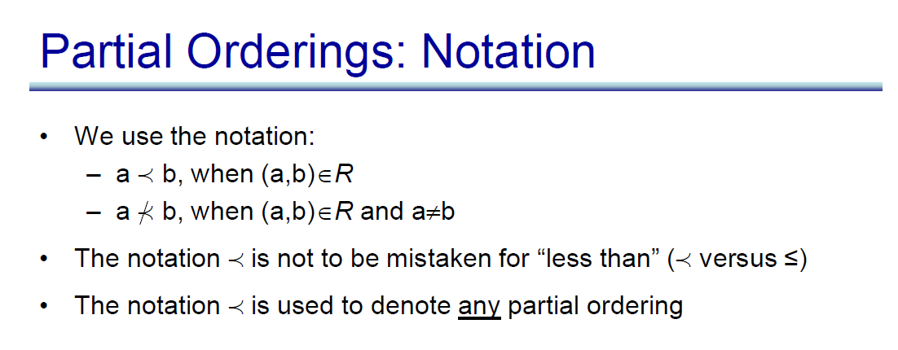

Slide 37
Example (2)
Show that ≥ is a partial order on the set of integers
It is reflexive: a ≥ a for all a ∈ Z
It is antisymmetric: if a ≥ b then the only way that b ≥ a is when b = a
It is transitive: if a ≥ b and b ≥ c, then a ≥ c
Note that ≥ is the partial ordering on the set of integers
(Z, ≥) is the partially ordered set, or poset
37
Notes:
37

Slide 38
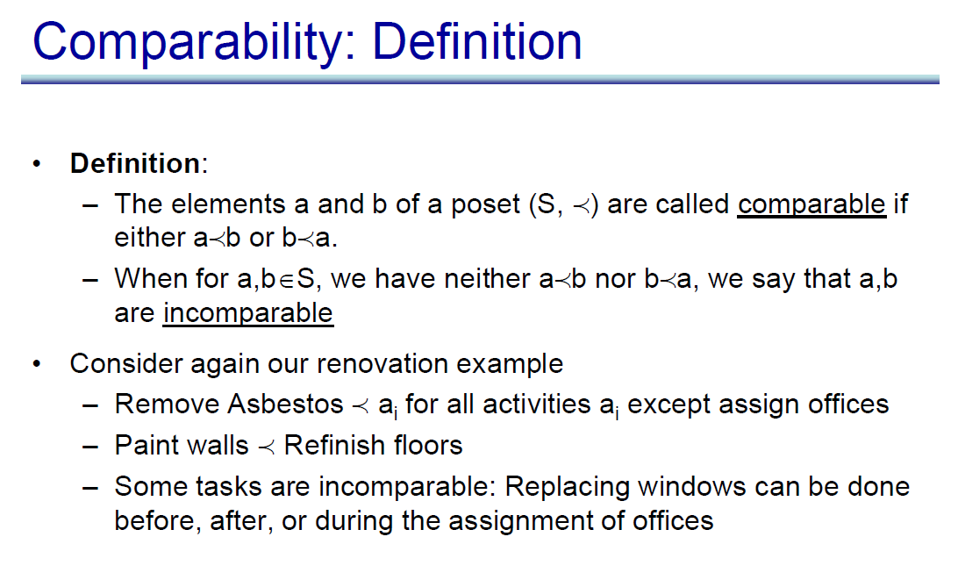

Slide 39
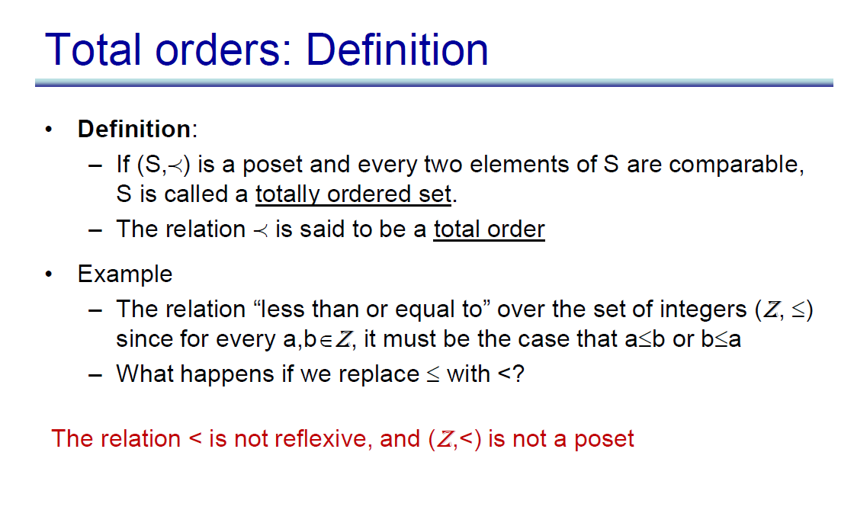
Total Order/ Chain/Totally ordered set

Slide 40
In the poset (Z⁺,≤), are the integers 3 and 9 comparable?
Yes, as 3 ≤ 9
Are 7 and 5 comparable?
Yes, as 5 ≤ 7
As all pairs of elements in Z⁺ are comparable, the poset (Z⁺,≤) is a total order
a.k.a. totally ordered poset, linear order, or chain
40
Notes:
40
40

Slide 41
In the poset (Z⁺,|) with “divides” operator |, are the integers 3 and 9 comparable?
Yes, as 3 | 9
Are 7 and 5 comparable?
No, as 7 | 5 and 5 | 7
Thus, as there are pairs of elements in Z⁺ that are not comparable, the poset (Z⁺,|) is a partial order. It is not a chain.
41
Notes:
41
41

Slide 42
Well-Ordered Set
(S, )
is a well-ordered set if it is a poset such that is a total ordering and such that every nonempty subset of S has a least element.
42
Notes:
42

Slide 43
Well-ordered sets examples
Example: (Z,≤)
Is a total ordered poset (every element is comparable to every other element)
It has no least element
Thus, it is not a well-ordered set
Example: (S,≤) where S = { 1, 2, 3, 4, 5 }
Is a total ordered poset (every element is comparable to every other element)
Has a least element (1)
Thus, it is a well-ordered set
43
Notes:
43
43

Slide 44
Hasse Diagrams
Given any partial order relation defined on a finite set, it is possible to draw the directed graph so that all of these properties are satisfied.
This makes it possible to associate a somewhat simpler graph, called a Hasse diagram, with a partial order relation defined on a finite set.
44
Notes:
44

Slide 45
Hasse Diagrams (continued)
Start with a directed graph of the relation in which all arrows point upward. Then eliminate:
the loops at all the vertices,
all arrows whose existence is implied by the transitive property,
the direction indicators on the arrows.
45
Notes:
45

Slide 46
Example
Let A = {1, 2, 3, 9, 18} and consider the “divides” relation on A:
18
9
2
3
1
46
Notes:
46

Slide 47
Example
Eliminate the loops at all the vertices.
Eliminate all arrows whose existence is implied by the transitive property.
Eliminate the direction indicators on the arrows.
18
9
2
3
1
47
Notes:
47

Slide 48
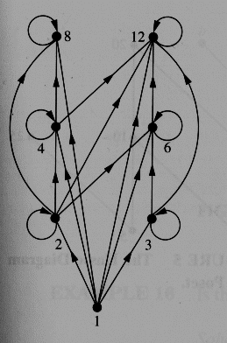
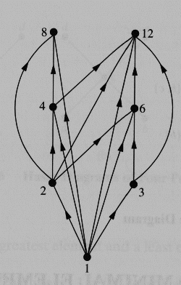
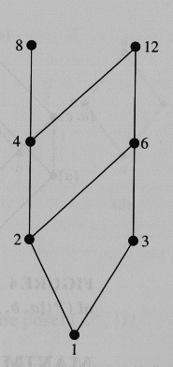
Hasse Diagram
For the poset ({1,2,3,4,6,8,12}, |)
48
Notes:
48
48

Slide 49
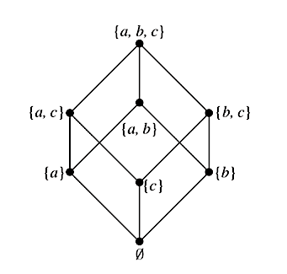
49
Notes:
49
49

Slide 50
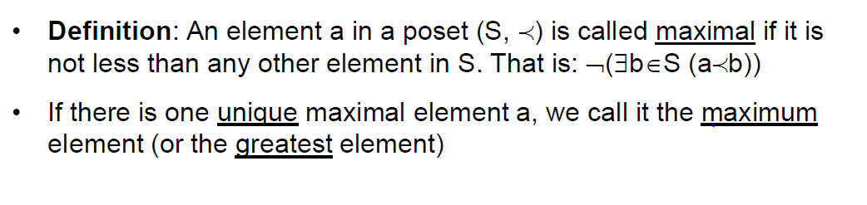
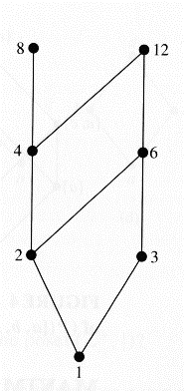
Maximal Elements
50
Notes:
50

Slide 51
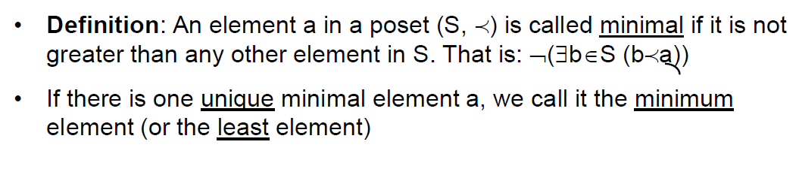
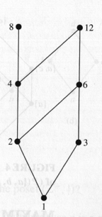
Minimal Elements
51
Notes:
51

Slide 52
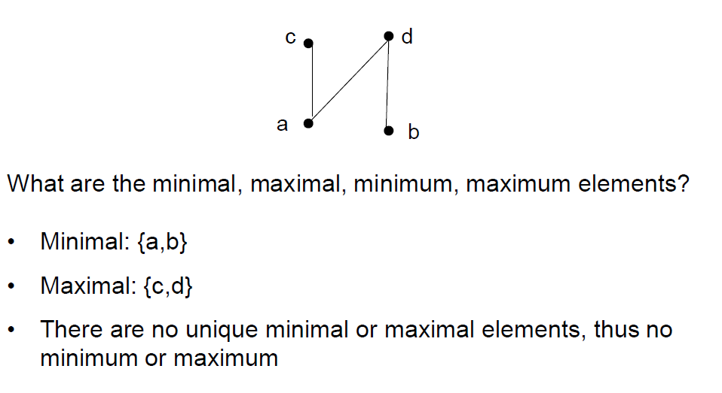

Slide 53
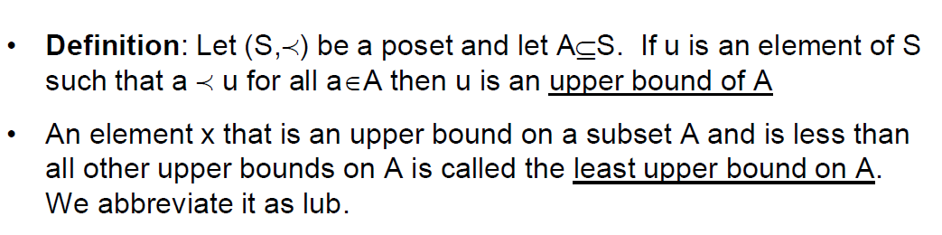
Upper bound
53
Notes:
53

Slide 54
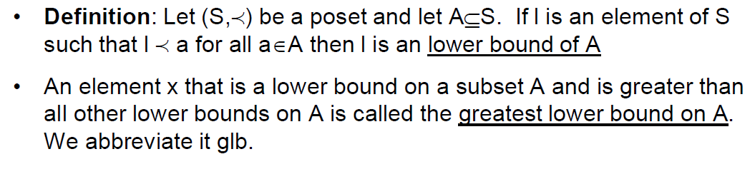
Lower Bound
54
Notes:
54

Slide 55
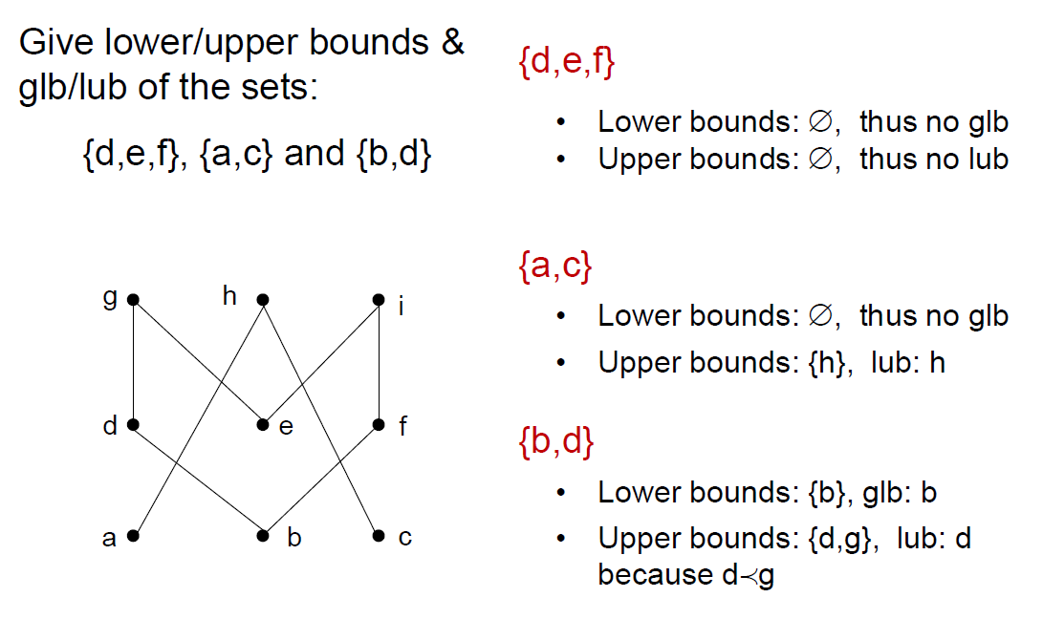

Slide 56
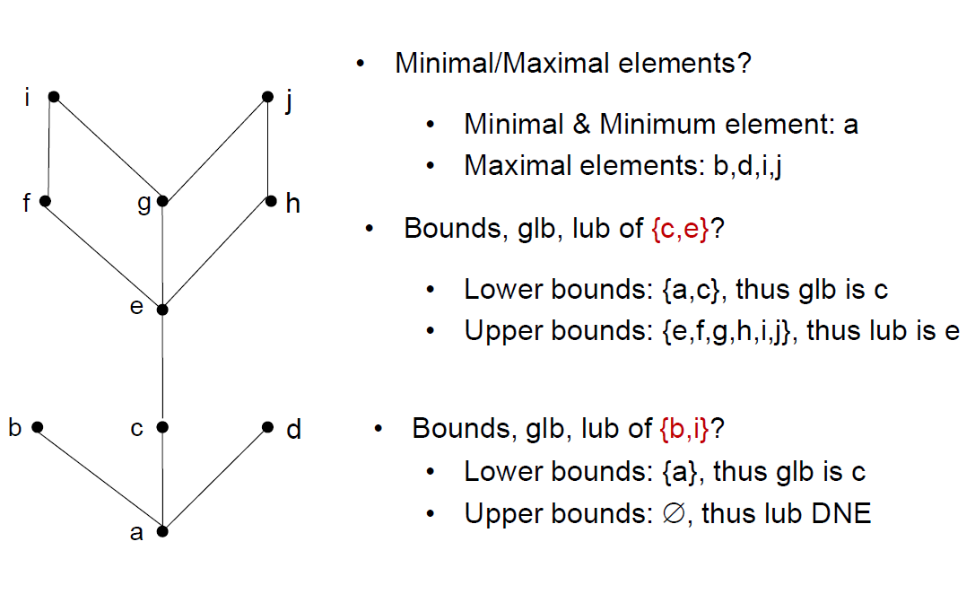

Slide 57
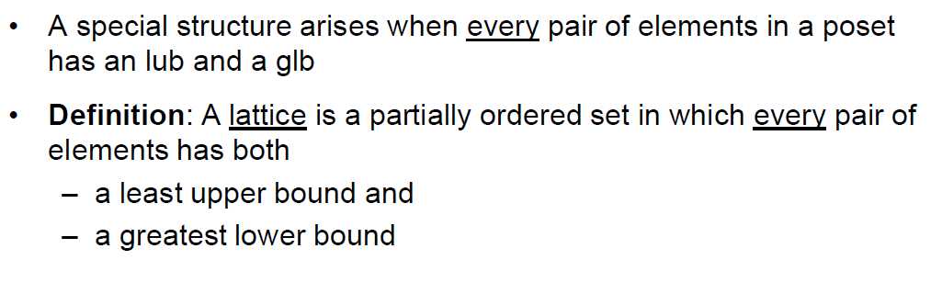
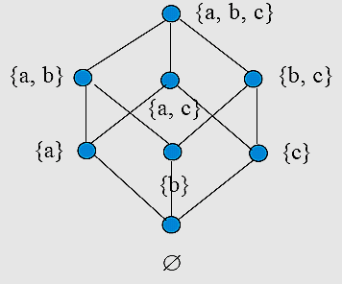
Lattices
57
Notes:
57

Slide 58
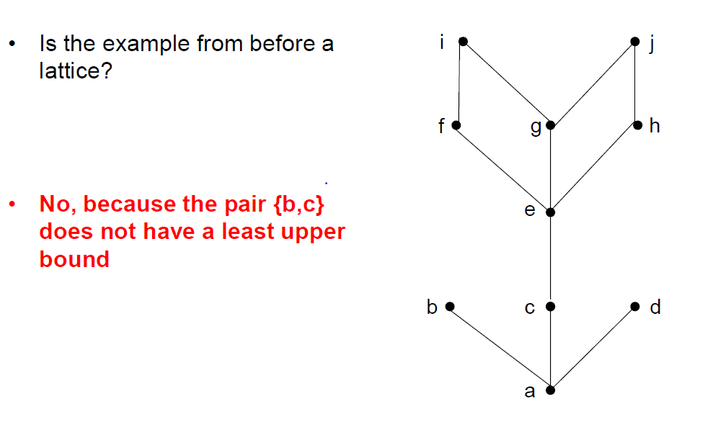

Slide 59
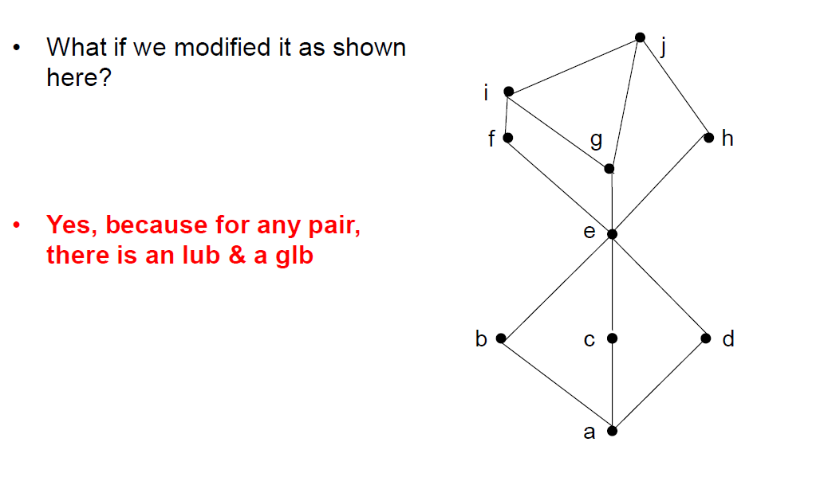

Slide 60
THANKS

