Slide 1
Presentation on
BUG LIFE CYCLE
Presentation by:
-Anudeep K
-Farvej H Kulmi
-Mahesh Parikipandla
-Mantharagiri Muttu
-Manavi M

Slide 2
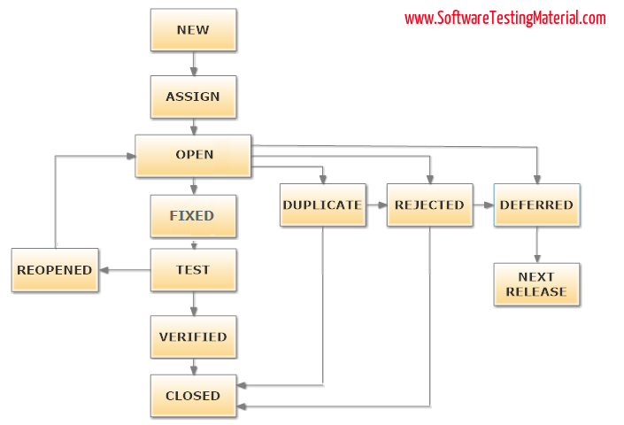
BUG LIFE CYCLE

Slide 3
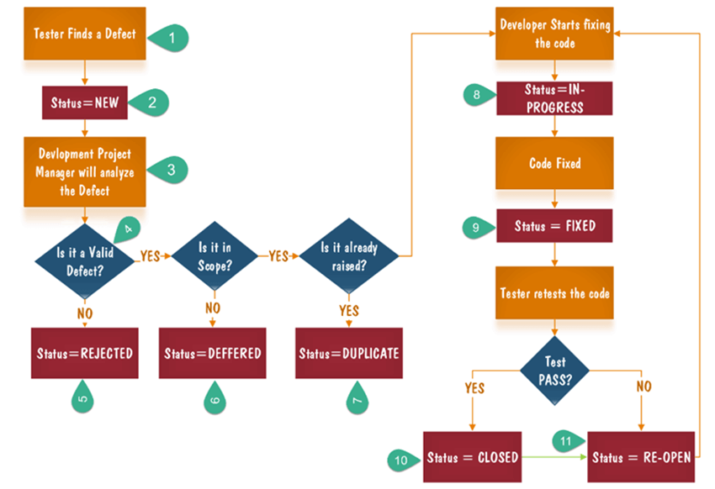
Flow of Cycle

