Slide 1

Python for Data Science (3150713)

Slide 2
Introduction
Project title: Spotify Data analysis.
Name:Patel Manav D.
Enrollment no: 200050131078
Branch: Computer Science Engineering
Divison: CSE-2

Slide 3
Description of Project
Data Analysis with Spotify Data analysis dataset from the years 1920 onward. Dataset has been downloaded from link and it can be found :-https://www.kaggle.com/zaheenhamidani.... The dataset contains two files: spotifydataset.csv and trackes.csv. The file used for this analysis is matches.csv.

Slide 4
About Data Set
Data available in data set:
1. genre
2. artist_name
3. track_name
4. track_id
5. popularity
6. acousticness
7. danceability

Slide 5
Continuous
8. duration_ms
9. energy
10. instrument
11. key
12. liveness
13. mode
14. speechiness
15. tempo

Slide 6
Continuous
16. valence
17. time_signature

Slide 7
Things Analysed from Data Set
1. Most listen Songs in every year.
2. Songs duration .
3. Most listen artist.
4. Most accessable playlist.
5. Most like song.
6. No. of songs play in each city.
7. No. of Songs added in playlist.
9. Top 10 songs based listening.

Slide 8
Continuous
10. Perticular time when people listen song.
11. Most visited songs.
12. Most follow genre.
13. Most follow artist.
14. Most awarded artist.
15. Best Songs for evey year.

Slide 9




Python Libraries we Have Used
1. NumPy
2. pandas
3. Matplotlib
4. seaborn

Slide 10
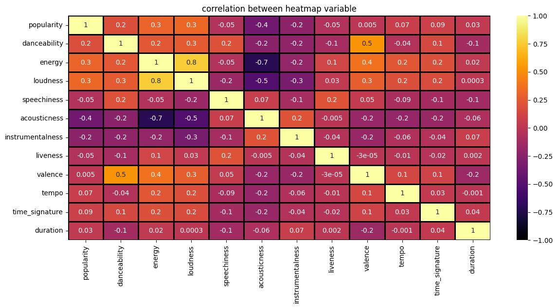
Some Result from Data Set

Slide 11
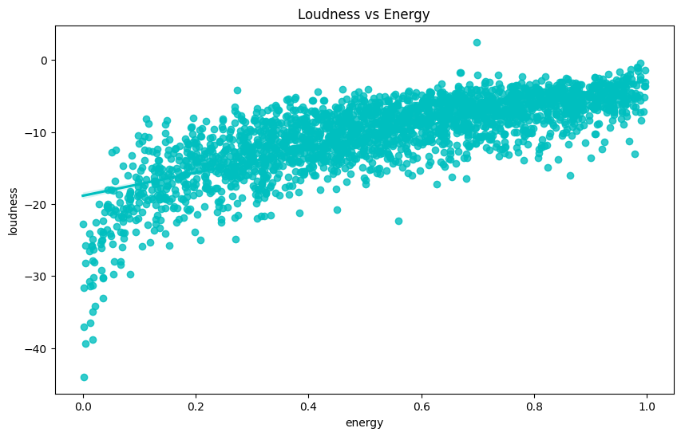
Continuous

Slide 12
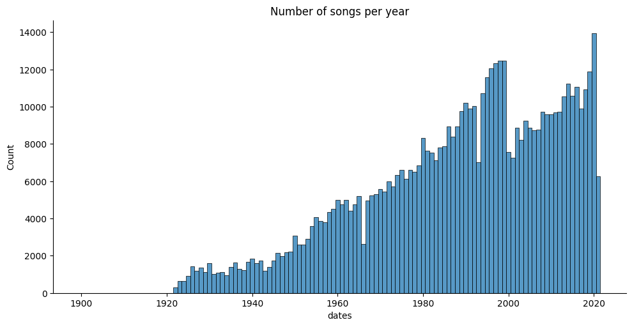
Continuous

Slide 13
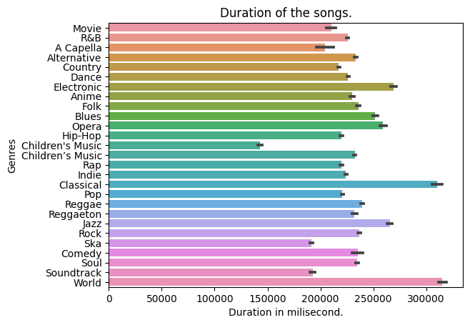
Continuous

Slide 14
Conclusion
The IPL data analysis is use to understand data. With the help of the data analysis we can find out the pros and cons of the player and work on the performance of the individual player and also the whole, it will help in taking decision. This application can be used for the selection commission to select the best player including bowler, batsman and even the fielder for the team and to perform well on the field during match. It is helpful for all type of game to work on the performance and predict the future performance of the player and team.

Slide 15



Use full links
https://github.com/Manavpatel1823/SpotifyDatasetAnalysis
https://colab.research.google.com/drive/1C3uRkjIG-spUtXDbBsdTIz6uIGRWzoSN
https://www.kaggle.com/datasets/zaheenhamidani/ultimate-spotify-tracks-db

Slide 16
Thank you

