Slide 1
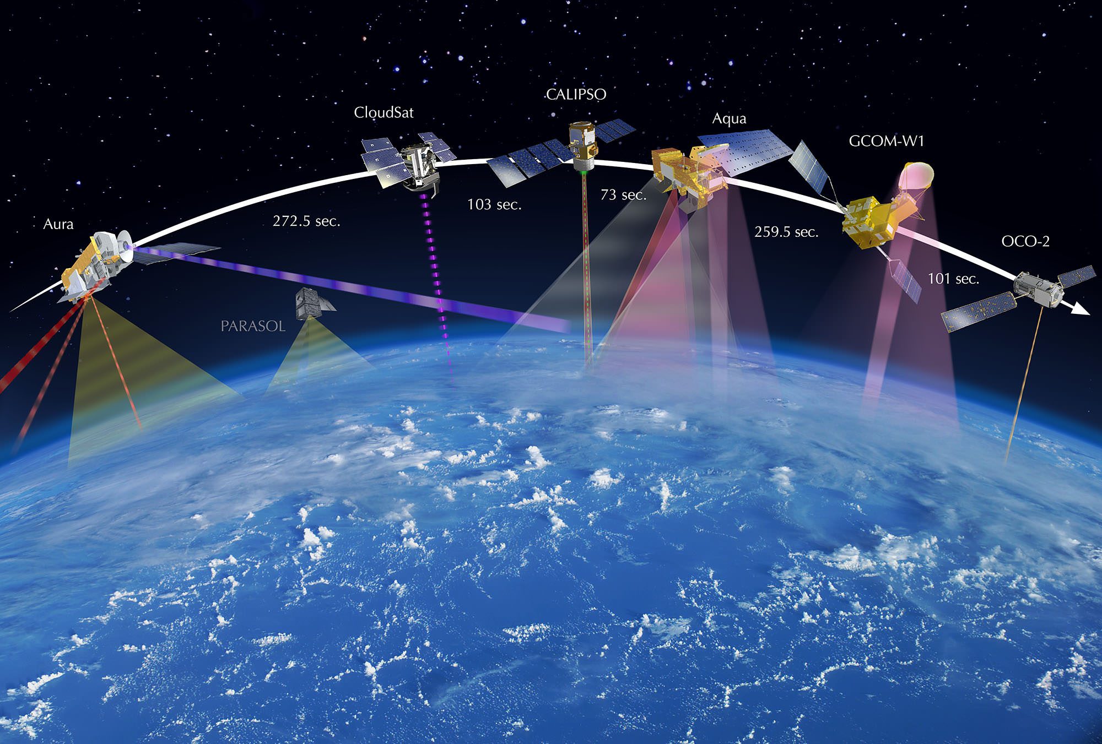
Satellite Image Analysis
using Vision Transformers
Achieving SOTA in Vision Classification
Manav Garg 21BAI1045,
Atharva Subhash Bodke 21BAI1855
Vellore Institute of Technology, Chennai

Slide 2
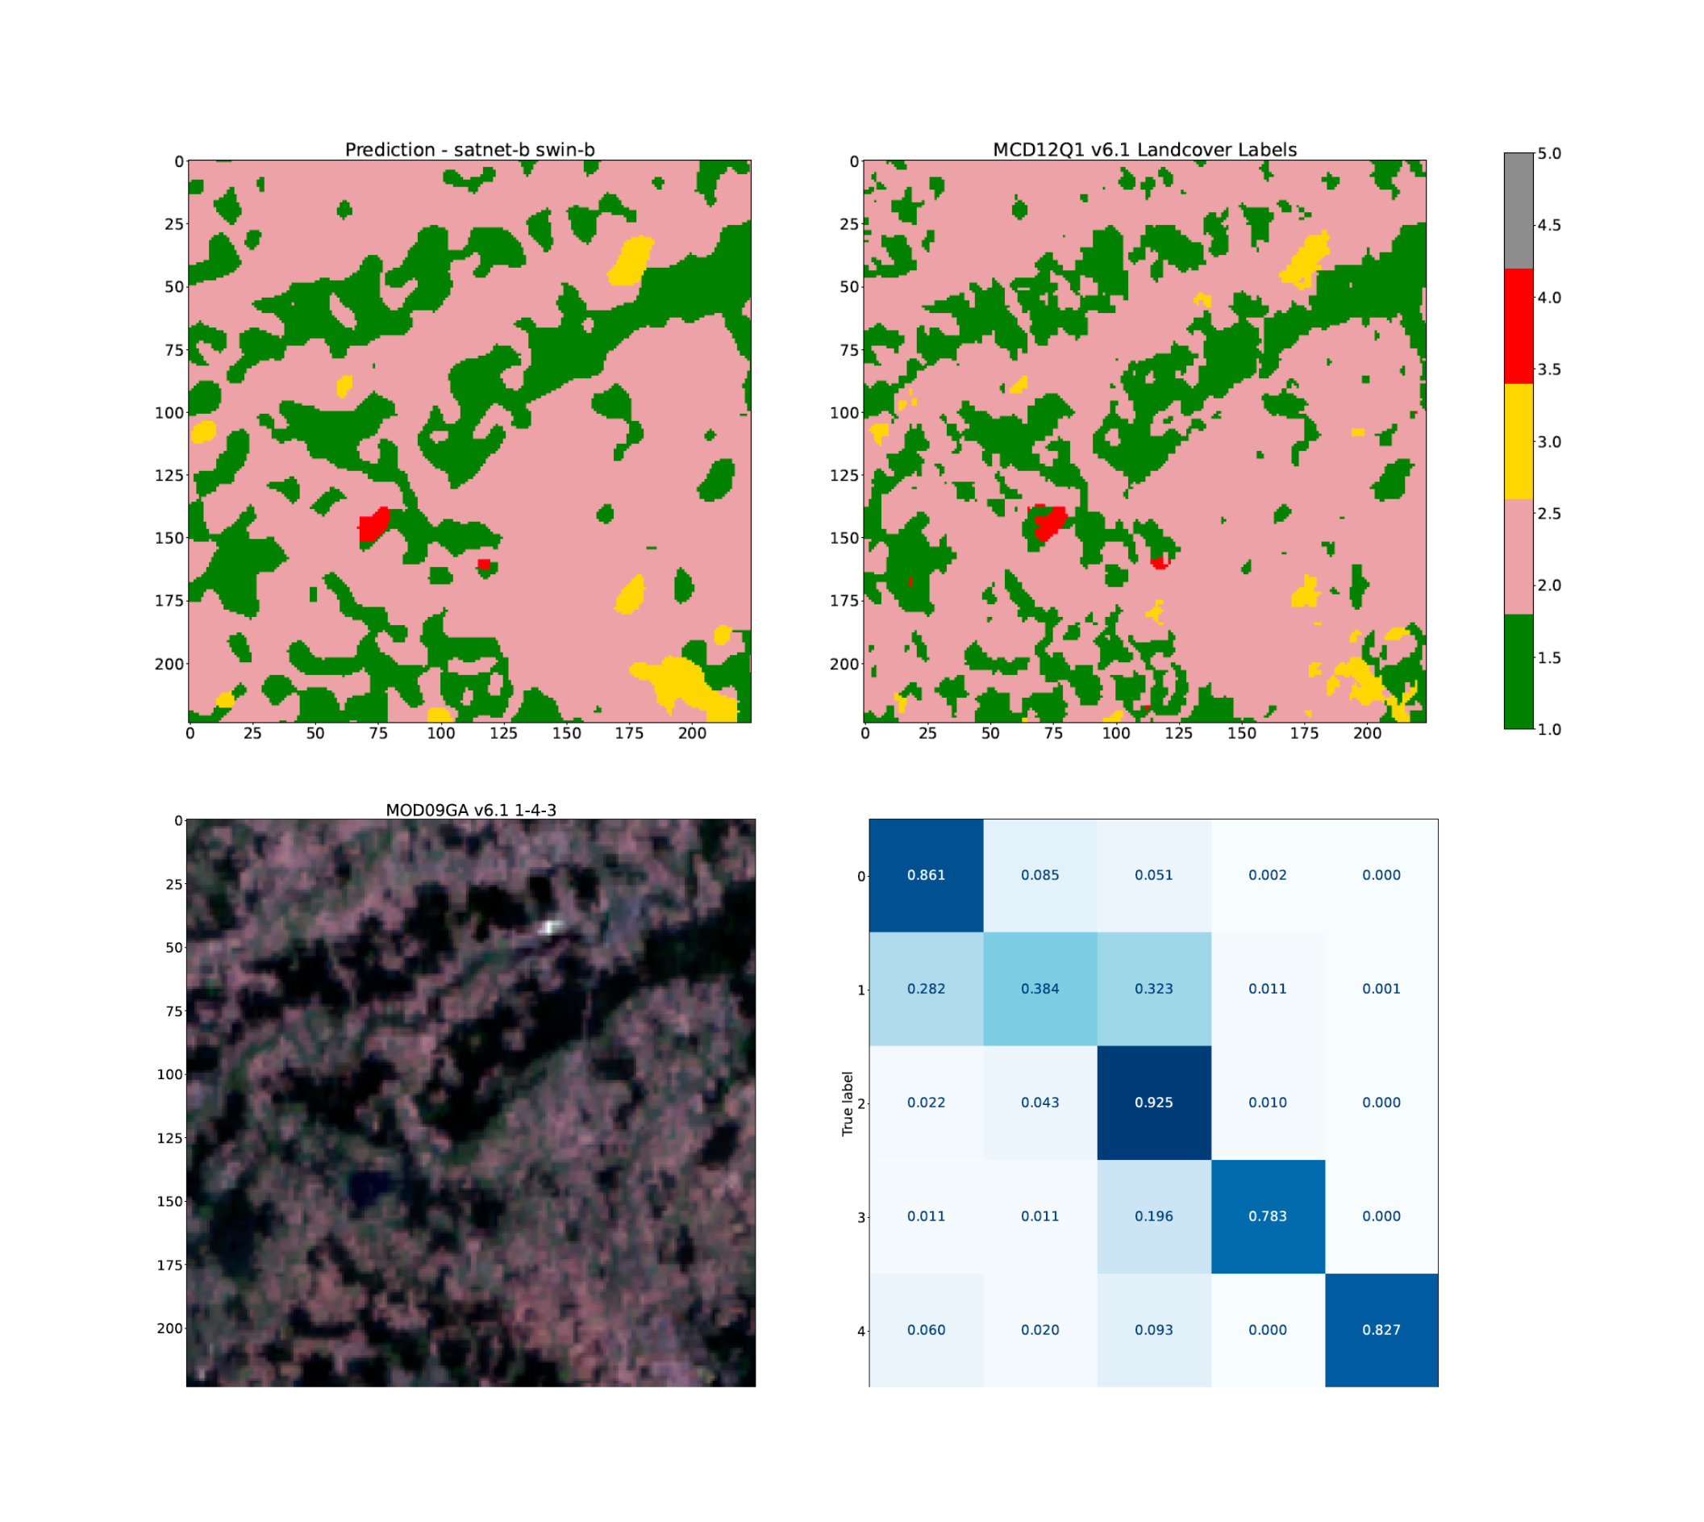
Satellite Image Analysis
Importance & Challenges
Satellite image analysis plays a vital role in various fields like urban planning, agriculture, and environmental monitoring.
The abundance of satellite data presents challenges in terms of storage, processing, and retrieval.
Machine learning algorithms are being used to automate the analysis of satellite images, enabling faster and more accurate results.
Satellite image analysis helps in detecting changes, identifying patterns, and understanding trends in land cover and land use.
Photo by Pexels

Slide 3
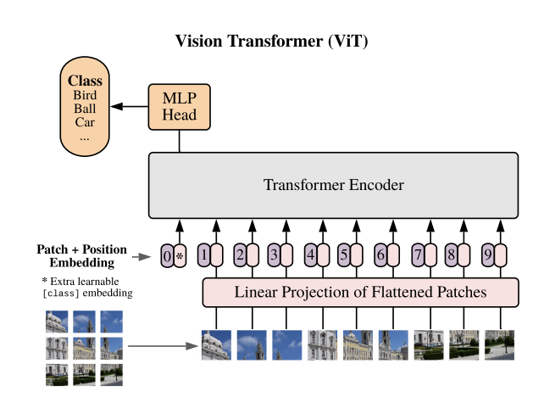
Vision Transformers (ViTs)
Revolutionary Image Analysis
Vision Transformers (ViTs) are a novel architecture for image analysis, replacing convolutions with self-attention mechanisms for better understanding visual context.
ViTs achieve state-of-the-art performance on various computer vision tasks, including image classification, object detection, and segmentation.
Unlike traditional CNNs, ViTs process images as sequences of patches, enabling better capturing of long-range dependencies and global context.
The self-attention mechanism in ViTs allows each patch to attend to all other patches, facilitating comprehensive feature extraction and semantic understanding.
Photo by Pexels

Slide 4
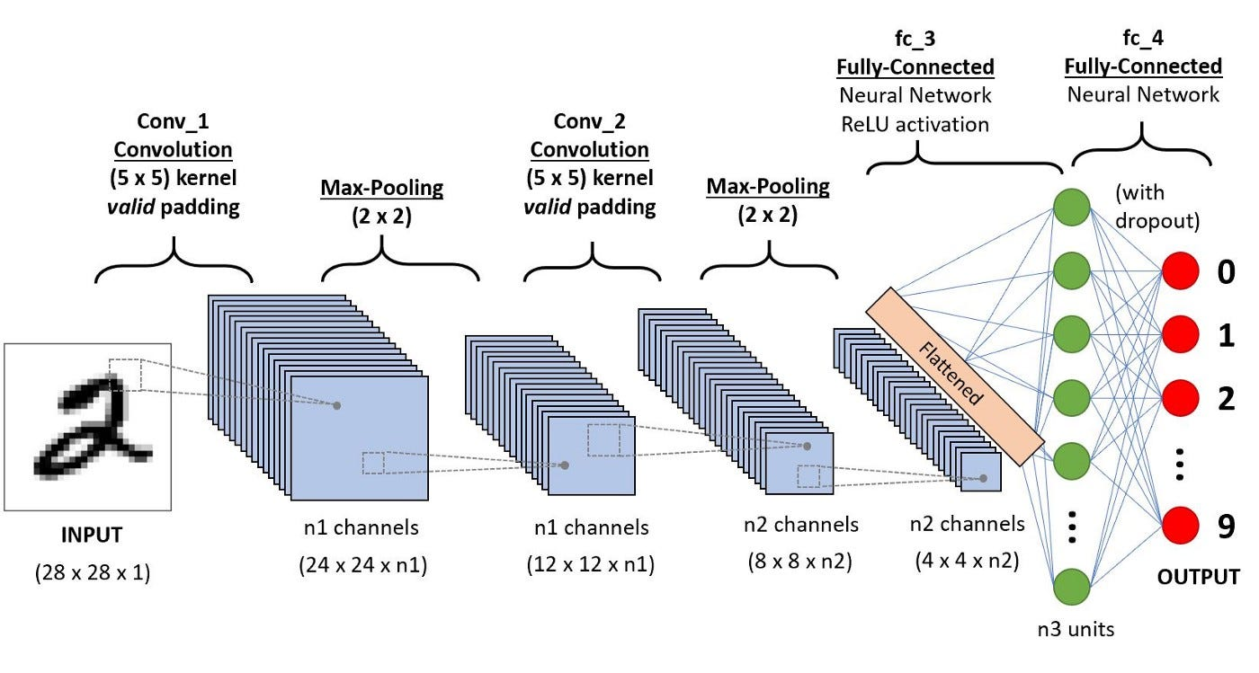
ViTs vs CNNs
Long-range dependencies
ViTs excel at capturing long-range dependencies in images by attending to all image patches at once.
CNNs rely on local receptive fields and hierarchical feature extraction to capture dependencies in images.
ViTs achieve this by using self-attention mechanisms in their transformer-based architecture.
CNNs achieve this through the use of convolutional layers and pooling operations.
VS
Photo by Pexels

Slide 5
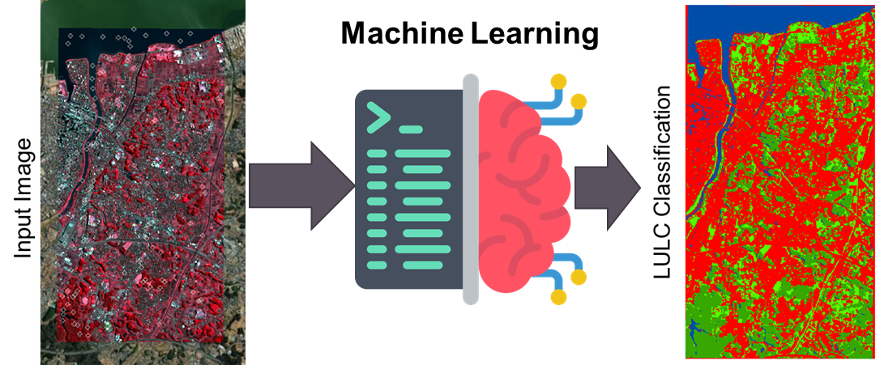
Exploring ViTs for Land Cover Classification
ViTs for Land Use
ViTs offer great potential for accurate land cover classification from satellite images.
With its attention mechanism, ViTs can capture spatial relationships and classify different land cover classes.
The transformer architecture of ViTs enables comprehensive feature extraction for improved classification accuracy.
ViTs can handle large-scale datasets and efficiently learn patterns in land use classification.

Slide 6
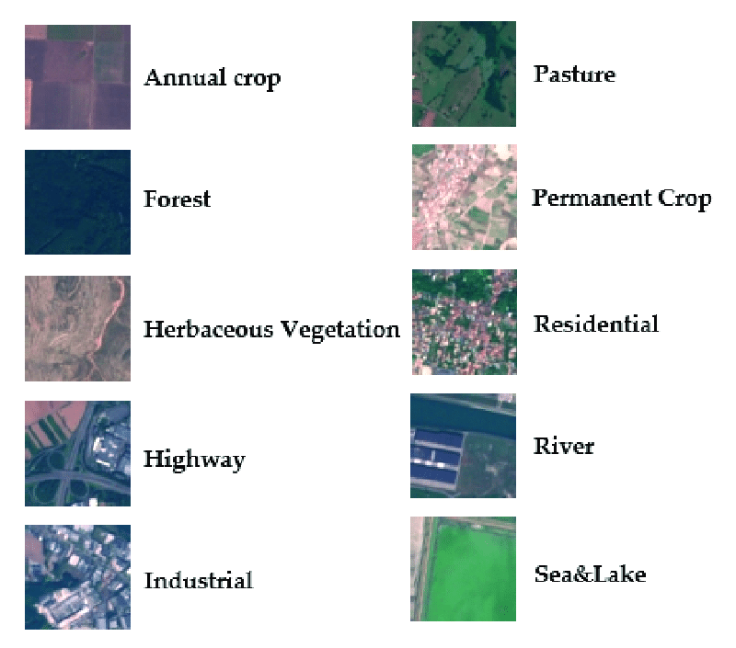
Introduction to EuroSAT Dataset
Fine-Tuning ViT Models
The EuroSAT dataset is a comprehensive collection of satellite images
It contains 27,000 labeled images distributed across 10 land use classes
EuroSAT dataset enables transfer learning with ViT models for image classification tasks
Fine-tuning ViT models with EuroSAT dataset achieves state-of-the-art results
Photo by Pexels

Slide 7
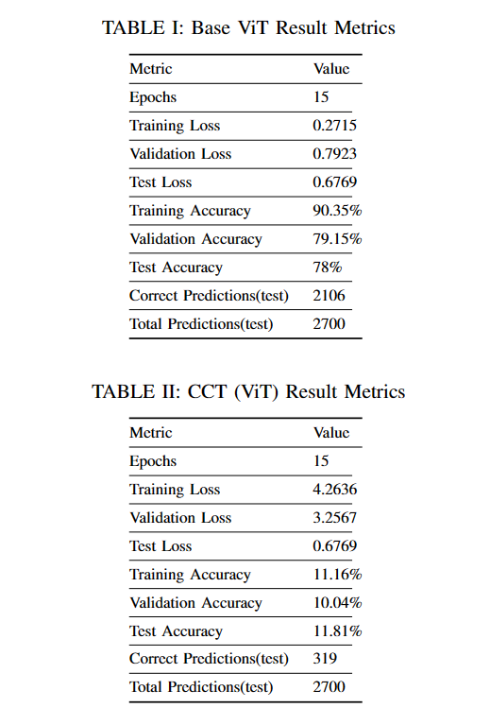
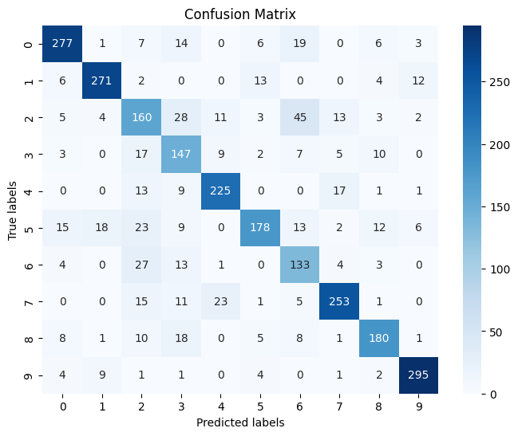
Evaluation Metrics for ViTs
Assessing ViT Efficacy
Evaluation metrics play a crucial role in assessing the performance of Vision Transformers (ViTs).
Common techniques include accuracy, precision, recall, and F1 score.
Accuracy measures the overall correctness of the model's predictions.
Precision focuses on the proportion of true positive predictions among the positives.
Photo by Pexels

Slide 8
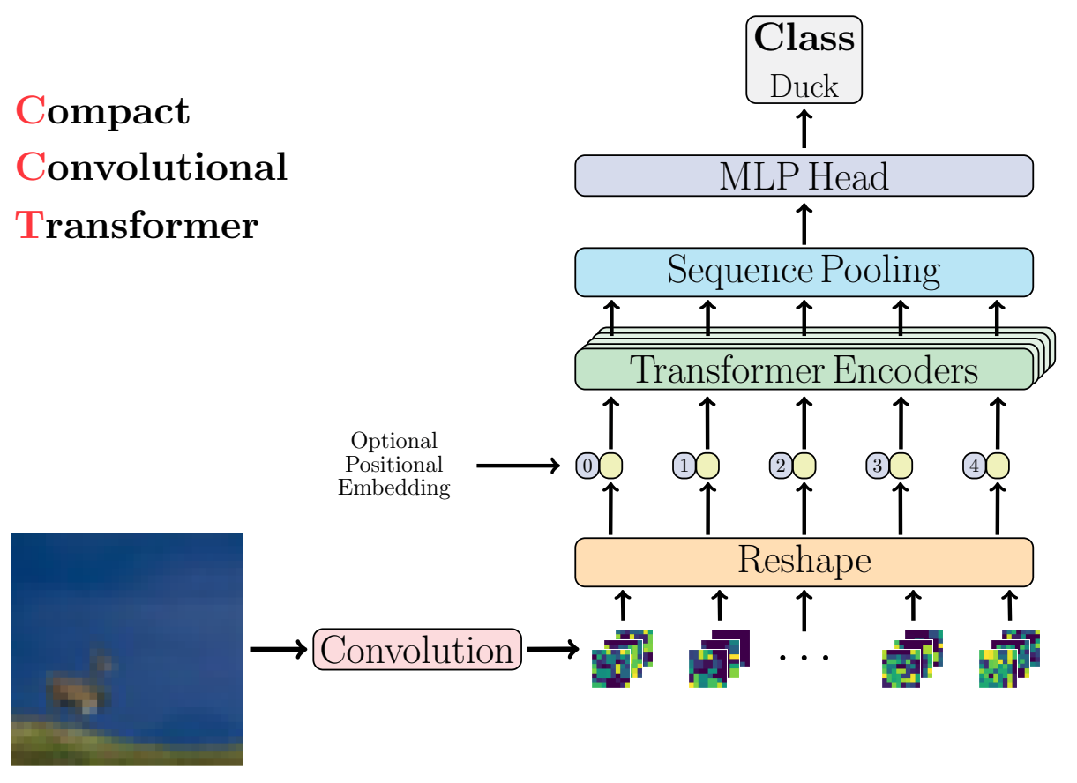
Comparison of ViT Models
Base ViT vs CCT
The base ViT model is a popular choice for satellite image classification.
It uses transformers to capture spatial information in the images.
However, the CCT model takes into account contextual information as well.
It incorporates data from multiple sources to improve classification accuracy.
VS

Slide 9
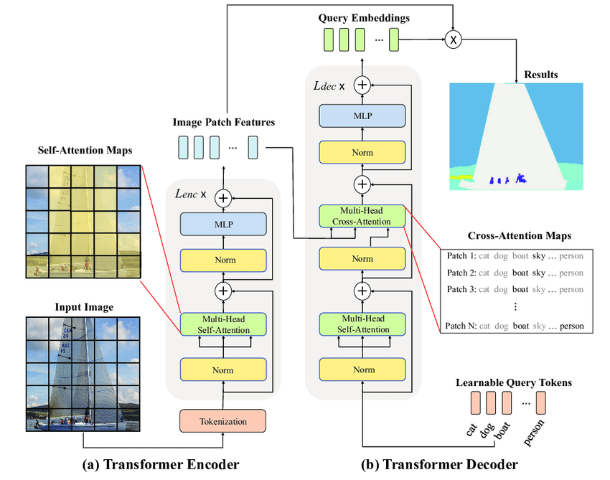
Prior Studies on Image Segmentation and Object Detection using ViTs
Deep Learning for Vision
Image segmentation and object detection tasks have seen significant advancements with the introduction of Vision Transformers (ViTs).
ViTs have shown promising results in various computer vision tasks, thanks to their ability to capture global context information.
In image segmentation, ViTs achieve state-of-the-art performance by leveraging self-attention mechanisms to incorporate long-range dependencies.
Similarly, in object detection, ViTs have outperformed traditional methods by effectively handling object localization and classification tasks.
Photo by Pexels

Slide 10
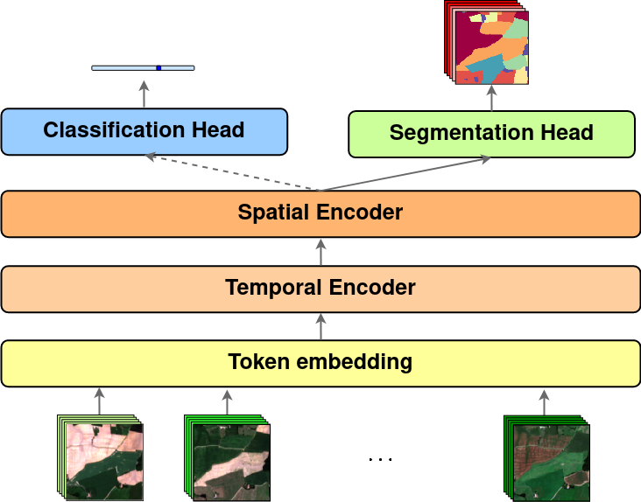
ViTs in Satellite Image Analysis
Insights & Contributions
ViTs have revolutionized satellite image analysis by leveraging transformer-based models for feature extraction and classification.
Compared to traditional methods, ViTs offer higher accuracy in land cover classification and object detection in satellite imagery.
The attention mechanism in ViTs allows them to capture global spatial relationships, enabling better interpretation of satellite data.
ViTs have contributed to advancements in disaster management, agriculture monitoring, urban planning, and environmental conservation.

Slide 11
Thank You

