Slide 1
Global Warming Detection Using Machine Learning
-Dhanush Srinivas (1DT21AI013)
G Praveen (1DT21AI017)
Jagatha Venkat Surya (1DT21AI027)
Manavendra Singh (1DT21AI033)
Sriraj SR (1DT21AI056)

Slide 2
Global Warming
Global warming refers to the increase in average global temperature since the Industrial Revolution.
The average global temperature has increased by about one degree Celsius since 1880.
Global warming is a continuous process, with scientists fearing that the average global temperature could rise an additional 0.3 to 0.7 °C by 2035.

Slide 3
Project
The main objective of the project is to analyze global warming by examining PM 2.5 air pollution levels for approximately 50 years based on the
data obtain from “The State wise PM 2.5 levels by WHO” [4] make predictions
for its future trends.
Major Objectives of this model are:
• To predict the change in the surface temperature of Earth for the next 10 years.
• To predict the change in greenhouse gases concentration for the next 10 years.
• To make a graphical representation based on the prediction model

Slide 4
Algorithm
Linear regression is a type of supervised machine learning algorithm that computes the linear relationship between a dependent variable and one or more independent features
The goal of the algorithm is to find the best linear equation that can predict the value of the dependent variable based on the independent variables
The slope of the line indicates how much the dependent variable changes for a unit change in the independent variable

Slide 5
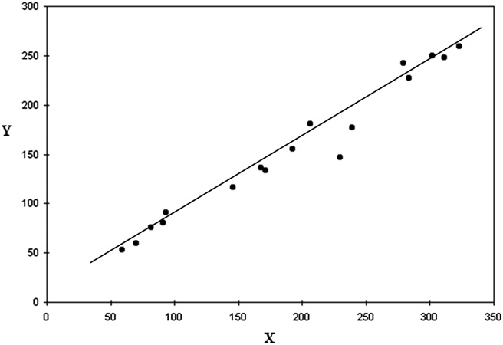
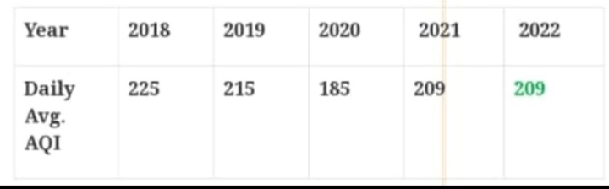
Algorithm

Slide 6
References
[1] ”Global Warming Prediction in India using Machine Learning” by D. Deva Hema, Anirban Pal, Vineet Loyer, Rajeev Gaurav International Journal of Engineering and Advanced Technology (IJEAT) ISSN: 2249 – 8958, Volume-9 Issue-1, October 2019
[2] Zheng, H. (2018) Analysis of Global Warming Using Machine Learning. Computational Water, Energy, and Environmental Engineering, 7, 127-141. https://doi.org/10.4236/cweee.2018.73009

Slide 7
Conclusion
We have seen a significant rise in concentration of greenhouse gases which tends to further increase if we do not take serious measures in our daily lives.
The gases have a direct effect in increasing the surface temperature
of the Earth; hence we also see an upward trend in the surface temperature of the Earth.
It should also be noted that although these changes seem minor, they are extrapolation of merely a decade, with every unit increase in the temperature, the living need to adapt more and more to survive.

Slide 8
Thank You

