Slide 1
Blockchain and its Applications
Submitted by-
Tanmya Rampal, Manbir Singh, Money Saxena, Gurpreet Kaur, Ashish Singh, Jagmandeep Singh , Jaskaran Singh

Slide 2
Introduction
Blockchain is a decentralized digital ledger technology that enables secure, transparent, and tamper-proof record-keeping. It allows participants in a network to maintain a shared database that can be accessed and updated without the need for a central authority.
Transactions are verified and recorded in a permanent and immutable way, making it difficult for any single entity to manipulate the data. This technology has the potential to transform industries ranging from finance and healthcare to supply chain management and voting systems.

Slide 3
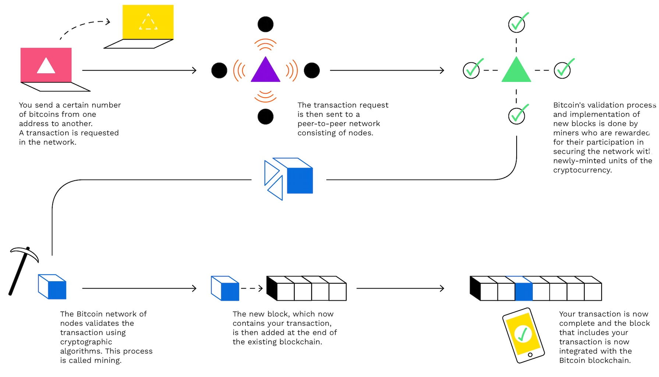
How does Blockchain Work?

Slide 4
How is Blockchain used for Bitcoin?
Bitcoin uses blockchain to keep track of all the transactions that occur on the network.
When someone sends Bitcoin to another person, this transaction is recorded in a block of data. Each block contains a unique code known as a hash, that is created using complex mathematical algorithms.
This hash code is unique to that particular block and serves as a digital fingerprint, making it virtually impossible for anyone to modify the contents of the block without being detected.
Once a block of transactions has been added to the blockchain, it is considered to be permanent and cannot be altered.

Slide 5
Applications of Blockchain
1. Voting Based on Bitcoin BEvote
BEvote is a decentralized voting system that uses the Bitcoin blockchain to provide a secure and transparent platform for elections, ensuring the integrity of the voting process.
The two main challenges in implementing Bitcoin-enabled E-voting are anonymity and robustness. The solution to these challenges is a more secure Bitcoin-based E-voting application- BEvote.
To achieve anonymity, before voting the system uses coin mixing techniques to separate a voter's genuine identity from their Bitcoin address, and this unspecified address is used throughout the voting process.
To ensure robustness, the system adopts an E-voting protocol based on secret sharing that securely distributes voting rights and prevents voting numbers from being leaked

Slide 6
Applications of Blockchain
Features of BEvote
The protocol includes an authentication mechanism based on public key cryptography to prevent Sybil attacks and an encryption policy using joint Shamir random secret sharing to prevent premature leakage of ballots by Supervisors.
The protocol involves several steps, including registration, anonymous address generation, secret sharing, ballot creation, and voting transaction broadcasting.
The security of the protocol may also depend on the implementation of the Supervisor's verification process, which is crucial in ensuring that only legitimate voters, candidates, and mixers participate in the election

Slide 7
Applications of Blockchain
2. Voting Based on Bitcoin My Vote
MyVote is a blockchain-based voting platform that enables users to cast their votes in a secure and transparent manner. By leveraging the power of blockchain technology, MyVote eliminates the need for a central authority or intermediary to oversee the voting process, ensuring the integrity of the election.

Slide 8
Applications of Blockchain
3. Follow my Vote
Online voting has been a topic of discussion for many years, with proponents citing increased convenience and accessibility as potential benefits. However, concerns about security and reliability have prevented the widespread adoption of online voting systems. Follow My Vote addresses these concerns using blockchain technology to provide a secure and transparent voting platform.

Slide 9
Application of Blockchain
Benefits of Follow my Vote
Transparency: Follow My Vote is highly transparent as all votes cast on the blockchain are publicly visible. This ensures that the voting process is fair and accurate, and reduces the likelihood of fraud.
Security: The use of blockchain technology in Follow My Vote provides a high level of security, making it extremely difficult for anyone to hack or manipulate the system.
Accuracy: The use of digital technology in Follow My Vote eliminates the possibility of human error in the vote counting process, leading to more accurate results.
Accessibility: Follow My Vote can be accessed from anywhere with an internet connection, making it much more convenient for voters

Slide 10
Application of Blockchain
Technical Implications of Follow my Vote
Use of Blockchain: Follow My Vote uses blockchain technology, which is a decentralized, secure, and transparent system that allows for the creation of immutable records of all voting activities.
Encryption: Follow My Vote uses encryption to secure all voting data and ensure that only authorized personnel can access it. This helps to prevent hacking and unauthorized access to sensitive information.
Digital Signatures: Follow My Vote uses digital signatures to ensure the integrity of the voting process. Digital signatures are unique identifiers that are assigned to each vote and can be used to verify the authenticity of the vote.
Verification: Follow My Vote allows for the verification of votes, ensuring that only valid votes are counted. This is achieved by using a cryptographic algorithm that ensures the authenticity and integrity of each vote.
Decentralized System: Follow My Vote is a decentralized system, which means that there is no single point of failure or control. This makes the system more resilient to attacks and ensures that the integrity of the voting process is maintained.

Slide 11
Application of Blockchain
Impact of Follow My Vote on Voter Turnout and Election Results
Increased Voter Turnout: Follow My Vote can increase voter turnout by making the voting process more accessible and convenient. The ability to vote remotely from any location with an internet connection can help overcome many barriers that prevent some people from participating in traditional voting methods.
Improved Voter Confidence: Follow My Vote can improve voter confidence in the election process by providing a transparent and secure system. Voters can verify that their vote was recorded accurately and that the results are tamper-proof.
Reduced Costs: Follow My Vote can reduce the costs associated with traditional voting methods, such as staffing polling stations, printing ballots, and transportation of ballot boxes. This can free up resources for other essential services and public projects.
Faster Election Results: Follow My Vote can produce faster election results since the votes are tallied automatically and almost instantly. This can help to reduce the uncertainty that often surrounds election results.

Slide 12
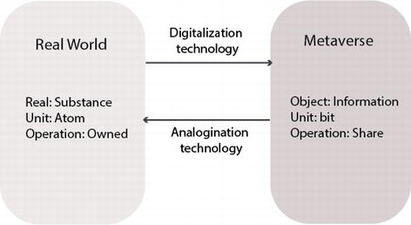
Applications of Blockchain
3. Non-Fungible Tokens – NFTs and Metaverse.
NFTs, or non-fungible tokens, are unique digital assets that are verified using blockchain technology. Unlike traditional cryptocurrencies, which are interchangeable, each NFT is one-of-a-kind and cannot be replicated.
The ownership and authenticity of an NFT are recorded on the blockchain, making it transparent and secure.

Slide 13
NFTs gained notoriety with the October 2017 launch of CryptoPunks and the subsequent record-breaking sale of Mike Winkelmann's art for almost USD 70 million. Since then, NFTs have seen steady growth, with artists and collectors taking notice.
From being a niche within blockchain communities to having global sales reaching up to USD 1.2 billion by July 2021, their market has expanded significantly.
Metaverse- Blockchain based technology which enables people to interact with virtual avatars in a simulated world.

Slide 14
Properties of NFT
1. Uniqueness- NFT’s can exist as digital or physical entities and possess unique properties.
2. Immutability- This property guarantees that no person has power to alter, delete or erase record data.
3. Non-Interchangeability- NFT’s cannot be substituted for another item even if there is a high degree of similarity between them.

Slide 15
NFT Applications
1. Digital Art – Digital art refers to creative content created in digital medium such as music, films and paintings etc. Digital art uses NFT’s to generate a unique hash that sets each piece apart from others.
2. Licenses and Certification – NFT’s are an efficient way for companies to verify important documents ultimately improving their administrative operations. NFT’s verify authenticity relieving the institutes issuing licenses and certifications

Slide 16
3. Boosting gaming potential – NFT’s have many benefits for gamers and game developers, including providing ownership data for in game objects facilitating economic system within games.
4. Sports – NFT’s have become a must have in the sports industry with a short time, boxing, basketball and baseball had become three of the top sports with expensive NFT’s- Golden State Warriors became America’s first American sports team.

Slide 17
Application of NFT’s in Metaverse
1. Identity- Identity is used in the Metaverse for authentication and must be unique and resistant to fraudulence.
1.1 Avatars- Profile Photo requires avatars to stand out among thousands of others in order to be recognized in the Metaverse. NFT’s can give these objects uniqueness.
1.2 Identity – Every entity in the Metaverse including users and objects requires a unique identifier. The metaverse allow users to link their real identities with their NFT based identities.

Slide 18
2. Digital asset- It is critical to protect and represent digital assets that exists only in the metaverse, without a physical twin.
2.1- Digital Items- in order to assign any digital item in Metaverse to a virtual group or person, an assignation mechanism must be put in place which guarantees ownership and security.
2.2 Metaverse Land – NFT’s are land documents that can be used to prove ownership, transfer property ownership and more.

Slide 19
Challenges Faced by NFT’s
Cyber Security- With high growth rate of NFT transactions in digital world, cyber security has become more of a priority. Malicious actors may create fake NFT’s under famous artists.
Intellectual Property Rights- Before Purchasing anything made from NFT seller, it is essential to confirm their ownership rights. Sometimes people have taken photos or made reproduction of NFT’s which could lead to disputes about ownership.

Slide 20
Security and Privacy- NFT’s face a number of challenges but Data Integrity and security must remain at the top making privacy and security for NFT’s a major challenge. Many NFT transactions rely on Ethereum platform which offers pseudo-anonymity but not total anonymity.
Environment- The environmental consequences are significant for example Ethereum alone is estimated to consume 44.94 Terawatt-hours annually of electricity.

Slide 21
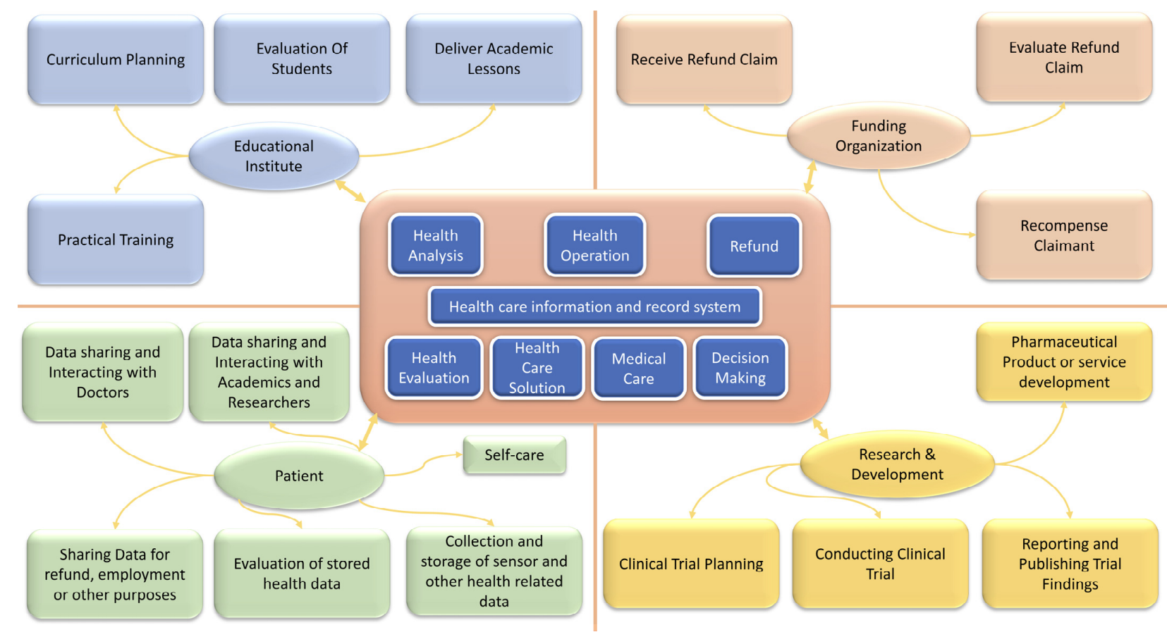
Applications of Blockchain
4. Healthcare
Blockchain technology has the potential to revolutionize healthcare by enabling secure and transparent sharing of medical data between patients, providers, and other stakeholders.

Slide 22
Application of Blockchain in Healthcare
Patient data management:
The most important application of blockchain technology is patient medical data management. Anybody entering a hospital must ensure that the data they provide, such as their social security number or credit card information, is protected. The only way to ensure that hackers won't have access to such crucial personal information is for a healthcare provider to use blockchain-enabled encryption.
Increasing the flow of information between patients and providers
Blockchain technology ensures that patient data is saved over a database dispersed over a network of nodes, providing a decentralized approach. This means that whenever a node updates data, the network as a whole updates the data as well, making it easier for doctors and other healthcare professionals to communicate updated information.
On a blockchain, all patient data is continuously valid, verifiable, up-to-date, and time-stamped. As a result, healthcare service providers may analyze and act on the information at hand with speed and ease, especially while handling medical emergencies.

Slide 23
Control of Healthcare Transactions
Hospitals and specialty clinics handle numerous patient payments and claims around-the-clock, in addition to sending internal requests for past-due patient payments. When competent hackers and rogue employees gained access to this kind of data in the past, it opened the door for all kinds of trouble.
Most of these procedures can be streamlined with blockchain technology to lower the likelihood of claim denials and payment issues. There is no opportunity for human mistake or time lags because all database modifications are visible in real-time to the network of users, including all stakeholders, and any incorrect entries that could result in underpayments are reported right away.
Monitoring Medical Credentials
Patients everywhere need to feel secure in their doctor's qualifications, their ability to back up their claims, the locations of their prior employment, and their degree of expertise. One of the applications of blockchain in healthcare is the verification of medical credentials. With the help of this technology, all provider data may be kept in a single database.

Slide 24
The blockchain will also assist in confirming the legitimacy of these credentials. Also, organizations hiring medical professionals at any level require a proven technique to verify all the credentials provided by job prospects without requiring additional bureaucracy.
Blockchain is useful for tracking the credentials and experience of medical professionals, much as it is used to trace the provenance of medical supplies and equipment.
Adaptation to wearable Internet of Things devices
The ability of blockchain developments to be employed with wearable internet of things (IoT) devices is one of its most impressive features. It enables both patients and doctors to more effectively monitor medical records. Blockchain can offer a simple authentication process and safe platform for integrating data from wearables like activity, health, or fitness trackers.
This protected, often updated data is accessible to both doctors and patients, making it simpler to track changes or patients' progress. As the use of wearable technology grows, blockchain healthcare app development should be at the top of the list.

Slide 25
Challenges of blockchain in healthcare
Absence of technical expertise
It's no secret that the majority of healthcare professionals haven't yet purchased hardware and software tailored to the blockchain. Nonetheless, the majority of consumers are still unfamiliar with the technology's inner workings. Because most people still largely identify blockchain with cryptocurrency, some people are still dubious about its potential use in their industry.
Healthcare service providers must be strategic in obtaining these technologies and educating their staff on how to use them if they want institutions to gain from blockchain technology. Additionally, individuals utilizing blockchain in healthcare must come up with novel ways to deploy improvements without adding to the workload of already overworked healthcare professionals.
Lack of Government Involvement
The majority of hospitals are controlled by the government, but governments continue to be slow to accept new technologies. As choices won't be made by a third party or a centralized authority due to blockchain decentralized structure, there is a dread of the unknown. Also, because it is still in its infancy, the industry's lack of standardization may make it difficult for it to be adopted, which would limit the opportunity to fully utilize its potential.

Slide 26
Reticence to Use Paperless Techniques
Most doctors and professionals still prefer to keep their medical records using the outdated filing systems since they become so accustomed to keeping paper data. Paperwork is still required by drug stores and patients who don't know any better since it's convenient. In particular, the advantages of automating file records and the possibilities for collaborative practices with other practitioners and service providers, as well as the usage of blockchain, must be made clear to doctors.
The new technology demands that all institutions involved in medical research and patient care be brought on board and ready to adopt them. The ability for blockchain to accommodate huge data sets like CAT scans and MRI images into a single transaction is of the utmost importance.

Slide 27
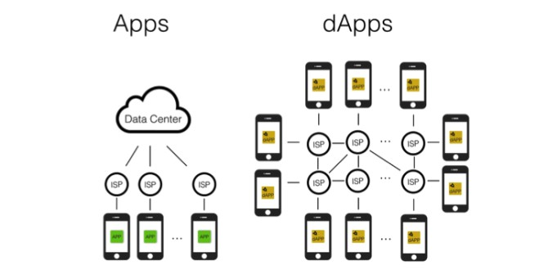
Applications of Blockchain
Decentralized Application – dApps
dApps operate on a decentralized network, such as a blockchain. Unlike traditional apps that rely on a central server, dApps use a distributed network of nodes to store and process data. This makes them more secure, transparent, and resistant to censorship or tampering. Some examples can be Lightning Network, Counterparty and OpenBazaar.

Slide 28
OpenBazaar
OpenBazaar is a decentralized marketplace that allows buyers and sellers to trade goods and services directly with each other, without relying on a centralized intermediary. It is built on blockchain technology and uses cryptocurrencies as its native payment method.
OpenBazaar provides a platform for individuals and small businesses to sell products and services globally, without the need for a third-party platform or fees. It enables secure, private, and censorship-resistant transactions, ensuring that users have complete control over their data and transactions.
Overall, OpenBazaar aims to create a more equitable and accessible marketplace for everyone, while also promoting the principles of decentralization and peer-to-peer trading.
https://openbazaar.org/

Slide 29
Lightning Network and Counterparty
The Lightning Network is dependent upon the underlying technology of the blockchain. By using real Bitcoin/blockchain transactions and using its native smart-contract scripting language, it is possible to create a secure network of participants which can transact at high volume and high speed.
Counterparty is a decentralized platform on top of Bitcoin blockchain for creating and trading custom digital assets without relying on a centralized exchange. Users can create their own tokens representing anything and trade them peer-to-peer without intermediaries.
https://lightning.network/
https://counterparty.io/

Slide 30
Challenges of Blockchain in dApps
Scalability - Limited Transaction processing capabilities
User experience - dApps are often challenging for users to navigate.
Security - dApps built on blockchain technology have been hacked or suffered from security breaches
Regulation - dApps must comply with various regulations, including data privacy laws and financial regulations.
Adoption - The adoption of blockchain technology and dApps is still in its early stages, and there is a lack of awareness and understanding among the general public.
Interoperability - Different blockchains have different protocols, and they cannot communicate with each other.

Slide 31
Improvement due to Blockchain
The Bitcoin-based electronic voting scheme with anonymity and robustness is designed to abstract a Bitcoin transaction as the voting process achieves strong anonymity through a coin-mixing-based system model. The protocol keeps the voting numbers private using a secret sharing-based E-voting protocol.
Blockchain helps by providing a decentralized and secure system for recording and verifying ownership and transactions of unique digital assets in NFTs. The decentralized and distributed ledger allows for transparent and tamper-proof recording of NFT ownership, preventing duplication or theft of digital assets.
Blockchain offers security in Lightning Network by enforcing the finality of transactions. When a channel is closed, its final state is recorded on the Bitcoin blockchain to ensure the transaction's authenticity and permanence.
Blockchain offers security by producing a tamper-proof record of every transaction. Because all OpenBazaar transactions are stored on the Bitcoin blockchain, they cannot be changed or reversed.
Blockchain contributes to security in Counterparty by offering a safe and decentralised ledger for tracking asset ownership and transactions.

Slide 32
Future Scope
The future scope of blockchain in NFTs, dApps, and voting protocols is vast and promising.
In NFTs, blockchain can improve the interoperability of NFTs across different platforms, enable the creation of fractional ownership of NFTs, and provide more efficient and scalable marketplaces for trading NFTs.
In dApps, blockchain can enable the creation of decentralized and transparent applications that operate autonomously, without the need for intermediaries. This can revolutionize industries such as finance, healthcare, and supply chain management.
In voting protocols, blockchain can enable more secure and transparent voting systems, reducing the risk of fraud or manipulation, and increasing voter participation.
Overall, blockchain technology has the potential to transform the way we interact with digital assets, applications, and democratic processes, paving the way for a more decentralized and democratized future.

Slide 33
Conclusion
Blockchain technology has had a significant impact on various industries, including art, finance, e-commerce, and voting.
The invention of NFTs has transformed digital ownership and value, while blockchain-based voting systems have improved accessibility, security, and transparency in the democratic process.
Additionally, blockchain technology has increased the speed and security of transactions, reduced costs, and opened up previously closed markets to innovation and disruption.
These blockchain-based solutions are expected to play an even bigger role in shaping the future of business, finance, and society.

Slide 34
References
101 Blockchains. (2022, August 15). Non-fungible tokens - risks and challenges. 101 Blockchains. Retrieved April 2, 2023, from https://101blockchains.com/nft-risks-and-challenges/
Pilkington, Marc. "11 Blockchain Technol-Ogy: Principles and Applications." Re-Search Handbook On Digital Transfor-Mations (2016)
Crosby, M., Pattanayak, P., Verma, S., & Kalyanaraman, V. (2016). Blockchain Tech-Nology: Beyond Bitcoin. Applied Innova-Tion.
S. Nakamoto, “Bitcoin: A Peer-to-Peer Electronic Cash System”, 2009. [Online] Available: https://bitcoin.org/bitcoin.pdf.
J. Kishigami et. al., “The Blockchain-based Digital Content Distribution System” in 2015 IEEE Fifth International Conference on Big Data and Cloud Computing, 2015.
G. Hurlburt and I. Bojanova, “Bitcoin: Benefit or Curse?” in IT Pro, vol. 16, no. 3, 2014
Raval, S., 2016. Decentralized applications: harnessing Bitcoin's blockchain technology. " O'Reilly Media, Inc.".
Verma, S., Dash, S. and Joshi, A., 2022, October. A Detailed Study of Blockchain and dapps. In 2022 International Conference on Cyber Resilience (ICCR) (pp. 1-5). IEEE.
Pranto K, Arindom C, Mehedi H, Khalid R, & Abdul H: Blockchain Application in Healthcare Systems. Received 21 November, 2022, from https://www.mdpi.com/2079-8954/11/1/38

