Slide 1
Challenges
Mini challenge 7

Slide 2
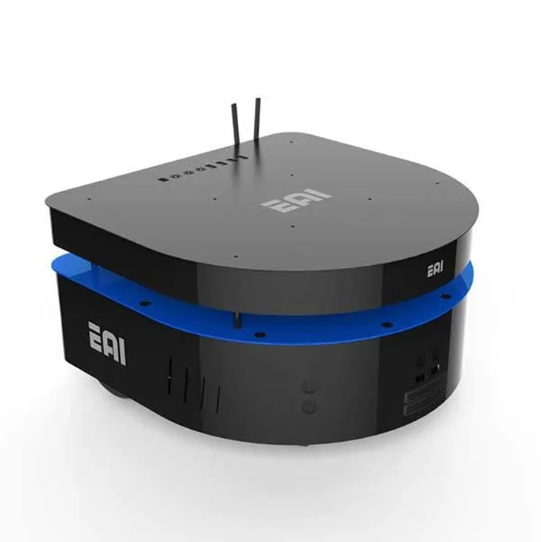
Mini challenge 6
This challenge is intended for the student to review the concepts introduced in this week.
Open loop control of a kinematic simulator and real robot for the EAI DashGo B1 robotic platform.

Slide 3
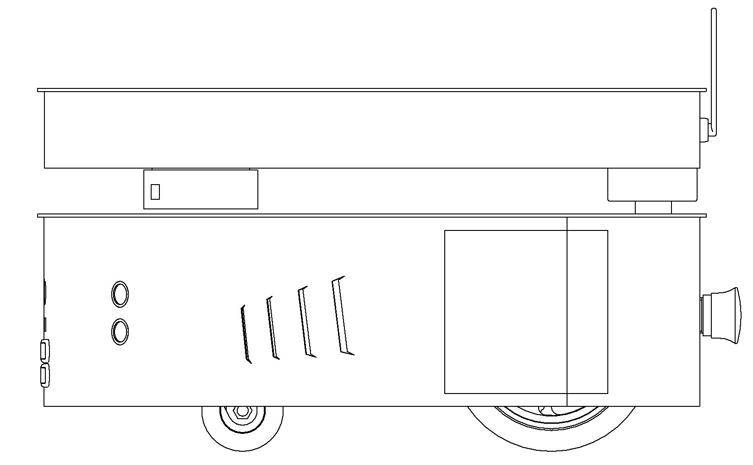
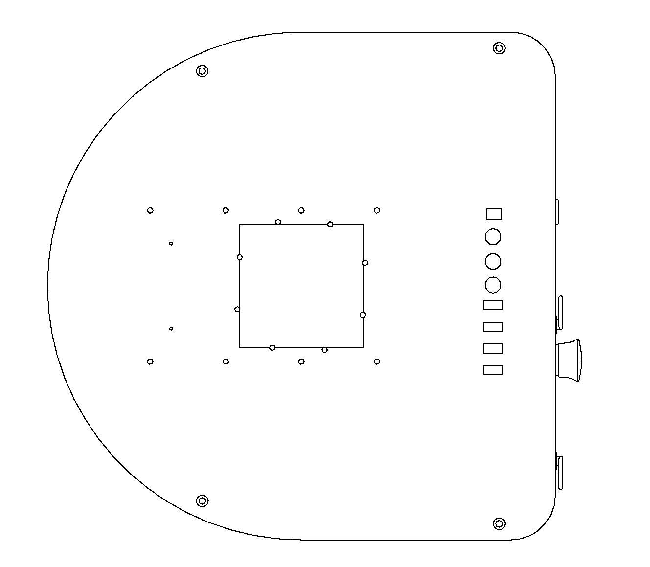
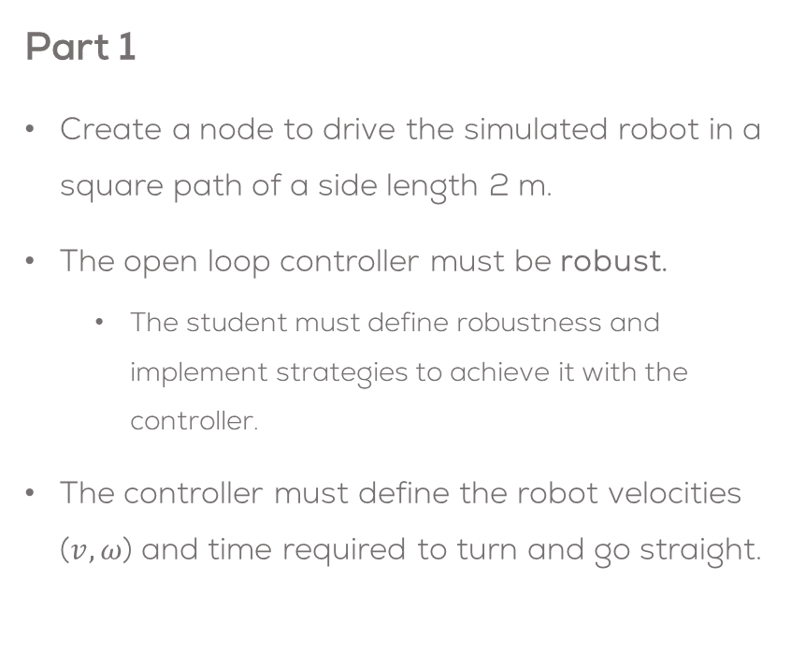
Mini challenge 7
Part 1
Create a node to drive the simulated robot in a square path of a side length 2 m.
The open loop controller must be robust.
The student must define robustness and implement strategies to achieve it with the controller.
The controller must define the robot velocities ($v, ω$) and time required to turn and go straight.
ROS Node
Open Loop
Controller
/cmd_vel
2 m
2 m

Slide 4

Mini challenge 7
Sim Robot
Part 1
Use the same node to move the real robot in a square of side length 2 m.
The open loop controller must be robust.
The student must define what is robustness and implement strategies to achieve it with the controller.
The controller must take into consideration, perturbation, nonlinearities and noise.
Compare the behaviour of the real robot and the simulated robot by measuring the position.
ROS Node
Open Loop
Controller
/cmd_vel
Real Robot
2 m
2 m

Slide 5
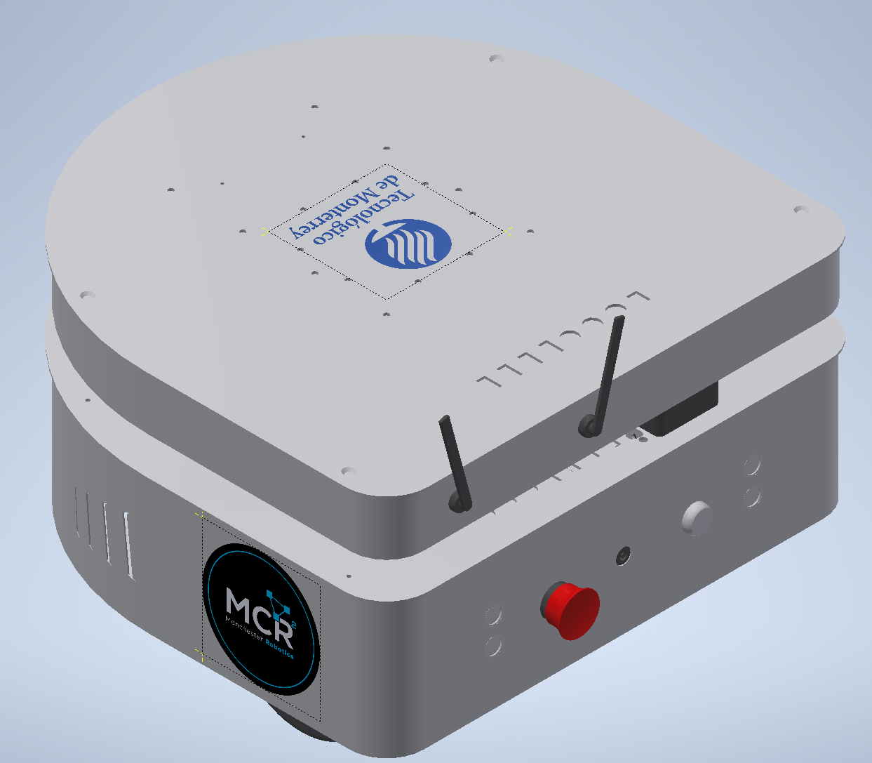


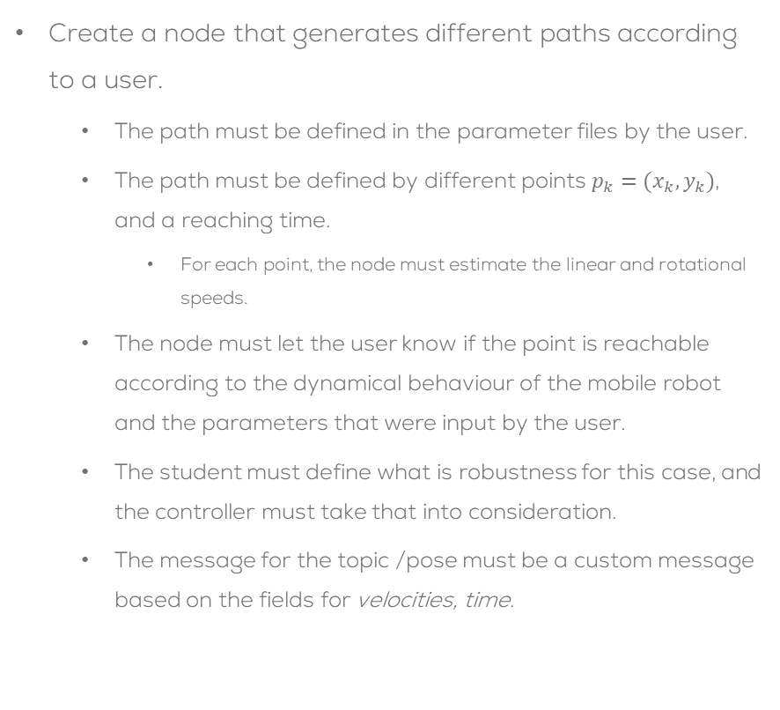




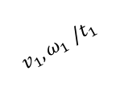

Mini challenge 7
Create a node that generates different paths according to a user.
The path must be defined in the parameter files by the user.
The path must be defined by different points $p_{k}=(x_{k},y_{k})$, and a reaching time.
For each point, the node must estimate the linear and rotational speeds.
The node must let the user know if the point is reachable according to the dynamical behaviour of the mobile robot and the parameters that were input by the user.
The student must define what is robustness for this case, and the controller must take that into consideration.
The message for the topic /pose must be a custom message based on the fields for velocities, time.
/cmd_vel
Path Generator
/pose
Open Loop Controller
Real Robot
$p_{3}=(x_{3},y_{3})$,
$$v_{3},ω_{3} /t_{3}$$
$p_{2}=(x_{2},y_{2})$,
$$v_{2},ω_{2} /t_{2}$$
$$v_{4},ω_{4} /t_{4}$$
$p_{1}=(x_{1},y_{1})$,
$$v_{1},ω_{1} /t_{1}$$
$p_{4}=(x_{4},y_{4})$,

Slide 6
Deliverables
The grade consists of:
Video = 100%
Deadline: Monday 09 October 2023.
This is a team challenge.
Teams:
The teams will be the same as in other classes of this concentration.
The teams must be multidisciplinary.
The students must respectfully help each other to understand all the topics.

Slide 7
Deliverables
Video (100%)
Duration: Under 5 min. (If longer, increase speed)
Show the team, names. Only one team member can speak at a time (not necessary for the whole team to speak in the video).
Video on YouTube (Unlisted)
Send the link to the video.
Video in English.
Extra Marks: Plot the simulated position and real robot position in RVIZ
Task
Brief introduction (problem to be solved, solution strategy, team tasks, etc.)
Explain how the program works (launch files, libraries made, the structure of the project, etc.)
Show the results of the (real robot and simulated robot), and the methodology followed to solve it.
Analysis of the behaviour of each robot and comparison of both behaviours. What is expected? Are both behaviours the same? Why? Advantages/disadvantages of this type of control?
A brief set of conclusions from the task.

Slide 8
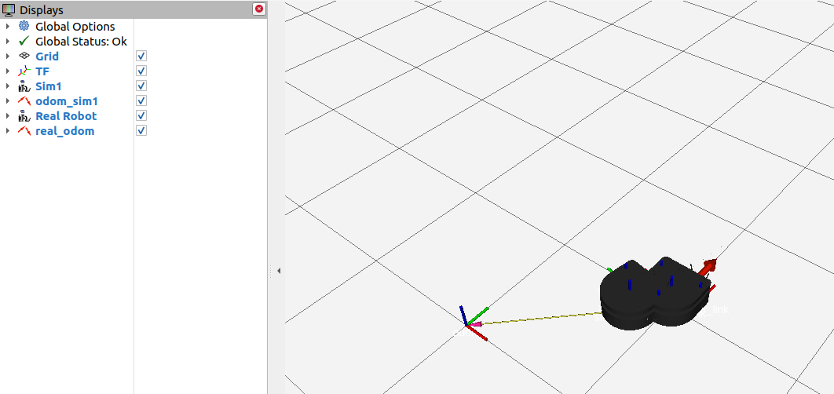
Deliverables
Extra Marks: Plot the simulated position and the estimated real robot position in RVIZ.
Plot both robots at the same time.
Robot 1 must be the simulated robot
Robot 2 must be the real robot after its odometry is calculated
Sim Robot
/cmd_vel
/sim/odom
RVIZ
ROS Node
Open Loop
Controller
/Rencoder
Odometry
RVIZ
/Lencoder
/real/odom
Real Robot

Slide 9
Rules
This is challenge not a class. The students are encouraged to research, improve tune explain their algorithms by themselves.
MCR2(Manchester Robotics) Reserves the right to answer a question if it is determined that the questions contains partially or totally an answer.
The students are welcomed to ask only about the theoretical aspect of the classed.
No remote control or any other form of human interaction with the simulator or ROS is allowed (except at the start when launching the files).
It is forbidden to use any other internet libraires with the exception of standard libraires or NumPy.
If in doubt about libraires please ask any teaching assistant.
Improvements to the algorithms are encouraged and may be used as long as the students provide the reasons and a detailed explanation on the improvements.
All the students must be respectful towards each other and abide by the previously defined rules.
Manchester robotics reserves the right to provide any form of grading. Grading and grading methodology are done by the professor in charge of the unit.

