Slide 1
Activity
Motor Simulation in RVIZ

Slide 2
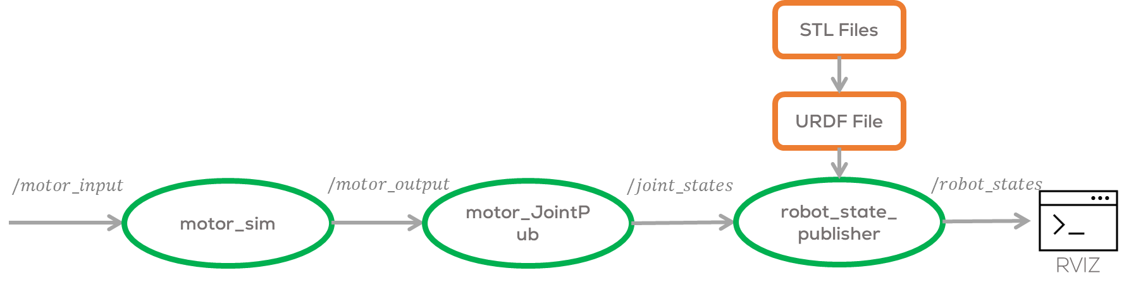
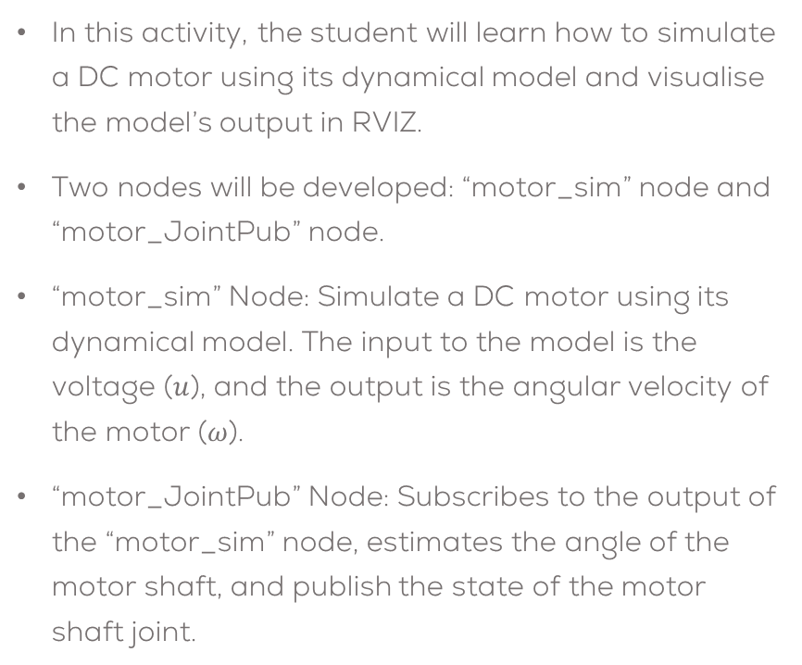
Activity
In this activity, the student will learn how to simulate a DC motor using its dynamical model and visualise the model’s output in RVIZ.
Two nodes will be developed: “motor_sim” node and “motor_JointPub” node.
“motor_sim” Node: Simulate a DC motor using its dynamical model. The input to the model is the voltage ($u$), and the output is the angular velocity of the motor ($ω$).
“motor_JointPub” Node: Subscribes to the output of the “motor_sim” node, estimates the angle of the motor shaft, and publish the state of the motor shaft joint.

Slide 3
Activity
Part 1: Motor Dynamical Simulation

Slide 4
Motor Simulation in RVIZ
Make a new package called “motor_sim”, with the following packages
rospy, std_msgs, tf2_ros, sensor_msgs, visualization_msgs tf_conversions, geometry_msgs
catkin_create_pkg motor_sim rospy std_msgs sensor_msgs geometry_msgs
Create a node called motor_sim.py inside the scripts folder
mkdir scripts && touch scripts/motor_sim.py
Give executable permission to the file
cd ~/catkin_ws/src/motor_sim/scripts/
sudo chmod +x motor_sim.py
Modify the CMake file to include the newly created node to the
catkin_install_python(PROGRAMS scripts/motor_sim.py
DESTINATION ${CATKIN_PACKAGE_BIN_DESTINATION})

Slide 5
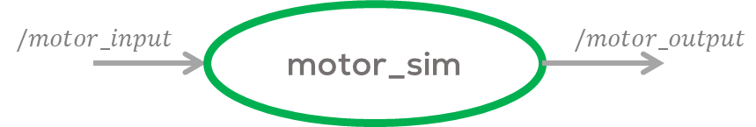
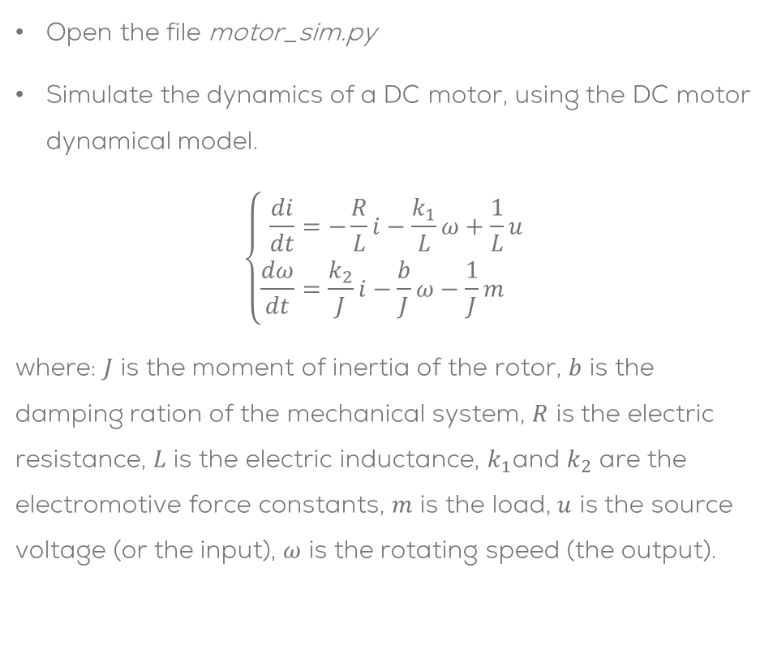
Motor Simulation in RVIZ
Open the file motor_sim.py
Simulate the dynamics of a DC motor, using the DC motor dynamical model.
$$\left\{\begin{aligned}\frac{di}{dt}&=−\frac{R}{L}i−\frac{k_{1}}{L}ω+\frac{1}{L}u \\ \frac{dω}{dt}&=\frac{k_{2}}{J}i−\frac{b}{J}ω−\frac{1}{J}m\end{aligned}\right.$$
where: $J$ is the moment of inertia of the rotor, $b$ is the damping ration of the mechanical system, $R$ is the electric resistance, $L$ is the electric inductance, $k_{1}$and $k_{2}$ are the electromotive force constants, $m$ is the load, $u$ is the source voltage (or the input), $ω$ is the rotating speed (the output).
#Motor Parameters
R = 6.0
L = 0.3
k1 = 0.04
k2 = k1
J = 0.00008
b = 0.00025
m = 0.0
#Motor governing equation
current_dot = -(R/L)*current-(k1/L)*omega+(1/L)*(u)
current += current_dot*dt
omega_dot = (k2/J)*current-(b/J)*omega-(1/J)*m
omega += omega_dot*dt

Slide 6
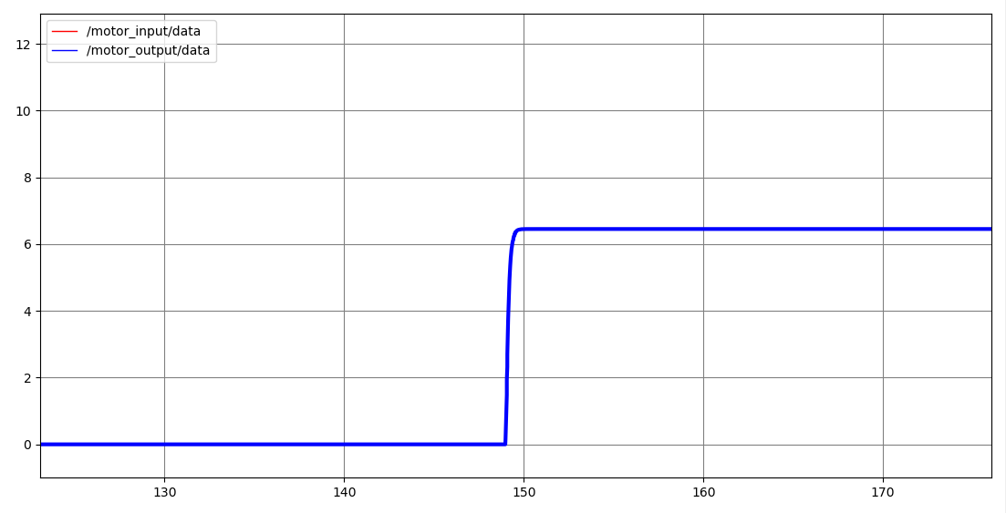

Motor Simulation in RVIZ
Subscribe the model to the topic “/motor_input” and publish the model’s output in the topic “/motor_output”.
Both messages can be Float32 messages.
Make sure to add print some values to verify the program is working properly (debug).
Compile the program
cd ~/catkin_ws
catkin_make
Start ROS
roscore
Run the node
rosrun motor_sim motor_sim.py
Open the rqt_plot to verify the results
Publish a value in the “/motor_input” topic in the range of $u=[−1,1]$.
rostopic pub /motor_input std_msgs/Float32 "data: 0.3"
Verify the results

Slide 7
Activity
Part 2: Visualisation

Slide 8
Motor Simulation in RVIZ
Create a node called motor_JointPub.py inside the scripts folder (use the previous package)
touch scripts/motor_JointPub.py
Give executable permission to the file
cd ~/catkin_ws/src/motor_sim/scripts/
sudo chmod +x motor_JointPub.py
Modify the CMake file to include the newly created node to the
catkin_install_python(PROGRAMS scripts/motor_sim.py
scripts/motor_JointPub.py DESTINATION ${CATKIN_PACKAGE_BIN_DESTINATION})

Slide 9
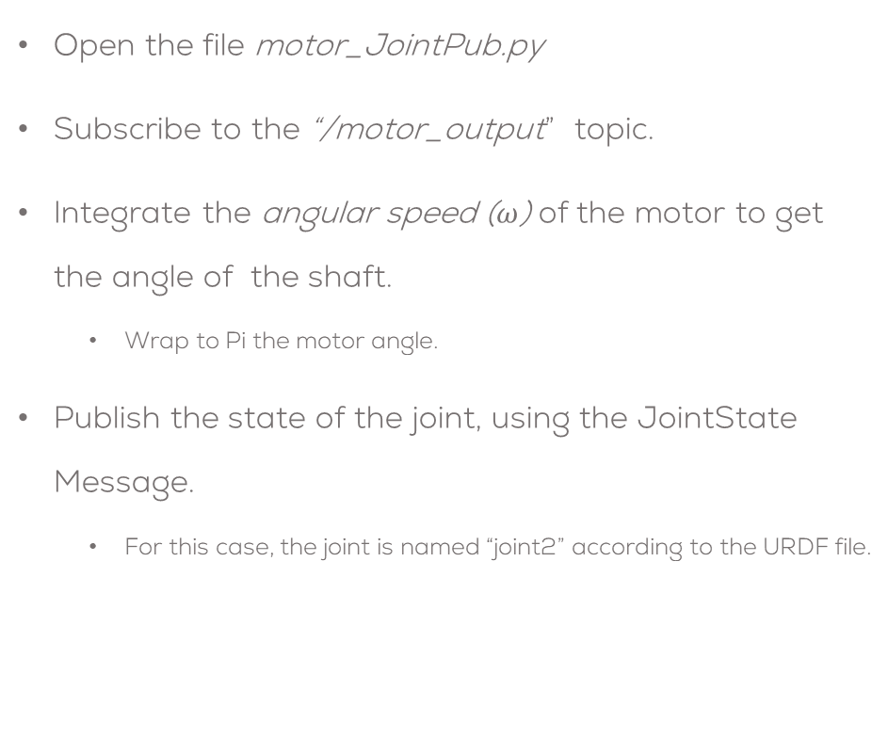
Motor Simulation in RVIZ
Open the file motor_JointPub.py
Subscribe to the “/motor_output” topic.
Integrate the angular speed ($ω$) of the motor to get the angle of the shaft.
Wrap to Pi the motor angle.
Publish the state of the joint, using the JointState Message.
For this case, the joint is named “joint2” according to the URDF file.
# Declare/initialise the output Messages (Joint names in URDF file)
contJoints = JointState()
contJoints.header.frame_id = "joint1"
contJoints.header.stamp = rospy.Time.now()
contJoints.name.append("joint2")
contJoints.position.append(0.0)
contJoints.velocity.append(0.0)
contJoints.effort.append(0.0)
#Integrate the speed to get the position
motorAngle += omega* dt
#Fill the message with the position information
contJoints.header.stamp = rospy.Time.now()
contJoints.position[0] = wrap_to_Pi(motorAngle)
#Publish the joint angle message
joint_pub.publish(contJoints)

Slide 10
Activity
Part 2: Launch File

Slide 11
Motor Simulation in RVIZ
Create a Launch file to launch all the required nodes
<?xml version="1.0"?>
<launch>
<!-- Load URDF-->
<arg name="motor_urdf" default="$(find links_act)/urdf/dc_motor.urdf"/>
<!--Set URDF file as a robot_description parameter-->
<param name="robot_description" command="cat $(arg motor_urdf)" />
<!--Initialise robot_state_publisher-->
<node pkg="robot_state_publisher" type="robot_state_publisher" name="motor_urdf_pub" >
</node>
<!--Initialise motor joint publisher-->
<node pkg="motor_sim" type="motor_JointPub.py" name="motor_JointPub" />
<!--Initialise motor dynamical simulation-->
<node pkg="motor_sim" type="motor_sim.py" name="motor_Sim" />
</launch>

Slide 12
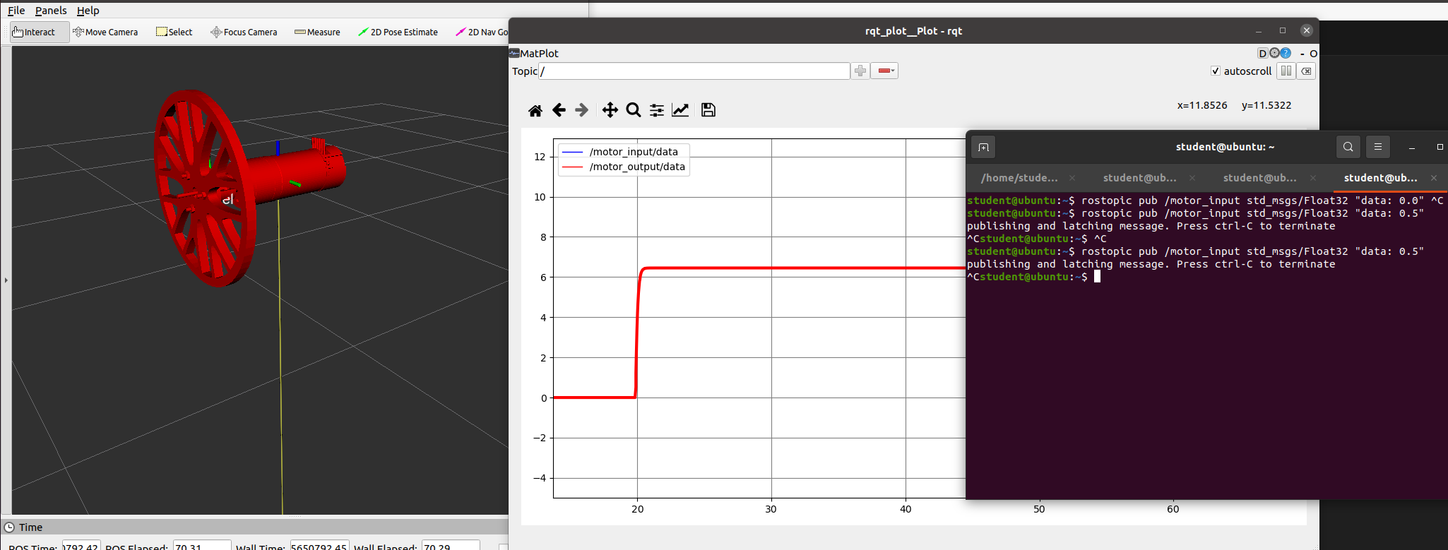
Motor Simulation in RVIZ

