Slide 1
Challenges
Mini challenge 3

Slide 2
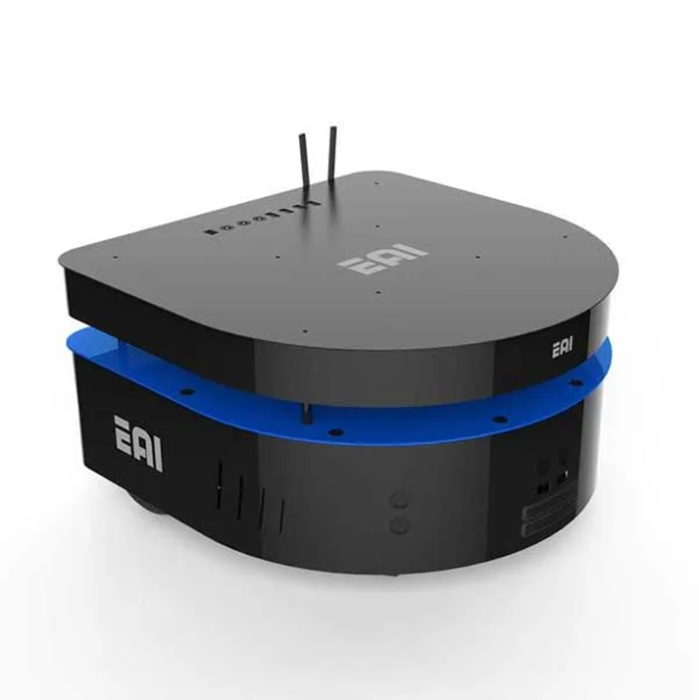
Mini challenge 3
This challenge is intended for the student to review the concepts introduced in this week.
Development of a kinematic simulator for the EAI DashGo B1 robotic platform using the kinematic model of a nonholonomic robot.

Slide 3
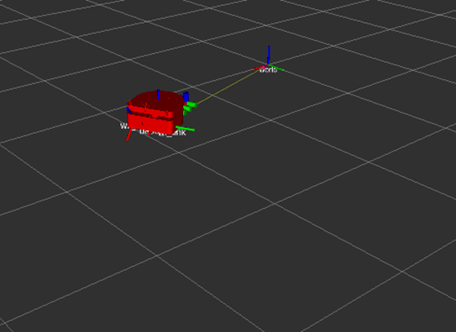
Mini challenge 3
This activity consists of creating a node that simulates a dynamical system.
Simulate a nonholonomic robot (e.g., EAI DashGo B1) using ROS.
The results of the simulation, must be visualised in RVIZ.
The visualisation must be a 3D robot on RVIZ.

Slide 4
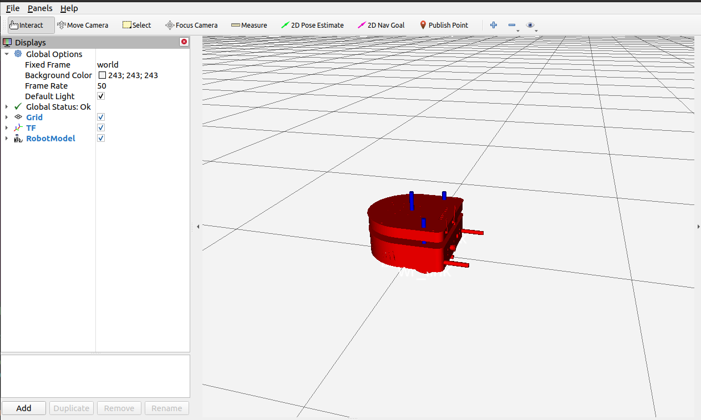
Mini challenge 3
Download the package “dashgo_b1” from GitHub to your catkin_ws.
Install the ROS teleoperation node using the following command on the terminal
Test that it works by compiling the project using “catkin_make” and launching the file “b1_robot.launch”
The following model should be displayed in RVIZ
$ sudo apt-get install ros-noetic-teleop-twist-keyboard

Slide 5
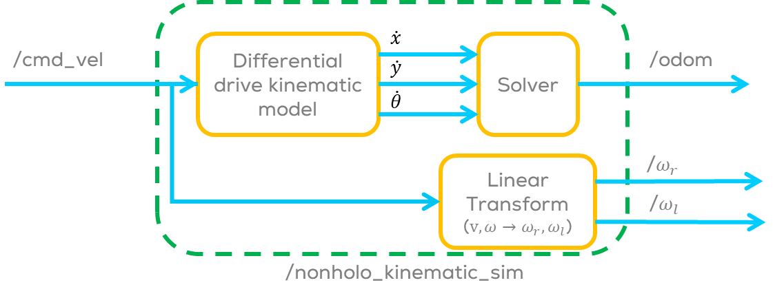
Mini challenge 3
The challenge consists of finishing the node template to simulate the kinematic model of a nonholonomic robot.
Open the nonholo_kinemtic_sim.py
Use the template instructions to develop the kinematic simulator node.
Update the values of the transforms and the message to be used, you just need to implement the transform from ‘odom’ to ‘base_link’.
Publish the required information.
Run the node using the launch file “b1_robot” provided.
Uncomment the “teleop_twist_keyboard” to drive the robot. More information here

Slide 6
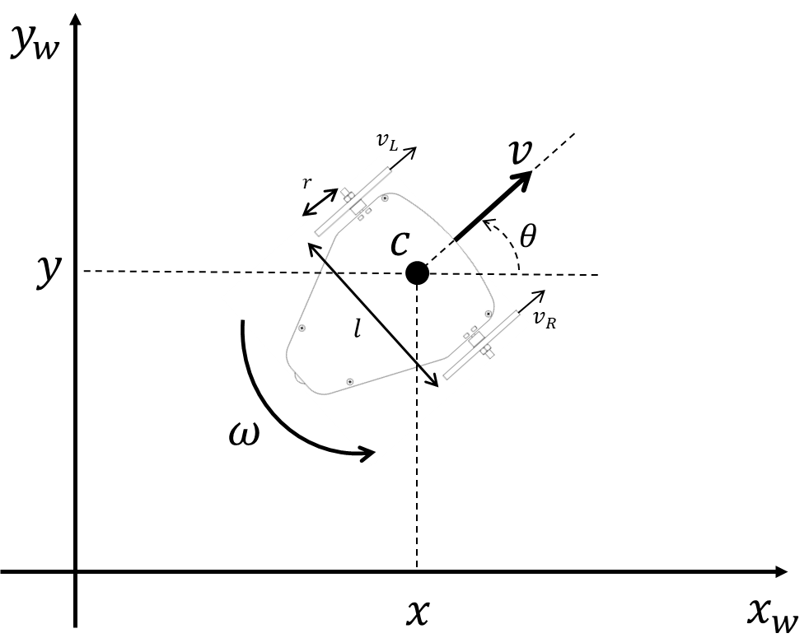
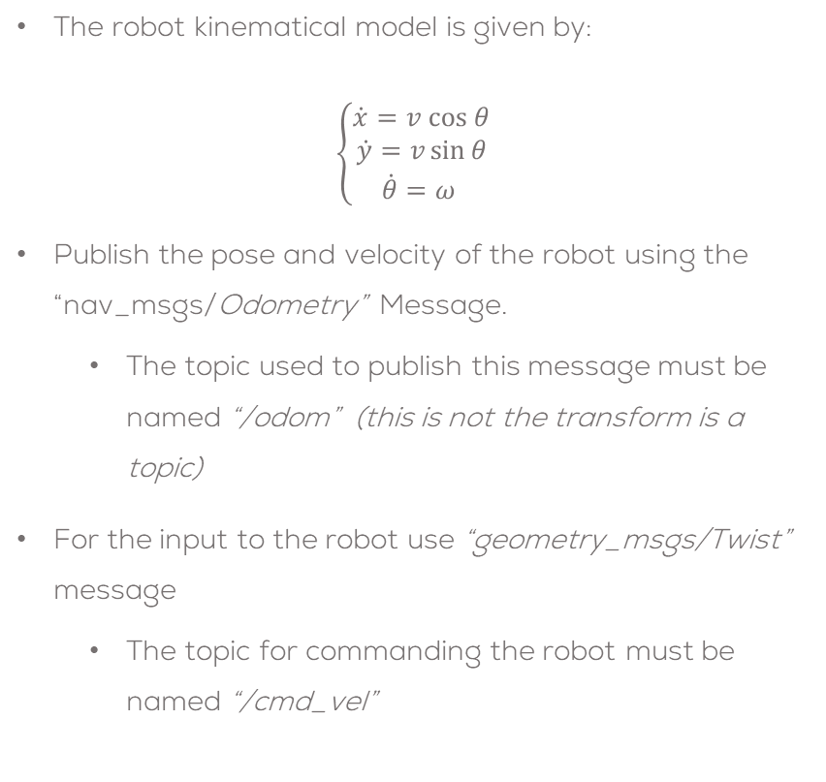
Mini challenge 3
The robot kinematical model is given by:
$$\left\{\begin{aligned}\dot{x}=v cos θ \\ \dot{y}=v\sin{θ} \\ \dot{θ}=ω \end{aligned}\right.$$
Publish the pose and velocity of the robot using the “nav_msgs/Odometry” Message.
The topic used to publish this message must be named “/odom” (this is not the transform is a topic)
For the input to the robot use “geometry_msgs/Twist” message
The topic for commanding the robot must be named “/cmd_vel”

Slide 7
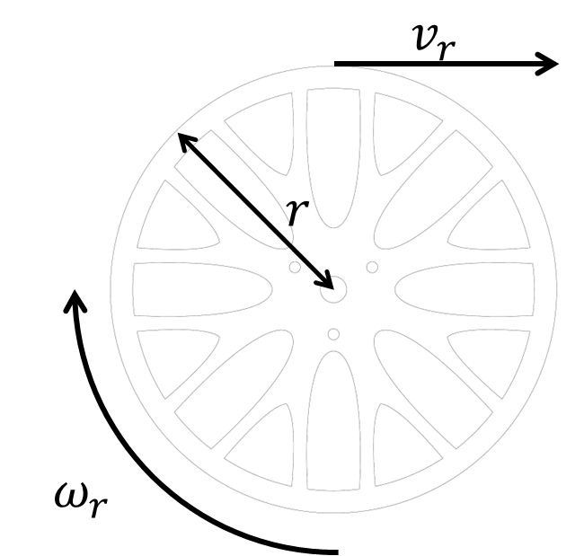
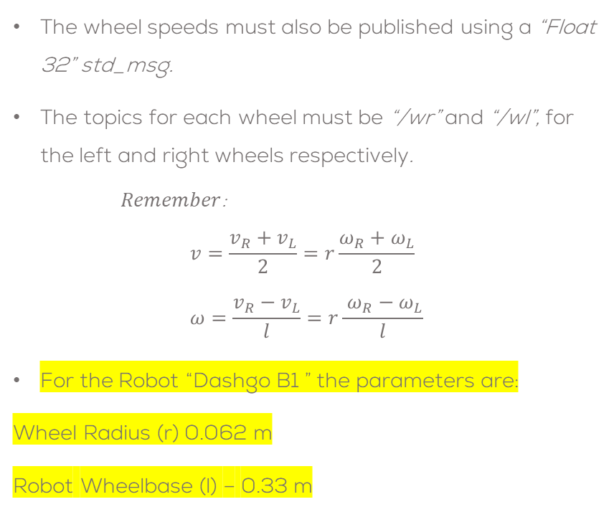
Mini challenge 3
The wheel speeds must also be published using a “Float 32” std_msg.
The topics for each wheel must be “/wr” and “/wl”, for the left and right wheels respectively.
$Remember$:
$$v=\frac{v_{R}+v_{L}}{2}=r\frac{ω_{R}+ω_{L}}{2} \\ ω=\frac{v_{R}−v_{L}}{l}=r\frac{ ω_{R}−ω_{L}}{l}$$
For the Robot “Dashgo B1 ” the parameters are:
Wheel Radius (r) 0.062 m
Robot Wheelbase (l) – 0.33 m

Slide 8
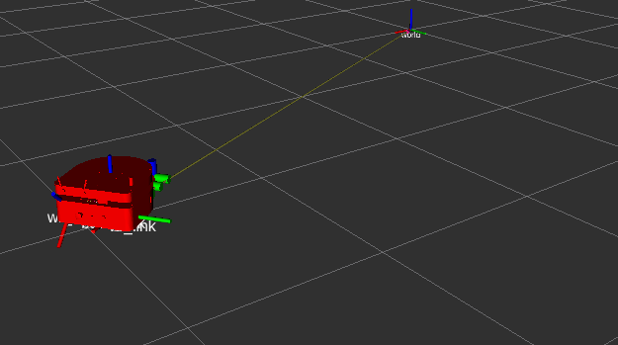
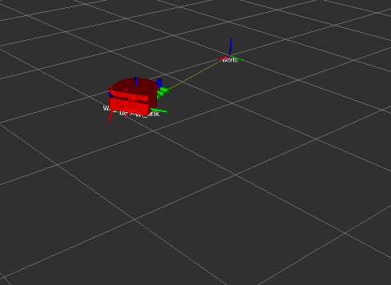
Mini challenge 3
Uncomment the “teleop_twist_keyboard” node in the launch file “b1_robot.launch” and follow the instructions on the terminal to operate the robot using the keyboard.
The simulation must be tested under different conditions, i.e., different speeds.
The students must define a correct sampling time for the simulation .
The students must solve the differential equations using numerical methods.
The usage of any library is strictly forbidden.
Expected results:

Slide 9

Tips and tricks
Tips
The geometry_msgs/Twist message considers the velocities for a 6DOF mobile robot.
For this case since the robot is a differential drive robot (2 DOF) the velocities are published only in the following parts of the message
More info: https://docs.ros.org/en/melodic/api/geometry_msgs/html/msg/Twist.html
Msg.linear.x = v
Msg.angular.z = w (omega)

Slide 10
Tips and tricks
Tips
The nav_msgs/odometry requires the frames where to publish the pose and the velocities; in this case, the header frame (parent) is the “odom” frame of reference, and the child link is the “base_link” frame of reference.
Do not forget to add the time stamp to the message.
The “pose.covriance” and “twist.covariance” sections of the “odometry message” are not required to be declared or can be left at 0
odom_msg.header.frame_id = "odom"
odom_msg.header.stamp = rospy.Time.now()
odom_msg.child_frame_id = "base_link"
odom_msg. pose.covariance = [0]*36
odom_msg. twist.covariance = [0]*36

Slide 11

Tips and tricks
Tips
The transform “pose_tf” between the “base_link” and the “odom” frames must be updated in the while loop with the updated pose of the robot ($x,y,θ$) to make sure markers are able to move in RVIZ.
pose_tf.transform.translation.x = … pose_tf.transform.translation.y = … pose_tf.transform.translation.z = … pose_tf.transform.rotation.x = …
pose_tf.transform.rotation.y = … pose_tf.transform.rotation.z = …
pose_tf.transform.rotation.w = …

Slide 12
Rules
The students are encouraged to research, improve tune explain their algorithms by themselves.
The students are welcomed to ask only about the theoretical aspect of the classed.
It is forbidden to use any other internet libraires with the exception of standard libraires or NumPy.
If in doubt about libraires please ask the professor.
Improvements to the algorithms are encouraged and may be used as long as the students provide the reasons and a detailed explanation on the improvements.
All the students must be respectful towards each other and abide by the previously defined rules.

Slide 13






Figures
Differential drive kinematic model
$$\dot{x}$$
Solver
/cmd_vel
$$\dot{y}$$
/odom
$$\dot{θ}$$
Linear Transform
($v,ω→ω_{r},ω_{l}$)
/$ω_{r}$
/$ω_{l}$
/nonholo_kinematic_sim

