Slide 1
Mobile Robots
Kinematic Models

Slide 2
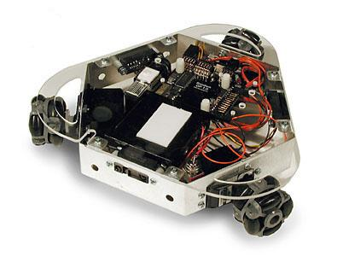
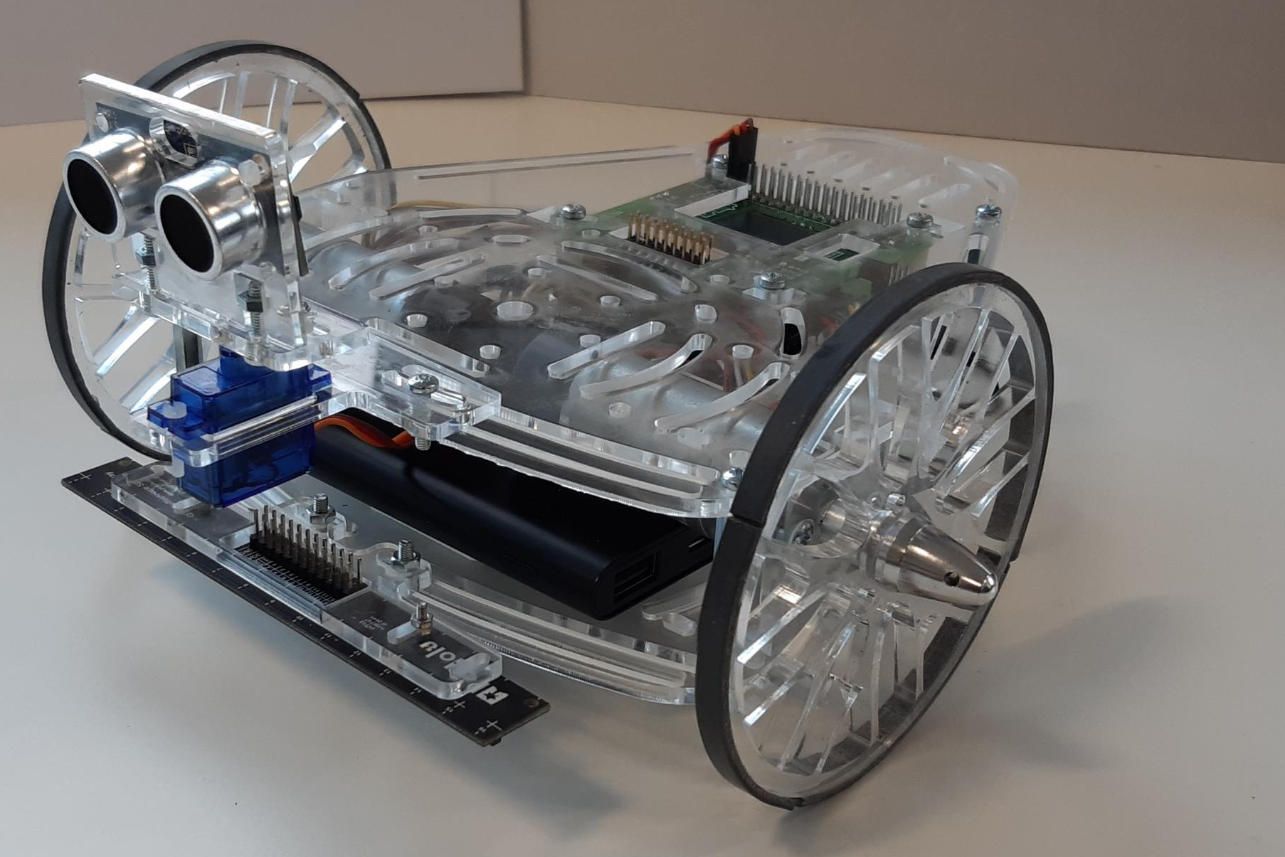
Mobile Robots
There exists many types of wheeled robotic platforms
Differential-Drive robots
Omnidirectional robots
Ackermann-steering robots
and many others...
In this course we will focus on differential drive robots, also known as “differential wheeled robots”.
Holonomic Robot
Acroname ©.
Differential-drive
Puzzlebot ©.
Notes:
Nowadays, there exist many different types of mobile robotic systems
Some examples of these type of systems (or robots) are:
Differential-Drive robots
Holonomic robots
Ackermann-steering robots
and many others...
In the following sessions we will focus on differential drive robots, also known as “differential wheeled robots”.

Slide 3
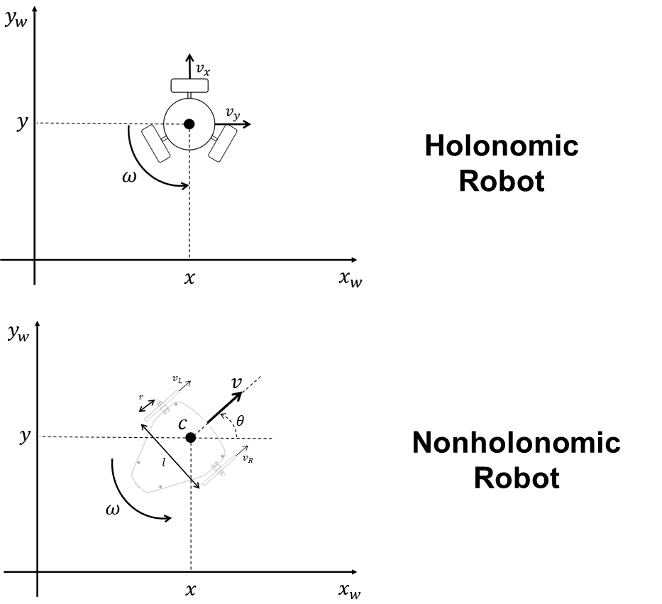
Mobile Robots
Mobile robots can be classified as "Holonomic" or "Nonholonomic“.
This classification depends on the relationship between controllable and total degrees of freedom of a robot.
Holonomic Robots: If the controllable degree of freedom is equal to total degrees of freedom, then the robot
Nonholonomic Robots: If the controllable degree of freedom is less than the total degrees of freedom. Such systems are therefore called underactuated. Differential Drive Systems fall into this category.

Slide 4
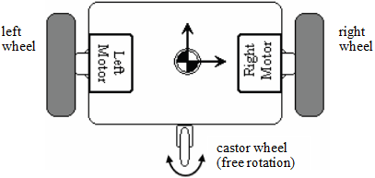
Differential drive robots
Also known as differential wheeled robots, these are mobile robots whose movement is based on two separately driven wheels placed on either side of the robot body. It can thus change its direction by varying the relative rate of rotation of its wheels, thereby requiring no additional steering motion.

Slide 5
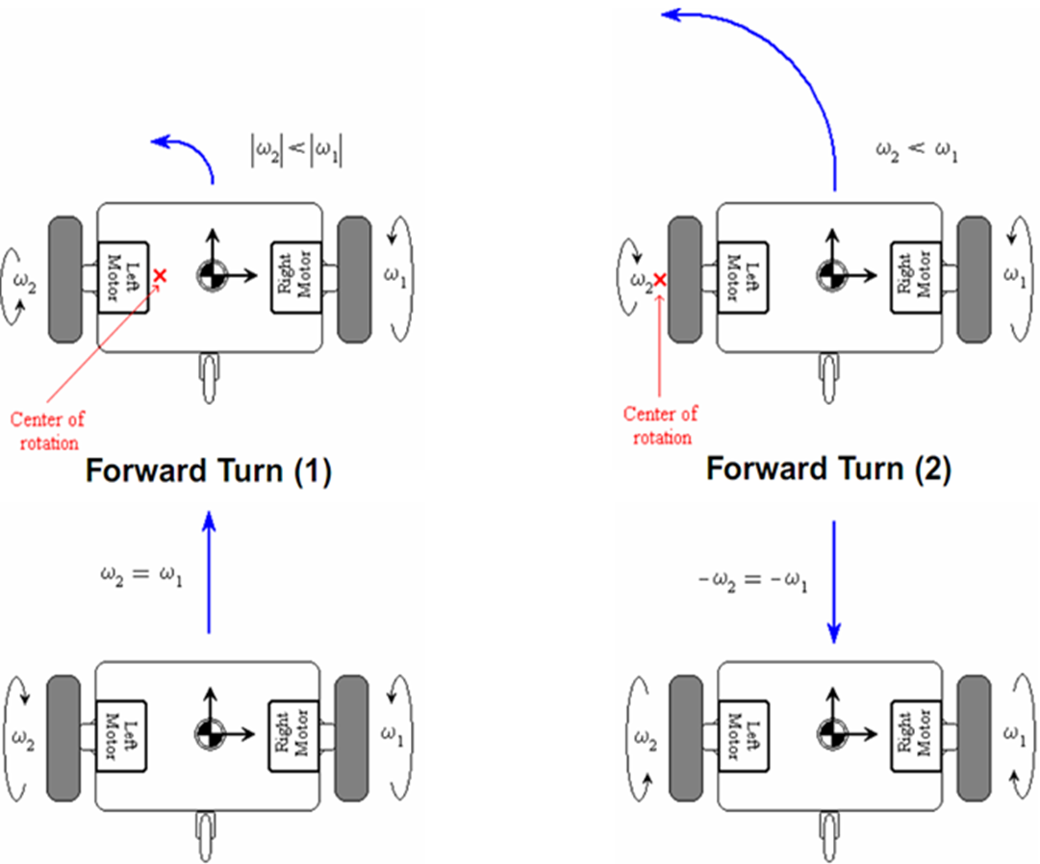
Differential drive kinematics

Slide 6
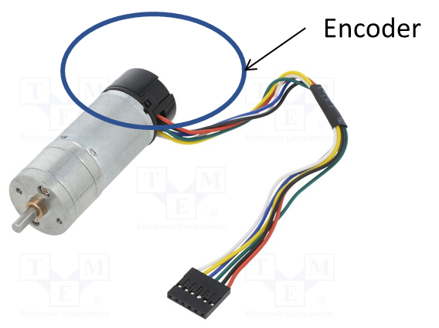
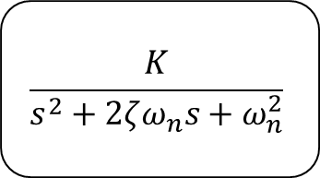


Robot Modelling (Kinematics)
In engineering, a System is an entity that consists of interconnected components, built with a desired purpose. For this case, the system is said to be the differential drive robot.
Systems can be modelled depending on their dynamical behavior. This models describe the behavior of a system using mathematical concepts and language.
Outputs depend on the present and past values of the inputs.
Changes over time.
Sometimes called dynamic systems or sequential systems.
Mathematically described with differential or difference equations.
Dynamic Modelling: Considers different time varying phenomena and the interaction between motions, forces and material properties.
Kinematic modelling: Studies the motion of a robot or mechanism under a set of constraints, regardless of the forces that cause it. Represent the relationship between the robot motor speeds (inputs) and the robot state.
DC Brushed Motor with encoder
$$In$$
$$\frac{K}{s^{2}+2ζω_{n}s+ω_{n}^{2}}$$
$$Out$$
2nd Order System

Slide 7
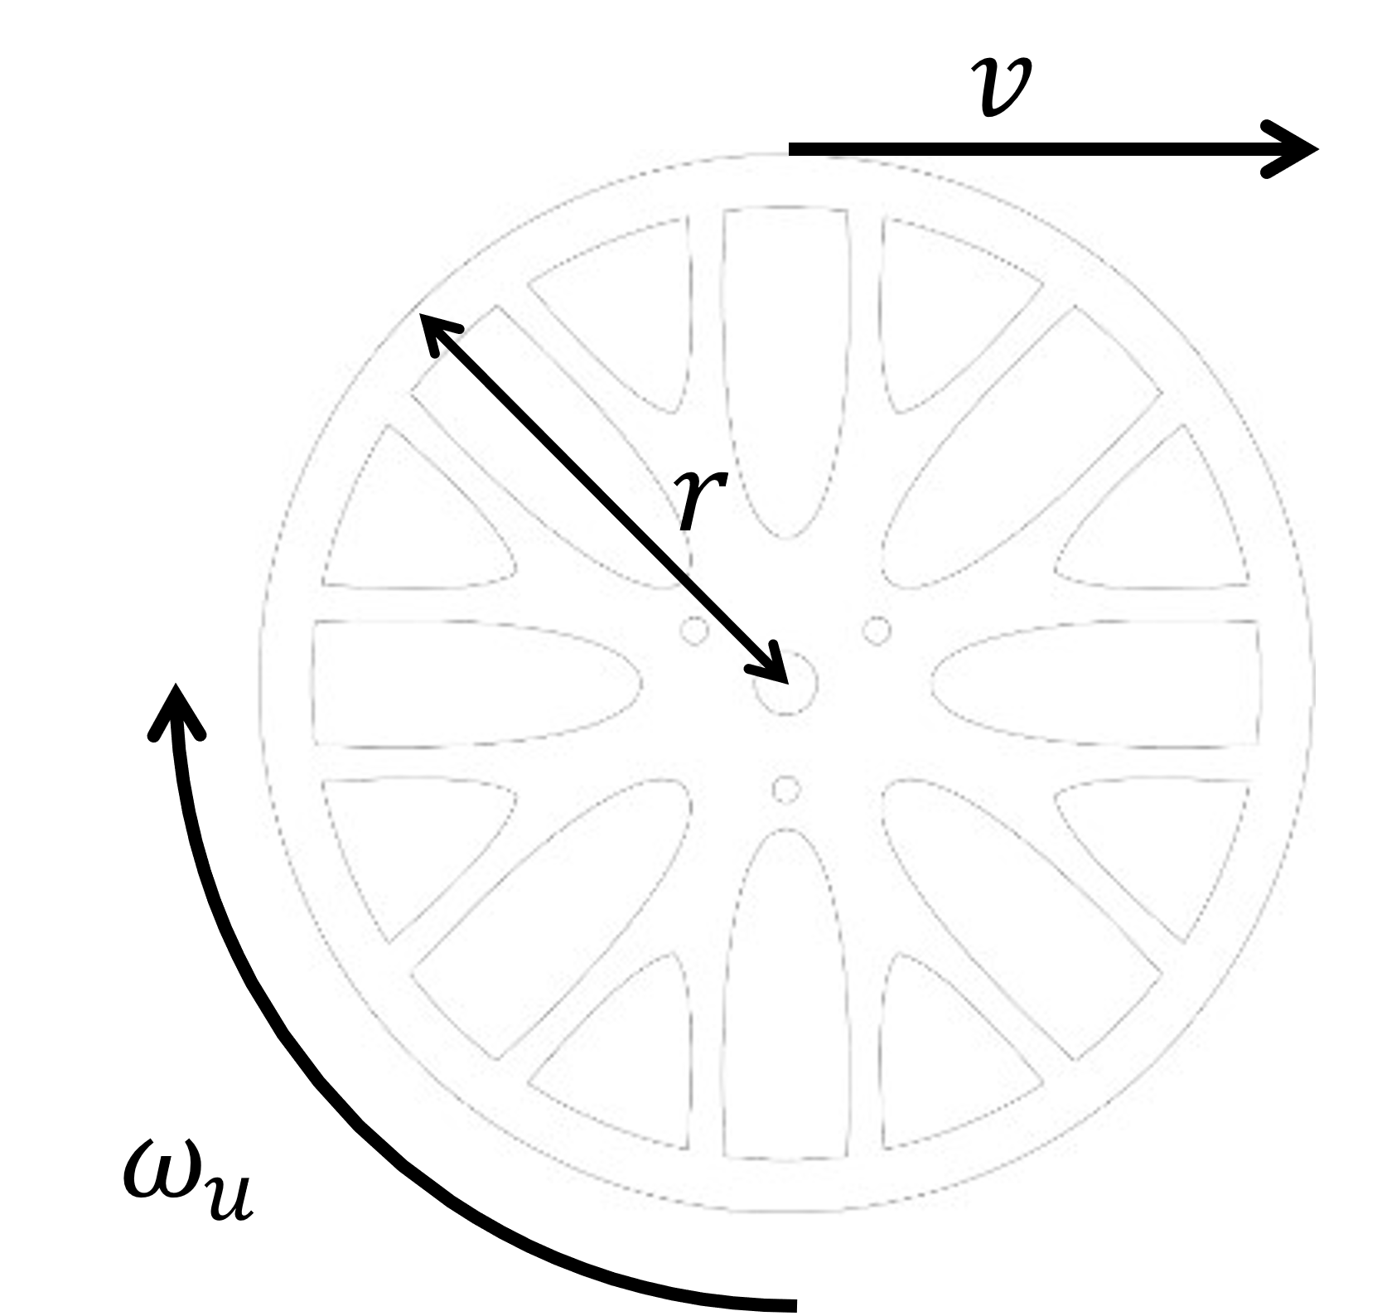
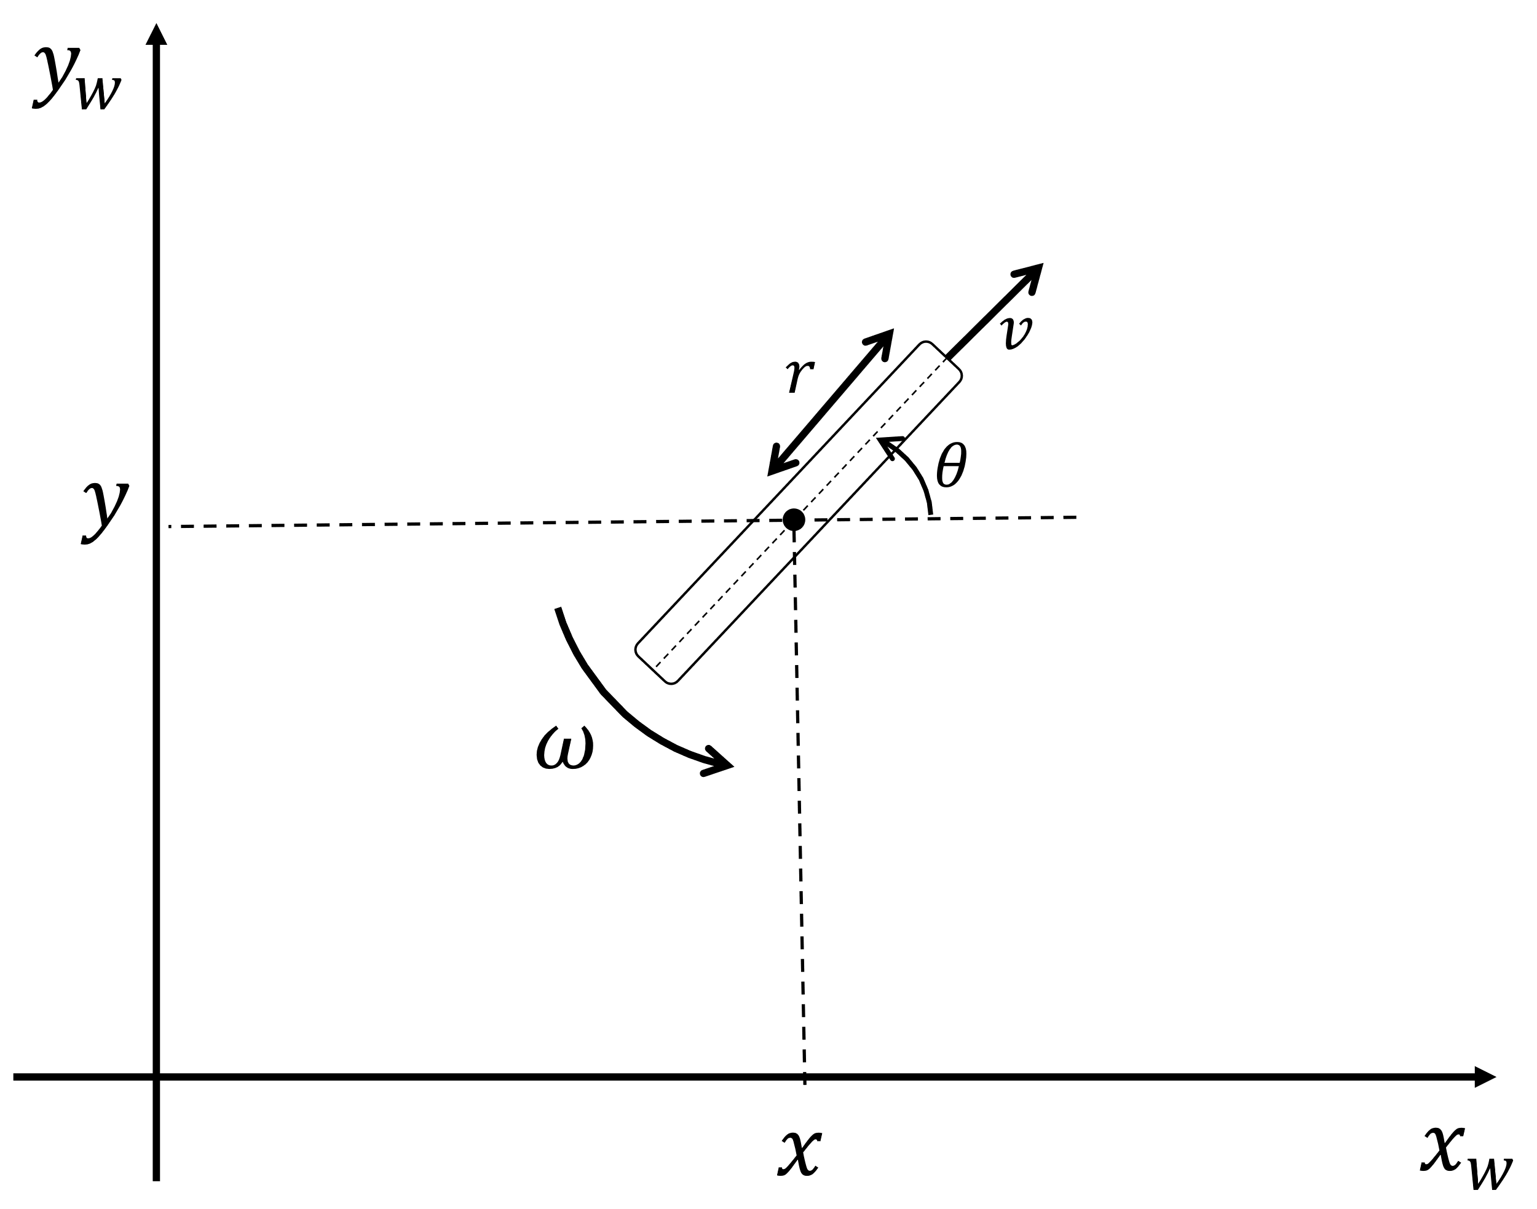
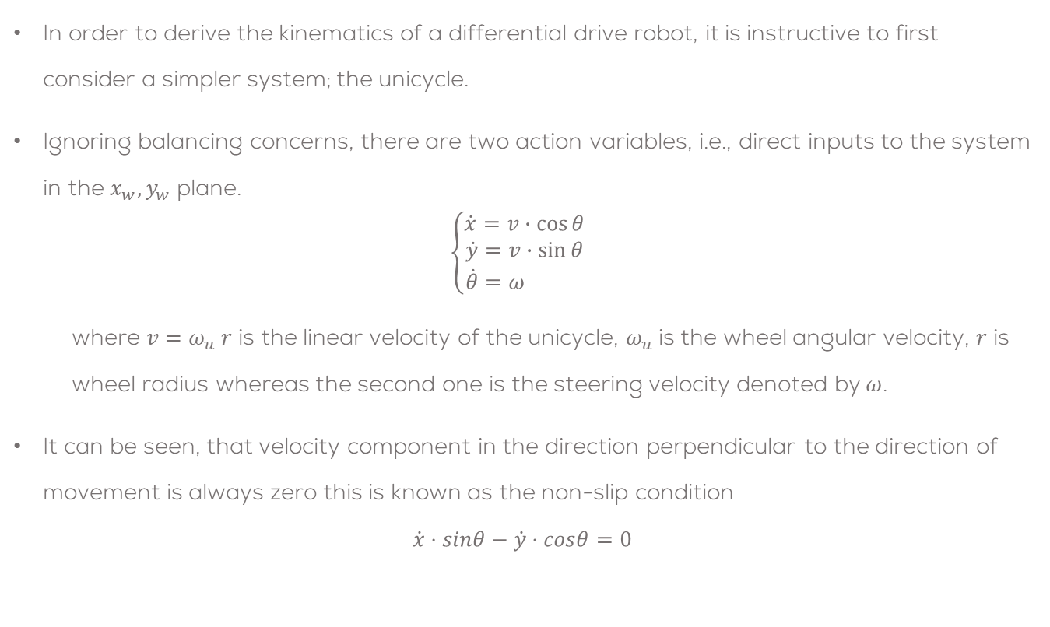
The Unicycle
In order to derive the kinematics of a differential drive robot, it is instructive to first consider a simpler system; the unicycle.
Ignoring balancing concerns, there are two action variables, i.e., direct inputs to the system in the $x_{w}, y_{w}$ plane.
$$\left\{\begin{aligned}\dot{x}=v∙\cos{θ} \\ \dot{y}&=v∙\sin{θ} \\ \dot{θ}&=ω \end{aligned}\right.$$
where $v=ω_{u} r$ is the linear velocity of the unicycle, $ω_{u}$ is the wheel angular velocity, $r$ is wheel radius whereas the second one is the steering velocity denoted by$ω$.
It can be seen, that velocity component in the direction perpendicular to the direction of movement is always zero this is known as the non-slip condition
$$\dot{x}⋅sinθ−\dot{y}⋅cosθ=0$$
Unicycle side and top views

Slide 8
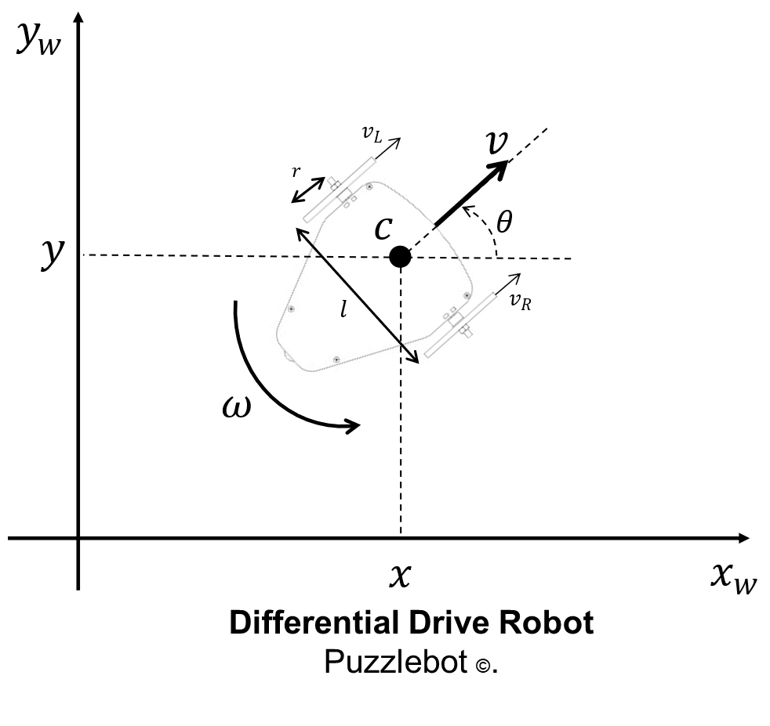
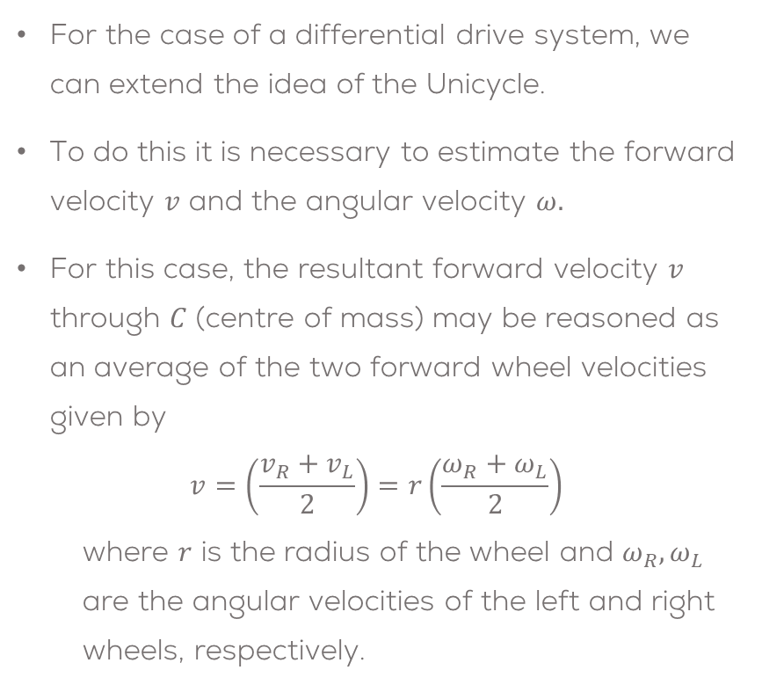
Differential Drive Kinematics
For the case of a differential drive system, we can extend the idea of the Unicycle.
To do this it is necessary to estimate the forward velocity $v$ and the angular velocity $ω.$
For this case, the resultant forward velocity $v$ through $C$ (centre of mass) may be reasoned as an average of the two forward wheel velocities given by
$$v=\left(\frac{v_{R}+v_{L}}{2}\right)=r\left(\frac{ω_{R}+ω_{L}}{2}\right)$$
where $r$ is the radius of the wheel and $ω_{R}, ω_{L}$ are the angular velocities of the left and right wheels, respectively.

Slide 9
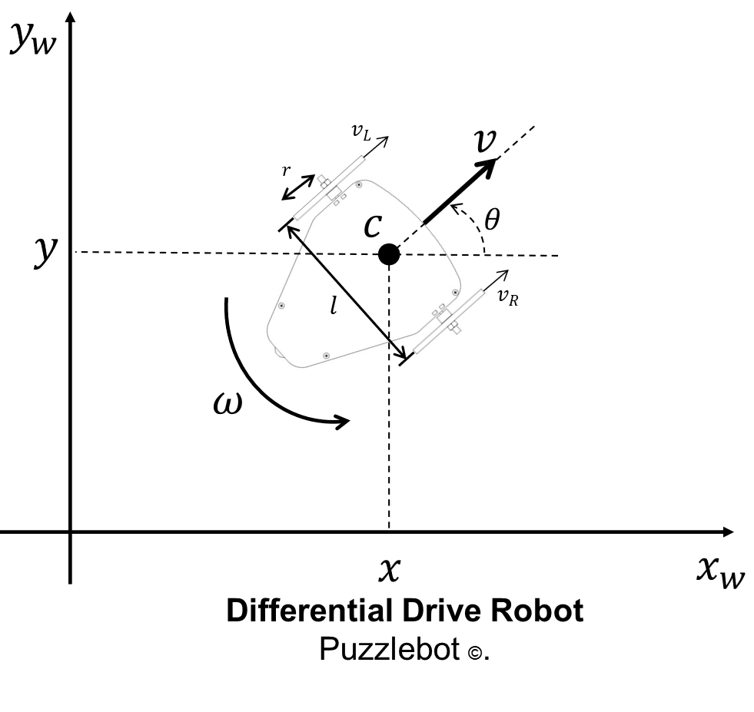
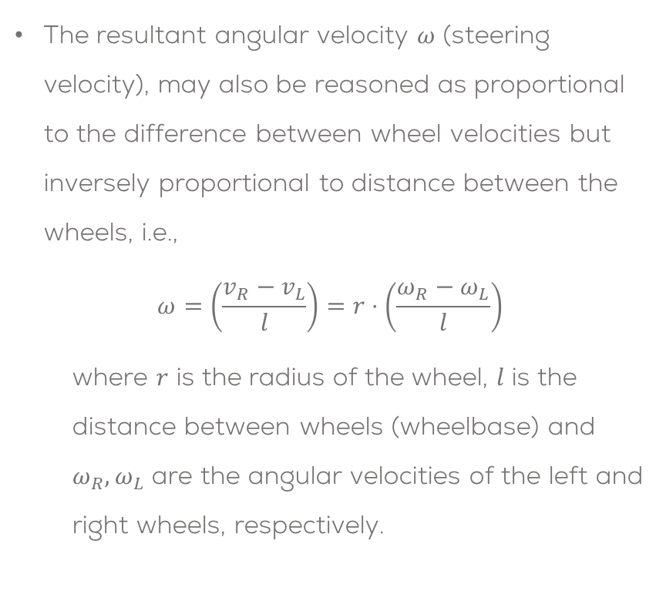
Differential Drive Kinematics
The resultant angular velocity $ω$ (steering velocity), may also be reasoned as proportional to the difference between wheel velocities but inversely proportional to distance between the wheels, i.e.,
$$ω=\left(\frac{v_{R}−v_{L}}{l}\right)=r⋅\left(\frac{ω_{R}−ω_{L}}{l}\right)$$
where $r$ is the radius of the wheel, $l$ is the distance between wheels (wheelbase) and $ω_{R}, ω_{L}$ are the angular velocities of the left and right wheels, respectively.

Slide 10
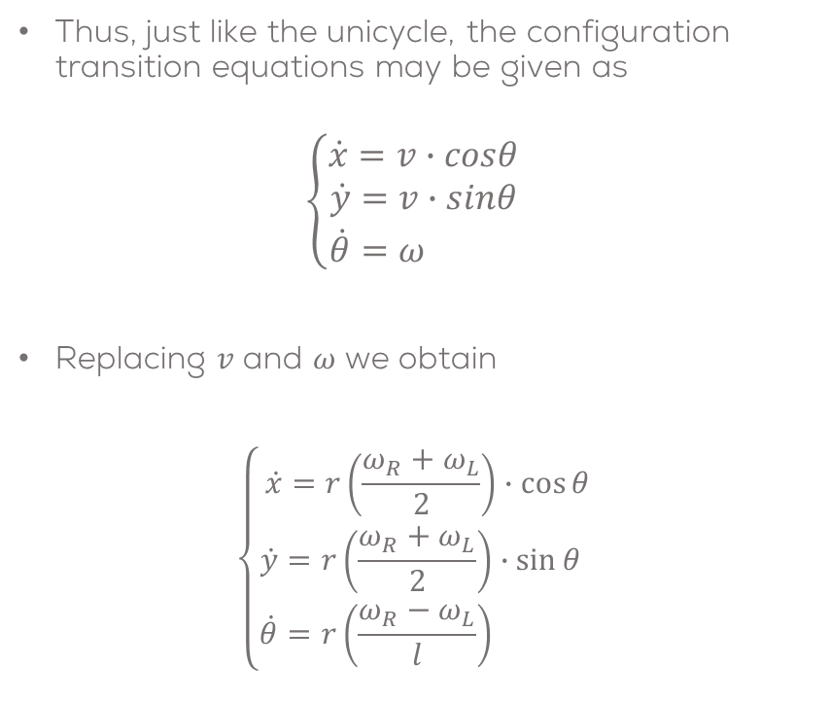
Differential Drive Kinematics
Thus, just like the unicycle, the configuration transition equations may be given as
$$\left\{\begin{aligned}\dot{x}=v∙cosθ \\ \dot{y}&=v∙sinθ \\ \dot{θ}&=ω \end{aligned}\right.$$
Replacing 𝑣 and 𝜔 we obtain
$$\left\{\begin{aligned}\dot{x}=r\left(\frac{ω_{R}+ω_{L}}{2}\right)∙\cos{θ} \\ \dot{y}&=r\left(\frac{ω_{R}+ω_{L}}{2}\right)∙\sin{θ} \\ \dot{θ}&=r\left(\frac{ω_{R}−ω_{L}}{l}\right)\end{aligned}\right.$$

Slide 11
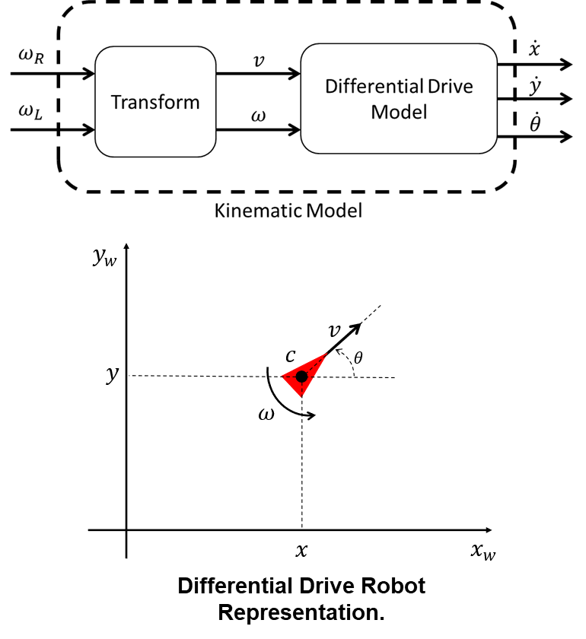
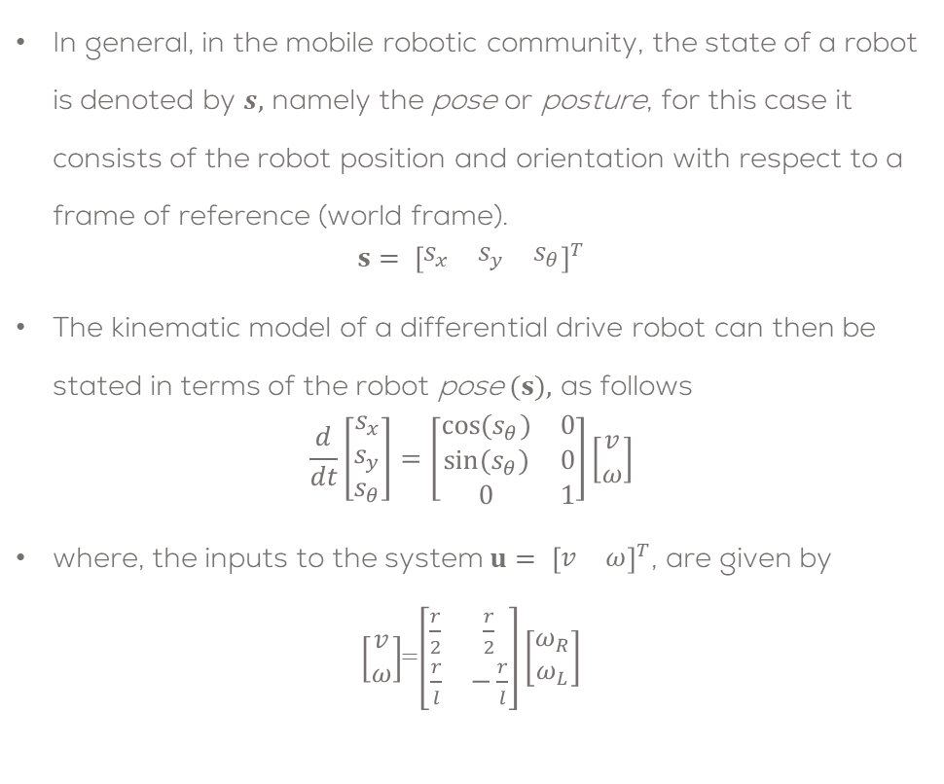
Differential Drive Kinematics
In general, in the mobile robotic community, the state of a robot is denoted by $s,$ namely the pose or posture, for this case it consists of the robot position and orientation with respect to a frame of reference (world frame).
$${s= \left[\begin{matrix}s_{x} & s_{y} & s_{θ}\end{matrix}\right]}^{T}$$
The kinematic model of a differential drive robot can then be stated in terms of the robot pose$(s),$ as follows
$$\frac{d}{dt}\left[\begin{matrix}s_{x} \\ s_{y} \\ s_{θ}\end{matrix}\right]=\left[\begin{matrix}cos⁡(s_{θ}) & 0 \\ sin⁡(s_{θ}) & 0 \\ 0 & 1\end{matrix}\right]\left[\begin{matrix}v \\ ω\end{matrix}\right]$$
where, the inputs to the system ${u= \left[\begin{matrix}v & ω\end{matrix}\right]}^{T}$, are given by
$\left[\begin{matrix}v \\ ω\end{matrix}\right]$=$\left[\begin{matrix}\frac{r}{2} & \frac{r}{2} \\ \frac{r}{l} & −\frac{r}{l}\end{matrix}\right]\left[\begin{matrix}ω_{R} \\ ω_{L}\end{matrix}\right]$

Slide 12
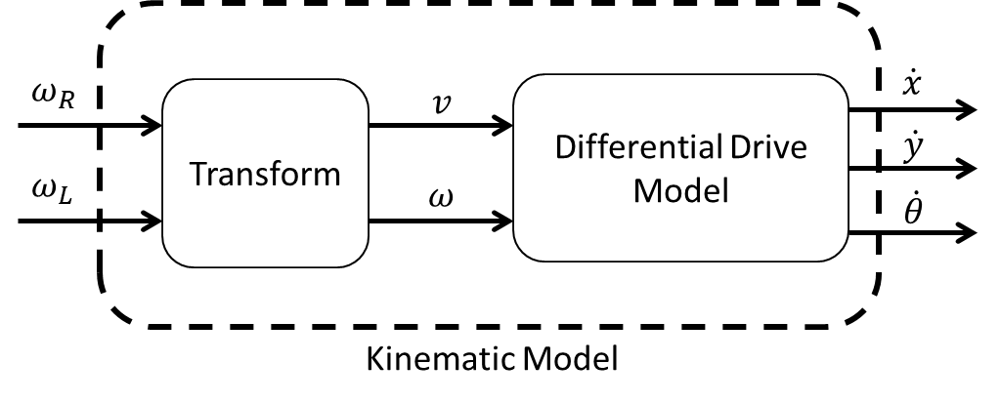
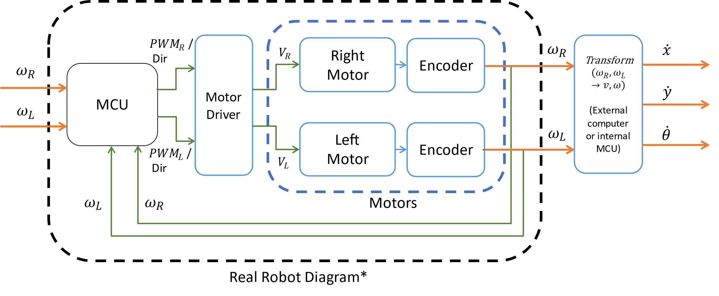

The Mobile Robot
The real robot, in comparison with the kinematic model, requires the usage of sensors and actuators to work.
For the real robot, a closed control loop for each of the motors is required, in order to reach the required velocities, set by the user.
In robotics this is called low level control. For the case of a wheeled mobile robot is a common practice to implement a PID control.
It can be observed that the inputs and outputs are the same, but the inner loop controller and actuators will determine how close the Real Robot will resemble the Kinematic Model.
$$\dot{s}$$

Slide 13
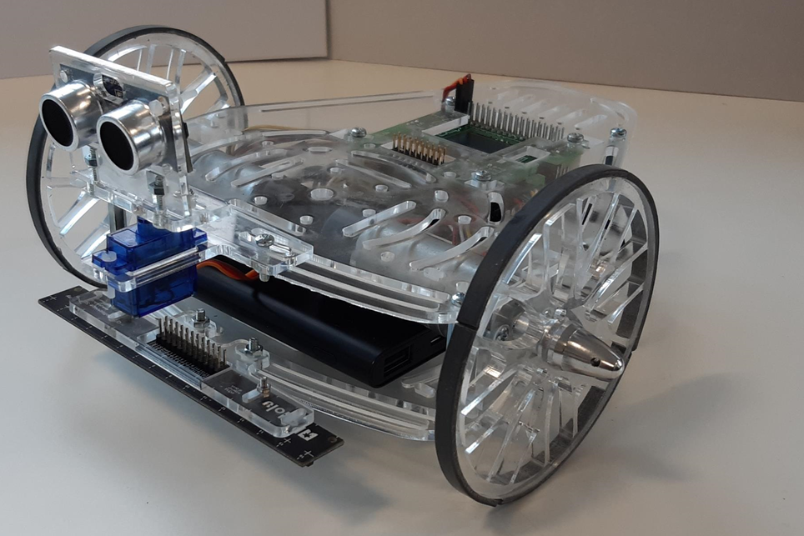
Sensors and Actuators for Differential Drive Robots
As stated before, the kinematic model of a differential drive does not consider the physical characteristics and forces of the robot.
This type of model is used when testing high level robotic algorithms (control) such as path planning, dead reckoning localization, trajectory tracking, AI, etc.
Differential drive robots in reality, have sensors and actuators (motors, encoders, etc.) that allow us to control them to reach the correct speed required to correctly perform its functions.
Differential Drive Robot Sensors and Actuators.

Slide 14
Thank you

Slide 15
T&C
Terms and conditions

Slide 16
Terms and conditions
THE PIECES, IMAGES, VIDEOS, DOCUMENTATION, ETC. SHOWN HERE ARE FOR INFORMATIVE PURPOSES ONLY. THE DESIGN IS PROPRIETARY AND CONFIDENTIAL TO MANCHESTER ROBOTICS LTD. (MCR2). THE INFORMATION, CODE, SIMULATORS, DRAWINGS, VIDEOS PRESENTATIONS ETC. CONTAINED IN THIS PRESENTATION IS THE SOLE PROPERTY OF MANCHESTER ROBOTICS LTD. ANY REPRODUCTION, RESELL, REDISTRIBUTION OR USAGE IN PART OR AS A WHOLE WITHOUT THE WRITTEN PERMISSION OF MANCHESTER ROBOTICS LTD. IS STRICTLY PROHIBITED.
THIS PRESENTATION MAY CONTAIN LINKS TO OTHER WEBSITES OR CONTENT BELONGING TO OR ORIGINATING FROM THIRD PARTIES OR LINKS TO WEBSITES AND FEATURES IN BANNERS OR OTHER ADVERTISING. SUCH EXTERNAL LINKS ARE NOT INVESTIGATED, MONITORED, OR CHECKED FOR ACCURACY, ADEQUACY, VALIDITY, RELIABILITY, AVAILABILITY OR COMPLETENESS BY US.
WE DO NOT WARRANT, ENDORSE, GUARANTEE, OR ASSUME RESPONSIBILITY FOR THE ACCURACY OR RELIABILITY OF ANY INFORMATION OFFERED BY THIRD-PARTY WEBSITES LINKED THROUGH THE SITE OR ANY WEBSITE OR FEATURE LINKED IN ANY BANNER OR OTHER ADVERTISING.

