Slide 1
Localisation
Dead Reckoning

Slide 2
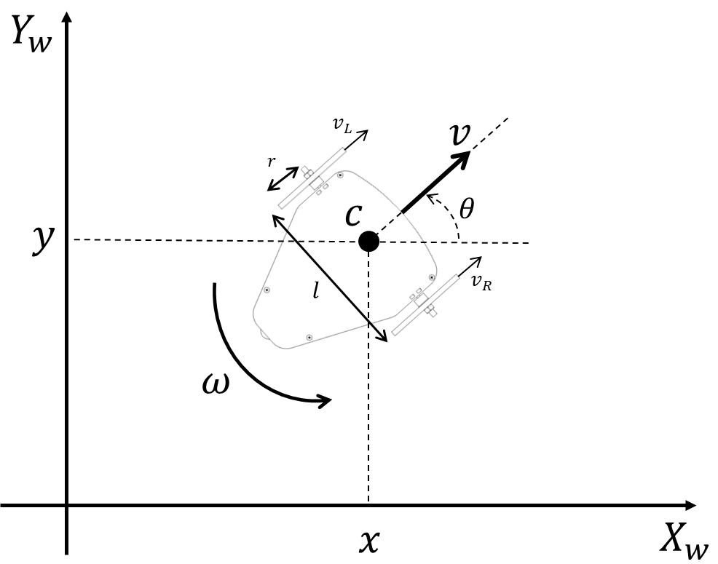
Mobile Robot Localisation
One of the basic functions of mobile robots is to traverse from a certain position to another one in the environment.
To accomplish this task the mobile robot needs to know its pose in the environment at any time to determine whether it has reached its destination; such process is called localisation.
There are many techniques to approach the localisation problem and they differ in the type of sensors used and how the uncertainty is addressed.

Slide 3


Mobile Robot Localisation
In general, in the mobile robotic community, the state of a robot is denoted by $"s",$ namely the pose or posture, for this case it consists of the robot position and orientation with respect to a frame of reference (world frame).
$${s= \left[\begin{matrix}s_{x} & s_{y} & s_{θ}\end{matrix}\right]}^{T}$$

Slide 4






Dead Reckoning
Dead reckoning (DR) is the typical standalone technique that old sailors used to determine the current position of their ship.
DR incrementally integrates the distance traveled and the direction of travel relative to a known start location.
A ship's direction used to be determined by magnetic compass, and the distance traveled was computed by the time of travel and the speed of the vehicle.
Posing the technical challenge of building mechanical clocks that work with high accuracy in an environment of rough motions and changing climates.
Ship’s Speed
Direction
Ship
Change in Position
Time

Slide 5
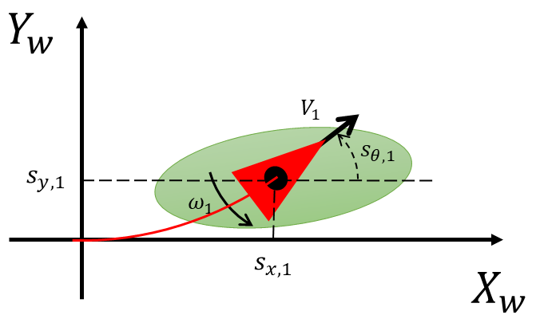
Dead Reckoning
In navigation, dead reckoning is the process of calculating the current position of a moving object by using a previously determined position, and incorporating estimates of speed, heading (or direction or course), and elapsed time.
This technique uses the internal kinematics of the robot to localise it in the environment.
The robot may also employ some proprioceptive or exteroceptive sensors such as: encoders, cameras or IMUs, to provide a better estimate of the pose change over time.
However, such technique suffers from the unbounded growth of uncertainty about the robot pose over time due to the numerical integration and accumulation of error.

Slide 6
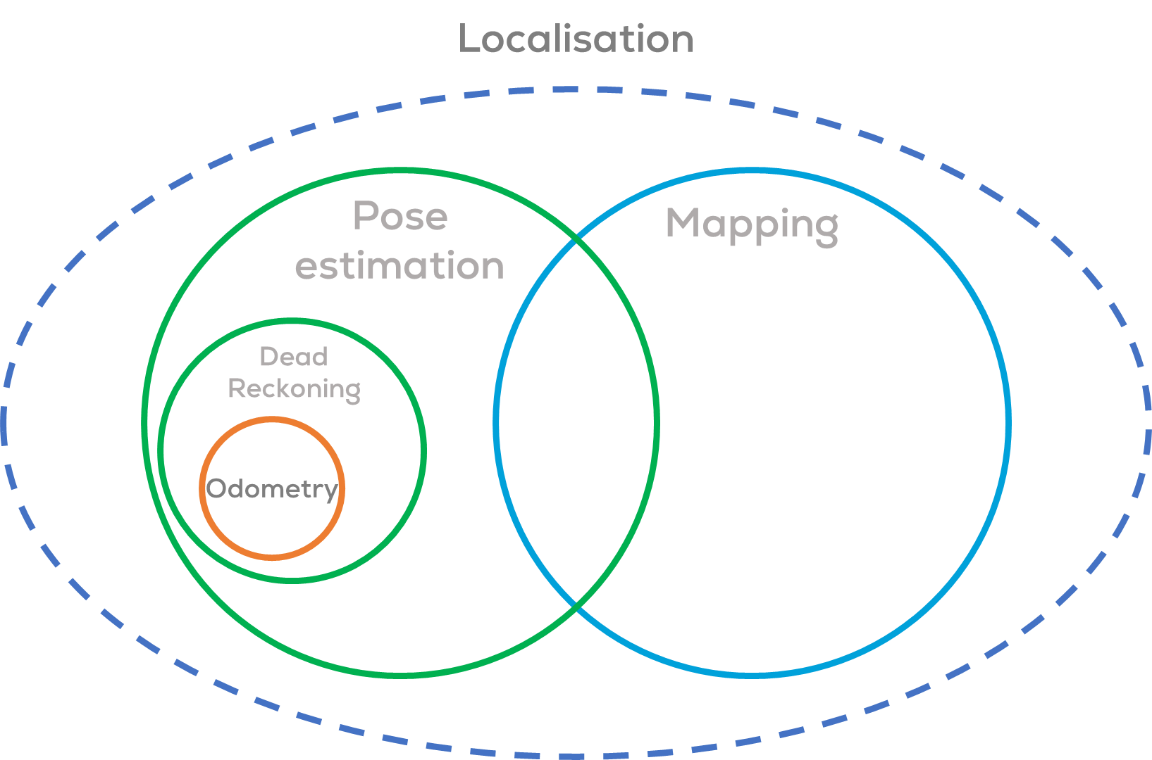
Odometry
The word odometry is composed of the Greek words odos (meaning "route") and metron (meaning "measure").
Odometry is the use of data from motion sensors (encoders for wheeled-based robots) to estimate changes in position over time.
Odometry is a type of dead reckoning localisation, based on estimating the distance travelled.
It is used in robotics by some legged or wheeled robots to estimate their position relative to a starting location.
This method, presents the same errors of other dead reckoning methods.
Rapid and accurate data collection, instrument calibration, and processing are required in most cases for odometry to be used effectively.

Slide 7
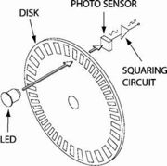
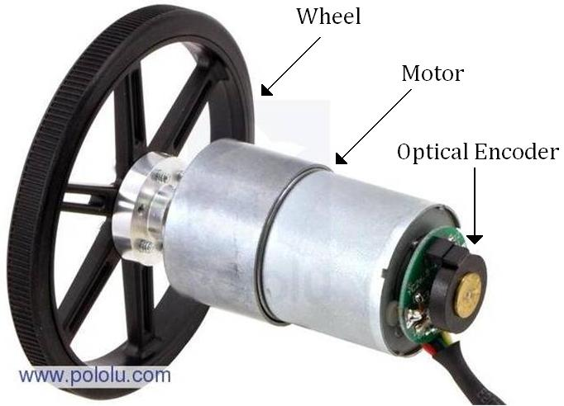
Proprioceptive sensors Rotary Encoders
Rotary optical encoders, are proprioceptive sensors, used to determine the angular position of the shaft they are attached to.
VERY IMPORTANT!!! Encoders in mobile robots are considered proprioceptive sensors because they only acquire information about the robot itself, not the structure of the environment.
Essentially, it is a mechanical light chopper that produces a certain number of pulses for each shaft revolution.

Slide 8
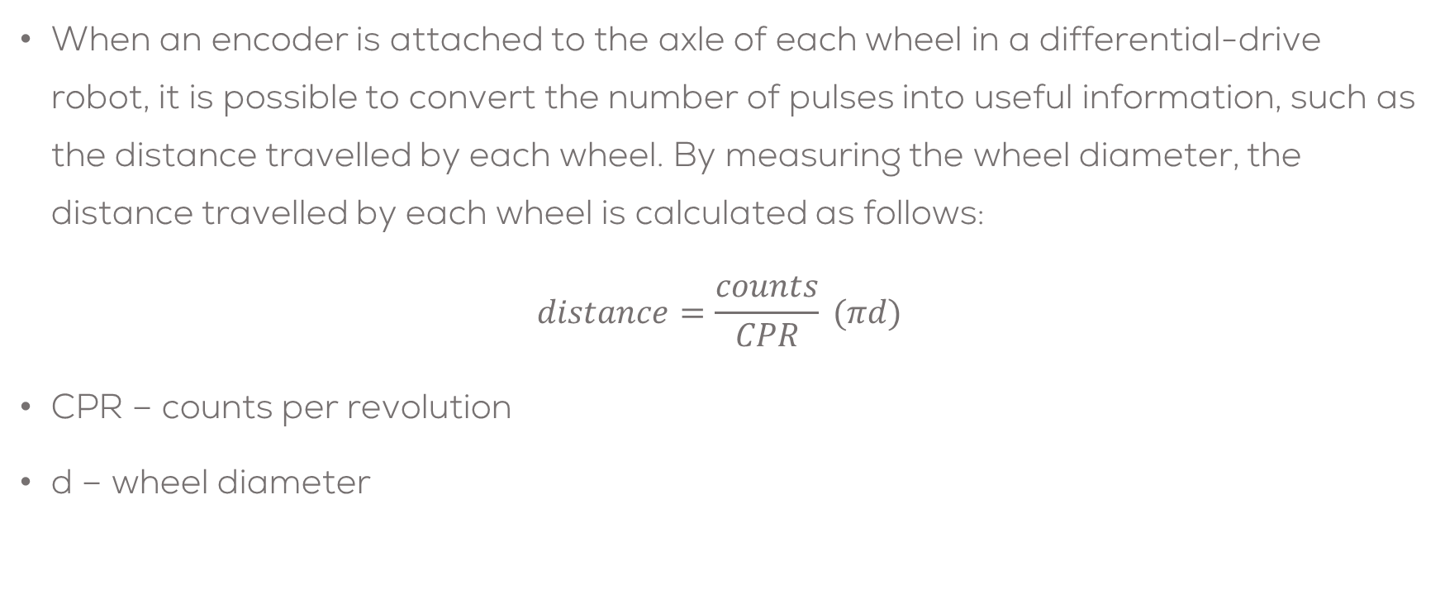
Proprioceptive sensors Rotary Encoders
When an encoder is attached to the axle of each wheel in a differential-drive robot, it is possible to convert the number of pulses into useful information, such as the distance travelled by each wheel. By measuring the wheel diameter, the distance travelled by each wheel is calculated as follows:
$$distance=\frac{counts}{CPR} (πd)$$
CPR – counts per revolution
d – wheel diameter

Slide 9
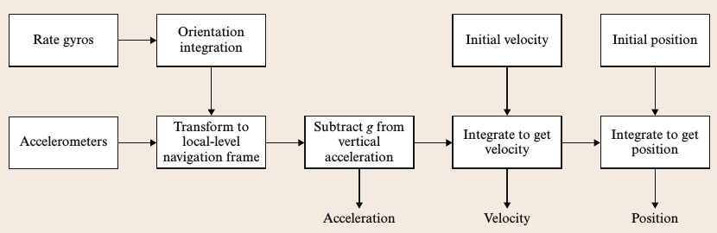
Proprioceptive sensors IMUs
Another type of proprioceptive sensing device is the inertial measurement unit (IMU). An IMU is an electronic sensor that maintains a 6-degree-of-freedom (DOF) estimate of the relative pose of a mobile vehicle, this is, position in x, y and z, and orientation roll, pitch and yaw. Such task is achieved using a set of gyroscopes and accelerometers. IMUs are a common navigational component of aircrafts and ships, particularly for their capability to determine changes in the yaw, pitch and roll.

Slide 10
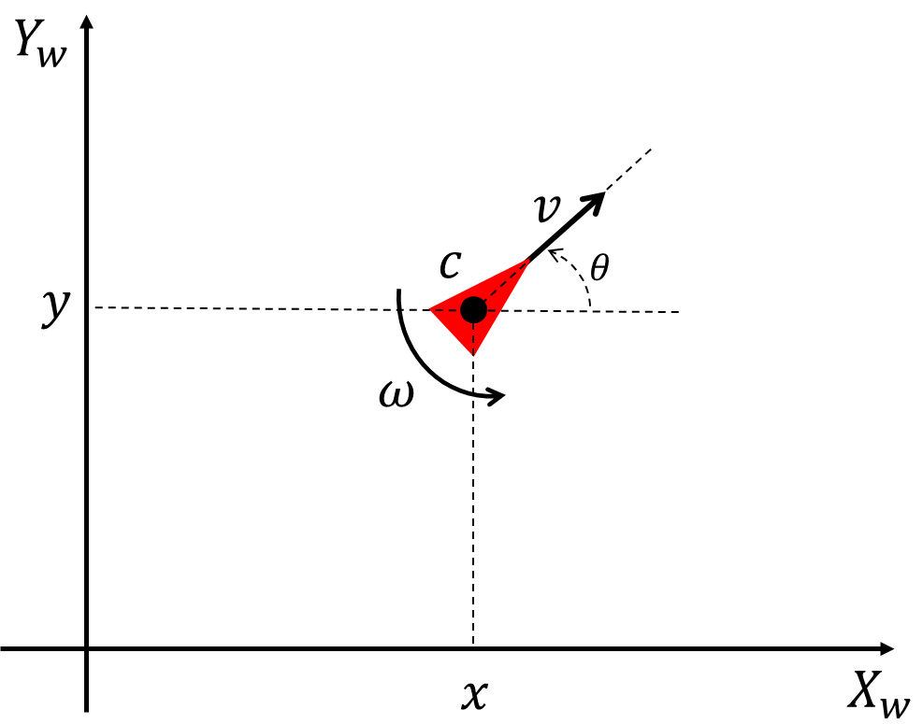

Motion-based Localisation (Dead Reckoning)
Kinematic model for a differential robot model
$$\frac{d}{dt}\left[\begin{matrix}s_{x} \\ s_{y} \\ s_{θ}\end{matrix}\right]=\left[\begin{matrix}cos⁡(s_{θ}) & 0 \\ sin⁡(s_{θ}) & 0 \\ 0 & 1\end{matrix}\right]\left[\begin{matrix}v \\ ω\end{matrix}\right]$$
The robot pose
$${s_{k}= \left[\begin{matrix}s_{x} & s_{y} & s_{θ}\end{matrix}\right]}^{T}$$
The robot inputs
$${u_{k}= \left[\begin{matrix}v & ω\end{matrix}\right]}^{T}$$

Slide 11

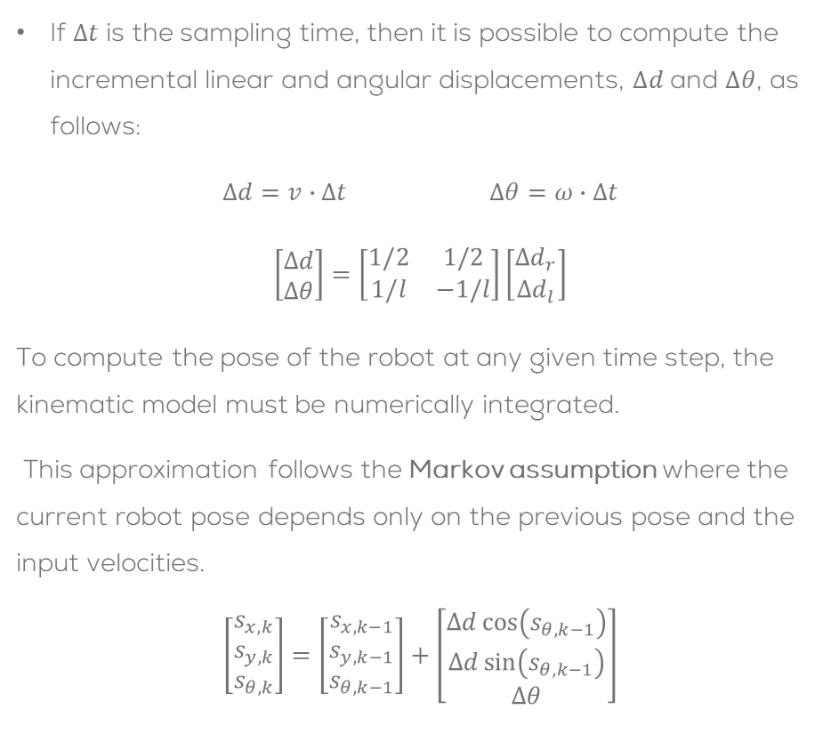
Motion-based Localisation (Dead Reckoning)
If $Δt$ is the sampling time, then it is possible to compute the incremental linear and angular displacements, $∆d$ and $∆θ$, as follows:
$Δd=v∙Δt$ $Δθ=ω∙Δt$
$$\left[\begin{matrix}Δd \\ Δθ\end{matrix}\right]=\left[\begin{matrix}1/2 & 1/2 \\ 1/l & −1/l\end{matrix}\right]\left[\begin{matrix}{Δd}_{r} \\ {Δd}_{l}\end{matrix}\right]$$
To compute the pose of the robot at any given time step, the kinematic model must be numerically integrated.
This approximation follows the Markov assumption where the current robot pose depends only on the previous pose and the input velocities.
$$\left[\begin{matrix}s_{x,k} \\ s_{y,k} \\ s_{θ,k}\end{matrix}\right]=\left[\begin{matrix}s_{x,k−1} \\ s_{y,k−1} \\ s_{θ,k−1}\end{matrix}\right]+\left[\begin{matrix}Δd\cos\left(s_{θ,k−1}\right) \\ Δd\sin\left(s_{θ,k−1}\right) \\ Δθ\end{matrix}\right]$$

Slide 12
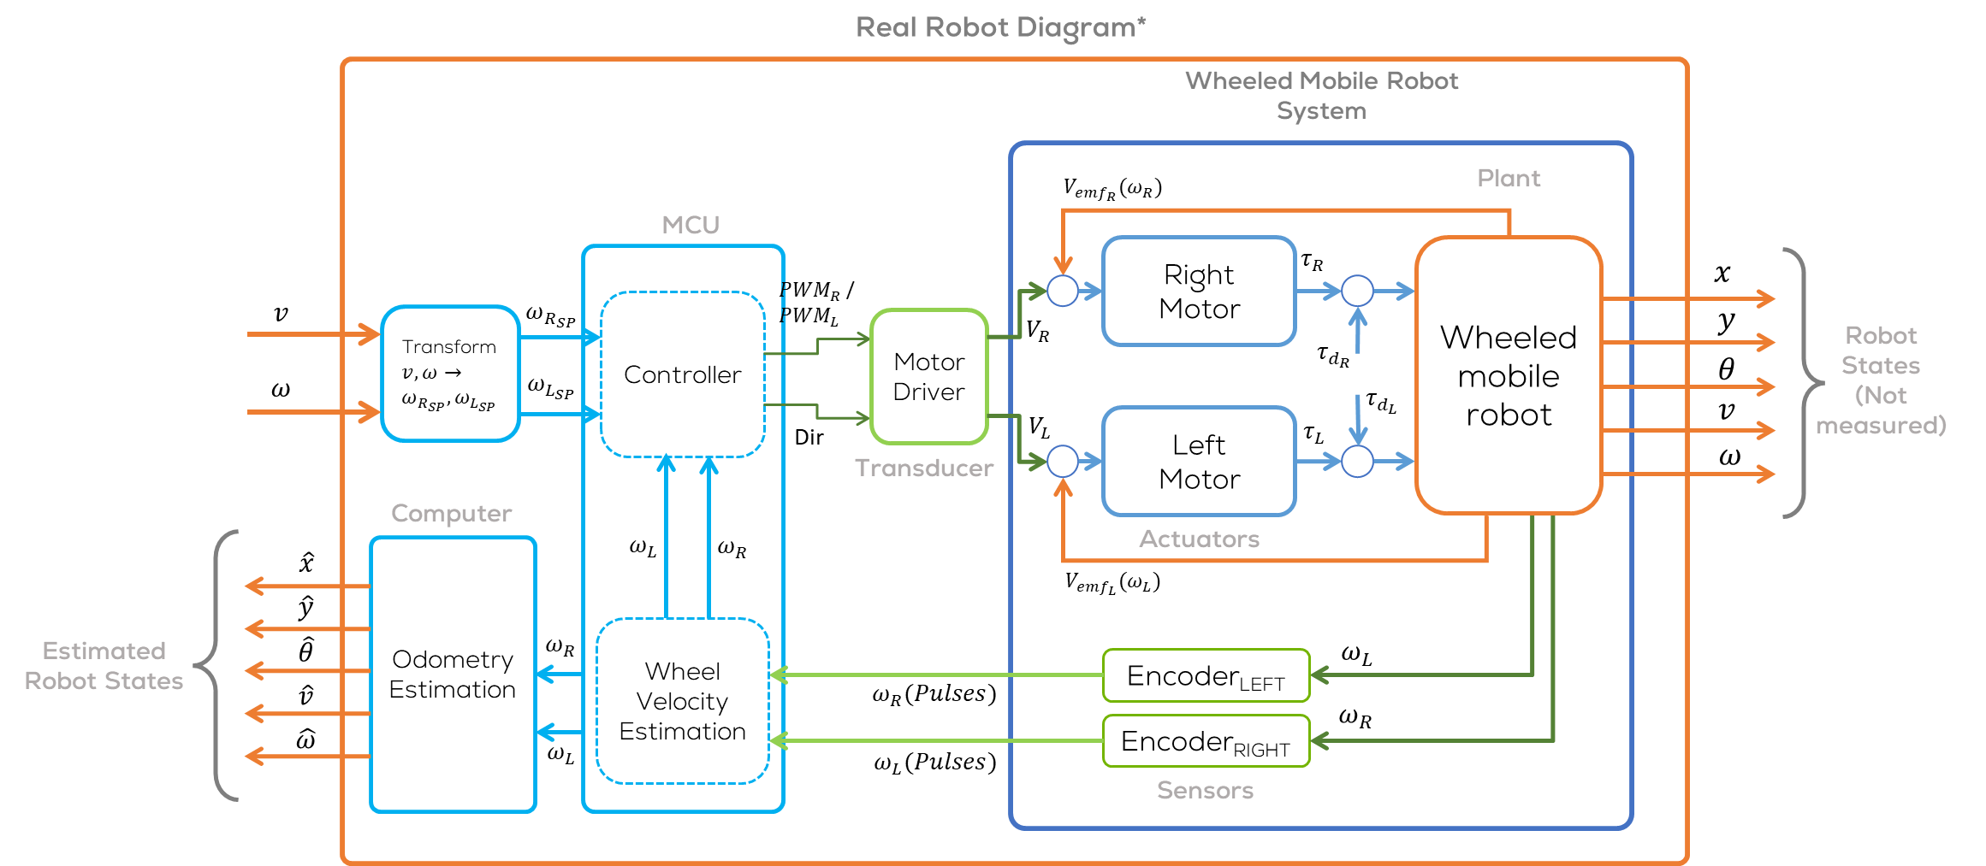

Slide 13
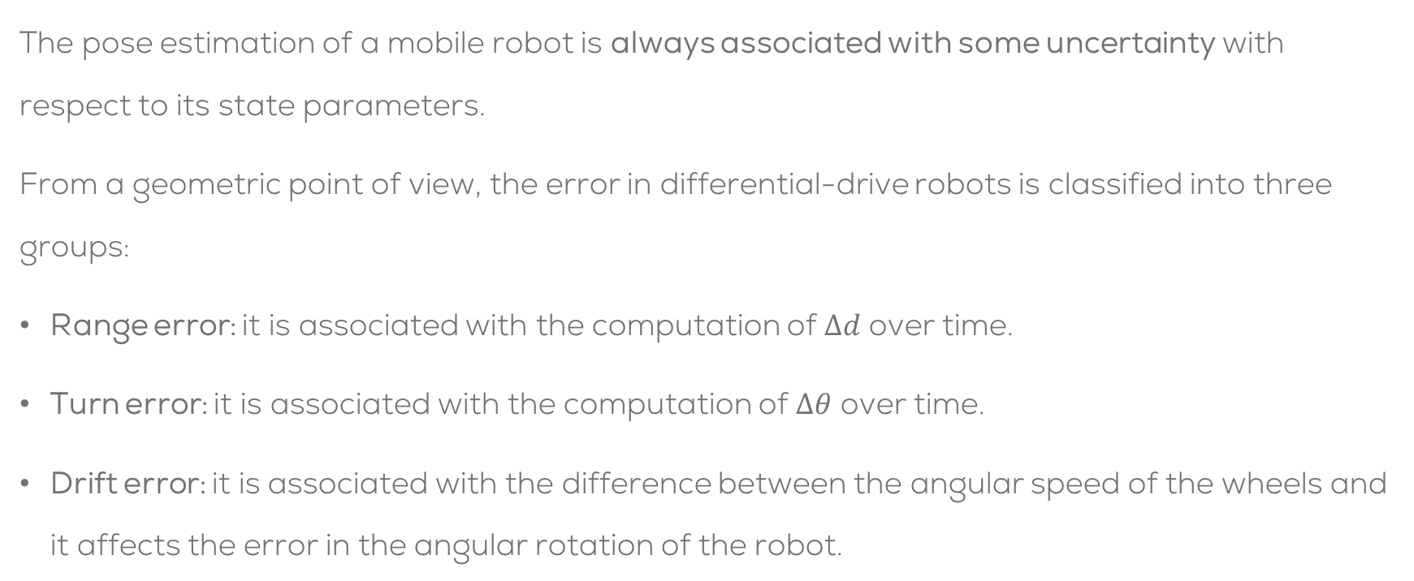
Motion-based Localisation (Dead Reckoning)
The pose estimation of a mobile robot is always associated with some uncertainty with respect to its state parameters.
From a geometric point of view, the error in differential-drive robots is classified into three groups:
Range error: it is associated with the computation of $Δd$ over time.
Turn error: it is associated with the computation of $Δθ$ over time.
Drift error: it is associated with the difference between the angular speed of the wheels and it affects the error in the angular rotation of the robot.

Slide 14
Activity 1
Localisation in ROS

Slide 15
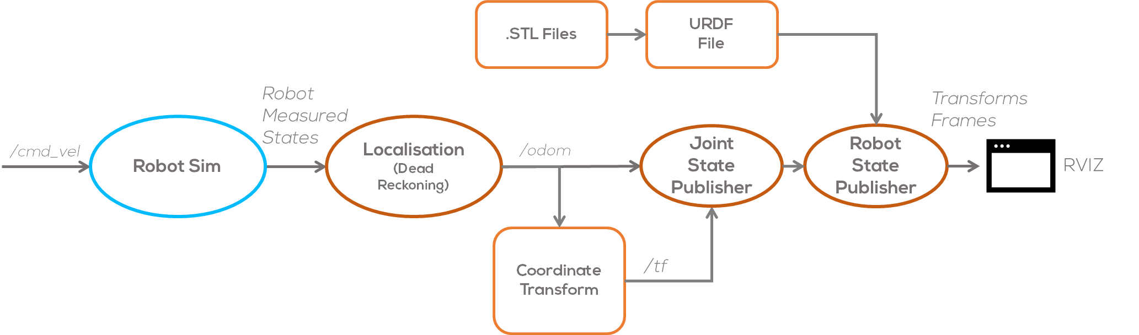
Localisation ROS
In this activity, the student will develop an odometry node in ROS.
In ROS, localisation is typically done in a separate node.
The concept of localisation, states that it should be an action independent of the robot, that may or may not be performed by an internal or using an external computing unit.
This provides more flexibility when developing robotics, and independence so that the user can define the internal parameters of the node and reuse it for other robots and not only for a specific type of robot platform.

Slide 16
Localisation ROS
In ROS, the odometry of a robot is published using an Odometry message.
The message is found in “nav_msgs/Odometry”
Typically, the odometry message uses the topic “/odom”.
The pose in this message corresponds to the estimated position of the robot in the odometric frame along with an optional covariance for the certainty of that pose estimate.
The twist in this message corresponds to the robot's velocity in the child frame, normally the coordinate frame of the mobile base, along with an optional covariance for the certainty of that velocity estimate.
Odometry Message:
# This represents an estimate of a position and velocity in free space.
# The pose in this message should be specified in the coordinate frame given by header.frame_id.
# The twist in this message should be specified in the coordinate frame given by the child_frame_id
Header header
string child_frame_id
geometry_msgs/PoseWithCovariance pose
geometry_msgs/TwistWithCovariance twist

Slide 17
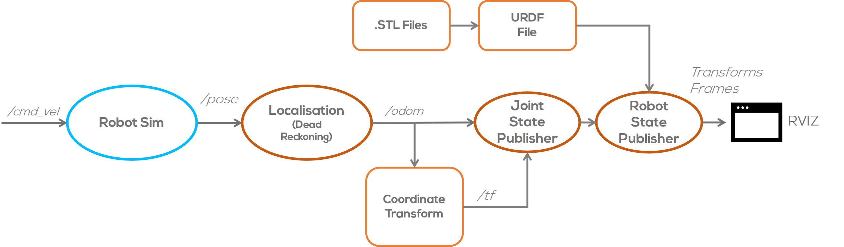
Activity 1
Develop a simple node called “localisation” that subscribes to the pose topic of the simulated robot.
Use this information to create an Odometry Message and publish the message in an /odom topic.
Establish the inertial frame to be called “odom”
Make a transform between the “odom” frame and the “base_link” frame.
Verify that the results are correct using the “rqt_plot” or the “rqt_multiplot”
Modify the previously defined Joint publisher for the Dashgo B1 robot to read the message and publish the joint information.
Use the robot State publisher to read the URDF file and publish the transformations for the Dasgho B1 robot.

Slide 18
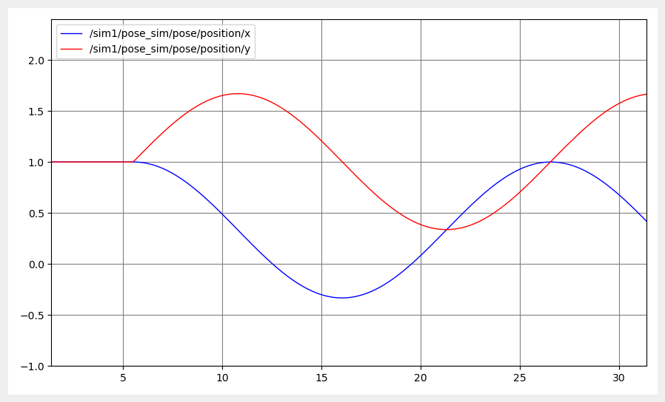
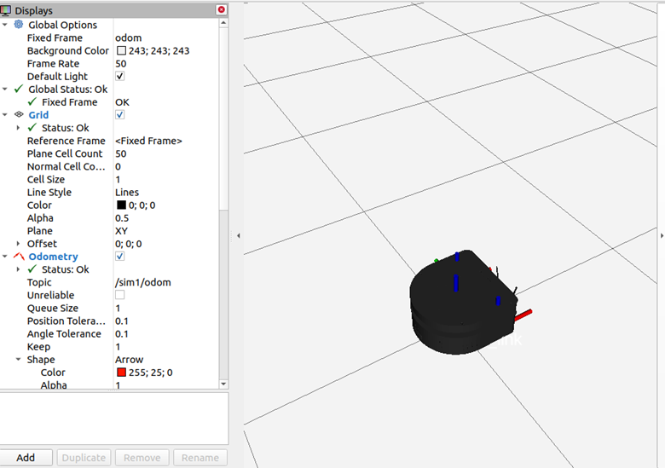
Activity 1
Use the Teleoperation node in ROS to control the robot in Open Loop.

Slide 19
Activity 2
Localisation in ROS

Slide 20
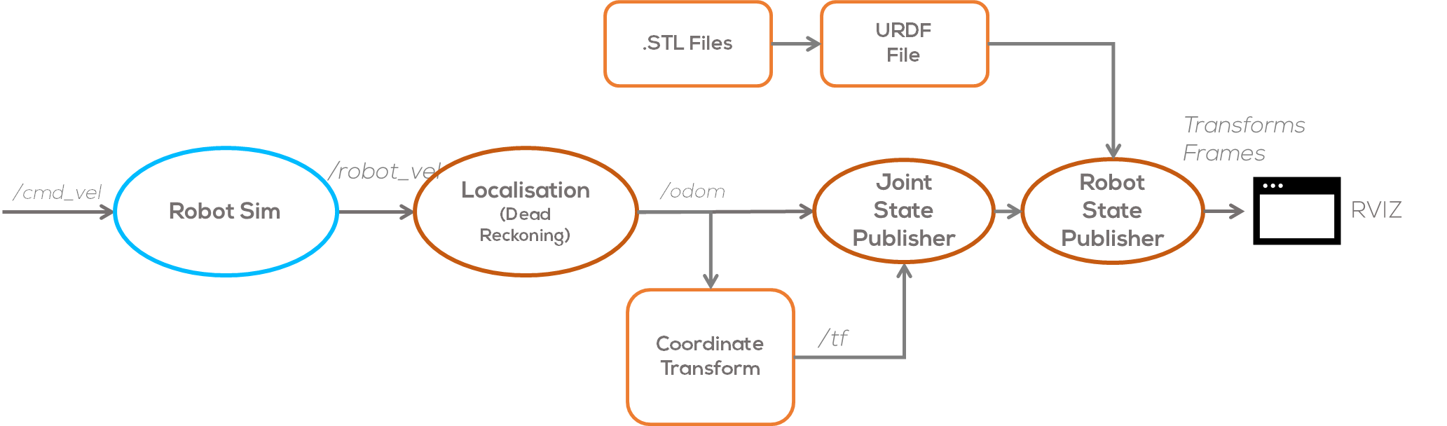
Activity 2
Repeat the previous activity, but this time, the “localisation” node must subscribe to the velocities output of the simulation “/robot_vel”
Use the robot State publisher to read the URDF file and publish the transformations for the Dasgho B1 robot.
Use the Teleoperation node in ROS to control the robot in Open Loop.

Slide 21
Activity 3
Localisation in ROS

Slide 22
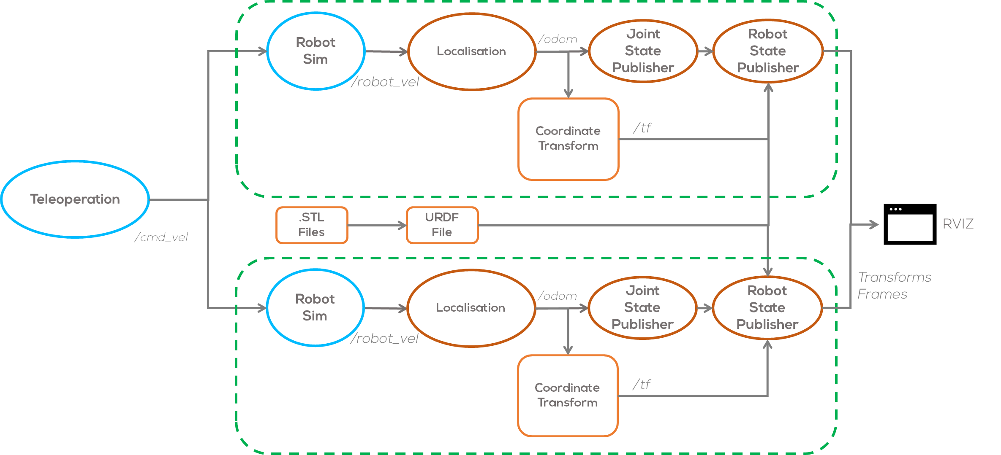
Activity 3
Use the “launch” files to simulate two independent robots at the same time.
Repeat the previous activity, but this time, the “localisation” node must subscribe to the velocities output of the simulation “/robot_vel”
Use the robot State publisher to read the URDF file and publish the transformations for the Dasgho B1 robot.
Use one single Teleoperation node in ROS to control both robots at the same time in Open Loop.

Slide 23
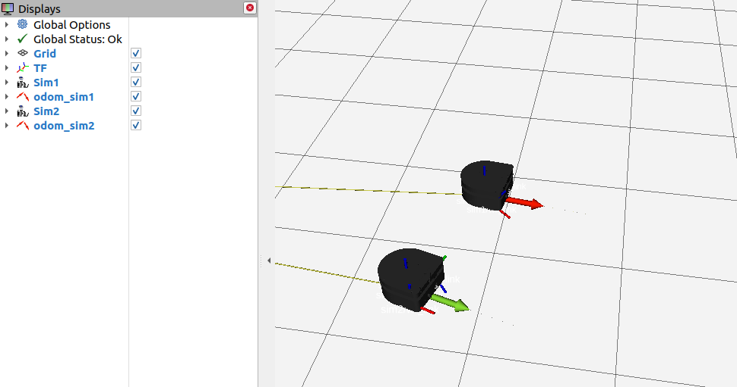
Activity 3

Slide 24
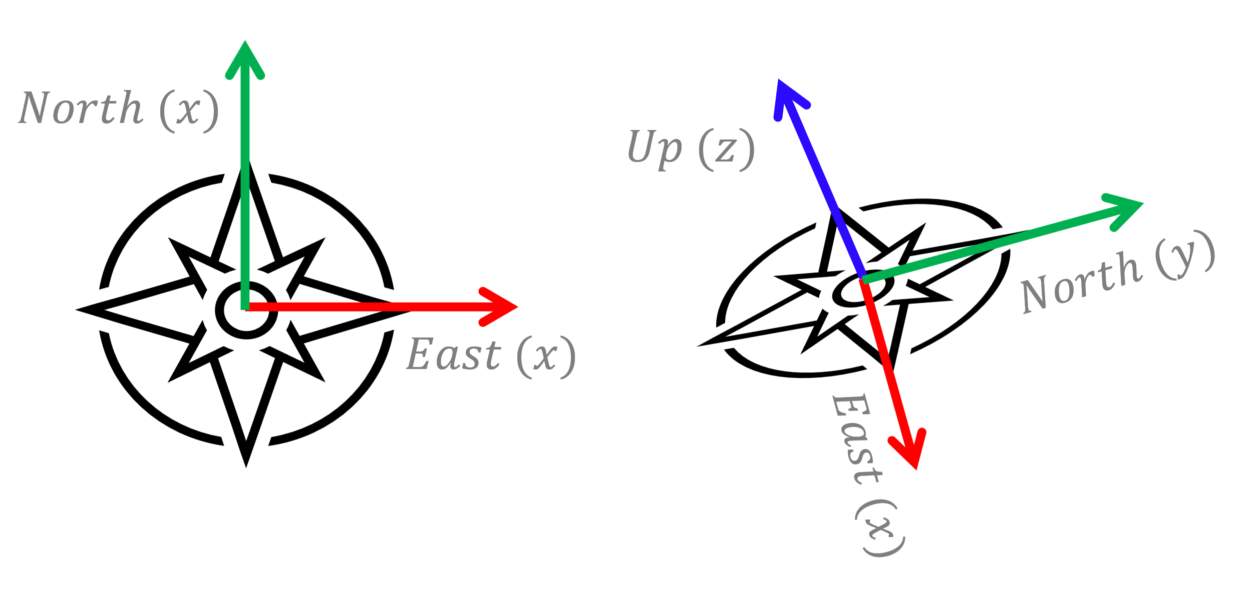
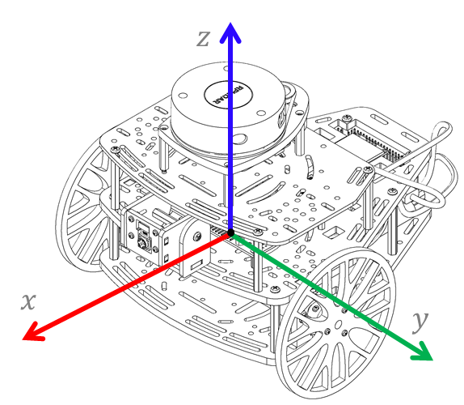
Localisation in ROS
According to ROS best practices, the frame conventions are as follows
Chirality
All systems are right-handed. This means they comply with the right-hand rule.
Axis Orientation
In relation to a body the standard is:
x forward
y left
z up
For short-range Cartesian representations of geographic locations, use the east-north up (ENU) convention:
X east
Y north
Z up
To avoid precision problems with large float32 values, it is recommended to choose a nearby origin, such as your system's starting position.

Slide 25
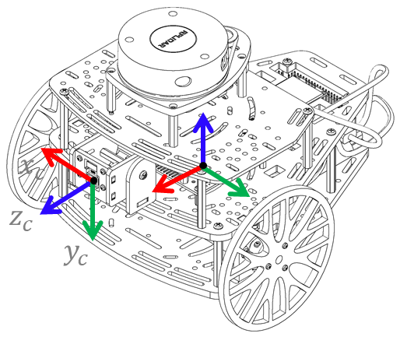
Localisation in ROS
Suffix Frames
In the case of cameras, there is often a second frame defined with a "_optical" suffix. This uses a slightly different convention:
z forward
x right
y down
For outdoor systems where it is desirable to work under the northeast down (NED) convention, define an appropriately transformed secondary frame with the "_ned" suffix:
X north
Y east
Z down

Slide 26
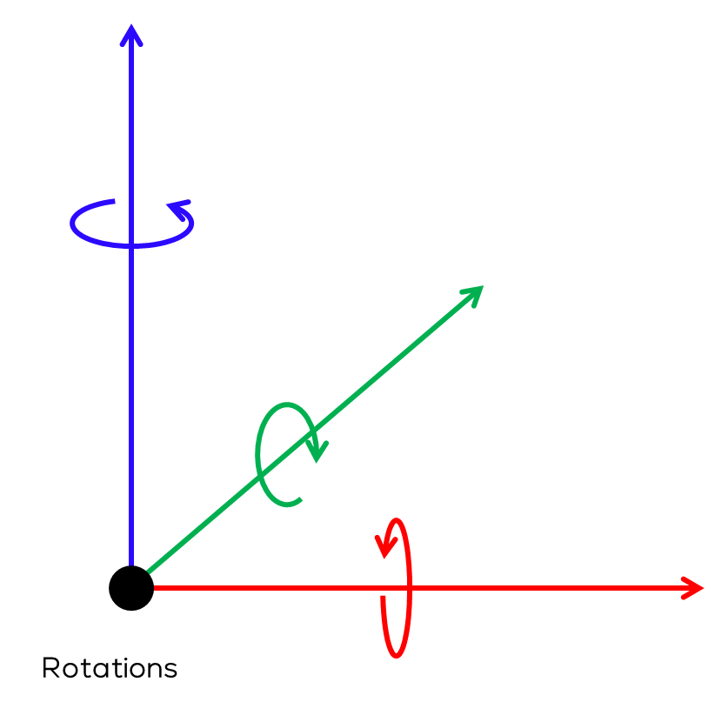
Localisation in ROS
Rotation Representation
There are many ways to represent rotations. The preferred order is listed below, along with rationale.
Quaternion
Compact representation
No singularities
rotation matrix
No singularities
fixed axis roll, pitch, yaw about X, Y, Z axes respectively
No ambiguity on order
Used for angular velocities
Euler angles yaw, pitch, and roll about Z, Y, X axes respectively
Euler angles are generally discouraged due to having 24 'valid' conventions with different domains using different conventions by default.

Slide 27
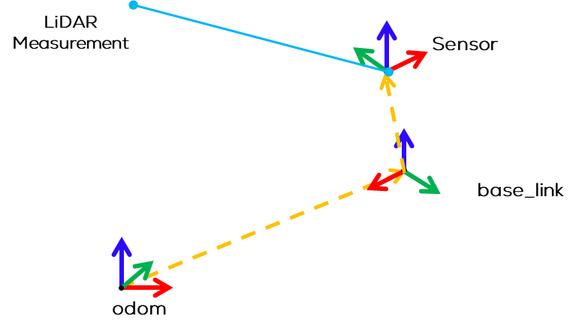
Coordinate frames mobile platforms
Motivation
Developers of drivers, models, and libraries need a shared convention for coordinate frames in order to integrate better and reuse software components.
Shared conventions for coordinate frames provide a specification for developers creating drivers and models for mobile bases.
Similarly, developers creating libraries and applications can more easily use their software with various mobile bases that are compatible with this specification.

Slide 28
Coordinate frames mobile platforms
Coordinate Frames
base_link
The coordinate frame called base_link is rigidly attached to the mobile robot base.
odom
The coordinate frame called odom is a world-fixed frame.
The pose of a mobile platform in the odom frame can drift over time, without any bounds.
This drift makes the odom frame useless as a long-term global reference.
However, the pose of a robot in the odom frame is guaranteed to be continuous, meaning that the pose of a mobile platform in the odom frame always evolves in a smooth way, without discrete jumps.
In a typical setup the odom frame is computed based on an odometry source, such as wheel odometry, visual odometry or an inertial measurement unit.

Slide 29
Coordinate frames mobile platforms
map
The coordinate frame called map is a world fixed frame, with its Z-axis pointing upwards.
The pose of a mobile platform, relative to the map frame, should not significantly drift over time. The map frame is not continuous, meaning the pose of a mobile platform in the map frame can change in discrete jumps at any time.
The map frame is not continuous, meaning the pose of a mobile platform in the map frame can change in discrete jumps at any time.
In a typical setup, a localization component constantly re-computes the robot pose in the map frame based on sensor observations, therefore eliminating drift, but causing discrete jumps when new sensor information arrives.
The map frame is useful as a long-term global reference, but discrete jumps in position estimators make it a poor reference frame for local sensing and acting.

Slide 30
