Slide 1
Mini challenge
Motor Dynamical Simulation

Slide 2
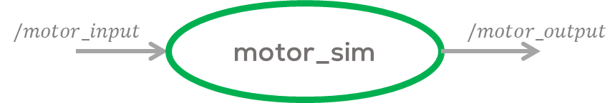
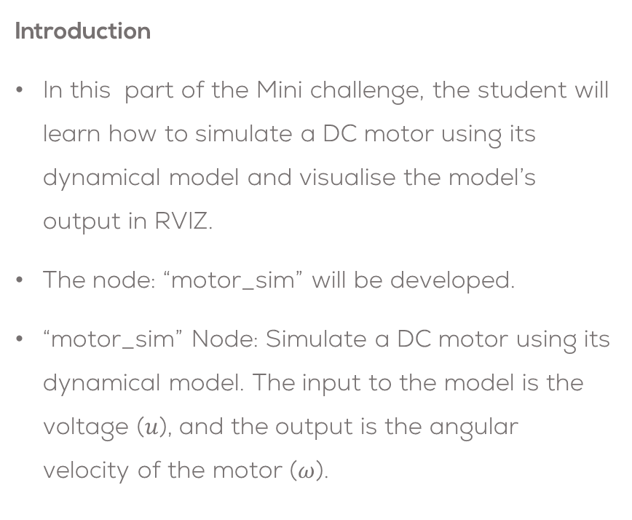
Motor simulation
Introduction
In this part of the Mini challenge, the student will learn how to simulate a DC motor using its dynamical model and visualise the model’s output in RVIZ.
The node: “motor_sim” will be developed.
“motor_sim” Node: Simulate a DC motor using its dynamical model. The input to the model is the voltage ($u$), and the output is the angular velocity of the motor ($ω$).

Slide 3
Motor Simulation in RVIZ
Download the package called “motor_sim”, from the folder “/Week1/Minichallenge/” to your “catkin_ws”
Create a node called “motor_sim.py”” inside the scripts folder
cd ~/catkin_ws/src/motor_sim/scripts/
touch motor_sim.py
Do not forget to give executable permission to the file
cd ~/catkin_ws/src/motor_sim/scripts/
sudo chmod +x motor_sim.py
Modify the CMake file to include the newly created node to the
catkin_install_python(PROGRAMS scripts/motor_sim.py
DESTINATION ${CATKIN_PACKAGE_BIN_DESTINATION})

Slide 4
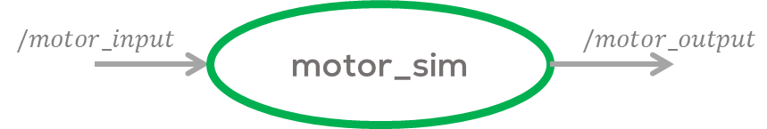
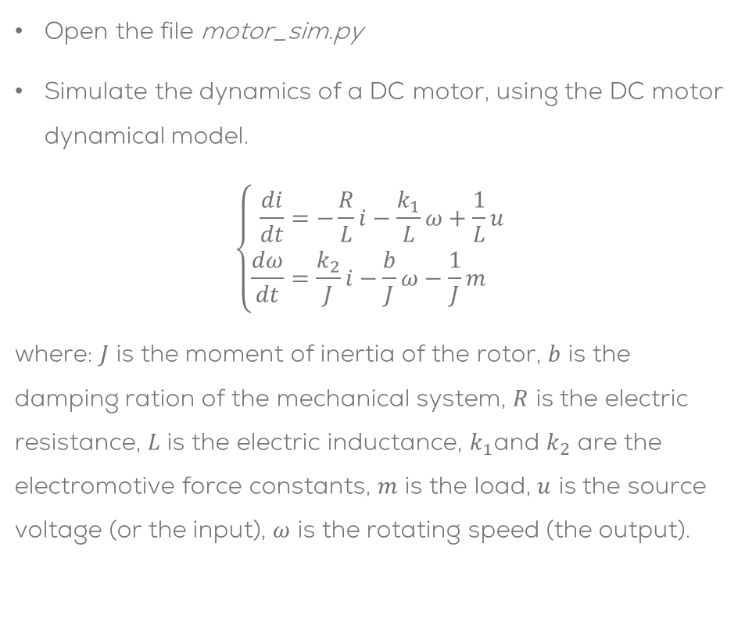
Motor Simulation in RVIZ
Open the file motor_sim.py
Simulate the dynamics of a DC motor, using the DC motor dynamical model.
$$\left\{\begin{aligned}\frac{di}{dt}&=−\frac{R}{L}i−\frac{k_{1}}{L}ω+\frac{1}{L}u \\ \frac{dω}{dt}&=\frac{k_{2}}{J}i−\frac{b}{J}ω−\frac{1}{J}m\end{aligned}\right.$$
where: $J$ is the moment of inertia of the rotor, $b$ is the damping ration of the mechanical system, $R$ is the electric resistance, $L$ is the electric inductance, $k_{1}$and $k_{2}$ are the electromotive force constants, $m$ is the load, $u$ is the source voltage (or the input), $ω$ is the rotating speed (the output).
#Motor Parameters
R = 6.0
L = 0.3
k1 = 0.04
k2 = k1
J = 0.00008
b = 0.00025
m = 0.0
#Motor governing equation
current_dot = -(R/L)*current-(k1/L)*omega+(1/L)*(u)
current += current_dot*dt
omega_dot = (k2/J)*current-(b/J)*omega-(1/J)*m
omega += omega_dot*dt

Slide 5
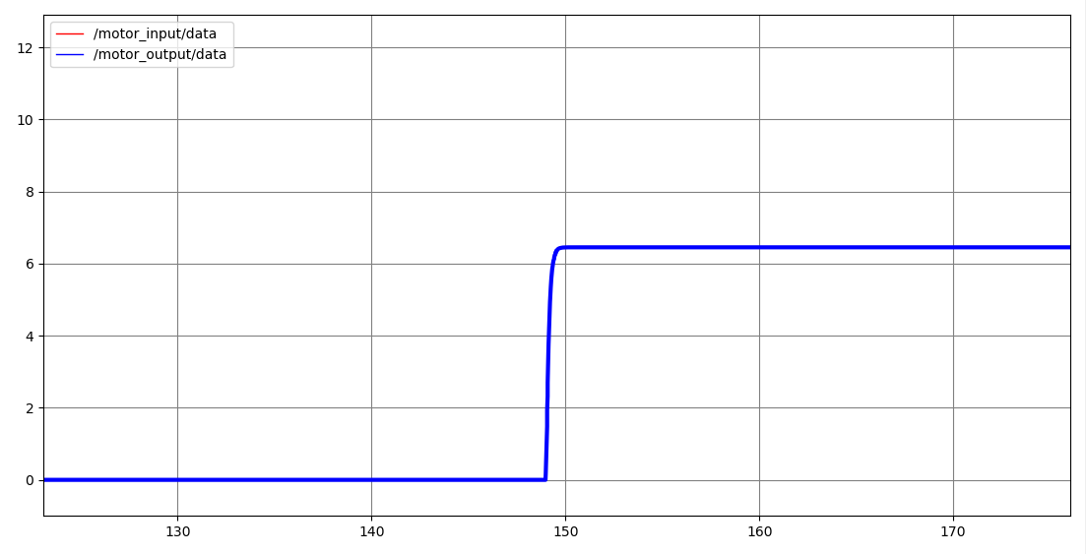

Motor Simulation in RVIZ
Subscribe the model to the topic “/motor_input” and publish the model’s output in the topic “/motor_output”.
Both messages can be Float32 messages.
Make sure to add print some values to verify the program is working properly (debug).
Compile the program
cd ~/catkin_ws
catkin_make
Start ROS
roscore
Run the node
rosrun motor_sim motor_sim.py
Open the rqt_plot to verify the results
Publish a value in the “/motor_input” topic in the range of $u=[−1,1]$.
rostopic pub /motor_input std_msgs/Float32 "data: 0.3"
Verify the results

Slide 6
Mini challenge
Part 2: Visualisation

Slide 7
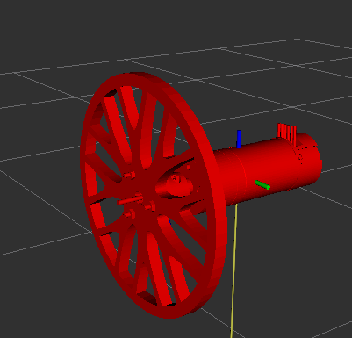
Motor modelling
This part of the mini-challenge is intended for the student to review the concepts introduced in the previous sessions.
This activity consists of visualising the dynamical behaviour of a DC Motor using URDF files and joint state publishers in RVIZ.
This activity employs a simple dynamical system simulation to dictate the motor’s state behaviour.

Slide 8
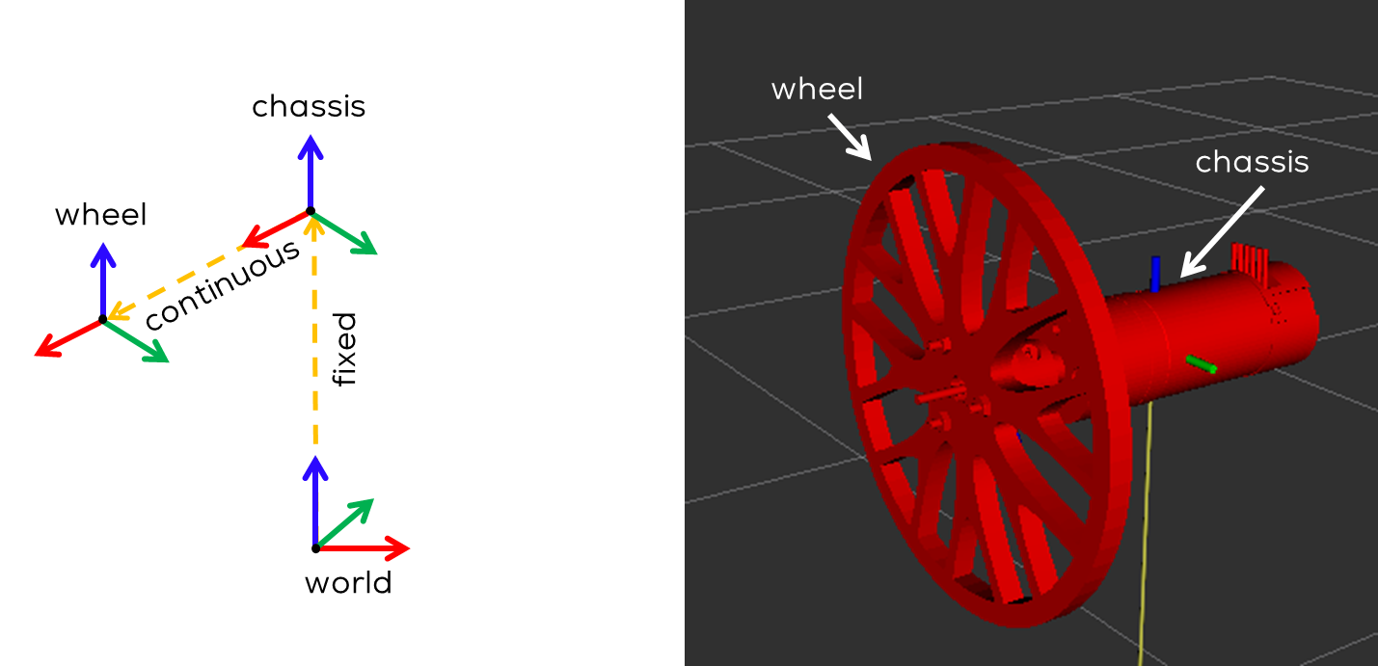
Motor modelling
The student must model their own DC motor using any CAD package (or use the files provided by MCR2).
The model must contain a robot chassis and a wheel to be attached to the motor shaft as shown in the figure.
The student must use a URDF description file to describe the links and joints of the motor model.
Three links must be defined: “world”, “chassis”, and ”wheel”.
The motor “chassis” must be fixed to a “world” frame.
The “wheel” must be attached to the chassis using a “continuous” joint.

Slide 9
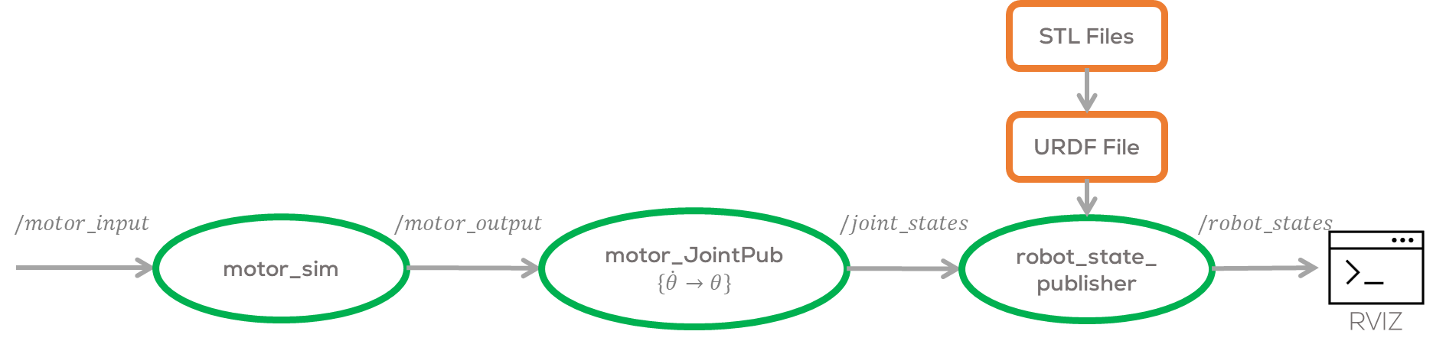
Motor modelling
The student must develop their joint state publisher for the “continuous” joint.
The joint state publisher must read the speed of the motor from the topic “/motor_output”.
The student must transform the motor speed into the angular position of the joint before publishing the information to the joint.
The user must publish the required information to move the joint (angle in radians).

Slide 10
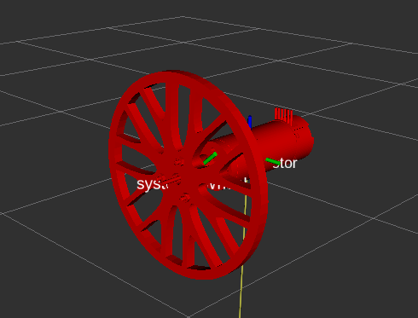
Expected results
The motor should spawn in the RVIZ world.
The wheel must be able to rotate according to the system’s dynamics.
Different inputs to the system must be tested.

Slide 11
Motor Simulation in RVIZ
Use the “motor_JointPub.py” to publish the data to the joints of the model.
Add the newly created node “motor_sim.py” to the launch file “motor_sim.launch”.
<?xml version="1.0"?>
<launch>
<!-- Load URDF-->
<arg name="motor_urdf" default="$(find links_act)/urdf/dc_motor.urdf"/>
<!--Set URDF file as a robot_description parameter-->
<param name="robot_description" command="cat $(arg motor_urdf)" />
<!--Initialise robot_state_publisher-->
<node pkg="robot_state_publisher" type="robot_state_publisher" name="motor_urdf_pub" >
</node>
<!--Initialise motor joint publisher-->
<node pkg="motor_sim" type="motor_JointPub.py" name="motor_JointPub" />
<!--Initialise motor dynamical simulation-->
<node pkg="motor_sim" type="motor_sim.py" name="motor_Sim" />
</launch>

Slide 12
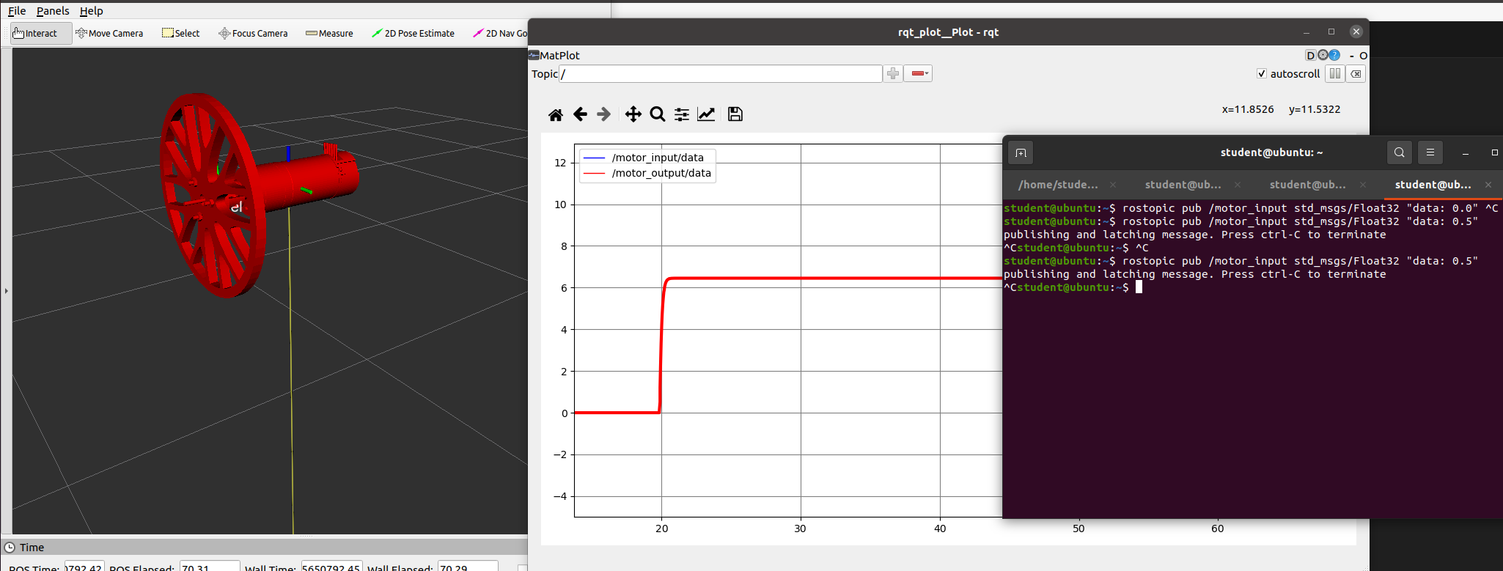
Motor Simulation in RVIZ

Slide 13
Mini challenge
Part 3: Control

Slide 14
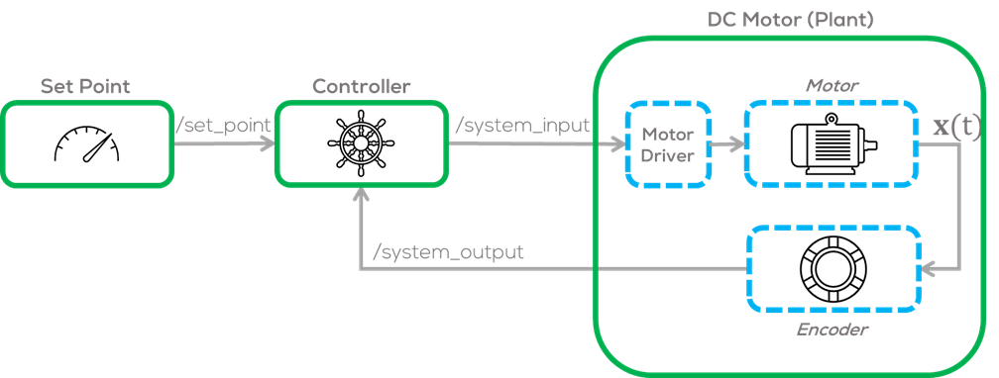
Controller
Introduction
The activity consists of creating a “controller” node and a “setPoint generator” node for the DC motor previously defined.
The “controller node” must control the speed of the motor.
The controller can be “P”, “PI” or “PID” controller (other controllers can be accepted upon agreement with the professor.).

Slide 15
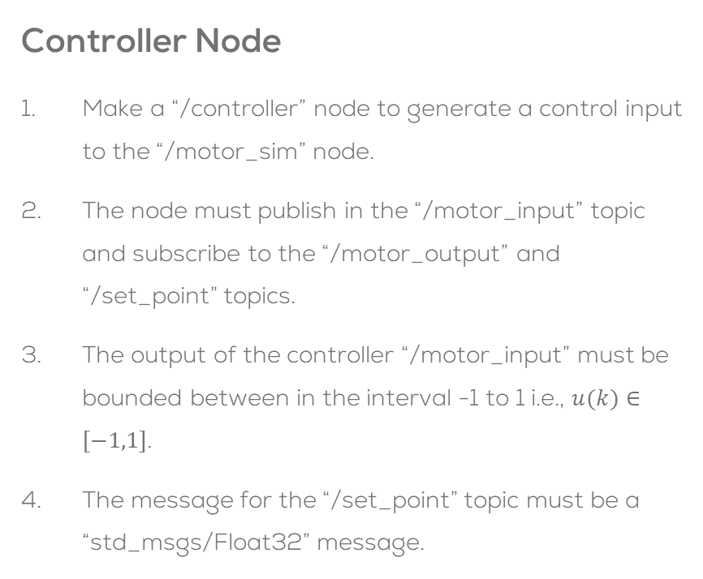
Controller node
Controller Node
Make a “/controller” node to generate a control input to the “/motor_sim” node.
The node must publish in the “/motor_input” topic and subscribe to the “/motor_output” and “/set_point” topics.
The output of the controller “/motor_input” must be bounded between in the interval -1 to 1 i.e., $u(k)∈[−1,1]$.
The message for the “/set_point” topic must be a “std_msgs/Float32” message.
The control node, must use a parameters, for all the required tunning variables.
The sampling time and rate can be the same as the “/motor_sim” node 0.01 s for the sampling time and rate of ~200Hz.
It is strictly forbidden to use any other python library, other than NumPy. The controller must be made without using any predefined online controllers or libraries.

Slide 16
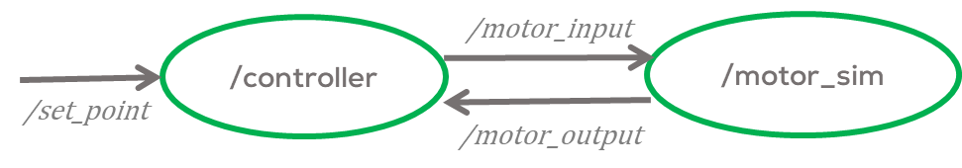
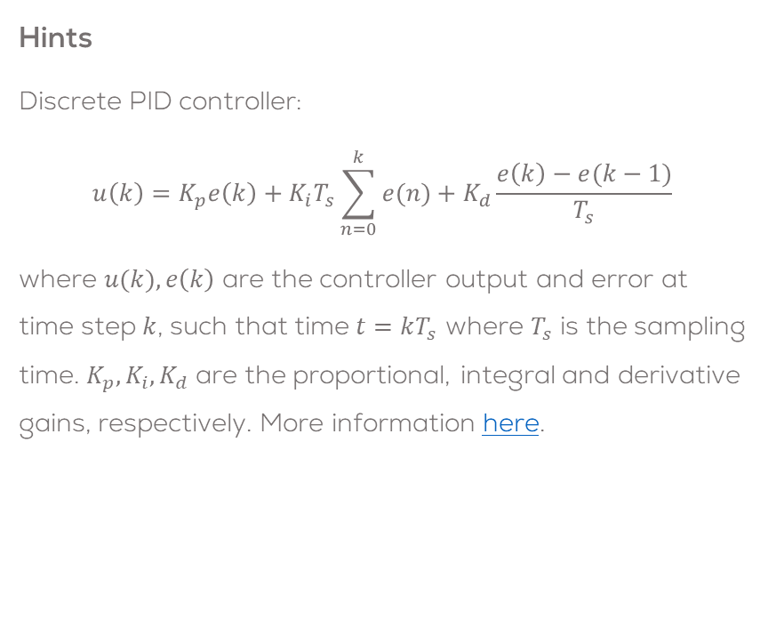
Controller node
Hints
Discrete PID controller:
$$u\left(k\right)=K_{p}e\left(k\right)+K_{i}T_{s}\sum_{n=0}^{k}{e(n)}+K_{d}\frac{e\left(k\right)−e(k−1)}{T_{s}}$$
where $u(k),e\left(k\right)$ are the controller output and error at time step $k$, such that time $t=kT_{s}$ where $T_{s}$ is the sampling time. $K_{p}, K_{i}, K_{d}$ are the proportional, integral and derivative gains, respectively. More information here.

Slide 17
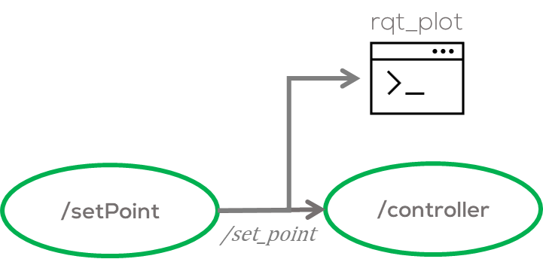
Set Point Generator
Instructions
Make a new node or use and modify the previously developed “/setPoint” node (Mini challenge 1) to generate a Set Point signal.
The output of the renamed “/setPoint” node must publish into the previously defined topic “/set_point” with the appropriate message.
The set point generator can be a sinusoidal signal, square signal, etc.
As before It is forbidden to use any libraries, except from NumPy for this exercise.
Make the necessary plots to analyse the system in rqt_plot

Slide 18
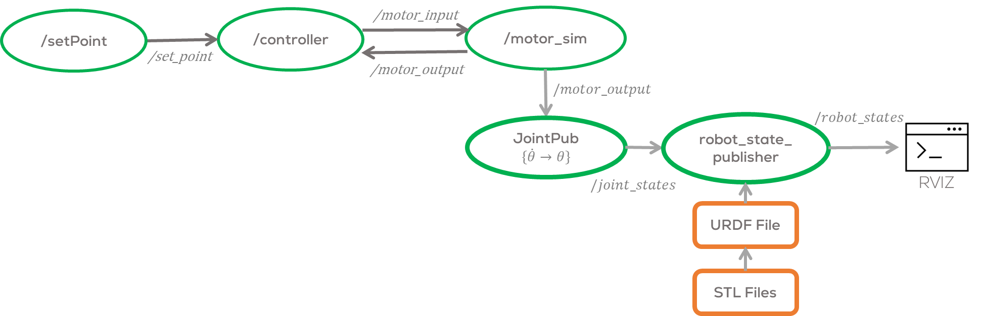
Expected Result

Slide 19
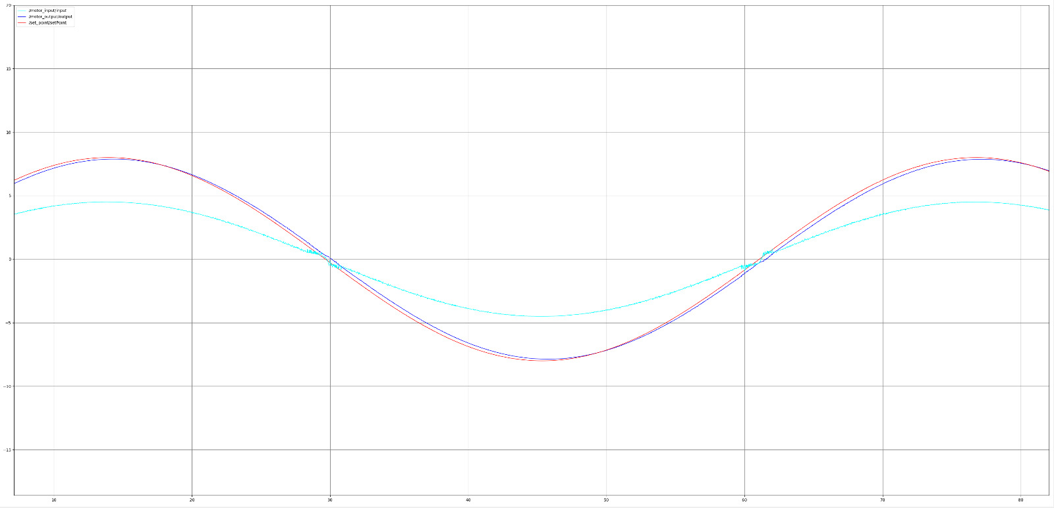
Expected Result
Launch File and Plotting
Use the ROS tool “rqt_plot” to plot the “/motor_input”, “/motor_output”, and “set_point” signals.
Make a Launch file to execute all the nodes at the same time.
Output (blue) Following the Set Point (red) and control signal (cyan)

