Slide 1
Activity
Dual Link Manipulator Simulation

Slide 2
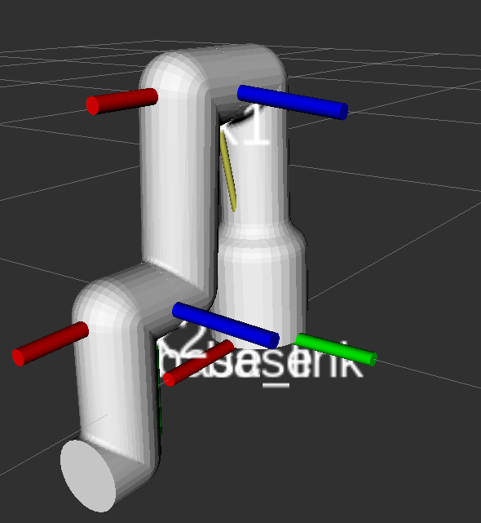
Activity
Introduction
In this activity, the student will learn how to simulate a dual link manipulator dynamics using the governing equations derived from the Euler-Lagrange methodology.

Slide 3
DLM Simulation in RVIZ
Download the package “simple_manipulator”, from GitHub “Week3/Challenge/simple_manipulator” to your “catkin_ws”
Open the file manipulator_dyn_sim.py inside the scripts folder
cd ~/catkin_ws/src/simple_manipulator/scripts/
Give executable permission to the file
cd ~/catkin_ws/src/simple_manipulator/scripts/
sudo chmod +x manipulator_dyn_sim.py

Slide 4
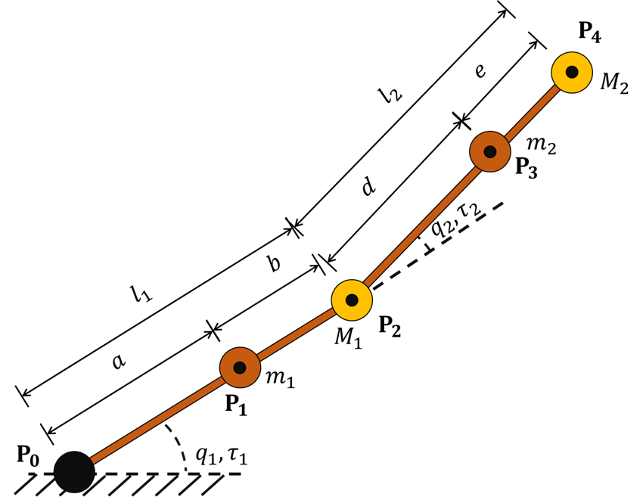
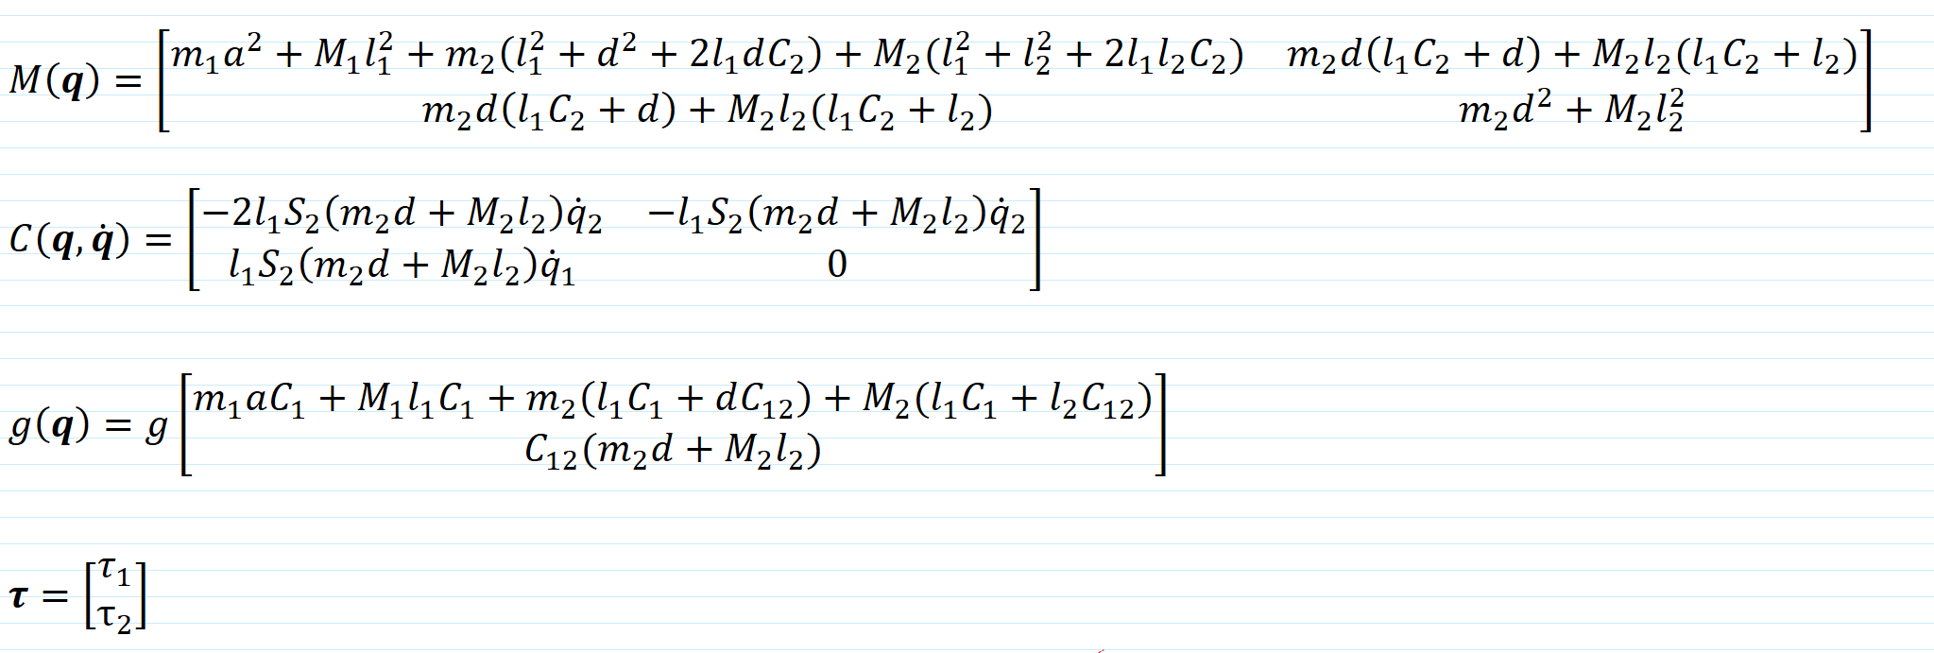
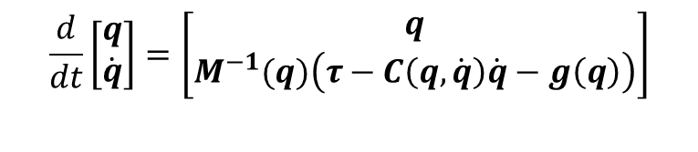
DLM Simulation in RVIZ
Open the file manipulator_dyn_sim.py
Simulate the dynamics of a Dual Link manipulator using the following dynamical model.
Where
$$\frac{d}{dt}\left[\begin{matrix}q \\ \dot{q}\end{matrix}\right]=\left[\begin{matrix}q \\ M^{−1}(q)\left(τ−C\left(q,\dot{q}\right)\dot{q}−g\left(q\right)\right)\end{matrix}\right]$$

Slide 5
DLM Simulation in RVIZ
#DLM Parameters
dt= sample_time = 0.02
m1= rod1_mass= 3.0
m2= rod2_mass= 3.0
M1= motor_mass= 1.5
M2= load_mass= 1.5
a= rod1_COM_pos= 0.2
d= rod2_COM_pos= 0.2
l1= rod1_length= 0.4
l2= rod2_length= 0.4
q1= q1_init_angle= 0.10
q2= q2_init_angle= 0.1
q1_dot= q1_dot_0= 0.0
q2_dot= q2_dot_0= 0.0
tau1= tau1_0= 0.0
tau2= tau2_0= 0.0
g= gravity= 9.8
Masses of the dual link manipulator
/tau
DLM Manipulator
/joint_states
Links lengths
And COM positions
Initial conditions
Initial torques (0=unforced response)
Environment variables

Slide 6
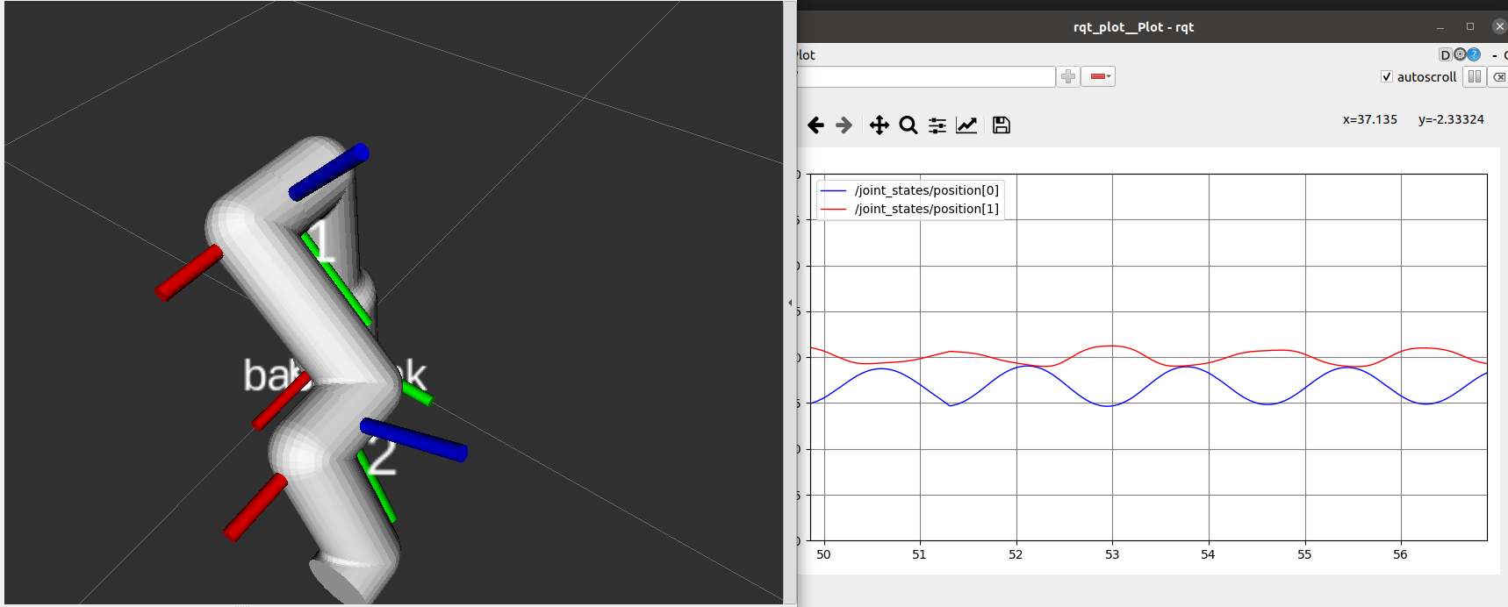
DLM Simulation in RVIZ
Subscribe the model to the topic “/tau” and publish the model’s output in the topic “/joint_states”.
Make sure to add print some values to verify the program is working properly (debug).
Compile the program
cd ~/catkin_ws
catkin_make
Launch the node from the launch file
roslaunch simple_manipulator manipulator.launch
Open rviz and rqt_plot to verify the results
rosrun rqt_plot rqt_plot

Slide 7
Tips and tricks
For the input “tau” the message type “Float32MultiArray” can be used.
from std_msgs.msg import Float32MultiArray
# Declare the input Message
tau = Float32MultiArray()
#Define the callback functions
def input_callback(self,msg):
tau = msg
tau_input = np.array([[self.tau.data[0]], [self.tau.data[1]]])

Slide 8
Tips and tricks
For the output “joint_states” the message type “JointState” can be used.
from sensor_msgs.msg import JointState
# Declare the process output message
robotJoints = JointState()
robotJoints.header.frame_id = "base"
robotJoints.header.stamp = rospy.Time.now()
robotJoints.name.extend(["joint2", "joint3"])
robotJoints.position.extend([0.0, 0.0])
robotJoints.velocity.extend([0.0, 0.0])
robotJoints.effort.extend([0.0, 0.0])
#Message to publish
robotJoints.header.stamp = rospy.Time.now()
robotJoints.position = [0.0 , 0.0]
robotJoints.velocity = [0.0 , 0.0]
#Publish message
state_pub.publish(robotJoints)

