Slide 1
Reference Trajectories
SLM and DLM Trajectories

Slide 2
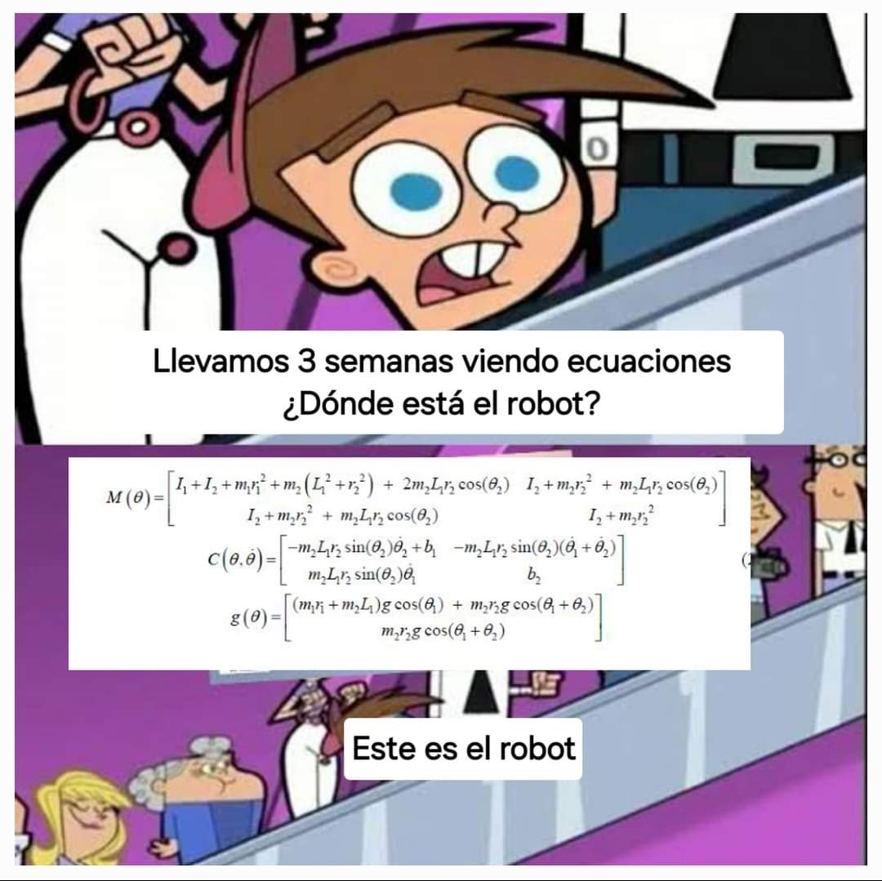

Slide 3
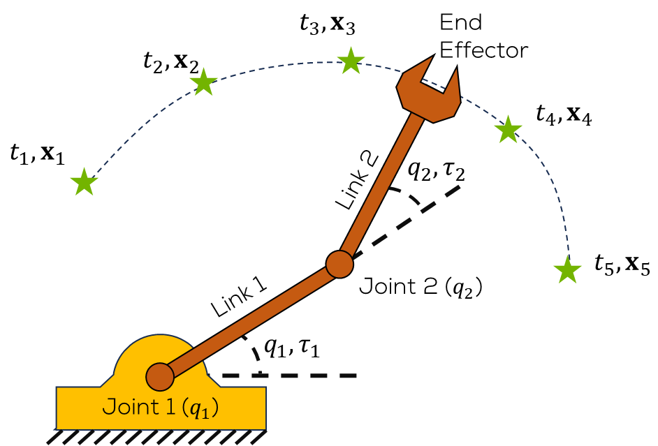
Introduction
The aim of this section is to describe how to generate a reference trajectory, using piecewise polynomials (splines), for a single link and double link manipulator
The objectives are:
Justification for continuous reference trajectories
Cubic spline representation
Matrix-based interpolation calculation
Single spline position trajectory example
Manipulator trajectories: workspace & singularity concerns

Slide 4
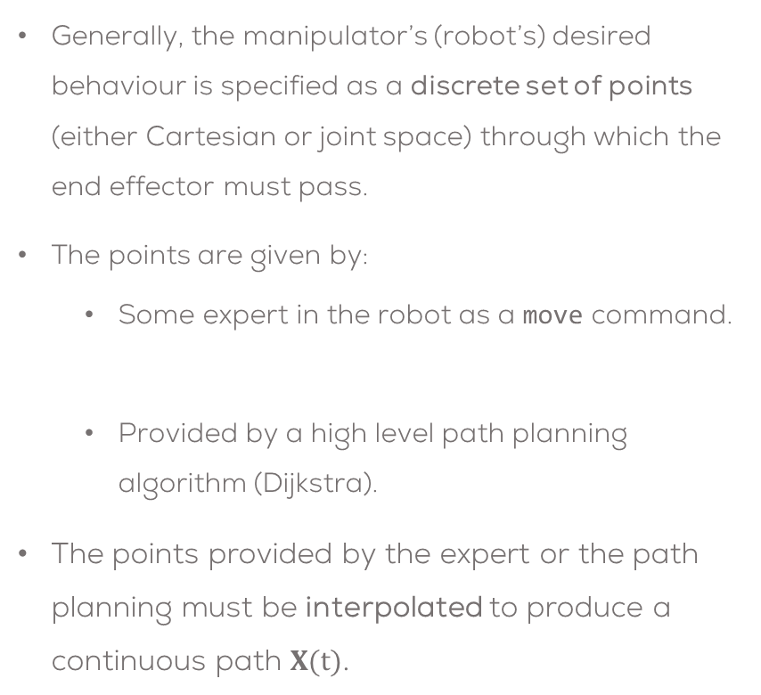


Trajectory Generation Problem
Generally, the manipulator’s (robot’s) desired behaviour is specified as a discrete set of points (either Cartesian or joint space) through which the end effector must pass.
The points are given by:
Some expert in the robot as a move command.
Provided by a high level path planning algorithm (Dijkstra).
The points provided by the expert or the path planning must be interpolated to produce a continuous path $X(t)$.
move(t1, x1, t2, x2, …)
Person (expert) / Path planning algorithm
$$\left\{x_{i},t_{i}\right\}$$
Trajectory Generator
$$X(t)$$

Slide 5

Why not use Step Reference Trajectories & Linear Feedback Control?
Feedback control often assumes that the controller is linear, error feedback (PID or state space)
Assumed that the reference signal is a step or a sequence of steps which specify the desired (joint) position at time points.
These assumptions can presents several characteristically behaviours such as: non smooth trajectories and poor set point following.

Slide 6
Step Reference trajectories disadvantages.
Step angle / position commands do not specify how the robot actually responds so collisions may occur with the environment
Smooth motion is required (not short steady state periods with sharp transients)
Joint errors are largest at the start, so are the calculated torques and this can significantly exceed the delivered torque
PID control zeros often produce overshoot
Robots are often quite non-linear
Error-based PID control is reactive, i.e. an error must exist for the control signal to be calculated
Highly accurate position specification & control is required

Slide 7
Step Reference trajectories disadvantages.
Other type of controller are needed for these tasks.
As an example it is possible to use Sliding mode control, feedback linearization, model predictive control.
These types of controllers, use the model of the system’s dynamical behaviour to follow reference trajectories in a smooth fashion.

Slide 8
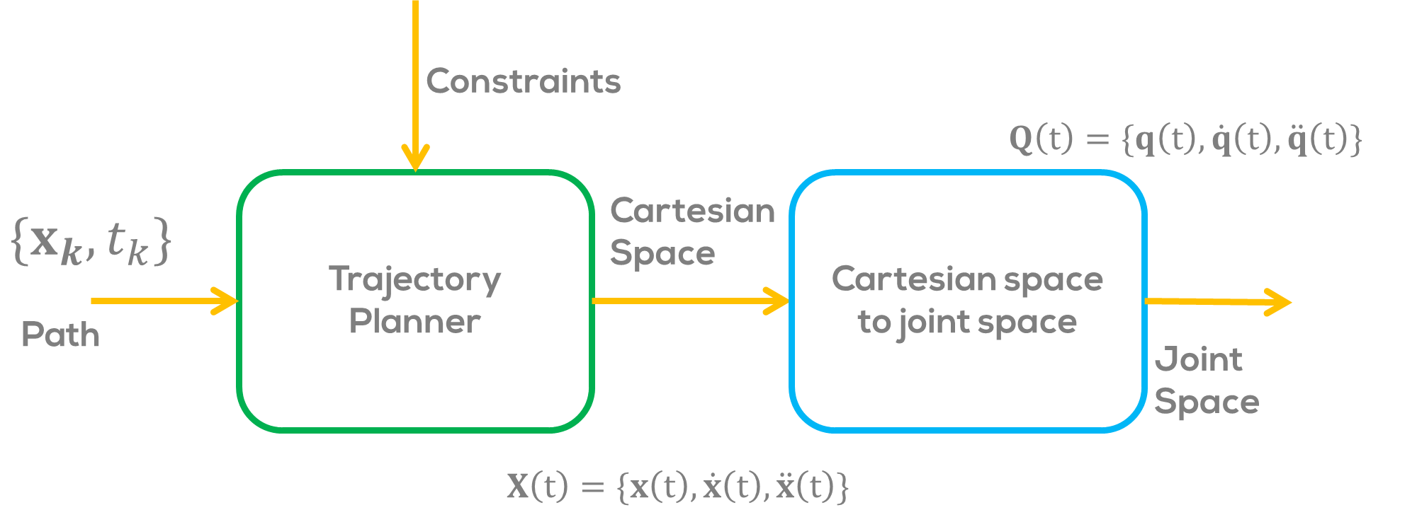
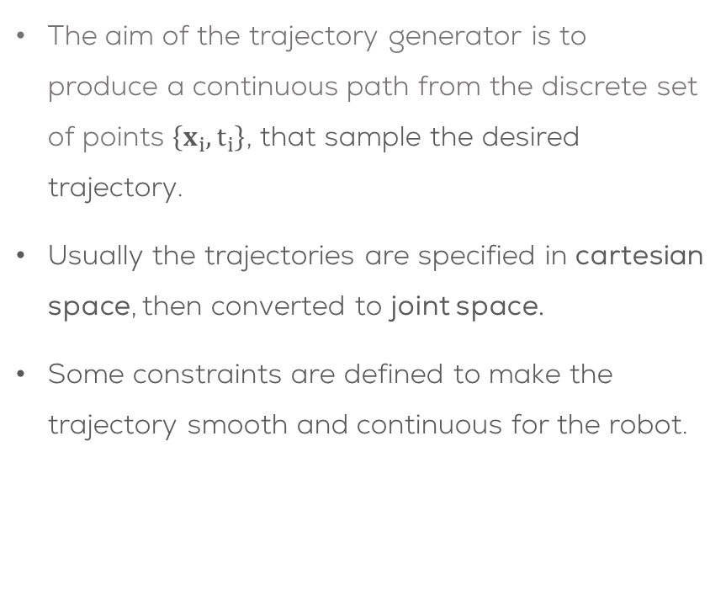
Trajectory generation
The aim of the trajectory generator is to produce a continuous path from the discrete set of points $\left\{x_{i},t_{i}\right\}$, that sample the desired trajectory.
Usually the trajectories are specified in cartesian space, then converted to joint space.
Some constraints are defined to make the trajectory smooth and continuous for the robot.

Slide 9
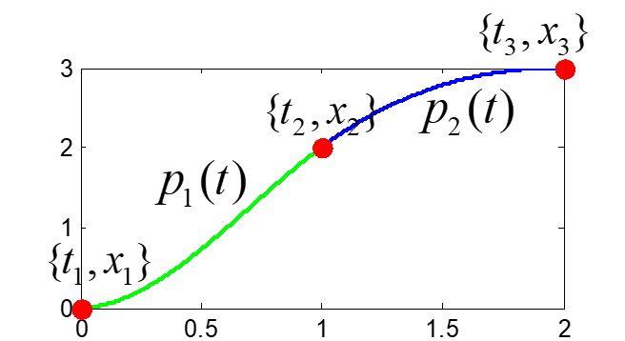
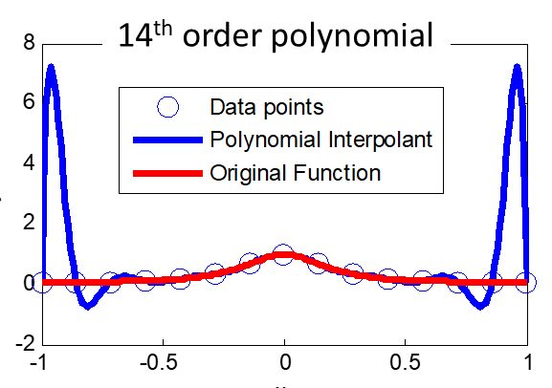
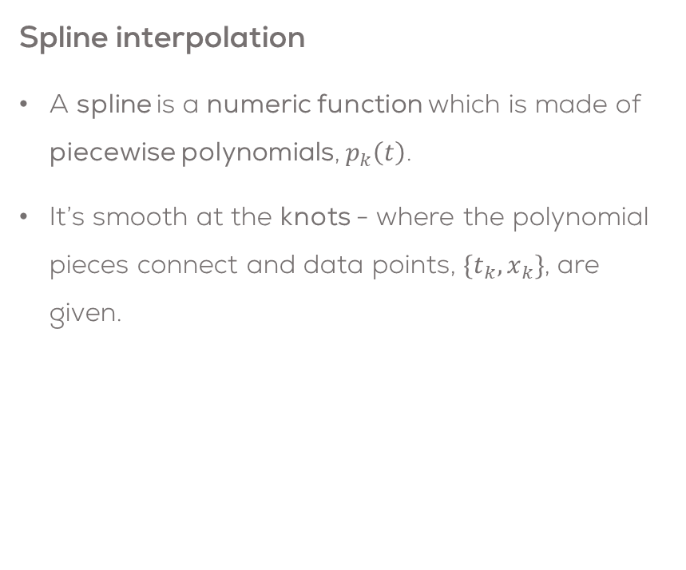
Polynomial Spline
Interpolation of a set of points can be done in different ways.
The two man ways are polynomial and spline interpolation.
Polynomial interpolation is good with higher order polynomials, but presents several problems such as Runge’s Phenomenon.
Spline interpolation
A spline is a numeric function which is made of piecewise polynomials, $p_{k}\left(t\right)$.
It’s smooth at the knots - where the polynomial pieces connect and data points, $\{t_{k},x_{k}\}$, are given.

Slide 10
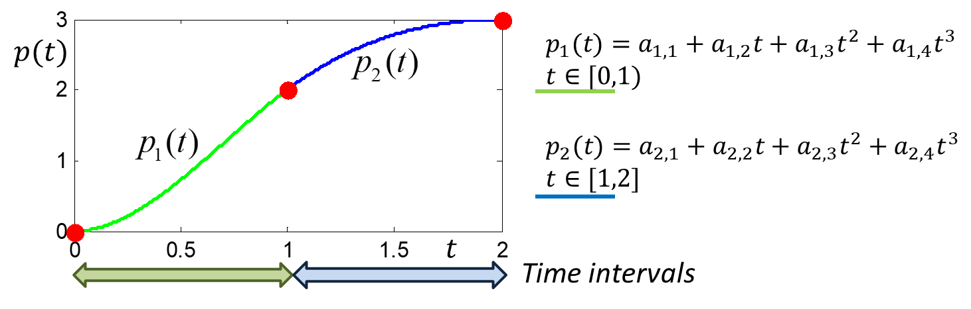
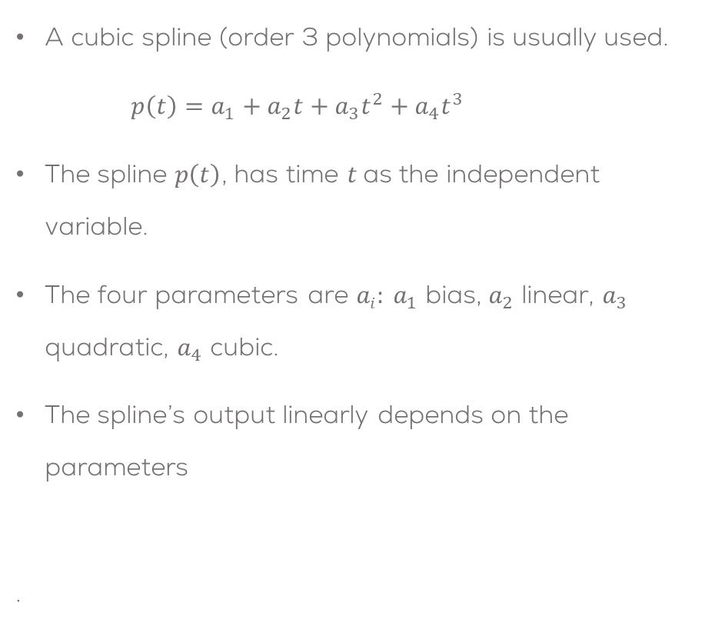
Cubic Polynomial Spline
A cubic spline (order 3 polynomials) is usually used.
$p\left(t\right)=a_{1}+a_{2}t+a_{3}t^{2}+a_{4}t^{3}$
The spline $p\left(t\right)$, has time $t$as the independent variable.
The four parameters are $ai: a_{1}$ bias, $a_{2}$ linear, $a_{3}$ quadratic, $a_{4}$ cubic.
The spline’s output linearly depends on the parameters
.
Four (independent) equations are needed to uniquely determine the parameter values (linear system of equations).
A (piecewise) cubic spline is simply a set of cubic polynomials, one for each of the time intervals which are specified by adjacent knots

Slide 11
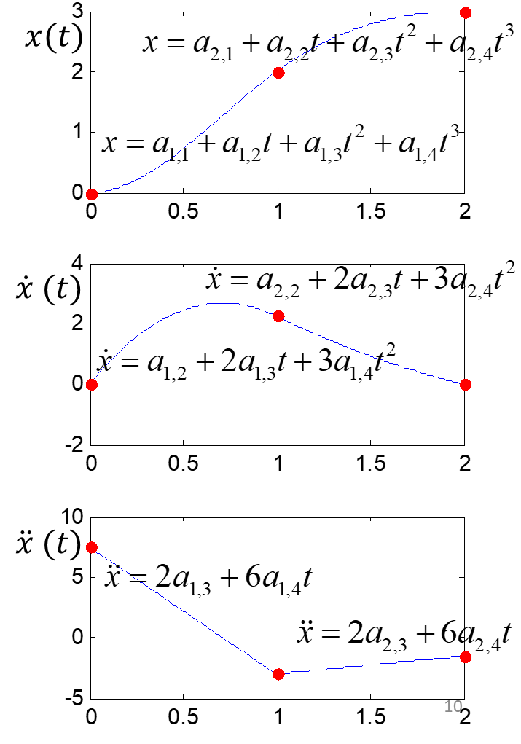
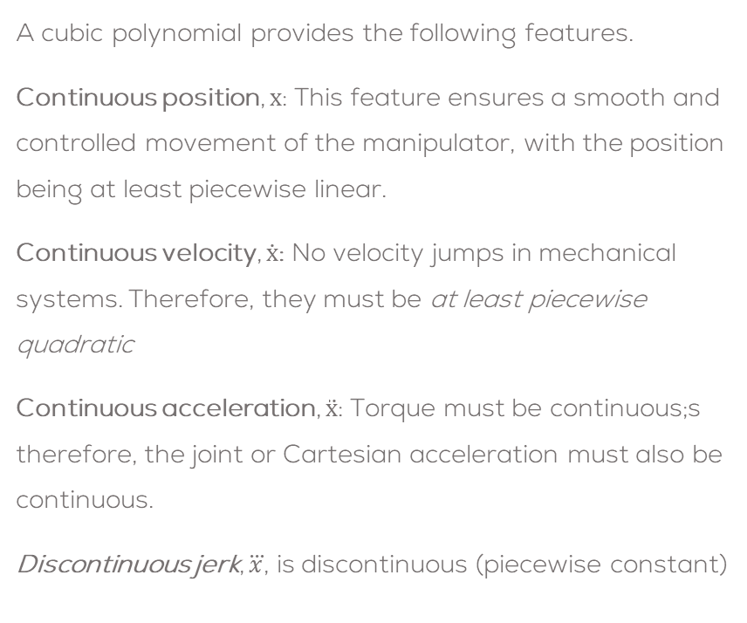
Why a Cubic Polynomial?
A cubic polynomial provides the following features.
Continuous position, $x$: This feature ensures a smooth and controlled movement of the manipulator, with the position being at least piecewise linear.
Continuous velocity, $\dot{x}$: No velocity jumps in mechanical systems. Therefore, they must be at least piecewise quadratic
Continuous acceleration, $\ddot{x}$: Torque must be continuous;s therefore, the joint or Cartesian acceleration must also be continuous.
Discontinuous jerk, $\overset{⃛}{x}$, is discontinuous (piecewise constant)

Slide 12
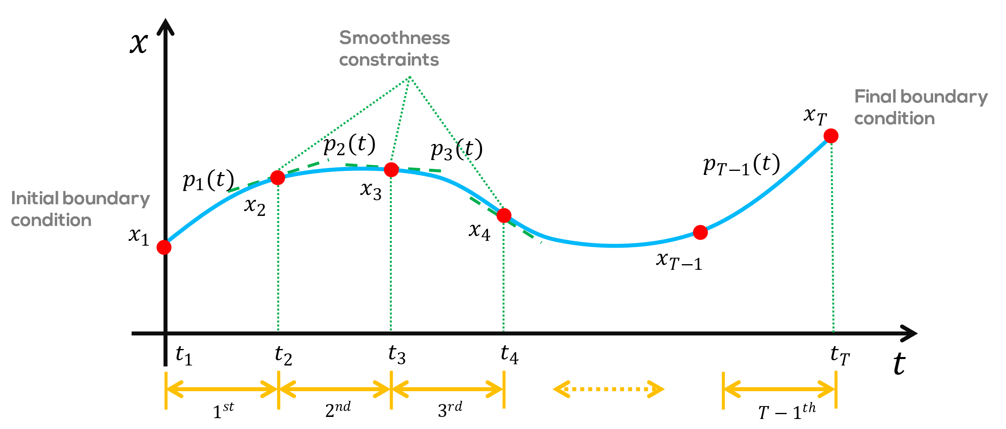
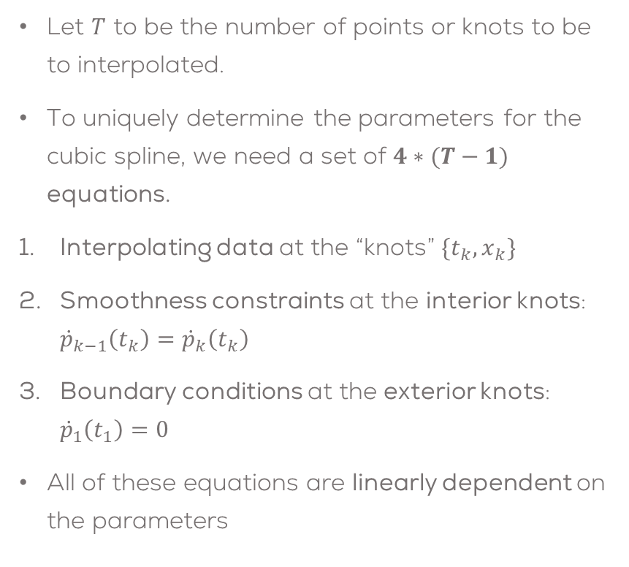
Parameters of a cubic spline
Let $T$ to be the number of points or knots to be to interpolated.
To uniquely determine the parameters for the cubic spline, we need a set of $4∗(T−1)$ equations.
Interpolating data at the “knots” $\{t_{k},x_{k}\}$
Smoothness constraints at the interior knots: ${\dot{p}}_{k−1}\left(t_{k}\right)={\dot{p}}_{k}\left(t_{k}\right)$
Boundary conditions at the exterior knots: ${\dot{p}}_{1}\left(t_{1}\right)=0$
All of these equations are linearly dependent on the parameters

Slide 13
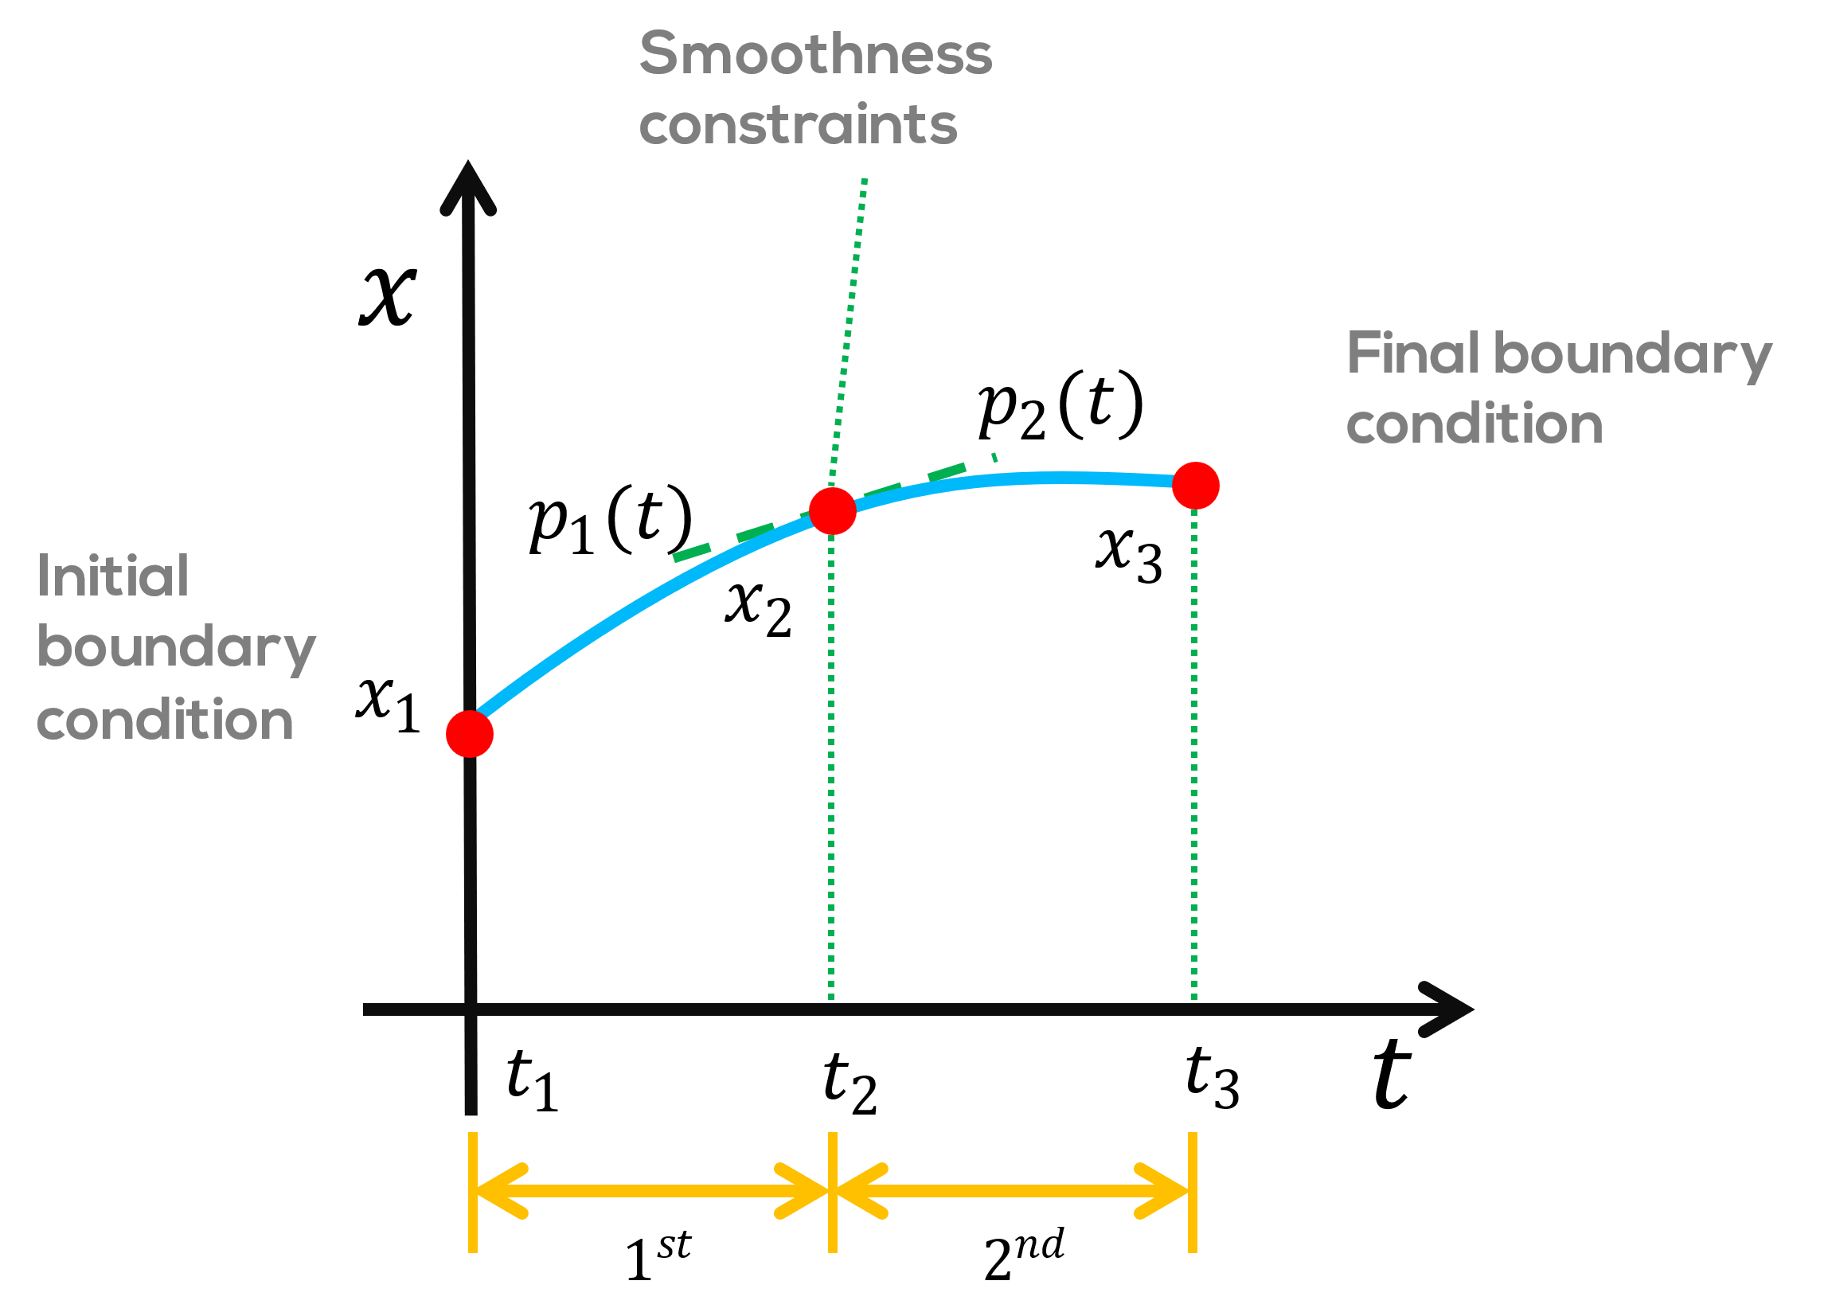
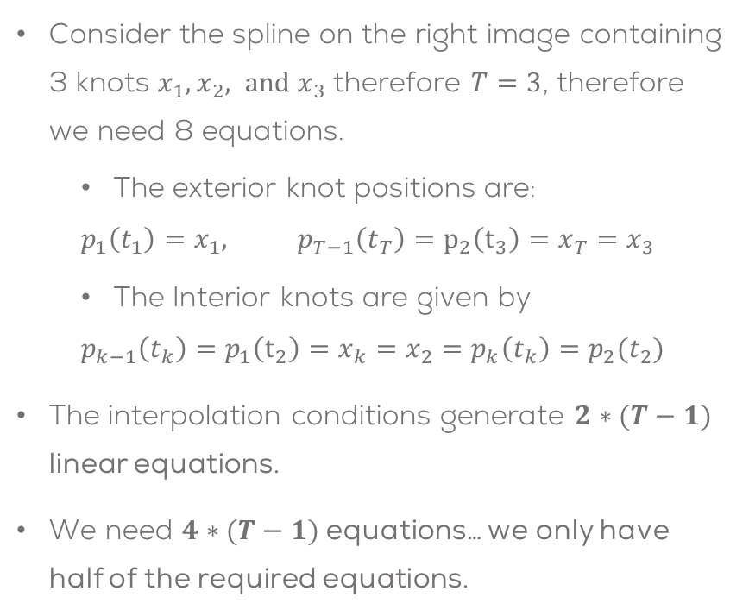
Data Interpolation at Knots
Consider the spline on the right image containing 3 knots $x_{1},x_{2}, and x_{3}$ therefore $T=3$, therefore we need 8 equations.
The exterior knot positions are:
$$p_{1}\left(t_{1}\right)=x_{1}, p_{T−1}\left(t_{T}\right)=p_{2}\left(t_{3}\right)=x_{T}=x_{3}$$
The Interior knots are given by
$$p_{k−1}\left(t_{k}\right)=p_{1}\left(t_{2}\right)=x_{k}=x_{2}=p_{k}\left(t_{k}\right)=p_{2}(t_{2})$$
The interpolation conditions generate $2∗(T−1)$ linear equations.
We need $4∗(T−1)$ equations… we only have half of the required equations.

Slide 14
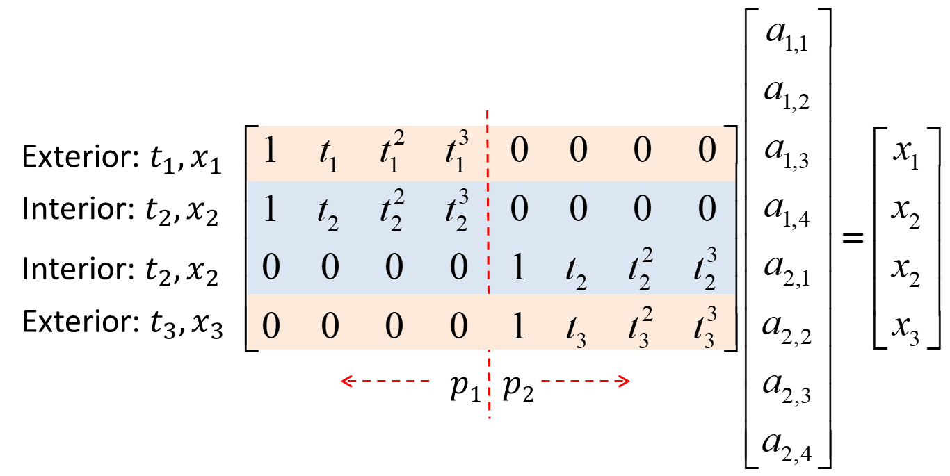

Data Interpolation at Knots
The interior and exterior position conditions can be written in a matrix form as:
$$p_{1}\left(t_{1}\right)=x_{1}, p_{2}\left(t_{3}\right)=x_{3}$$
$$p_{1}\left(t_{2}\right)=x_{2}=p_{2}(t_{2})$$

Slide 15
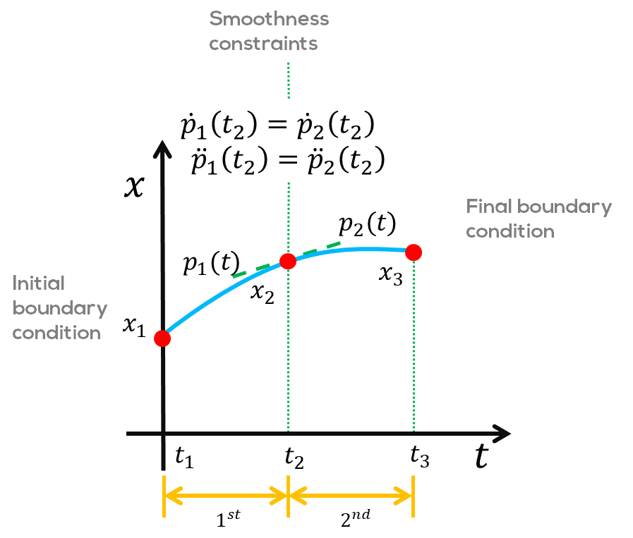
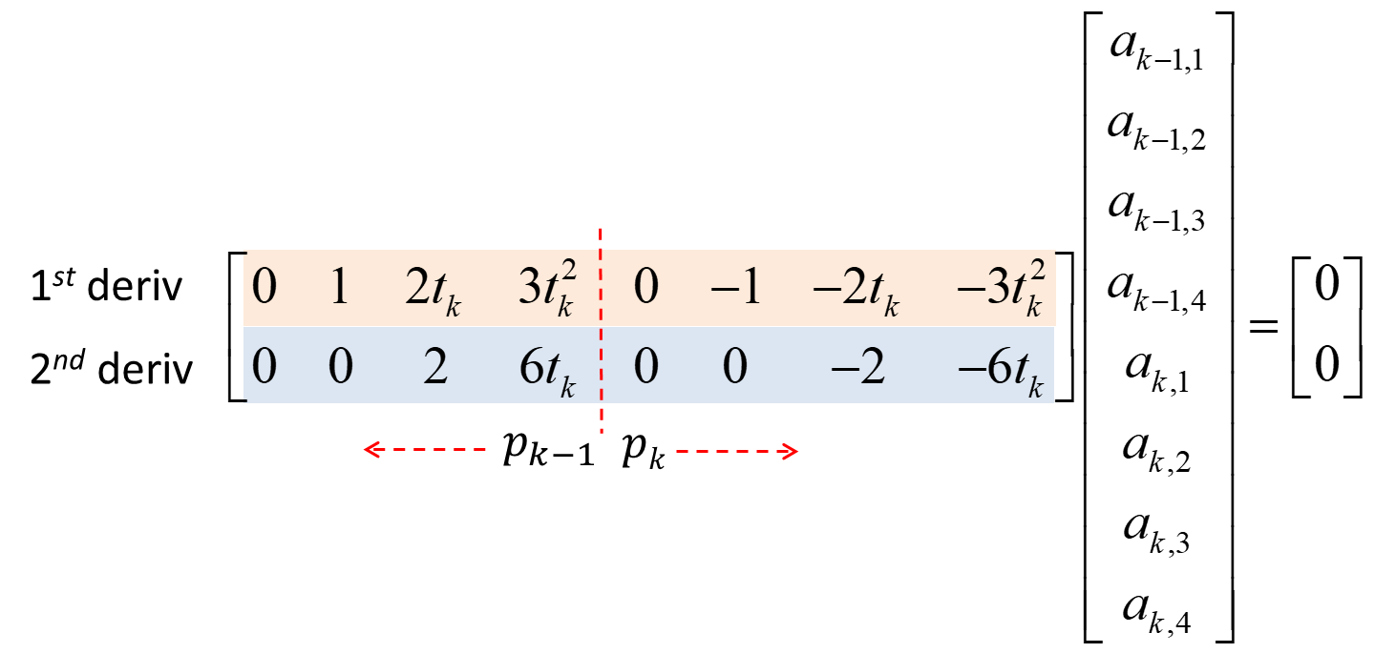

Internal Smoothness Constraints
Smoothness constraints ensure two neighbouring cubic polynomials join smoothly at the interior knots
1st derivative: ${\dot{p}}_{k−1}\left(t_{k}\right)={\dot{p}}_{k}\left(t_{k}\right)$
2nd derivative: ${\ddot{p}}_{k−1}\left(t_{k}\right)={\ddot{p}}_{k}\left(t_{k}\right)$
This gives an additional 2*(T-2) linear equations

Slide 16

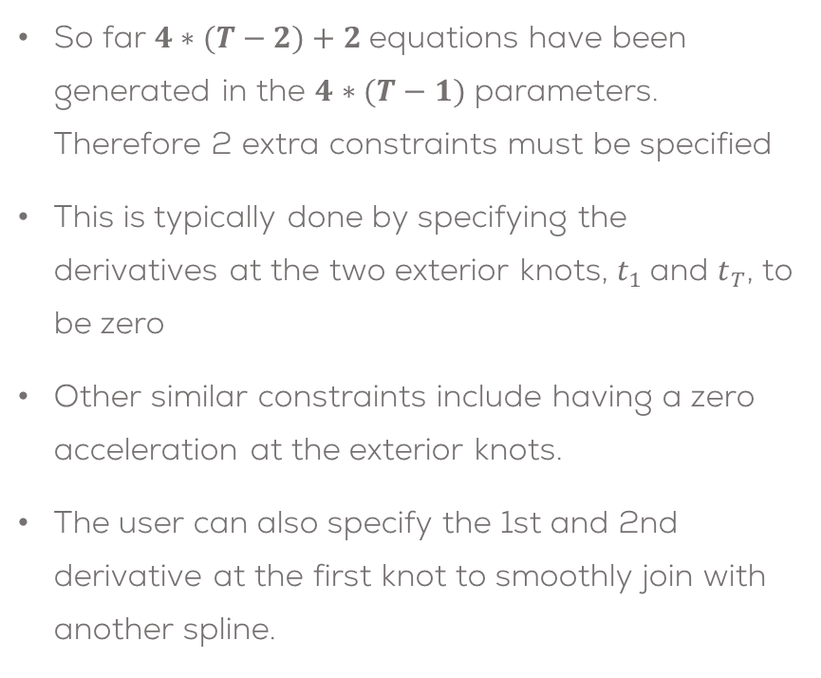


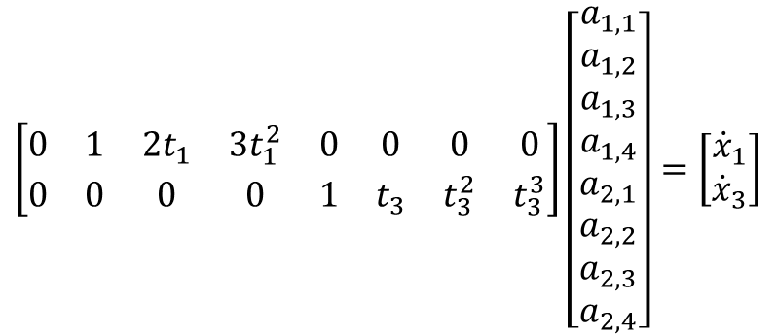
Boundary Conditions
So far $4∗(T−2)+2$equations have been generated in the $4∗(T−1)$ parameters. Therefore 2 extra constraints must be specified
This is typically done by specifying the derivatives at the two exterior knots, $t_{1}$and $t_{T}$, to be zero
Other similar constraints include having a zero acceleration at the exterior knots.
The user can also specify the 1st and 2nd derivative at the first knot to smoothly join with another spline.
$$\left[\begin{matrix}0 & 1 & 2t_{1} & 3t_{1}^{2} & 0 & 0 & 0 & 0 \\ 0 & 0 & 0 & 0 & 1 & t_{3} & t_{3}^{2} & t_{3}^{3}\end{matrix}\right]\left[\begin{matrix}a_{1,1} \\ a_{1,2} \\ a_{1,3} \\ a_{1,4} \\ a_{2,1} \\ a_{2,2} \\ a_{2,3} \\ a_{2,4}\end{matrix}\right]=\left[\begin{matrix}{\dot{x}}_{1} \\ {\dot{x}}_{3}\end{matrix}\right]$$
$$p_{k−1}$$
$$pk$$

Slide 17

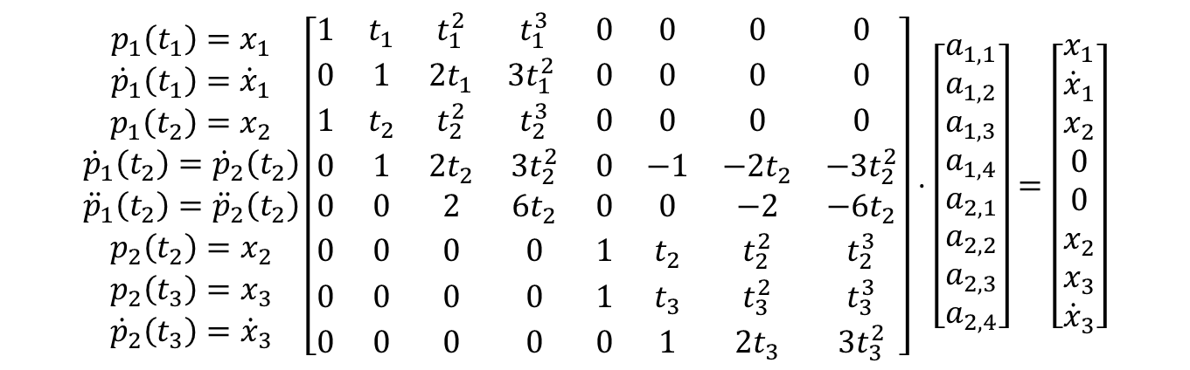

$$\begin{matrix}p_{1}\left(t_{1}\right)=x_{1} \\ {\dot{p}}_{1}\left(t_{1}\right)={\dot{x}}_{1} \\ p_{1}\left(t_{2}\right)=x_{2} \\ {\dot{p}}_{1}\left(t_{2}\right)={\dot{p}}_{2}\left(t_{2}\right) \\ {\ddot{p}}_{1}\left(t_{2}\right)={\ddot{p}}_{2}\left(t_{2}\right) \\ p_{2}\left(t_{2}\right)=x_{2} \\ p_{2}\left(t_{3}\right)=x_{3} \\ {\dot{p}}_{2}\left(t_{3}\right)={\dot{x}}_{3}\end{matrix}\left[\begin{matrix}1 & t_{1} & t_{1}^{2} & t_{1}^{3} & 0 & 0 & 0 & 0 \\ 0 & 1 & 2t_{1} & 3t_{1}^{2} & 0 & 0 & 0 & 0 \\ 1 & t_{2} & t_{2}^{2} & t_{2}^{3} & 0 & 0 & 0 & 0 \\ 0 & 1 & 2t_{2} & 3t_{2}^{2} & 0 & −1 & −2t_{2} & −3t_{2}^{2} \\ 0 & 0 & 2 & 6t_{2} & 0 & 0 & −2 & −6t_{2} \\ 0 & 0 & 0 & 0 & 1 & t_{2} & t_{2}^{2} & t_{2}^{3} \\ 0 & 0 & 0 & 0 & 1 & t_{3} & t_{3}^{2} & t_{3}^{3} \\ 0 & 0 & 0 & 0 & 0 & 1 & 2t_{3} & 3t_{3}^{2}\end{matrix}\right]⋅\left[\begin{matrix}a_{1,1} \\ a_{1,2} \\ a_{1,3} \\ a_{1,4} \\ a_{2,1} \\ a_{2,2} \\ a_{2,3} \\ a_{2,4}\end{matrix}\right]=\left[\begin{matrix}x_{1} \\ {\dot{x}}_{1} \\ x_{2} \\ 0 \\ 0 \\ x_{2} \\ x_{3} \\ {\dot{x}}_{3}\end{matrix}\right]$$
$$p_{1}$$
$$p2$$

Slide 18





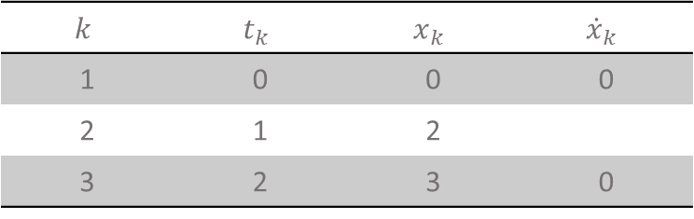







Example: Cubic Spline Trajectory
This example will calculate a cubic spline trajectory for the following points:
Continuous position, velocity and acceleration.
Note:
The variable could be joint, y-position, ….
There is no requirement for the points to be equally spaced
There is generally more than 2 intervals & polynomials (or equivalently one interior knot)
$$x_{3} \\ {\dot{x}}_{3}$$
Final boundary condition
$$x$$
$$p_{2}(t)$$
$$k$$ | $$t_{k}$$ | $$x_{k}$$ | $${\dot{x}}_{k}$$
1 | 0 | 0 | 0
2 | 1 | 2
3 | 2 | 3 | 0
$$x_{2}$$
$$p_{1}(t)$$
Initial boundary condition
$$x_{1} \\ {\dot{x}}_{1}$$
$$0$$
$$1$$
$$2$$
$$t$$
$$1^{st}$$
$$2^{nd}$$

Slide 19
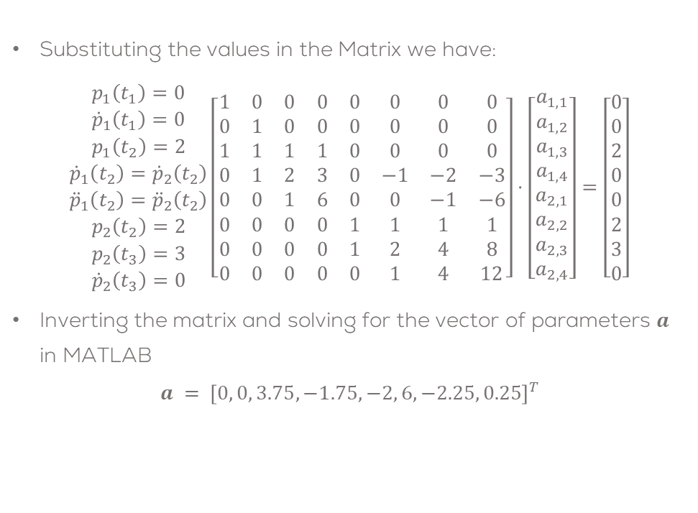
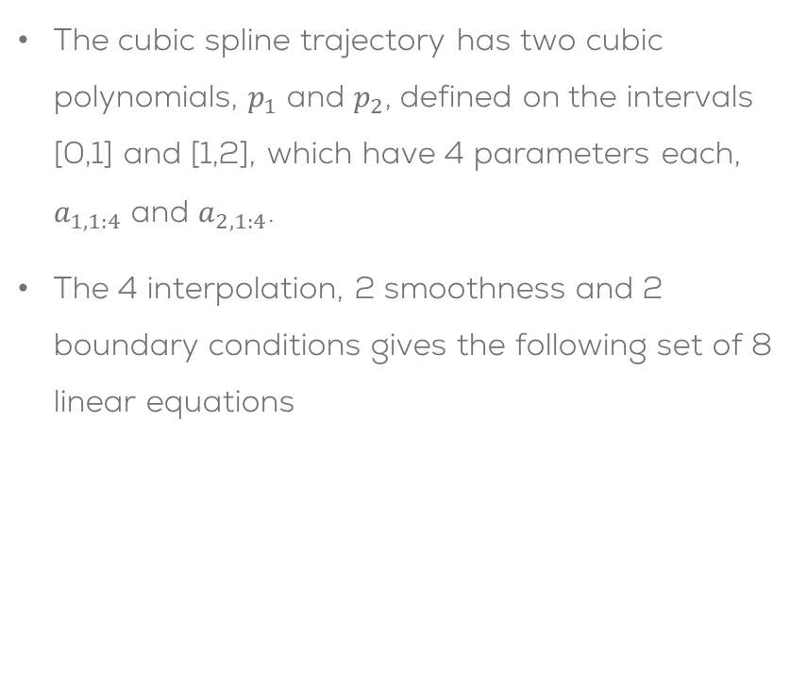
Example: Cubic Spline Trajectory
The cubic spline trajectory has two cubic polynomials, $p_{1}$ and $p_{2}$, defined on the intervals [0,1] and [1,2], which have 4 parameters each, $a_{1,1:4}$ and $a_{2,1:4}$.
The 4 interpolation, 2 smoothness and 2 boundary conditions gives the following set of 8 linear equations
Substituting the values in the Matrix we have:
$$\begin{matrix}p_{1}\left(t_{1}\right)=0 \\ {\dot{p}}_{1}\left(t_{1}\right)=0 \\ p_{1}\left(t_{2}\right)=2 \\ {\dot{p}}_{1}\left(t_{2}\right)={\dot{p}}_{2}\left(t_{2}\right) \\ {\ddot{p}}_{1}\left(t_{2}\right)={\ddot{p}}_{2}\left(t_{2}\right) \\ p_{2}\left(t_{2}\right)=2 \\ p_{2}\left(t_{3}\right)=3 \\ {\dot{p}}_{2}\left(t_{3}\right)=0\end{matrix}\left[\begin{matrix}1 & 0 & 0 & 0 & 0 & 0 & 0 & 0 \\ 0 & 1 & 0 & 0 & 0 & 0 & 0 & 0 \\ 1 & 1 & 1 & 1 & 0 & 0 & 0 & 0 \\ 0 & 1 & 2 & 3 & 0 & −1 & −2 & −3 \\ 0 & 0 & 1 & 6 & 0 & 0 & −1 & −6 \\ 0 & 0 & 0 & 0 & 1 & 1 & 1 & 1 \\ 0 & 0 & 0 & 0 & 1 & 2 & 4 & 8 \\ 0 & 0 & 0 & 0 & 0 & 1 & 4 & 12\end{matrix}\right]⋅\left[\begin{matrix}a_{1,1} \\ a_{1,2} \\ a_{1,3} \\ a_{1,4} \\ a_{2,1} \\ a_{2,2} \\ a_{2,3} \\ a_{2,4}\end{matrix}\right]=\left[\begin{matrix}0 \\ 0 \\ 2 \\ 0 \\ 0 \\ 2 \\ 3 \\ 0\end{matrix}\right]$$
Inverting the matrix and solving for the vector of parameters $a$ in MATLAB
$$a = {\left[0, 0, 3.75, −1.75, −2, 6, −2.25, 0.25\right]}^{T}$$

Slide 20
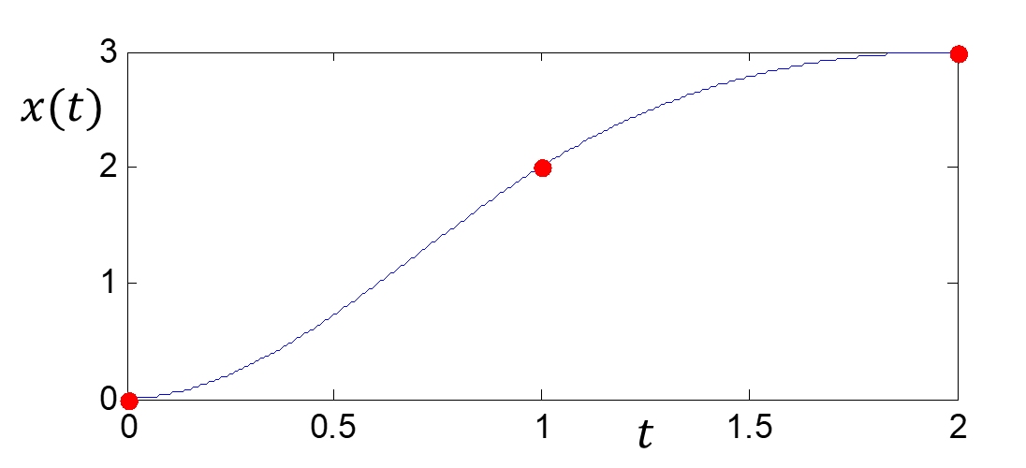
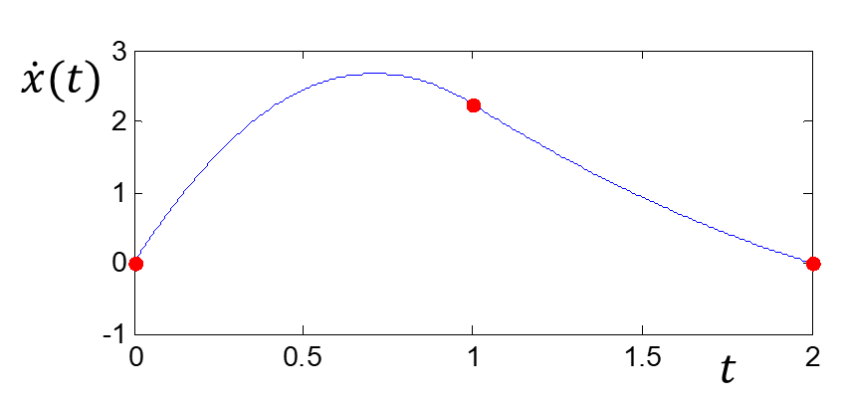
Results
The original data points and the interpolating spline trajectory can therefore be plotted.
Each segment is cubic.
Velocity (first derivative) of the cubic spline.
Each segment is quadratic.
First derivative meets specified boundary conditions.
Still appears smooth.

Slide 21
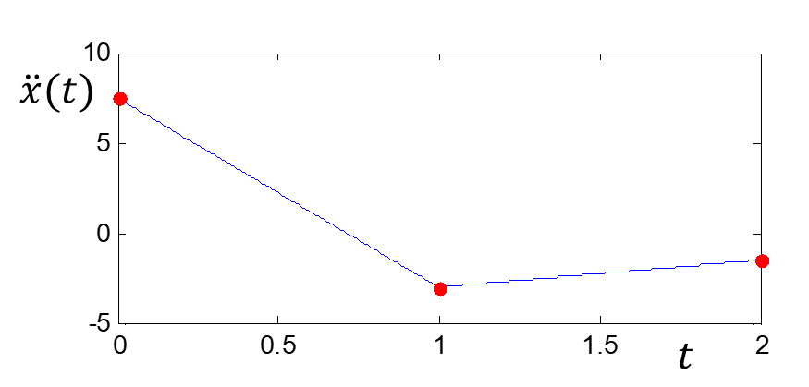
Results
Acceleration (second derivative) of the cubic spline.
Each segment is linear.
Second derivative (acceleration) is piecewise linear.
Discontinuous in jerk.
%% MATLAB CODE
% Points to interpolate
td = [0 1 2];
xp = [0 2 3];
% Estimate parameters of cubic spline
T = [1 td(1) td(1)^2 td(1)^3 0 0 0 0; ...
0 1 2*td(1) 3*td(1)^2 0 0 0 0; ...
1 td(2) td(2)^2 td(2)^3 0 0 0 0; ...
0 1 2*td(2) 3*td(2)^2 0 -1 -2*td(2) -3*td(2)^2; ...
0 0 2 6*td(2) 0 0 -2 -6*td(2); ...
0 0 0 0 1 td(2) td(2)^2 td(2)^3; ...
0 0 0 0 1 td(3) td(3)^2 td(3)^3; ...
0 0 0 0 0 1 2*td(3) 3*td(3)^2];
x = [xp(1) 0 xp(2) 0 0 xp(2) xp(3) 0]';
a = inv(T)*x;

Slide 22

Kinematic / Joint Considerations
In practice the trajectories are as $\left\{t_{k}, x_{k}, y_{k}, z_{k}\right\}$
In this case, each of the signals must be interpolated.
After the interpolation, they must be then converted into a joint space reference trajectory.
As engineers, we need to ensure
That the trajectory is reachable (lies in the workspace)
Singular configurations are avoided
Excessive torques (joint accelerations) are not demanded

Slide 23






Single Joint Manipulator
For a single joint manipulator, the spline would need to be specified in joint space, as the workspace is a circle of radius $l$ centred on the joint
If you specify a reference trajectory via a cubic spline in Cartesian space, it will lie outside the circle (workspace) and would not be realisable; in other words, the inverse kinematics will not give a solution
A realisable (cubic spline) trajectory would have to be specified in joint space
$$l$$
Workspace
$x=l\left[\begin{matrix}cos⁡(q) \\ sin⁡(q)\end{matrix}\right]$
$$y$$
$$q$$
$$x$$

Slide 24
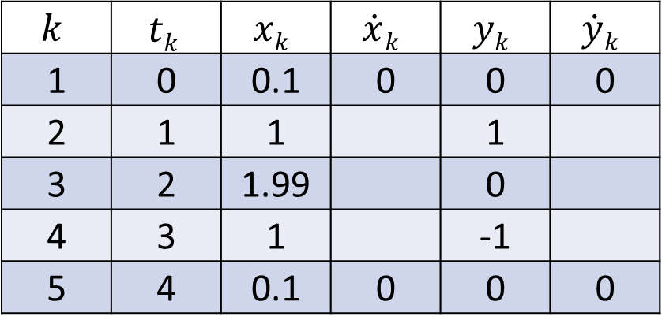

Dual Link Manipulator
Build a reference trajectory for a dual link manipulator. For this example (for simplicity), the links are $l_{1}=l_{2}=1 m$, and the trajectory is specified by the points:
The splines in Cartesian or joint space will give different trajectories, because the inverse kinematics are non-linear.
$$k$$ | $$tk$$ | $$xk$$ | $$\dot{x}k$$ | $$yk$$ | $$\dot{y}k$$
1 | 0 | 0.1 | 0 | 0 | 0
2 | 1 | 1 |  | 1
3 | 2 | 1.99 |  | 0
4 | 3 | 1 |  | -1
5 | 4 | 0.1 | 0 | 0 | 0

Slide 25
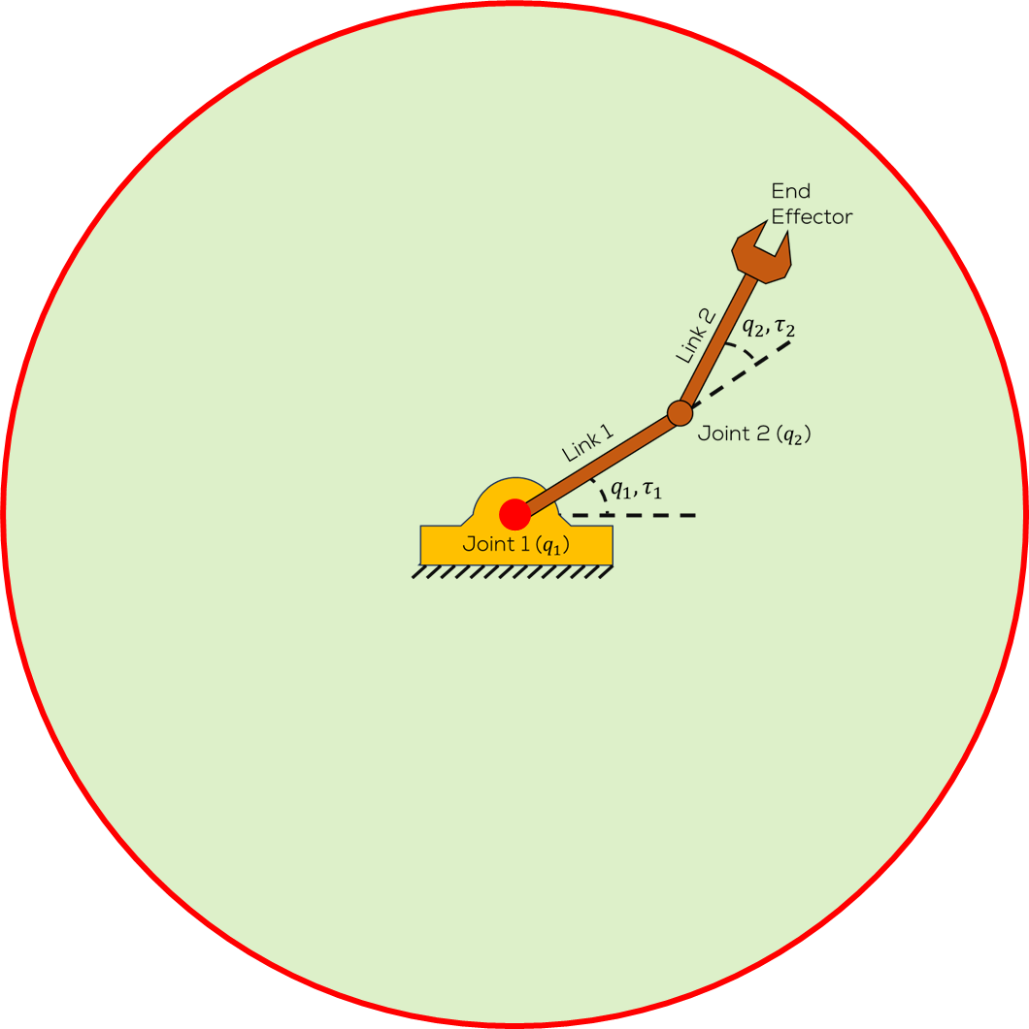
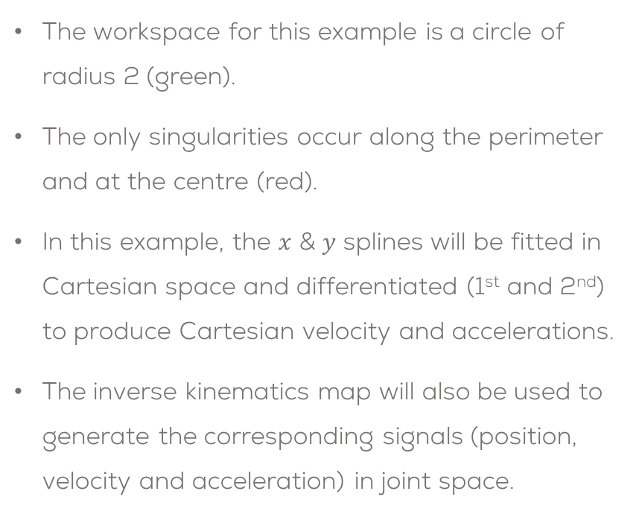
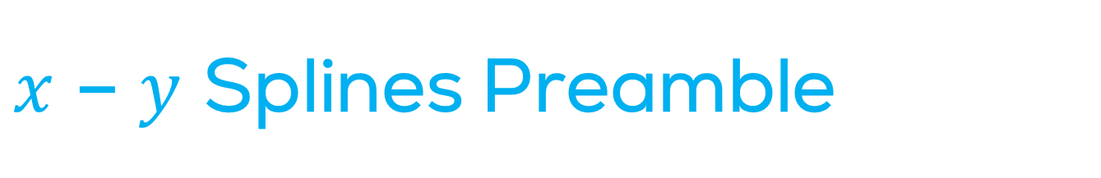
$x$ – $y$ Splines Preamble
The workspace for this example is a circle of radius 2 (green).
The only singularities occur along the perimeter and at the centre (red).
In this example, the $x$ & $y$ splines will be fitted in Cartesian space and differentiated (1st and 2nd) to produce Cartesian velocity and accelerations.
The inverse kinematics map will also be used to generate the corresponding signals (position, velocity and acceleration) in joint space.

Slide 26
$x$ – $y$ Splines Preamble
For each of the two splines, there are
4 intervals
16 parameters
6 internal smoothness constraints,
8 data interpolation constraints and
2 velocity boundary conditions.
Therefore, there is a 16*16 matrix which must be inverted to estimate the parameters.

Slide 27





Result: End-Effector Trajectories
Fitting the two splines Cartesian x – y splines produces:
$$x$$
$$y$$
$$t$$
$$y$$
$$x$$
$$t$$

Slide 28








Cartesian Velocity & Accelerations
$$\dot{x}$$
$$\ddot{x}$$
$$t$$
$$t$$
$$\ddot{y}$$
$$\dot{y}$$
$$t$$
$$t$$
Piecewise quadratic velocity and linear accelerations

Slide 29




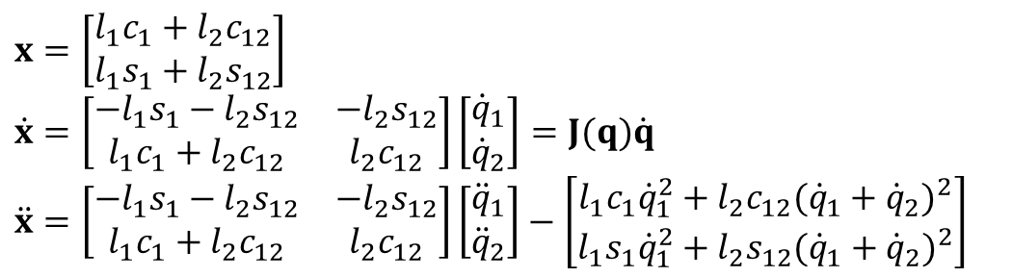


Joint Trajectories
$$q_{1}$$
$$q_{2}$$
Using the inverse kinematics map allows us to view the splines / trajectories in joint space
$$t$$
$$q_{2}$$
$$q_{1}$$
$$x=\left[\begin{matrix}l_{1}c_{1}+l_{2}c_{12} \\ l_{1}s_{1}+l_{2}s_{12}\end{matrix}\right] \\ \dot{x}=\left[\begin{matrix}−l_{1}s_{1}−l_{2}s_{12} & −l_{2}s_{12} \\ l_{1}c_{1}+l_{2}c_{12} & l_{2}c_{12}\end{matrix}\right]\left[\begin{matrix}{\dot{q}}_{1} \\ {\dot{q}}_{2}\end{matrix}\right]=J(q)\dot{q} \\ \ddot{x}=\left[\begin{matrix}−l_{1}s_{1}−l_{2}s_{12} & −l_{2}s_{12} \\ l_{1}c_{1}+l_{2}c_{12} & l_{2}c_{12}\end{matrix}\right]\left[\begin{matrix}{\ddot{q}}_{1} \\ {\ddot{q}}_{2}\end{matrix}\right]−\left[\begin{matrix}l_{1}c_{1}{\dot{q}}_{1}^{2}+l_{2}c_{12}({\dot{q}}_{1}+{\dot{q}}_{2})^{2} \\ l_{1}s_{1}{\dot{q}}_{1}^{2}+l_{2}s_{12}({\dot{q}}_{1}+{\dot{q}}_{2})^{2}\end{matrix}\right]$$
$$t$$

Slide 30








Joint Velocities and Accelerations
$${\dot{q}}_{1}$$
$${\ddot{q}}_{1}$$
$$t$$
$$t$$
$${\ddot{q}}_{2}$$
$${\dot{q}}_{2}$$
$$t$$
$$t$$
Joint accelerations are peaking at the start, end (joint 1) and middle (joint 2)

Slide 31

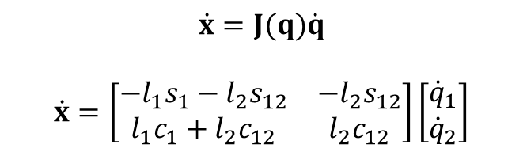


Result: Jacobian Singularities
The high joint accelerations may be suspected from the other plots, but they’re not easy to see.
We must calculate the $det⁡(J)$ or $det⁡(J^{−1})$
$$\dot{x}=\left[\begin{matrix}−l_{1}s_{1}−l_{2}s_{12} & −l_{2}s_{12} \\ l_{1}c_{1}+l_{2}c_{12} & l_{2}c_{12}\end{matrix}\right]\left[\begin{matrix}{\dot{q}}_{1} \\ {\dot{q}}_{2}\end{matrix}\right]=J(q)\dot{q}$$
The matrix is becoming singular at the start, middle and end (really the determinant is much higher / closer to zero before we call it near singular)
$$det⁡(J^{−1})$$
$$\dot{x}=J(q)\dot{q}$$
$$\dot{x}=\left[\begin{matrix}−l_{1}s_{1}−l_{2}s_{12} & −l_{2}s_{12} \\ l_{1}c_{1}+l_{2}c_{12} & l_{2}c_{12}\end{matrix}\right]\left[\begin{matrix}{\dot{q}}_{1} \\ {\dot{q}}_{2}\end{matrix}\right]$$
$$t$$

Slide 32
Conclusions
Precise trajectory specification / determination as well as joint control is a defining feature of how robotic manipulators and locomotion is implemented (not transient set point changes)
This ensures robots behave in a predictable fashion, avoiding obstacles, foot placement on stairs, …
Done by interpolating set-points, specified either in joint or Cartesian (operational) space
Using piecewise cubic polynomial ensures that a continuous (piecewise linear) acceleration is achieved
Polynomial parameter determination is formed as a linear matrix problem
Interpolation, smoothness and end-point constraints are enough to uniquely determine the parameters
Must analyse trajectory in joint space as well as Cartesian

Slide 33
Thank you

Slide 34
T&C
Terms and conditions

Slide 35
Terms and conditions
THE PIECES, IMAGES, VIDEOS, DOCUMENTATION, ETC. SHOWN HERE ARE FOR INFORMATIVE PURPOSES ONLY. THE DESIGN IS PROPRIETARY AND CONFIDENTIAL TO MANCHESTER ROBOTICS LTD. (MCR2). THE INFORMATION, CODE, SIMULATORS, DRAWINGS, VIDEOS PRESENTATIONS ETC. CONTAINED IN THIS PRESENTATION IS THE SOLE PROPERTY OF MANCHESTER ROBOTICS LTD. ANY REPRODUCTION, RESELL, REDISTRIBUTION OR USAGE IN PART OR AS A WHOLE WITHOUT THE WRITTEN PERMISSION OF MANCHESTER ROBOTICS LTD. IS STRICTLY PROHIBITED.
THIS PRESENTATION MAY CONTAIN LINKS TO OTHER WEBSITES OR CONTENT BELONGING TO OR ORIGINATING FROM THIRD PARTIES OR LINKS TO WEBSITES AND FEATURES IN BANNERS OR OTHER ADVERTISING. SUCH EXTERNAL LINKS ARE NOT INVESTIGATED, MONITORED, OR CHECKED FOR ACCURACY, ADEQUACY, VALIDITY, RELIABILITY, AVAILABILITY OR COMPLETENESS BY US.
WE DO NOT WARRANT, ENDORSE, GUARANTEE, OR ASSUME RESPONSIBILITY FOR THE ACCURACY OR RELIABILITY OF ANY INFORMATION OFFERED BY THIRD-PARTY WEBSITES LINKED THROUGH THE SITE OR ANY WEBSITE OR FEATURE LINKED IN ANY BANNER OR OTHER ADVERTISING.

